Slide 1


MAJOR PROJECT
DEPARTMENT OF COMPUTER SCIENCE AND ENGINEERING(DATA SCIENCE)
BATCH NO:-4 DSA4
P. MAITHRI [22891A6741] UNDER THE GUIDANCE OF:
MB. VARUN KRISHNA [23895A6703]
Y. LOKESH [23895A6704] Mrs K. ARUNA GAYATHRI
S. AMARNATH [23895A6705] (Assistant Professor)

Slide 2
DIGITALIZED SMART RATION DISTRIBUTION SYSTEM

Slide 3
ABSTRACT
The Digitalized Smart Ration Distribution System aims to modernize the traditional public distribution system by using digital technologies to improve efficiency and transparency. The system enables ration card holders to check real-time stock availability and book time-based tokens through a digital platform, reducing long queues and overcrowding at ration shops. It provides separate modules for users, dealers, and government authorities to manage ration distribution, stock updates, and monitoring. Centralized data storage and notification services such as SMS and IVR ensure accurate tracking and timely communication. This system helps minimize corruption, prevent stock mismanagement, and ensure fair and efficient distribution of essential commodities.

Slide 4
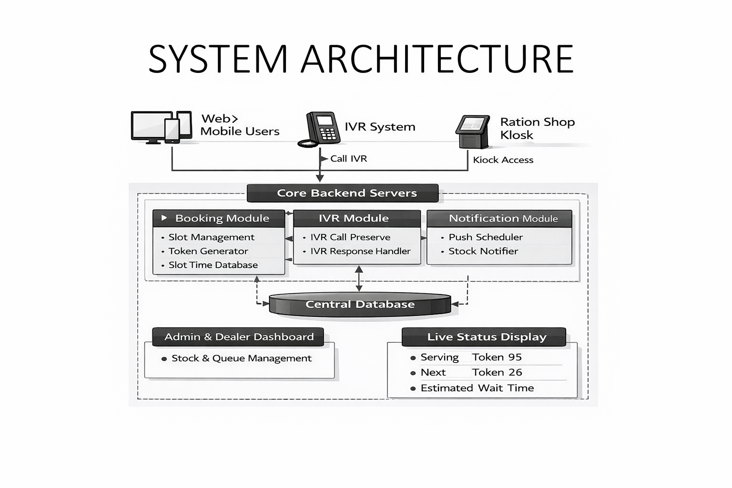

Slide 5
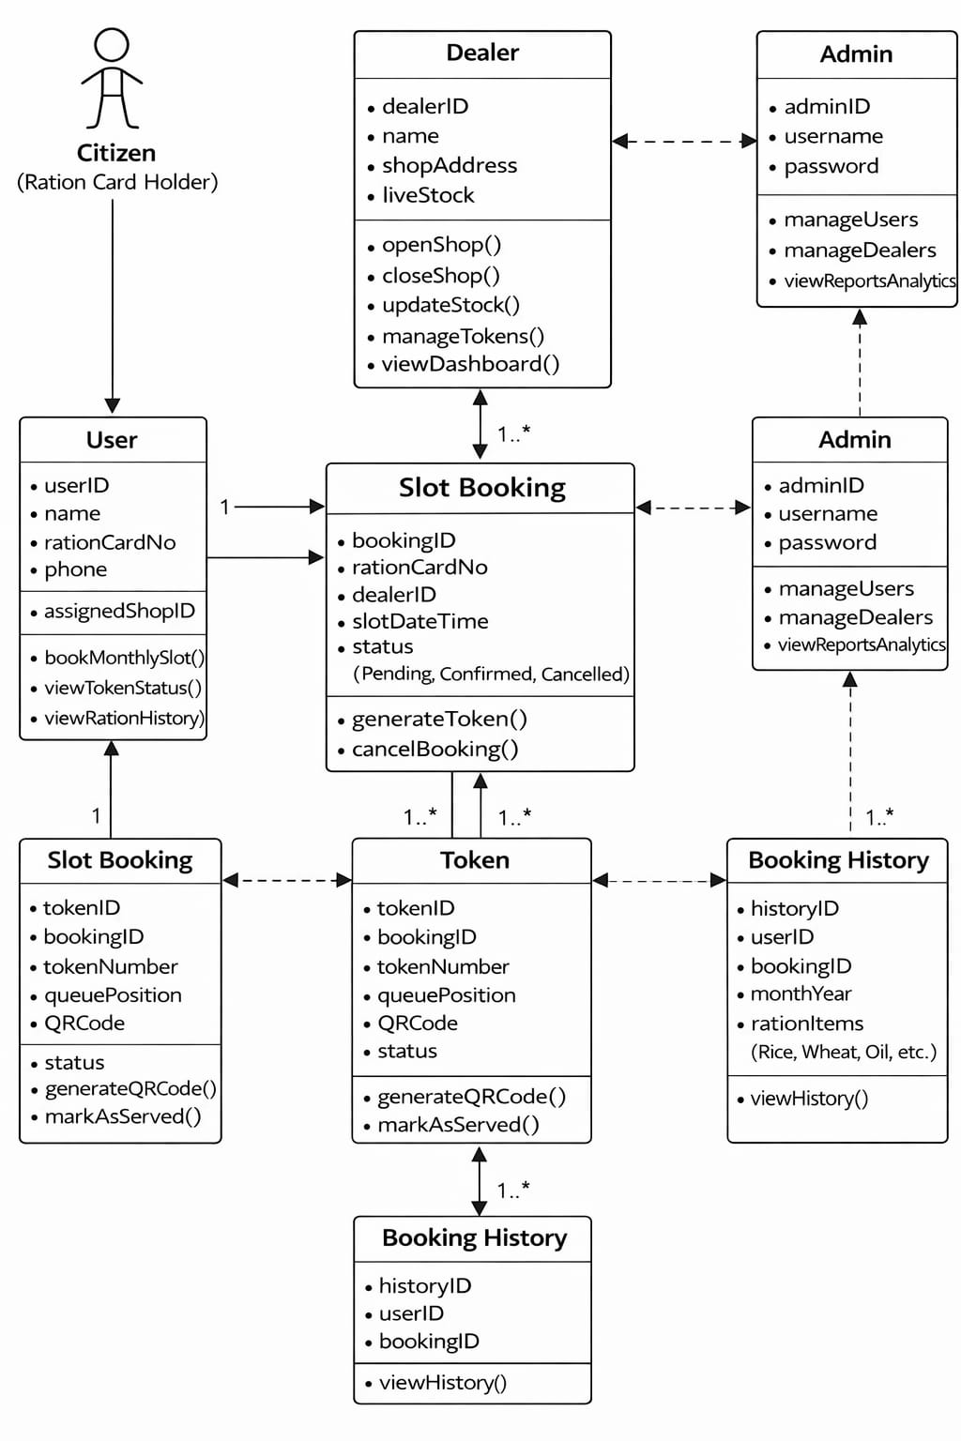
Class Diagram

Slide 6
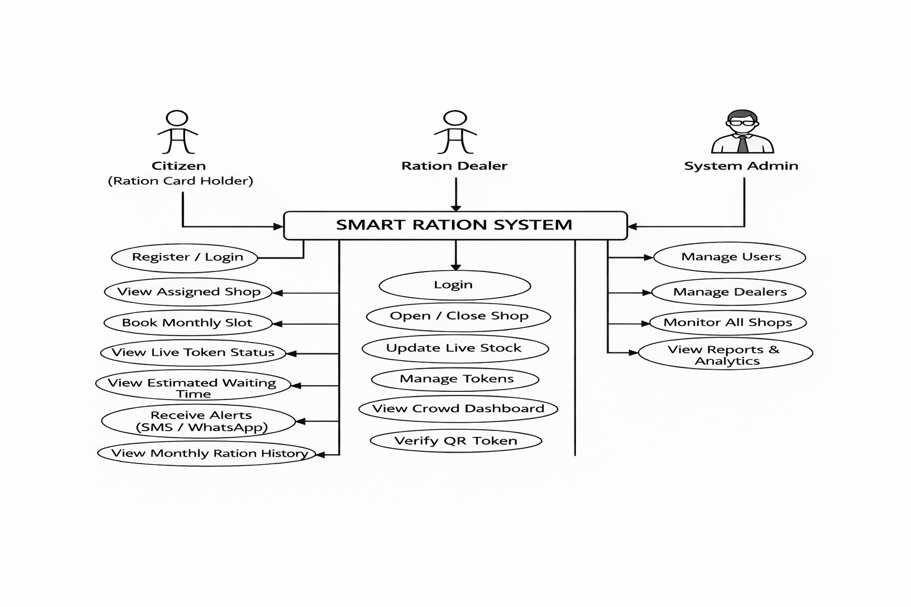
Use case Diagram

Slide 7
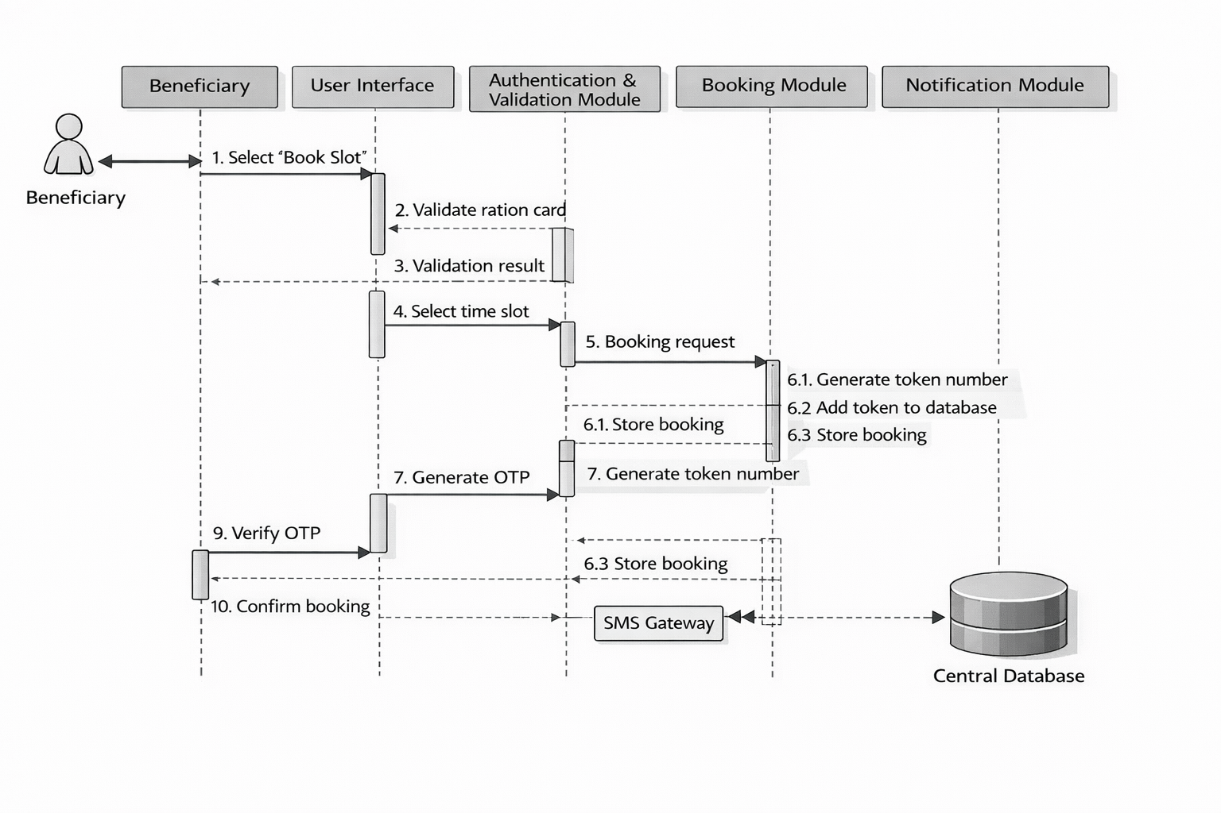
Sequence Diagram

Slide 8
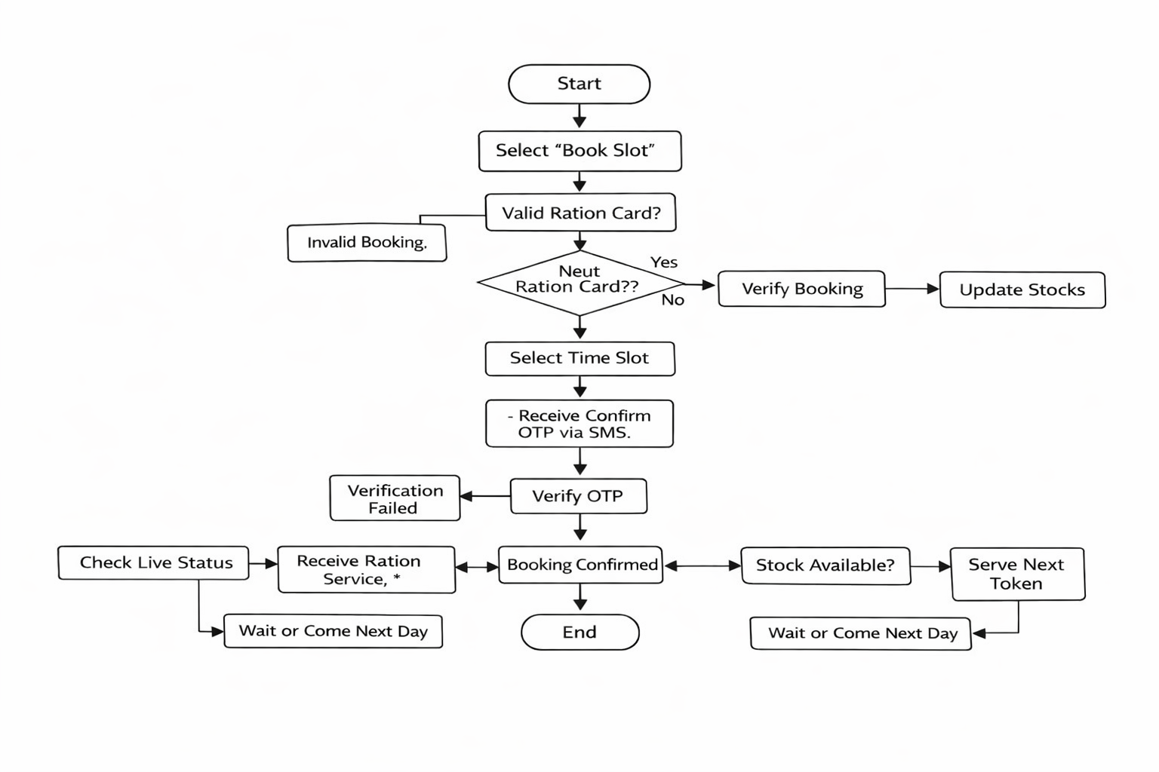
Activity diagram

Slide 9


