Slide 1
Unified Process
Notes:
© Dr. Jim Arlow 2000 v1.0

Slide 2
Content
Overview
Concepts
Characteristics
Notes:
© Dr. Jim Arlow 2000 v1.0

Slide 3
Content
Overview
Concepts
Characteristics
Notes:
© Dr. Jim Arlow 2000 v1.0

Slide 4
UML and Software Process
The UML is largely process-independent, meaning that you can use it with a number of software engineering processes.
The Unified Process is one such life cycle approach that is especially well-suited to the UML.

Slide 5
The Unified Process (UP)
The Unified Software Development Process is an industry standard software engineering process
  It is commonly referred to as the "Unified Process" or UP
UP is a task framework to transfer requirements to software.
UP captures some of the best current software development practice in a form that is tailorable for a wide range of projects and organizations.
UP uses UML as standard language for modeling software-intensive systems

Slide 6
The Unified Process (UP)
UP is a generic software engineering process. It has to be customised (instantiated) for your project
  In house standards, document templates, tools, databases, lifecycle modifications, …
Rational Unified Process (RUP) is an instantiation of UP
  RUP is a product marketed and owned by Rational Corporation
  RUP also has to be instantiated for your project
Notes:
© Dr. Jim Arlow 2000 v1.0

Slide 7
Content
Overview
Concepts
Characteristics
Notes:
© Dr. Jim Arlow 2000 v1.0

Slide 8
UP history
Ericsson
Approach
Specification
& Description
Language
Objectory
Rational
Approach
Rational
Objectory
Process
Rational
Unified
Process
(RUP)
Unified
Software
Development
Process
RUP
2001
Ongoing
RUP
development
Prehistory
1967
1976
1987
1995
1997
1998
1999
2001
2004
Jacobson
working at
Ericsson
Jacobson
establishes
Objectory AB
Rational
acquires
Objectory AB
UML becomes
an industry
standard
Notes:
© Dr. Jim Arlow 2000 v1.0

Slide 9
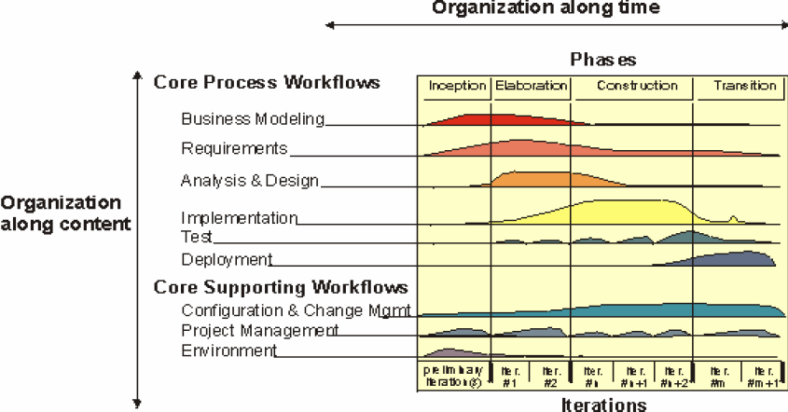
UP Process Model

Slide 10
Phases
Inception
Elaboration
Construction
Transition

Slide 11
Core Workflow
Core Process Workflows
  Business Modeling
  Requirements
  Analysis & Design
  Implementation
  Test
  Deployment

Slide 12
Core Workflow
Core Supporting Workflows
  Configuration & Change Management
  Project Management
  Environment

Slide 13
UP and Model
UP assumes that the use of models plays an important role in any software development activity.
Models are used to document the evolving system at the different levels of detail implied by the various workflows.

Slide 14
Phases and Workflows
For each phase we will consider:
  The focus in terms of the core workflows
  The goal for the phase
  The milestone at the end of the phase
Requirements
Inception
Elaboration
Construction
Transition
amount of work
Analysis
Design
Implementation
Test
Preliminary Iterations
I1
I2
In
In+1
In+2
Im
Im+1
Notes:
© Dr. Jim Arlow 2000 v1.0

Slide 15
Iterations
Each iteration is like a mini-project including:
  Planning
  Analysis and design
  Integration and test
  An internal or external release
We arrive at a final product release through a sequence of iterations
Iterations are organised into phases
get early and continuous feedback
Notes:
© Dr. Jim Arlow 2000 v1.0

Slide 16
Iteration workflows
Each iteration may contain all of the core workflows but with a different emphasis depending on where the iteration is in the lifecycle
UP specifies 5 core workflows
Requirements
Analysis
Design
Implementation
Test
An iteration
Planning
Project specific…
Assessment
other workflows
Notes:
© Dr. Jim Arlow 2000 v1.0

Slide 17
Baselines and increments
Each iteration generates a baseline
A baseline is a set of reviewed and approved artefacts that:
  Provide an agreed basis for further review and development
  Can be changed only through formal procedures such as configuration and change management
An increment is the difference between the baseline generated by one iteration and the baseline generated by the next iteration
  This is why the UP is called “iterative and incremental”
Notes:
© Dr. Jim Arlow 2000 v1.0

Slide 18
UP Structure
Life-cycle
Objectives
Life-cycle
Architecture
Initial
Operational
Capability
Product
Release
Milestone
Inception
Elaboration
Construction
Transition
Phase
Iterations
Iter 1
Iter 2
Iter 3
Iter 4
Iter 5
Iter 6
5 Core
Workflows
…
…
…
…
…
R
A
D
I
T
Each phase can include several iterations
  The exact number of iterations per phase depends on the size of the project! e.g. one iteration per phase for small projects
Each phase concludes with a major milestone
Notes:
© Dr. Jim Arlow 2000 v1.0

Slide 19
Inception
amount of work
in each core workflow
R
A
D
I
Focus
Requirements – establish business case and scope. Capture core requirements
Inception
Elaboration
Construction
Transition
Analysis – establish feasibility
Design – design proof of concept or technical prototypes
Implementation – build proof of concept or technical prototype
Test – not generally applicable
Goals
Establish feasibility of the project - create proof of concept/technical prototypes
Create a business case
Scope the system - capture key requirements
Identify critical risks
Notes:
© Dr. Jim Arlow 2000 v1.0

Slide 20
Inception - milestone
Life Cycle Objectives - conditions of satisfaction:
  System scope has been defined
  Key requirements for the system have been captured. These have been defined and agreed with the stakeholders
  An architectural vision exists. This is just a sketch at this stage
  A Risk Assessment
  A Business Case
  Project feasibility is confirmed
  The stakeholders agree on the objectives of the project
Notes:
© Dr. Jim Arlow 2000 v1.0

Slide 21
Related Models
Use case model
Class diagram
Activity diagram
…

Slide 22
Elaboration
R
A
D
I
T
Focus
Requirements – refine system scope and requirements
Inception
Elaboration
Construction
Transition
Analysis – establish what to build
Design – create a stable architectural baseline
Implementation – build the architectural baseline
Test – test the architectural baseline
Goals
Create an executable architectural baseline
Refine Risk Assessment and define quality attributes (defect rates etc.)
Capture use cases to 80% of the functional requirements
Create a plan with sufficient detail for the construction phase
Formulate a bid which includes resources, time, equipment, staff, cost
Notes:
© Dr. Jim Arlow 2000 v1.0

Slide 23
Elaboration - milestone
Lifecycle Architecture - conditions of satisfaction:
  A resilient, robust executable architectural baseline has been created
  The Risk Assessment has been updated
  A project plan has been created to enable a realistic bid to be formulated
  The business case has been verified against the plan
  The stakeholders agree to continue
Notes:
© Dr. Jim Arlow 2000 v1.0

Slide 24
Related Models
Use case model
Class diagram
Activity diagram
Package diagram
Interaction diagram
…

Slide 25
Construction
I
A
D
T
R
Focus
Requirements – uncover any requirements that had been missed
Inception
Elaboration
Construction
Transition
Analysis – finish the analysis model
Design – finish the design model
Implementation – build the Initial Operational Capability
Test – test the Initial Operational Capability
Goals
Complete use case identification, description and realization
Finish analysis, design, implementation and test
Maintain the integrity of the system architecture
Revise the Risk Assessment
Notes:
© Dr. Jim Arlow 2000 v1.0

Slide 26
Construction - milestone
Initial Operational Capability - conditions of satisfaction:
  The product is ready for beta testing in the user environment
Notes:
© Dr. Jim Arlow 2000 v1.0

Slide 27
Related Models
Use case model
Class diagram
Activity diagram
Package diagram
Interaction diagram
State machine diagram
Component diagram
Deployment diagram
…

Slide 28
Transition
D
I
T
Focus
Requirements – not applicable
Inception
Elaboration
Construction
Transition
Analysis – not applicable
Design – modify the design if problems emerge in beta testing
Implementation – tailor the software for the user site. Fix bugs uncovered in beta testing
Test – perform beta testing and acceptance testing at the user site
Goals
Correct defects
Prepare the user site for the new software and tailor the software to operate at the user site
Modify software if unforeseen problems arise
Create user manuals and other documentation
Provide customer consultancy
Conduct post project review
Notes:
© Dr. Jim Arlow 2000 v1.0

Slide 29
Transition – milestone
Product Release - conditions of satisfaction:
  Beta testing, acceptance testing and defect repair are finished
  The product is released into the user community
Notes:
© Dr. Jim Arlow 2000 v1.0

Slide 30
UP Tailoring
The RUP framework constitutes guidance on a rich set of software engineering practices
It is applicable to projects of different size and complexity, as well as for different development environments and domains
This means that no single project will benefit from using of all of RUP. Applying all of RUP on a single project will likely result in an inefficient project environment
Thus, it is recommended that all projects tailor the RUP

Slide 31
UP Tailoring
The overall approach for tailoring a process is as follows
  Determine the needed workflows
  Determine the input and output artifacts of each workflow
  Determine the evolutionary plan of 4 phases
  Determine the iteration plan of each phase
  Determine the internal structures of workflows

Slide 32
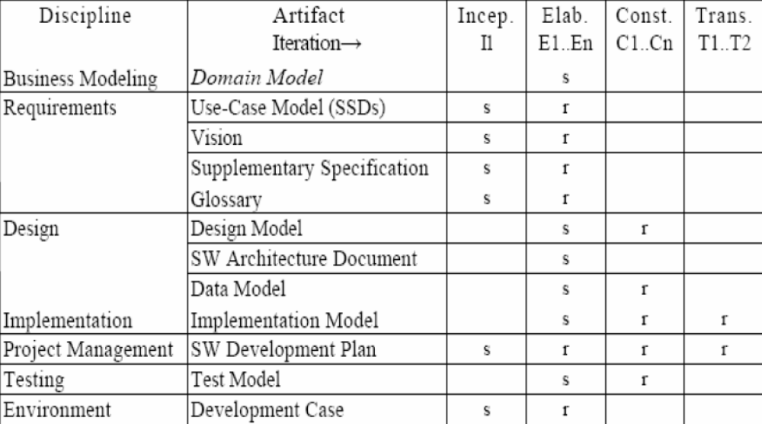
Sample Development Case of UP artifacts

Slide 33
Content
Overview
Concepts
Characteristics
Notes:
© Dr. Jim Arlow 2000 v1.0

Slide 34
Characteristics of UP
Use case (requirements) driven
Architecture centric
Iterative and incremental
…

