Slide 1
Course Review
Notes:
© Dr. Jim Arlow 2000 v1.0

Slide 2
Content
OO
UML
UP
Notes:
© Dr. Jim Arlow 2000 v1.0

Slide 3
OO
OO method vs. structured method?
OO essential concepts?
- Object
- Class
- Message
- Inheritance
- Polymorphism
…

Slide 4
UML
What is UML?
Unified Modelling Language (UML) is a general purpose, open, extensible, industry standard visual modelling language.
Why UML?
UML structure?

Slide 5
UML
structural thing
behavioral thing
thing
grouping thing
annotational thing
dependency
basic building block
relationship
association
generalization
realization
diagram
name
scope
rule
visibility
integrity
stereotype
execution
specification
tagged value
adornment
common mechanism
common division
constraint
extensibility mechanism
architecture -- 4+1 view

Slide 6
4+1 View of Architecture
vocabulary
functionality
system assembly
configuration management
Logical view
Implementation view
The 4+1 View of Architecture, Philippe Kruchten, IEEE Software, 12(6) Nov. 1995, p. 45-50
Use case view
behaviour
Process view
Deployment view
performance
scalability
throughput
system topology
distribution delivery
installation
Notes:
© Dr. Jim Arlow 2000 v1.0

Slide 7
Use case model
Use case model? When to use?
Model elements of use case diagram?
Actor?
Use case?
Relationship?
Methods?

Slide 8
Class diagram
Class diagram? When to use?
Model elements?
Relationships? Notations?
Differences between aggregation and composition?
Methods?
OOD Principles?
-- OCP, LSP, DIP, ISP

Slide 9
Class diagram
subdirectory
0..*
Directory
1
0..*
File
0..1
parent
reflexive association
autoexec
C
config
Windows
My Documents
Corel
To John
Command
directories
files
Notes:
© Dr. Jim Arlow 2000 v1.0

Slide 10
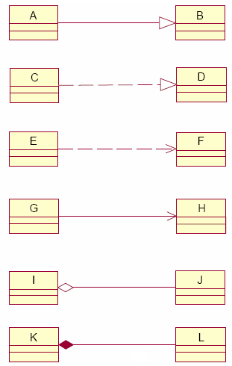
Relationships

Slide 11
Object diagram
Object diagram? When to use?
An object diagram is a snapshot of the objects in a system at a point in time.
Model elements?

Slide 12
Package diagram
Package diagram? When to use?
Model elements?
Package? — grouping thing

Slide 13
Interaction diagram
Four types of interaction diagrams? Emphasis?
Model elements of Sequence diagrams?
Communication diagrams?
Timing diagrams?
Interaction overview diagrams are a grafting together of?
Methods?

Slide 14
State machine diagram
State machine diagram? When to use?
A state machine models the lifetime of a single object.
Model elements?
Methods?

Slide 15
Activity diagram
Activity diagram? When to use?
Model elements?
Decision (branching) and fork?
Swim lane?

Slide 16
Component diagram
Component diagram? When to use?
Model elements?
Component?

Slide 17
Deployment diagram
Deployment diagram? When to use?
A deployment diagram models the mapping between the software architecture and the physical system architecture.
Model elements?
Node?

Slide 18
UP
Process model?
Phases? Milestones?
Characteristics?

