Slide 1
Interaction Diagrams
Notes:
© Dr. Jim Arlow 2000 v1.0

Slide 2
Content
Overview
Sequence Diagrams
Communication Diagrams
Timing Diagrams
Interaction Overview Diagrams
Methods
Notes:
© Dr. Jim Arlow 2000 v1.0

Slide 3
Content
Overview
Sequence Diagrams
Communication Diagrams
Timing Diagrams
Interaction Overview Diagrams
Methods
Notes:
© Dr. Jim Arlow 2000 v1.0

Slide 4
Overview
In every interesting system, objects don’t just sit idle; they interact with one another by passing messages.
An interaction is a behavior that comprises a set of messages exchanged among a set of objects within a context to accomplish a purpose.
Notes:
© Dr. Jim Arlow 2000 v1.0

Slide 5
Overview
Interaction diagrams describe how groups of objects collaborate in some behavior.
The UML defines several forms of interaction diagram, of which the most common is the sequence diagram.
Notes:
© Dr. Jim Arlow 2000 v1.0

Slide 6
Interaction diagrams
Sequence diagrams
  Emphasize time-ordered sequence of message sends
  Show interactions arranged in a time sequence
  Are the richest and most expressive interaction diagram
  Do not show object relationships explicitly - these can be inferred from message sends
Communication diagrams
  Emphasize the structural relationships between objects
  Use communication diagrams to make object relationships explicit
Interaction overview diagrams
  Are a grafting together of activity diagrams and sequence diagrams.
  Show how complex behavior is realized by a set of simpler interactions
Timing diagrams
  Emphasize the real-time aspects of an interaction
Notes:
© Dr. Jim Arlow 2000 v1.0

Slide 7
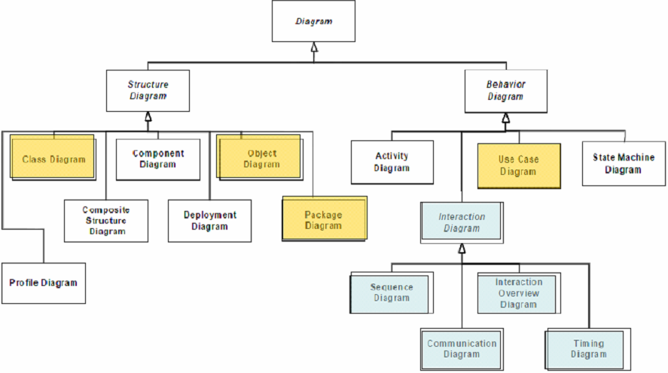
Overview

Slide 8
Content
Overview
Sequence Diagrams
Communication Diagrams
Timing Diagrams
Interaction Overview Diagrams
Methods
Notes:
© Dr. Jim Arlow 2000 v1.0

Slide 9
Sequence Diagrams
A sequence diagram shows a number of example objects and the messages that are passed between these objects within the use case.
A sequence diagram emphasizes the time ordering of messages.
Notes:
© Dr. Jim Arlow 2000 v1.0

Slide 10
Sequence diagram syntax
sd AddCourse
synchronous
message
:RegistrationManager
:Registrar
addCourse( "UML" )
lifeline
The Registrar selects
"add course".
object creation message
«create»
uml:Course
The system creates
the new Course.
activation
object is
created at
this point
notes can form
a "script"
describing the flow
message
return
All interaction diagrams may be prefixed sd to indicate their type
  You can generally infer diagram types from diagram syntax
Activations indicate when a lifeline has focus of control - they are often omitted from sequence diagrams
Notes:
© Dr. Jim Arlow 2000 v1.0

Slide 11
Objects
jimsAccount [ id = "1234" ] : Account
name
selector
type
An object represents a single participant in an interaction
  Shows how a classifier instance may participate in the interaction
Objects have:
  name - the name used to refer to the lifeline in the interaction
  selector - a boolean condition that selects a specific instance
  type - the classifier that the object represents an instance of
They must be uniquely identifiable within an interaction by name, type or both
The object has the same icon as the classifier that it represents
  The object jimsAccount represents an instance of the Account class
  The selector [ id = "1234" ] selects a specific Account instance with the id "1234"
Notes:
© Dr. Jim Arlow 2000 v1.0

Slide 12
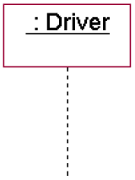
Lifeline
An object lifeline is the vertical dashed line that represents the existence of an object over a period of time.

Slide 13
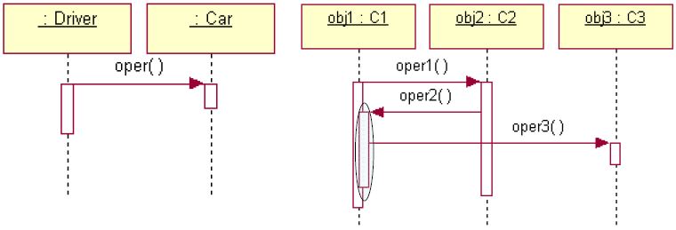
Focus of control(Activation)
The focus of control is a tall, thin rectangle that shows the period of time during which an object is performing an action.
You can show the nesting of a focus of control by stacking another focus of control slightly to the right of its parent.

Slide 14
Messages
A message represents a communication between two objects.
In UML, you can model several kinds of messages:
Call: Invokes an operation on an object
Return: Returns a value to the caller
Send: Sends a signal to an object
Create: Create an object
Destroy: Destroy an object

Slide 15
Messages
sender
receiver/
target
type of
message
semantics
synchronous
message
calling an operation synchronously
the sender waits for the receiver to complete
asynchronous
send
calling an operation asynchronously, sending a signal
the sender does not wait for the receiver to complete
message
return
returning from a synchronous operation call
the receiver returns focus of control to the sender
:A
creation
the sender creates the target
destruction
the sender destroys the receiver
found
message
the message is sent from outside the scope of the interaction
lost
message
the message fails to reach its destination
Notes:
© Dr. Jim Arlow 2000 v1.0

Slide 16
Message syntax
[predecessor][guard-condition][sequence-expression] [return-value:=] message-name ([argumentlist])

Slide 17
Deletion and self-delegation
sd DeleteCourse
:RegistrationManager
uml:Course
:Registrar
deleteCourse( "UML" )
self delegation
findCourse( "UML" )
nested activation
«destroy»
object is
deleted at
this point
Self delegation is when a lifeline sends a message to itself
  Generates a nested activation
Object deletion is shown by terminating the lifeline's tail at the point of deletion by a large X
Notes:
© Dr. Jim Arlow 2000 v1.0

Slide 18
State invariants and constraints
sd ProcessAnOrder
:OrderManager
:DeliveryManager
:Customer
raiseOrder()
«create»
:Order
state invariant
label
acceptPayment()
unpaid
A
acceptPayment()
constraint
paid
deliver()
{B – A <= 28 days}
deliver()
delivered
B
Notes:
© Dr. Jim Arlow 2000 v1.0

Slide 19
Combined fragments
:A
:B
:C
a( )
operator
combined fragment
name op
[guard condition 1]
b( )
operands
[guard condition 2]
c( )
guard conditions must be placed above the first event occurrence
Sequence diagrams may be divided into areas called combined fragments
Combined fragments have one or more operands
Operators determine how the operands are executed
Guard conditions determine whether operands execute. Execution occurs if the guard condition evaluates to true
  A single condition may apply to all operands OR
  Each operand may be protected by its own condition
Notes:
© Dr. Jim Arlow 2000 v1.0

Slide 20
Common operators
operator | long name | semantics
opt | Option | There is a single operand that executes if the condition is true (like if … then)
alt | Alternatives | The operand whose condition is true is executed. The keyword else may be used in place of a Boolean expression (like select… case)
loop | Loop | This has a special syntax: loop min, max [condition] Iterate min times and then up to max times while condition is true
break | Break | The combined fragment is executed rather than the rest of the enclosing interaction
ref | Reference | The combined fragment refers to another interaction
ref
findStudent(name):Student
ref has a single operand that is a reference to another interaction.
This is an interaction use.
Notes:
© Dr. Jim Arlow 2000 v1.0

Slide 21
The rest of the operators
These operators are less common
operator | long name | semantics
par | parallel | Both operands execute in parallel
seq | weak sequencing | The operands execute in parallel subject to the constraint that event occurrences on the same lifeline from different operands must happen in the same sequence as the operands
strict | strict sequencing | The operands execute in strict sequence
neg | negative | The combined fragment represents interactions that are invalid
critical | critical region | The interaction must execute atomically without interruption
ignore | ignore | Specifies that some messages are intentionally ignored in the interaction
consider | consider | Lists the messages that are considered in the interaction (all others are ignored)
assert | assertion | The operands of the combined fragments are the only valid continuations of the interaction
Notes:
© Dr. Jim Arlow 2000 v1.0

Slide 22
branching with opt and alt
opt semantics:
  single operand that executes if the condition is true
alt semantics:
  two or more operands each protected by its own condition
  an operand executes if its condition is true
  use else to indicate the operand that executes if none of the conditions are true
sd example of opt and alt
:A
:B
:C
:D
opt [condition]
do this if condition is true
alt
[condition1]
do this if condition1 is true
[condition2]
do this if condition2 is true
[else]
do this if neither condition is true
Notes:
© Dr. Jim Arlow 2000 v1.0

Slide 23
Iteration with loop and break
loop semantics:
  Loop min times, then loop (max – min) times while condition is true
loop syntax
  A loop without min, max or condition is an infinite loop
  If only min is specified then max = min
  condition can be
    Boolean expression
    Plain text expression provided it is clear!
Break specifies what happens when the loop is broken out of:
  The break fragment executes
  The rest of the loop after the break does not execute
The break fragment is outside the loop and so should overlap it as shown
sd examples of loop
:A
:B
loop min, max [condition]
do something
loop while guard
condition is true
loop [condition]
do something
break
on breaking out do this
do something else
must be global
relative to loop
Notes:
© Dr. Jim Arlow 2000 v1.0

Slide 24
loop idioms
type of loop | semantics | loop expression
infinite loop | keep looping forever | loop *
for i = 1 to n {body} | repeat ( n ) times | loop n
while( booleanExpression ) {body} | repeat while booleanExpression is true | loop [ booleanExpression ]
repeat {body} while( booleanExpression ) | execute once then repeat while booleanExpression is true | loop 1, * [booleanExpression]
forEach object in collection {body} | Execute the loop once for each object in a collection | loop [for each object in collection]
forEach object in ObjectType {body} | Execute the loop once for each object of a particular type | loop [for each object in :ObjectType]
Notes:
© Dr. Jim Arlow 2000 v1.0

Slide 25
Interaction occurrences
interaction
sd I2
sd I1
:A
:B
:C
:A
:B
interaction use
n1
m1
n2
ref
An interaction use is inserted into the including interaction
  All lifelines in the interaction use must also be in the including interaction
  Be very aware of where the interaction use leaves the focus of control!
Draw the interaction use across the lifelines it uses
I1
n3
Sequence of messages in I2:
n1
n2
m1 from I1
n3
Notes:
© Dr. Jim Arlow 2000 v1.0

Slide 26
Concurrency – active classes
Active classes are classes whose instances are active objects
  Active objects have concurrent threads of control
class diagram security system
ControlBox
1
1
Siren
1
active class
1
1
SecuritySensorMonitor
FireSensorMonitor
1
1
0..*
0..*
SecuritySensor
FireSensor
Notes:
© Dr. Jim Arlow 2000 v1.0

Slide 27
Concurrency with par
sd ActivateAll
:ControlBox
:SecuritySensor
Monitor
:FireSensor
Monitor
:FireSensor
:Security
Sensor
:Siren
:Security Guard
activate()
soundActivatedAlarm()
par
monitor()
loop 1, * [!fire]
fire = isTriggered()
critical
fire()
soundFireAlarm()
monitor()
loop 1, * [(!intruder) & (!fire)]
intruder = isTriggered()
opt [!fire]
intruder()
soundIntruderAlarm()
Notes:
© Dr. Jim Arlow 2000 v1.0

Slide 28
Content
Overview
Sequence Diagrams
Communication Diagrams
Timing Diagrams
Interaction Overview Diagrams
Methods
Notes:
© Dr. Jim Arlow 2000 v1.0

Slide 29
Communication diagram syntax
Communication diagrams emphasize the structural aspects of an interaction
sd AddCourses
object
uml:Course
sequence number
message
1: addCourse( "UML" )
1.1: «create»
2: addCourse( "MDA" )
:RegistrationManager
:Registrar
link
2.1: «create»
mda:Course
object creation
message
Notes:
© Dr. Jim Arlow 2000 v1.0

Slide 30
Branching
return value from message
sd register student for course
1.1: student = findStudent( "Jim" )
1.2: course = findCourse( "UML" )
1: register ( "Jim", "UML" )
:RegistrationManager
1.4 [!found] : error()
:Registrar
1.3 [found] : register( student )
guard condition
found = (student != null) & (course != null)
course:Course
Branching is modelled by prefixing the sequence number with a guard condition
  There is no prescribed UML syntax for guard conditions!
  In the example above, we use the variable found. This is true if both the student and the course are found, otherwise it is false
Notes:
© Dr. Jim Arlow 2000 v1.0

Slide 31
Iteration
iteration specifier
Iteration is shown by using the iteration specifier (*), and an optional iteration clause
  There is no prescribed UML syntax for iteration clauses
  Use code or pseudo code
sd PrintCourses
iteration clause
1.1 * [for i = 1 to n] : printCourse( i )
1: printCourses( )
:RegistrationManager
:Registrar
1.1.1: print()
[i]:Course
Notes:
© Dr. Jim Arlow 2000 v1.0

Slide 32
Concurrency – active objects
sd ActivateAll
1.3 A : soundFireAlarm ()
1.3 B : soundIntruderAlarm ()
1: activate ()
:ControlBox
:Siren
1.1 A : monitor()
1.2 A :
fire()
1.2 B : [!fire]
intruder()
1.1 B : monitor()
:SecurityGuard
:FireSensorMonitor
:SecuritySensorMonitor
1.1.1 A * [!fire] :
fire = isTriggered()
1.1.1 B *[(!intruder) & (!fire)] :
intruder = isTriggered()
:FireSensor
:SecuritySensor
Each separate thread of execution is given its own name
  Messages labelled A execute concurrently to messages labelled B
  e.g. 1.1 A executes concurrently to 1.1 B
Notes:
© Dr. Jim Arlow 2000 v1.0

Slide 33
Comparison between Sequence and Communication Diagram
A sequence diagram emphasizes the time ordering of messages. A communication diagram emphasizes the organization of the objects that participate in an interaction
Because they both derive from the same information in the UML's metamodel, sequence diagrams and communication diagrams are semantically equivalent
Sequence Diagram
➢Lifeline
➢Focus of control
Communication Diagram
➢Object link
Sequence number

Slide 34
Content
Overview
Sequence Diagrams
Communication Diagrams
Timing Diagrams
Interaction Overview Diagrams
Methods
Notes:
© Dr. Jim Arlow 2000 v1.0

Slide 35
Timing diagrams
Emphasize the real-time aspects of an interaction
Used to model timing constraints
Objects, their states or conditions are drawn vertically, time horizontally
It's important to state the time units you use in the timing diagram
sd IntruderThenFire
duration constraint
soundingFireAlarm
object
{t <= 15}
{t = 30}
:Siren
soundingIntruderAlarm
fire
state or
condition
off
event
intruder
resting
intruder
timing ruler
0
10
20
30
40
50
60
70
80
90
100
time in minutes
sd IntruderThenFire
all times in minutes
state or condition
compact
form
{t <= 15}
{t > 30}
{t = 10}
:Siren
sounding
Intruder
Alarm
sounding
Intruder
Alarm
sounding
fire Alarm
off
resting
Notes:
© Dr. Jim Arlow 2000 v1.0

Slide 36
Messages on timing diagrams
You can show messages between lifelines on timing diagrams
Each lifeline has its own partition
sd SirenBehavior
{t <= 0.016}
all times in minutes
triggered
:FireSensorMonitor
notTriggered
{t <= 0.016}
:IntruderSensorMonitor
triggered
messages
notTriggered
soundFireAlarm()
soundingFireAlarm
soundIntruderAlarm()
soundIntruderAlarm()
soundIntruderAlarm()
soundingIntruderAlarm
:Siren
soundIntruderAlarm()
off
resting
{t <= 15}
{t = 30}
{t <= 15}
Notes:
© Dr. Jim Arlow 2000 v1.0

Slide 37
Content
Overview
Sequence Diagrams
Communication Diagrams
Timing Diagrams
Interaction Overview Diagrams
Methods
Notes:
© Dr. Jim Arlow 2000 v1.0

Slide 38
Interaction overview diagrams
Model the high level flow of control between interactions
Show interactions and interaction occurrences
Have activity diagram syntax
sd ManageCourses lifelines :Registrar, :RegistrationUI, :Course
sd ref
Logon
interaction use
sd ref
GetCourseOption
inline interaction
[find]
[add]
[remove]
sd AddCourse
sd ref
sd ref
RemoveCourse
FindCourse
:RegistrationManager
:Registrar
addCourse( “UML” )
«create»
else
uml:Course
[exit]
Notes:
© Dr. Jim Arlow 2000 v1.0

Slide 39
Content
Overview
Sequence Diagrams
Communication Diagrams
Timing Diagrams
Interaction Overview Diagrams
Methods
Notes:
© Dr. Jim Arlow 2000 v1.0

Slide 40
Centralized or distributed?
We have an order and are going to invoke a command on it to calculate its price. To do that, the order needs to look at all the line items on the order and determine their prices, which are based on the pricing rules of the order line's products. Having done that for all the line items, the order then needs to compute an overall discount, which is based on rules tied to the customer.

Slide 41
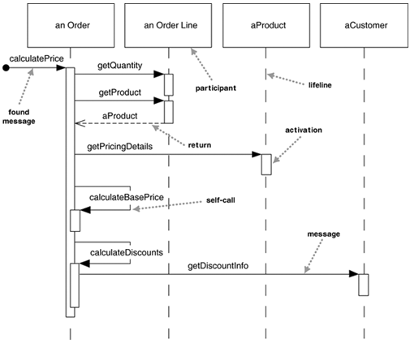
A sequence diagram for centralized control

Slide 42
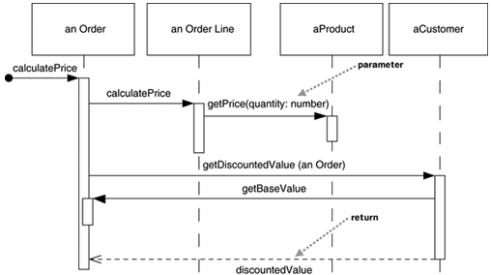
A sequence diagram for distributed control

Slide 43
Distributed control
Object bigots strongly prefer distributed control.
One of the main goals of good design is to localize the effects of change. Data and behavior that accesses that data often change together. So putting the data and the behavior that uses it together in one place is the first rule of object-oriented design.
By distributing control, you create more opportunities for using polymorphism rather than using conditional logic.

Slide 44
Distributed control
In general the OO style is to use a lot of little objects with a lot of little methods that give us a lot of plug points for overriding and variation.

Slide 45
GRASP
A Design Model may define many classes, and an application may require many responsibilities to fulfilled.
During object design, when the interactions between objects are defined, we make choices about the assignment of responsibilities to classes.
Done well, systems tend to be easier to understand, maintain, extend, and reuse.
Deciding what methods belong where, and how the objects should interact is terribly important.

Slide 46
GRASP
GRASP is an acronym that stands for General Responsibility Assignment Software Patterns.
The name was chosen to suggest the importance of grasping these principles to successfully design object-oriented software.

Slide 47
GRASP
The GRASP patterns help methodically apply fundamental principles for assigning responsibilities to objects.
The GRASP patterns are a learning aid to help one understand essential object design, and apply design reasoning in a methodical, rational, explainable way.

Slide 48
GRASP
GRASP: General Responsibility Assignment Software Patterns
Information Expert
Creator
Low Coupling
High Cohesion
Controller
Polymorphism
Indirection
Pure Fabrication
Protected Variations

Slide 49
Information Expert
Pattern Name: Information Expert
Problem It Solves: What is a basic principle by which to assign responsibility to objects?
Solution: Assign a responsibility to the class that has the information needed to fulfill it.

Slide 50
Information Expert
Information Expert is a basic guiding principle used continuously in object design.
The fulfillment of a responsibility often requires information that is spread across different classes of objects. This implies that there are many “partial” information experts who will collaborate in the task.

Slide 51
Information Expert
Benefits:
Information encapsulation is maintained, since objects use their own information to fulfill tasks. This usually supports low coupling, which leads to more robust and maintainable systems.
Behavior is distributed across the classes that have the required information, thus encourage more cohesive “lightweight” class definitions that are easier to understand and maintain. High cohesion is usually supported.

Slide 52
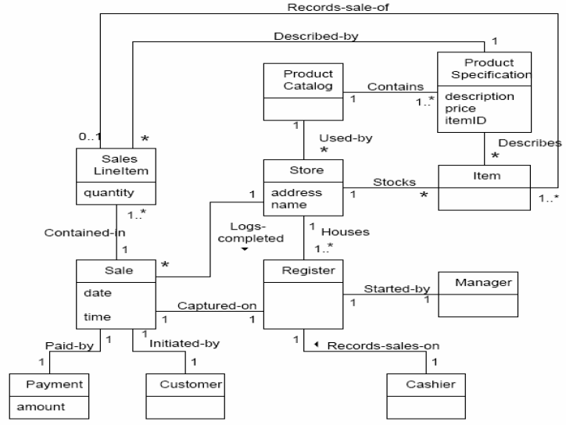
Information Expert

Slide 53
Information Expert
Q: Who should be responsible for knowing the grand total of a sale?
A: What information is needed to determine the grand total? It is necessary to know about all the SalesLineItem instances of a sale and the sum of their subtotals. A sale instance contains these; therefore, Sale is an information expert for the work.

Slide 54
Information Expert
What information is needed to determine the line item subtotal? SalesLineItem.quantity and ProductionSpecification.price are needed. The SalesLineItem knows its quantity and its associated ProductionSpecification; therefore, it is the information expert….

Slide 55
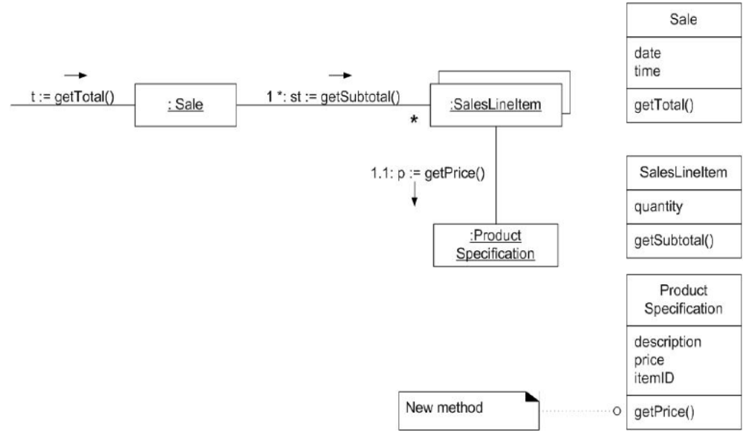
Information Expert

Slide 56
Creator
Name: Creator
Problem: Who should be responsible for creating a new instance of some class?
Solution: Assign class B the responsibility to create an instance of class A if one or more of the following is true:
B aggregates A objects.
B contains A objects.
B records of A objects.
B closely uses A objects.
B has the initializing data that will be passed to A when it is created.
B is a creator of A objects.

Slide 57
Creator
Benefits:
Low coupling is supported. Coupling is probably not increased because the created class is likely already visible to the creator class, due to the existing associations that motivated its choice as creator.

Slide 58
Creator
Q: Who should be responsible for creating a SalesLineItem instance?
A: We should look for a class that aggregates, contains, and so on, SalesLineItem instances. Since a Sale contains many SalesLineItem objects, the Creator suggests that Sale is a good candidate.

Slide 59
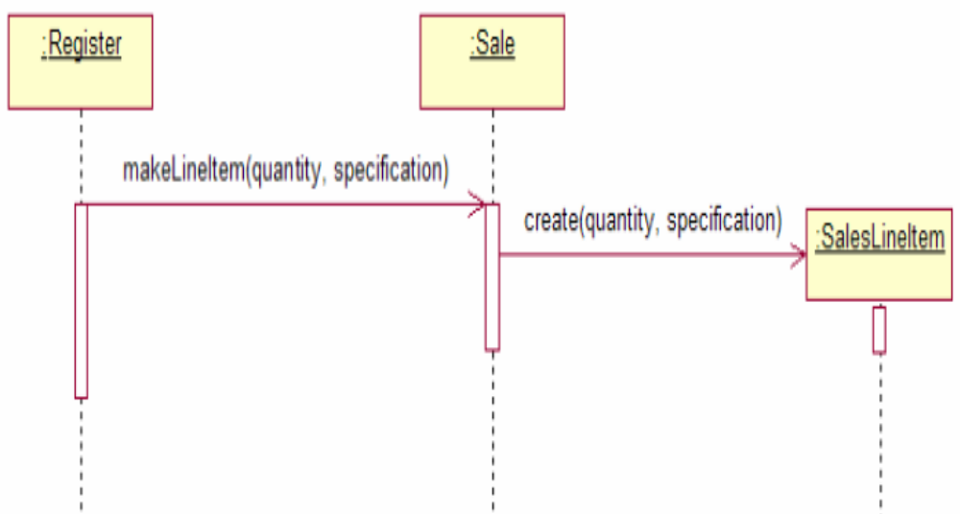
Creator

Slide 60
Low Coupling
Name: Low Coupling
Problem: How to support low dependency, low change impact, and increased reuse?
Solution: Assign a responsibility so that coupling remains low.

Slide 61
Low Coupling
Benefits:
Not affected by changes in other components
Simple to understand in isolation
Convenient to reuse

Slide 62
Low Coupling
Q: Assume we have a need to create a Payment instance and associate it with the Sale. What class should be responsible for this?

Slide 63
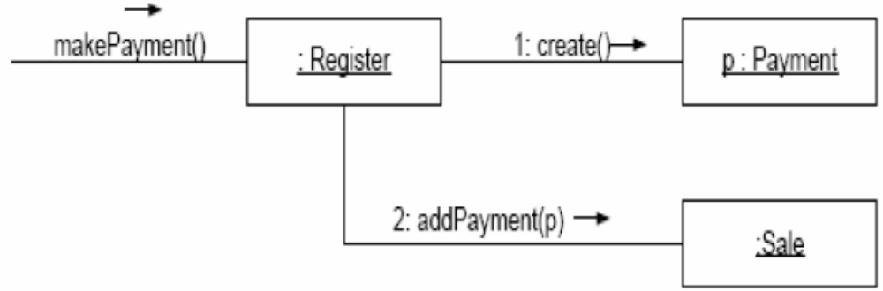
Low Coupling
Design 1: The creator pattern suggests Register as a candidate for creating the Payment. The Register instance could then send an addPayment message to the Sale, passing along the new Payment as a parameter.

Slide 64
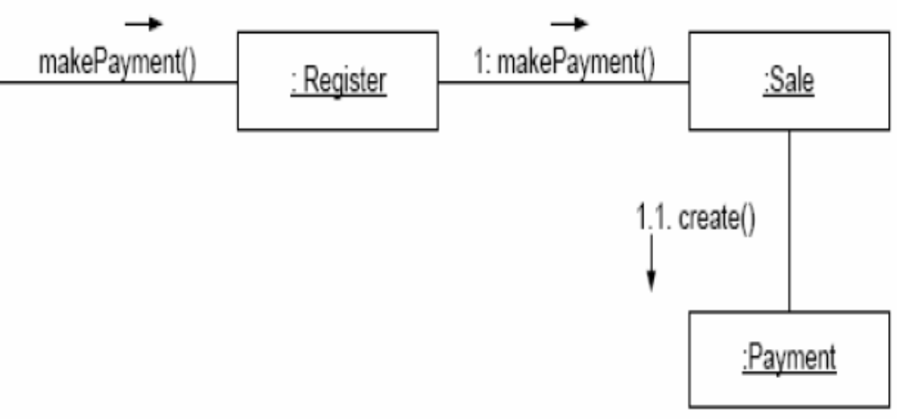
Low Coupling
Design 2: The Sale does the creation of a Payment.

Slide 65
Low Coupling
A: Purely from the point of view of coupling, Design 2 is preferable because overall lower coupling is maintained.

Slide 66
High Cohesion
Name: High Cohesion
Problem: How to keep complexity manageable?
Solution: Assign a responsibility so that cohesion remains high.

Slide 67
High Cohesion
Benefits:
Clarity and ease of comprehension of the design is increased.
Maintenance and enhancements are simplified.
Low coupling is often supported.
The fine grain of highly related functionality supports increased reuse because a cohesive class can be used for a very specific purpose.

Slide 68
Controller
Name: Controller
Problem: Who should be responsible for handling an input system event?
Solution: Assign the responsibility for receiving or handling a system event message to a class representing one of the following choices:
Represents the overall system, device, or subsystem.
Represents a use case scenario within which the system event occurs, often named <UCName>Handler, <UCName>Coordinator or <UCName>Session.

Slide 69
Controller
Benefits:
Increased potential for reuse and pluggable interfaces.
Reason about the state of the use case.

Slide 70
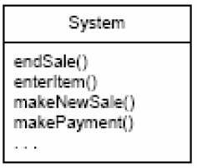
Controller
In the POS application, there are several system operations. Who should be the controller for system events such as enterItem and endSale?

Slide 71
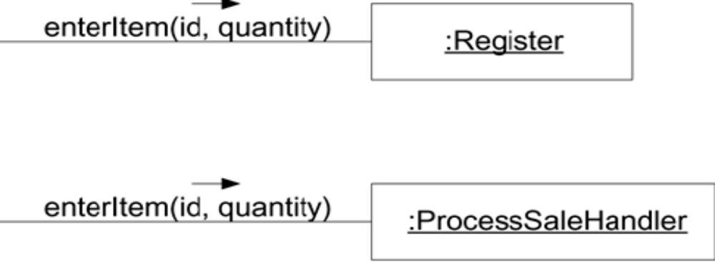
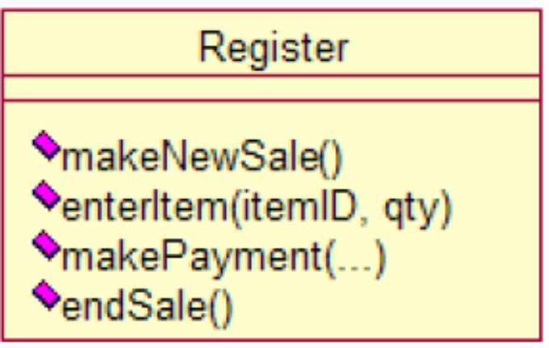
Controller

Slide 72
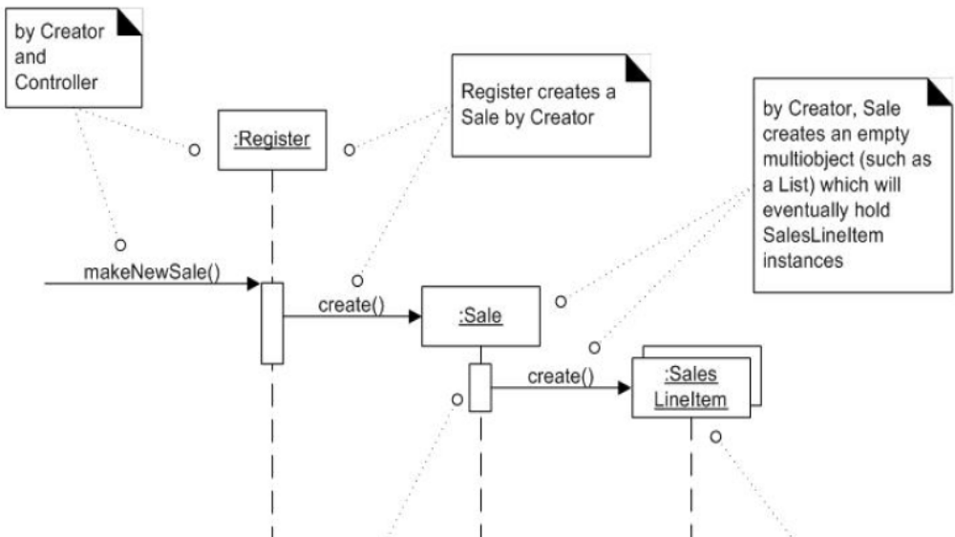
GRASP

Slide 73
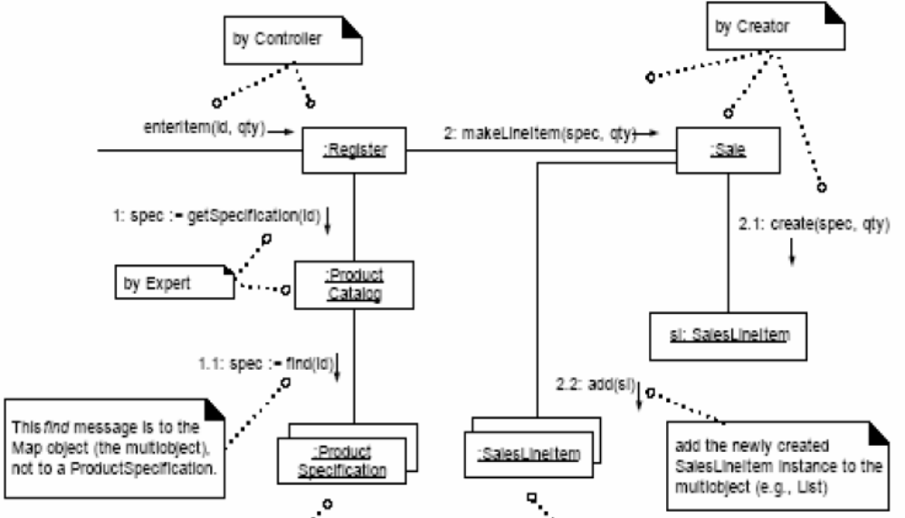
GRASP

Slide 74
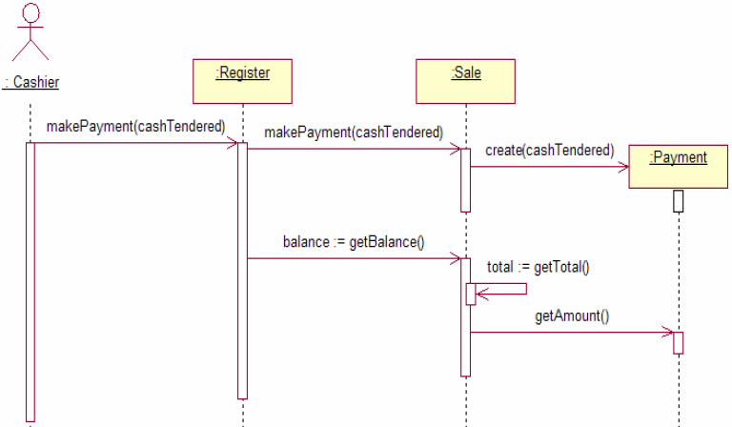
GRASP

Slide 75
Project
Use interaction diagrams to describe the collaborations among objects within the “BorrowBook” use case.

