Slide 1
Activity Diagrams
Notes:
© Dr. Jim Arlow 2000 v1.0

Slide 2
Content
Overview
Concepts
Methods
Notes:
© Dr. Jim Arlow 2000 v1.0

Slide 3
Content
Overview
Concepts
Methods
Notes:
© Dr. Jim Arlow 2000 v1.0

Slide 4
Overview
An activity diagram shows the flow from activity to activity.
You use activity diagrams to model the dynamic aspects of a system. For the most part, this involves modeling the sequential or concurrent steps in a process.

Slide 5
Overview
Use activity diagrams to model the behavior of:
  use cases
  classes
  interfaces
  components
  collaborations
  operations and methods
  business processes
Notes:
© Dr. Jim Arlow 2000 v1.0

Slide 6
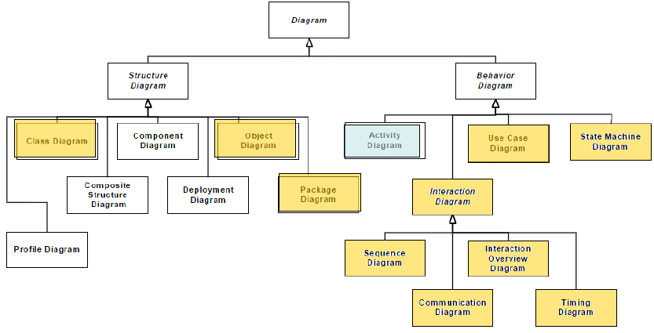
Overview

Slide 7
Content
Overview
Concepts
Methods
Notes:
© Dr. Jim Arlow 2000 v1.0

Slide 8
Activity Diagrams: The Essentials
Initial nodes and Final nodes
Activity nodes
Control flows
Decision and Merge nodes
Fork and join nodes
Partitions and Swim Lanes
Object Flows

Slide 9
Activity diagram syntax
Activities are networks of nodes connected by edges
Activities usually start in an initial node and terminate in a final node
When an activity node finishes, it emits a token that may traverse an edge to trigger the next action
Send letter
initial node
activity node
Write letter
edge
Address letter
control flow
Post letter
final node
activity
Notes:
© Dr. Jim Arlow 2000 v1.0

Slide 10

Initial nodes and Final nodes
Initial node
➢An initial node acts as a starting point for executing an activity
➢Initial nodes are notated as a solid circle
Final node
➢A final node is a control node at which a flow in an activity stops
➢Activity final nodes are notated as a solid circle within a hollow circle
➢Flow final nodes are noted as a circle with an “X” cross inside it

Slide 11
Activity Nodes
An activity node is an organizational unit within an activity
In general, activity nodes are nested groupings of actions or other nested activity nodes
Deliver order

Slide 12

Control Flows
When an action or activity node completes execution, flow of control passes immediately to the next action or activity node
You specify this flow by using flow arrows to show the path of control from one action or activity node to the next action or activity node
In the UML, you represent a flow as a simple arrow from the predecessor action to its successor, without an event label

Slide 13
Decision and merge nodes
A decision node is a control node that has one input edge and two or more alternate output edges
  Each edge out of the decision is protected by a guard condition
  guard conditions must be mutually exclusive
  The edge can be taken if and only if the guard condition evaluates to true
  The keyword else specifies the path that is taken if none of the guard conditions are true
A merge node accepts one of several alternate flows
  It has two or more input edges and exactly one output edge
Process mail
Get mail
guard
condition
keyword
else
[is junk]
decision
node
Open mail
Bin mail
merge node
Notes:
© Dr. Jim Arlow 2000 v1.0

Slide 14
Fork and join nodes - concurrency
Forks nodes model concurrent flows of work
  Tokens on the single input edge are replicated at the multiple output edges
Join nodes synchronize two or more concurrent flows
  Joins have two or more incoming edges and exactly one outgoing edge
  A token is offered on the outgoing edge when there are tokens on all the incoming edges i.e. when the concurrent flows of work have all finished
Product process
Design new
product
fork node
Market
product
Manufacture
product
join node
Sell
product
Notes:
© Dr. Jim Arlow 2000 v1.0

Slide 15
Partitions and Swim Lanes
You'll find it useful, especially when you are modeling workflows of business processes, to partition the activity states on an activity diagram into groups, each group representing the business organization responsible for those activities
If you want to show who does what, you can divide an activity diagram into partitions

Slide 16
Swim lanes
The simple one-dimensional partitioning style is often referred to as swim lanes, for obvious reasons and was the only form used in UML 1.x.

Slide 17
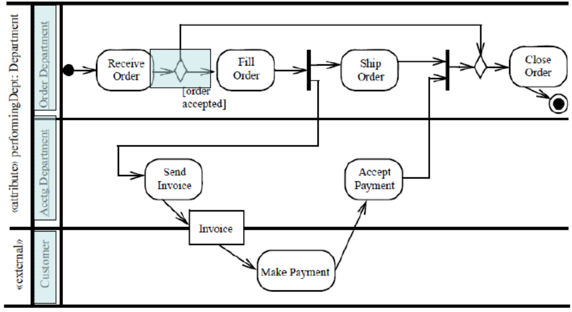
Swim lanes

Slide 18
Partitions
In UML 2, you can use a two-dimensional grid, so the swimming metaphor no longer holds water. You can also take each dimension and divide the rows or columns hierarchically.

Slide 19
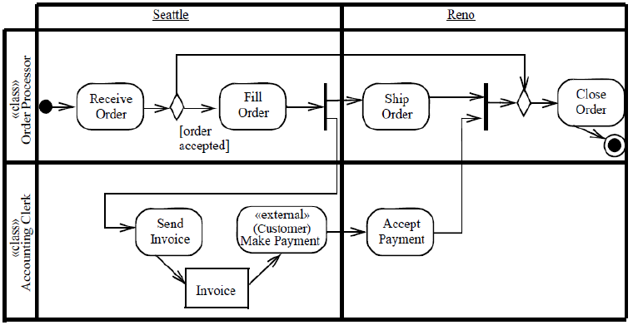
Partitions

Slide 20
Partitions
Each activity partition represents a high-level grouping of a set of related actions
  Partitions can be hierarchical
  Partitions can be vertical, horizontal or both
Partitions can refer to many different things e.g. business organisations, classes, components and so on
If partitions can’t be shown clearly using parallel lines, put their name in brackets directly above the name of the activities
Course production
dimension name
Location
Zurich
London
Marketing
Scheduling
Development
Create course business case
Develop course
Schedule course
activity partition
Book trainers
Market course
Book rooms
(London::Marketing)
Market product
(p1, p2)
SomeAction
nested partitions
multiple partitions
Notes:
© Dr. Jim Arlow 2000 v1.0

Slide 21
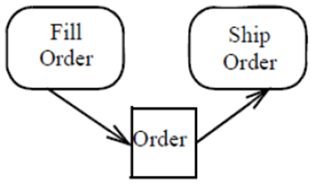
Object Flow
Objects may be involved in the flow of control associated with an activity diagram

Slide 22
Activity Diagrams-Advanced Concepts
Sub-activity
Join Specification
Signal
Pin
Expansion Region

Slide 23
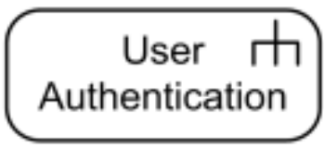
Sub-activity
The rake in the bottom corner of an activity indicates that the activity is described by a more finely detailed activity diagram

Slide 24
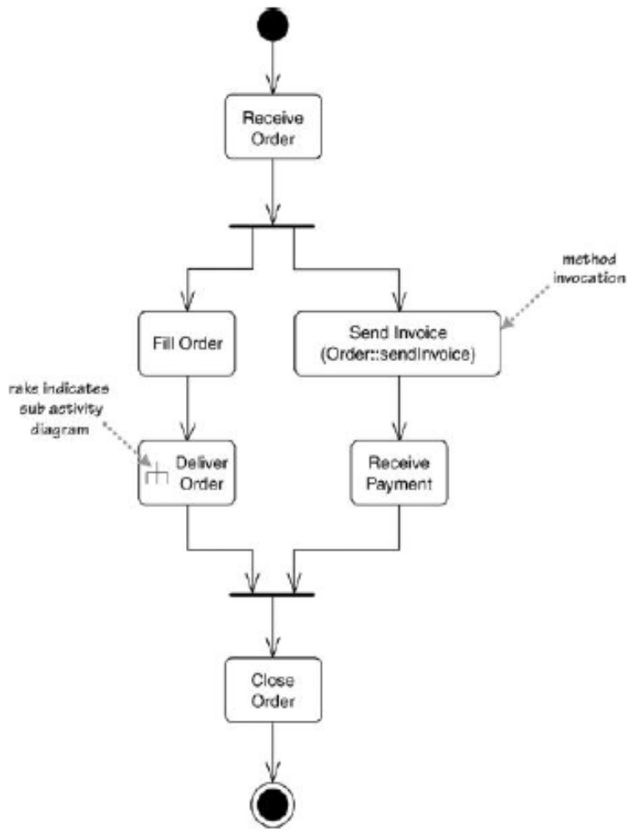
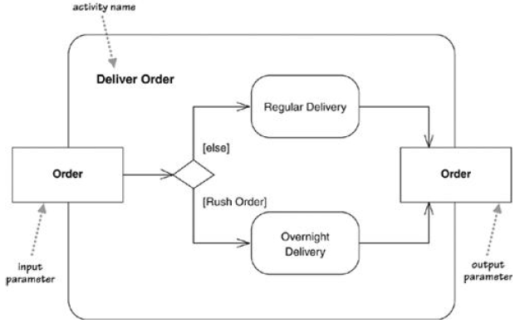
Sub-activity

Slide 25
Join Specification
A join specification is a Boolean expression attached to a join. Each time a token arrives at the join, the join specification is evaluated and if true, an output token is emitted.

Slide 26
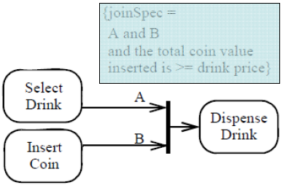
Join Specification

Slide 27
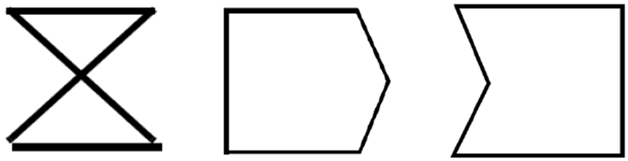
Signal Action
A signal is a kind of event that represents the specification of an asynchronous message communicated between instances
Accept time event action
Send signal action
Accept event action

Slide 28
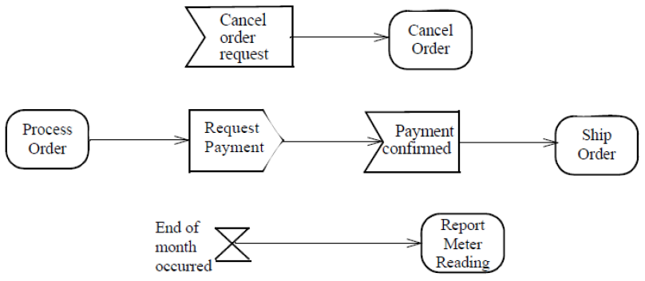
Signal

Slide 29
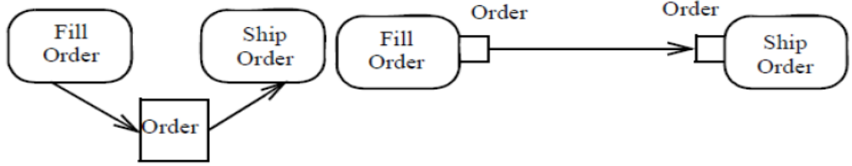
Pins
A Pin represents an input to an Action or an output from an Action

Slide 30
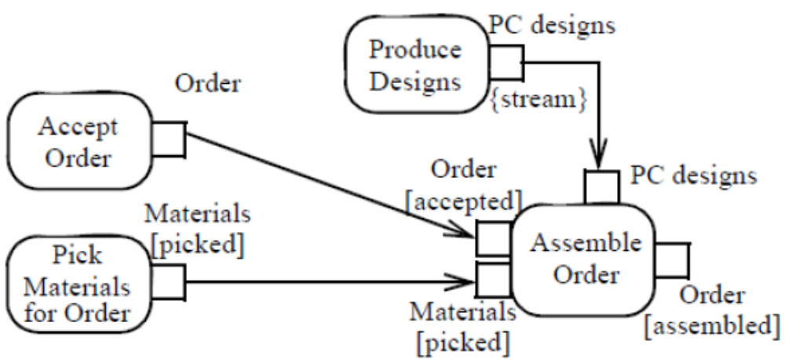
Pins

Slide 31
Expansion Region
An Expansion Region is a Structured Activity Node that executes its contained elements multiple times corresponding to elements of an input collection

Slide 32
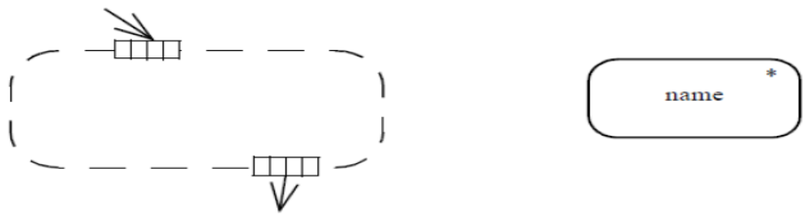
Expansion Region
The Expansion Node symbols are placed on the boundary of the dashed box
➢Usually, Activity Edge arrows inside and outside the Expansion Region will distinguish input and output expansion nodes

Slide 33
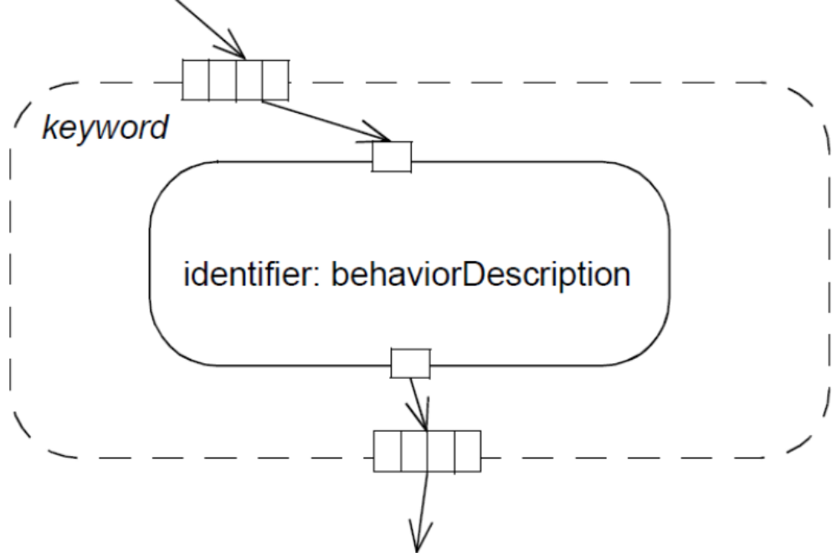
Expansion Region

Slide 34
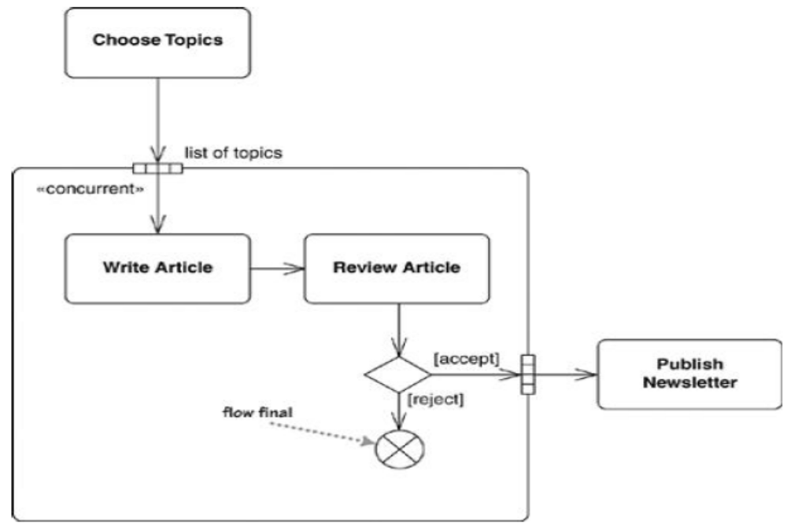
Expansion Region

Slide 35
Content
Overview
Concepts
Methods
Notes:
© Dr. Jim Arlow 2000 v1.0

Slide 36
Methods
Define the scope of the activity diagram
Add the initial node and final node
Add the activity node
Add the decision node
Identify parallel activities
Add the control flows

Slide 37
Tips
Use the basic modeling elements to draw a activity diagram, such as branch, fork node and join node
Use the swim lane according to whether the activity diagram should reflect the different actors
If necessary, add the object flow
If necessary, add the advanced modeling elements, such as Sub-activity, Join Specification, Signal, Pin and Expansion Region

Slide 38
Style of UML Activity Diagram
Ensure That Each Activity Edge Leaving a Decision Point Has a Guard
Ensure That Guards on Decision Points Form a Complete Set
Do Not Overlap Guards

Slide 39
Style of UML Activity Diagram
Ensure That Forks Have Corresponding Joins
Ensure That a Fork Has Only One Entry
Ensure That a Join Has Only One Exit

Slide 40
Project
Build an activity diagram to describe the process of “BorrowBook”.

