Slide 1
Austin Housing Bubble Analysis
Or: To Buy or Not To Buy
Shweta Banerjee
Yedidya Erque
Bowie Hand
Jessica Serna
Lu Wang

Slide 2
Approach
Define “Market Bubble”
Establish postulates
Evaluate 2007/2008 housing market crash to confirm or reject postulates based on:
National indicators – Household Debt, Mortgage Originations, Foreclosures, Delinquency Trends
Metropolitan Statistical Areas (MSA) – Housing Price Index, Homeownership Rates, Vacancy Rates, Affordable Housing
Determine cities most impacted by subprime crisis and compare to Austin 2018 environment

Slide 3
Bubble Definition per Investopedia
A bubble is a type of investing phenomenon that demonstrates the most basic type of "emotional investing." A bubble occurs when investors put so much demand on a asset that they drive the price beyond any accurate or rational reflection of its actual worth.
5 steps to a bubble
Displacement – introduction of a new paradigm (tech, interest rates, etc.)
Boom – large scale growth, i.e. ‘fear of missing out.’
Euphoria – buy regardless of price
Profit Taking – institution investors (banks, lenders, etc.) exit the market
Panic – massive liquidation

Slide 4
Postulates of a Market Bubble
During expansion
Housing prices increase
Mortgage rates increase
Occupancy rates increase and vacancy rates decrease
House hold debt increases
During deflation
Housing prices decrease
Mortgage rates decrease
Occupancy rates decrease and vacancy rates increase
Mortgage defaults and delinquencies increase

Slide 5
National Indicators

Slide 6
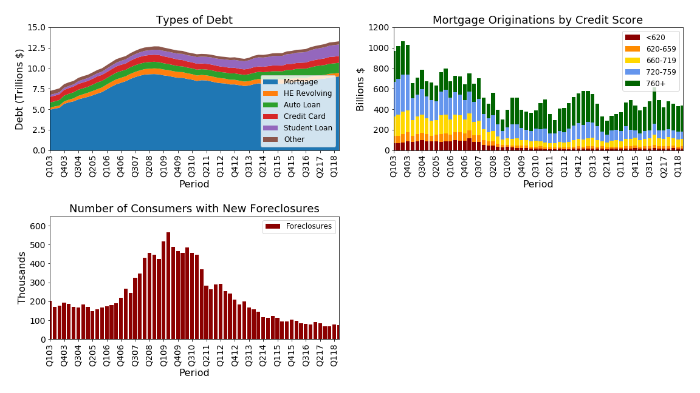
Warning signs of the mortgage crisis
Increased household debt
Lending to consumers with poor credit scores
Increasing rate of foreclosures
Increased delinquencies

Slide 7
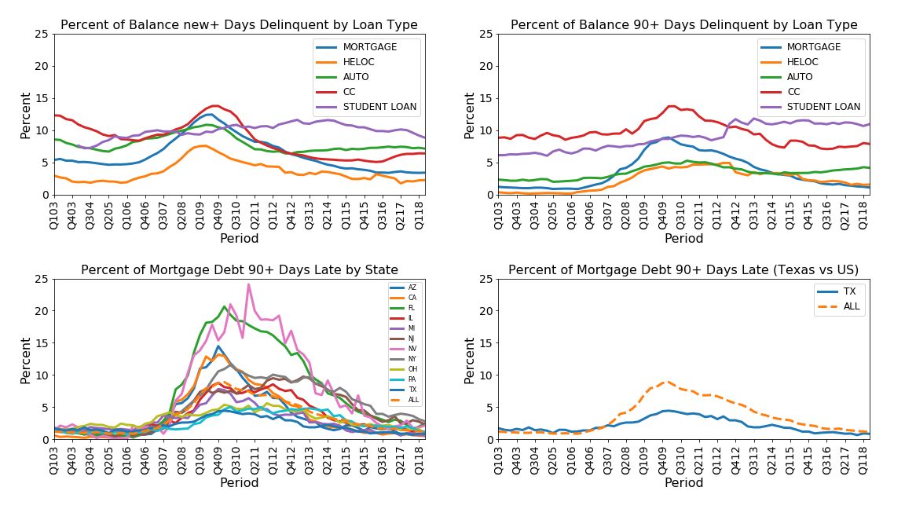

Slide 8
Housing Price Index

Slide 9
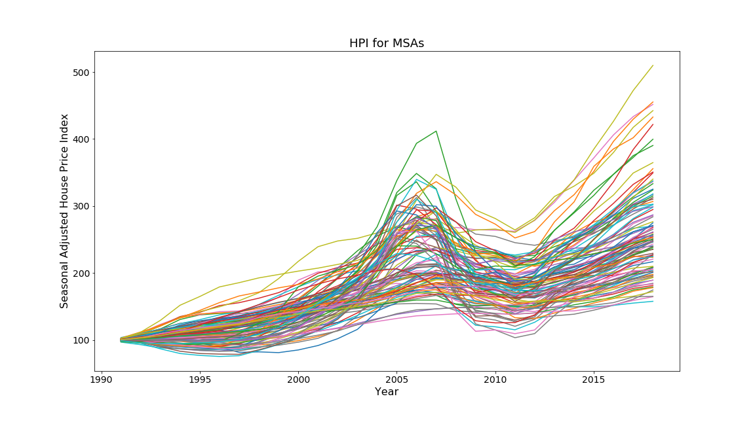

Slide 10
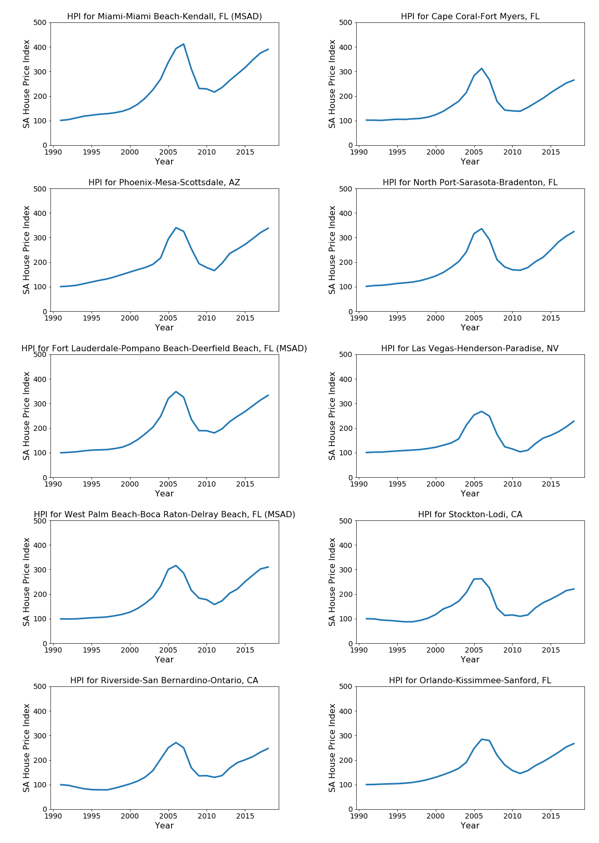
HPI Top 10 Cities
TOP 4 CITIES
Miami-Fort Lauderdale
Phoenix-Mesa-Scottsdale
Las Vegas-Paradise
Riverside-San Bernardino

Slide 11
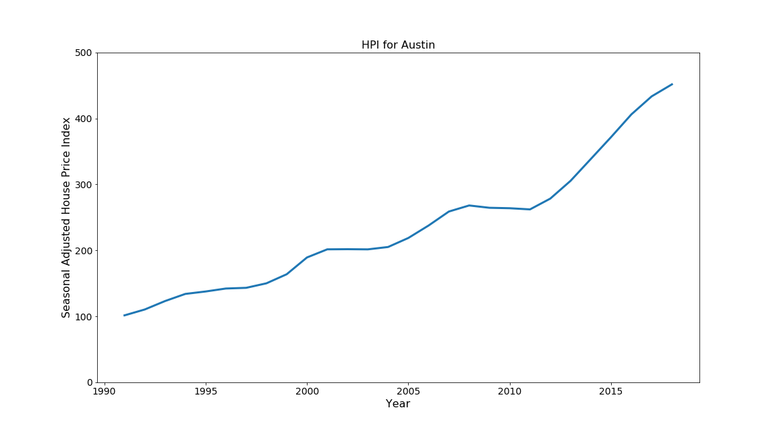

Slide 12
Homeownership Rates

Slide 13
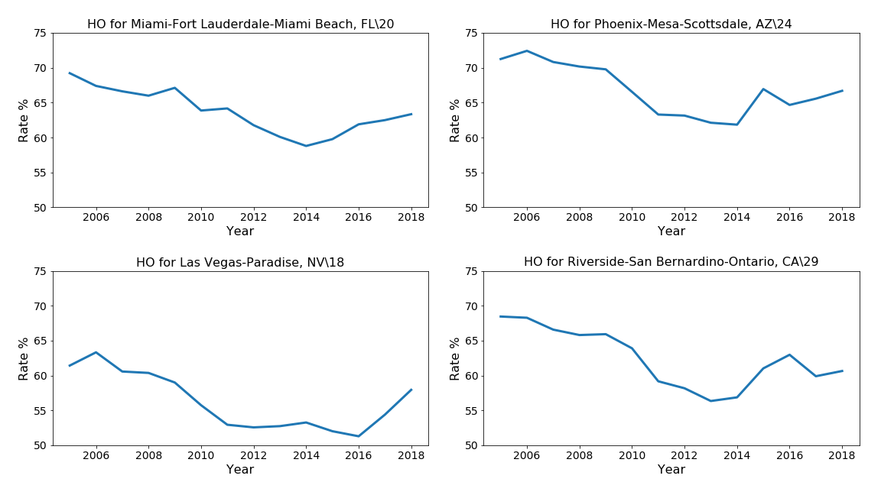

Slide 14
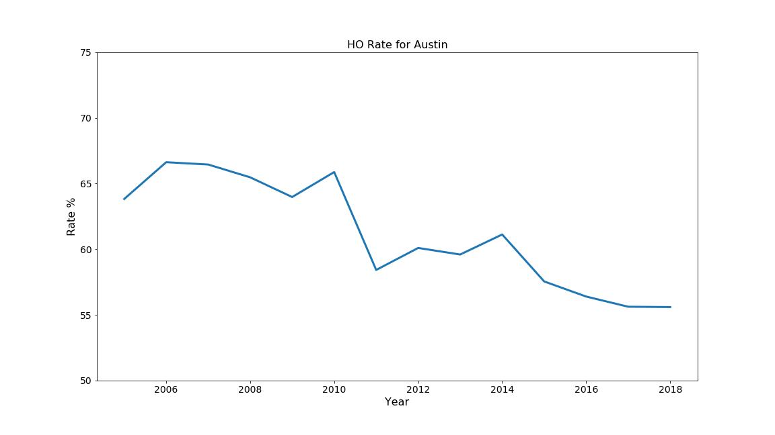

Slide 15
Vacancy Rates

Slide 16
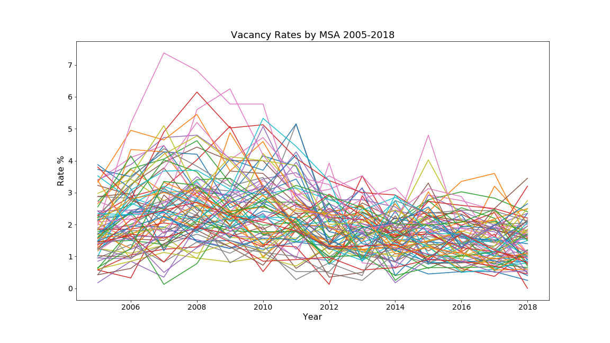

Slide 17
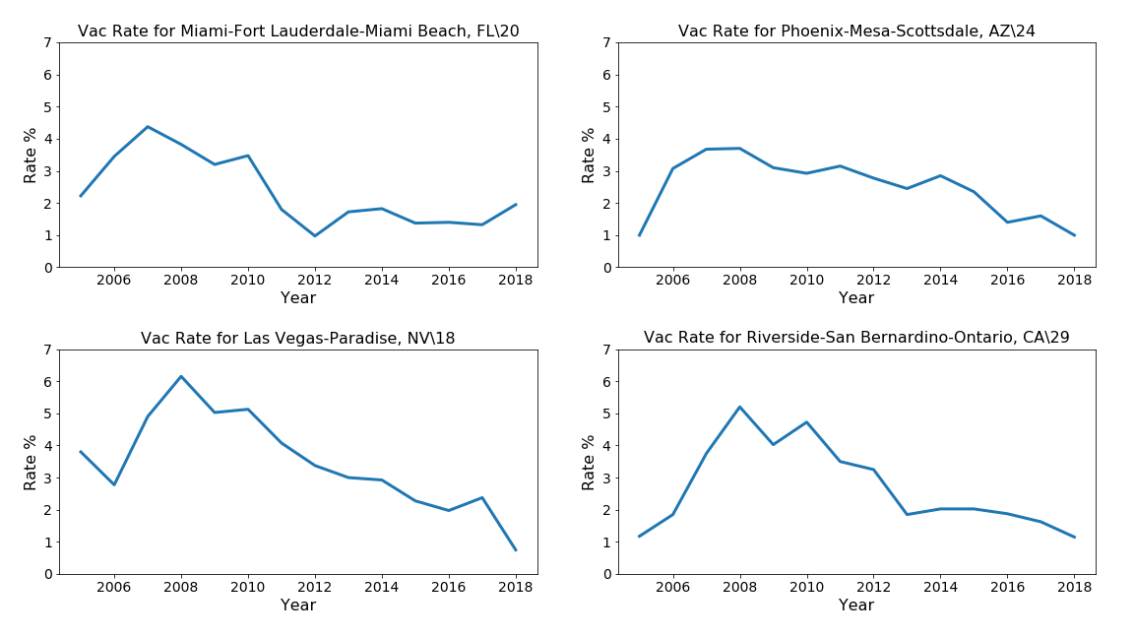

Slide 18
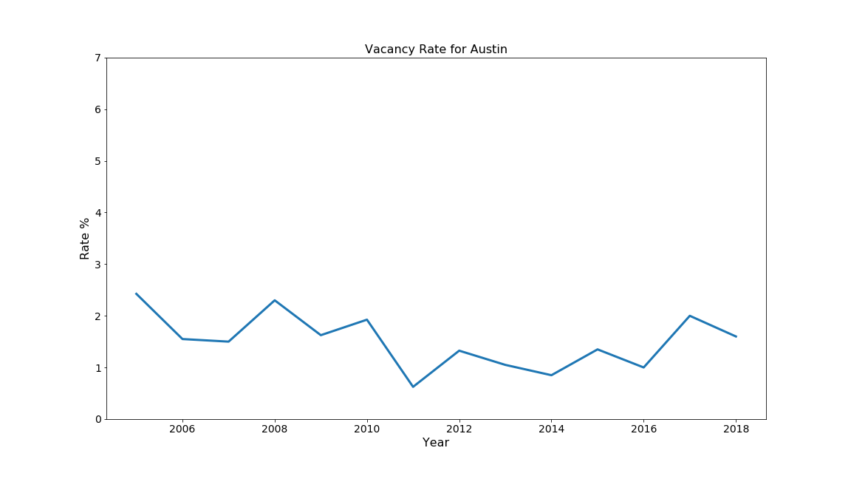

Slide 19
Affordable Housing Inventory

Slide 20
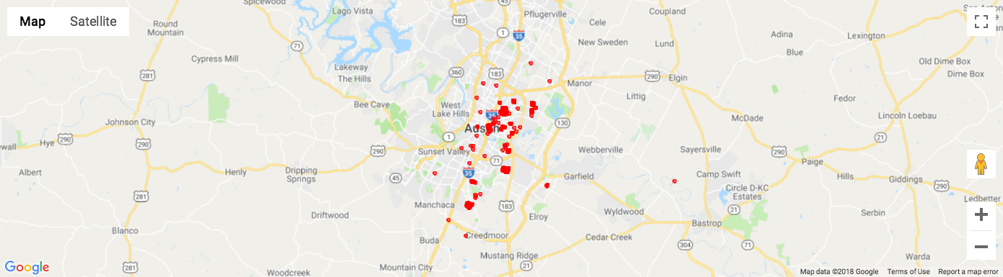
Affordable Housing Inventory

Slide 21
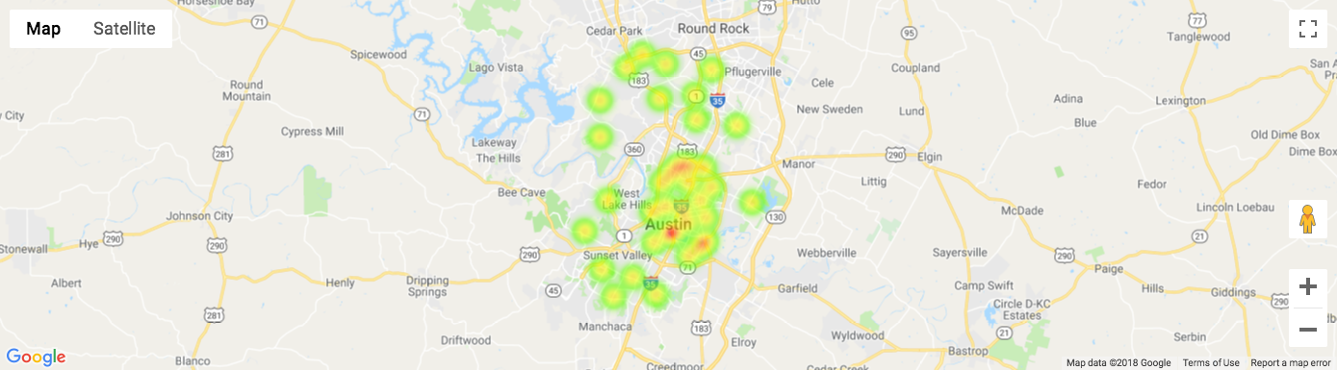
Austin Housing Price Increases

Slide 22
Postulates of a Market Bubble - Revisited
During expansion
Housing prices increase - confirmed
Mortgage rates increase – insufficient data
Occupancy rates increase and vacancy rates decrease - undetermined
House hold debt increases - confirmed
During deflation
Housing prices decrease - confirmed
Mortgage rates decrease – insufficient data
Occupancy rates decrease and vacancy rates increase - undetermined
Mortgage defaults and delinquencies increase

Slide 23
Conclusions
Current national indicators (mortgage rates, household debt, foreclosure rates) shows no signs of a repeat of the 2007/2008 event.
Although the subprime mortgage crisis of 2007/2008 wrecked the overall US economy, based on the HPI and delinquency data, Austin housing was only minorly affected.
Based on current data, there are no indicators that suggest Austin is in a housing market bubble.

Slide 24
Lessons Learned
Data wrangling; the collection and alignment of data consumed a majority of group work
MSAs defined differently
Timelines mis-aligned
Survey vs. Census
National vs. Regional vs. State
Stumbled learning and using Git and Github for collaboration.
Leave more time for statistical analysis
Homeownership and Vacancy rate require more analysis
Affordable Housing Inventory require more analysis

Slide 25
Useful Code Tidbits
df3 = pd.read_excel(xls, 'Page 3 Data', skiprows = [0,1], nrows = 7)
axcredit = plt.subplot(2,2,2); plt.tight_layout(pad = 2.5)
VR = pd.melt(VR, id_vars='MSA', value_vars = quarters2, var_name = "Period", value_name = "Rate")

Slide 26
Sources
Household Debt and Credit Report – NY Fed
Homeownership and Vacancy Rates – Census Bureau
Housing Price Index – Federal Housing Finance Agency
Affordable Housing Inventory – AustinTexas.gov

Slide 27
Q&A

Slide 28
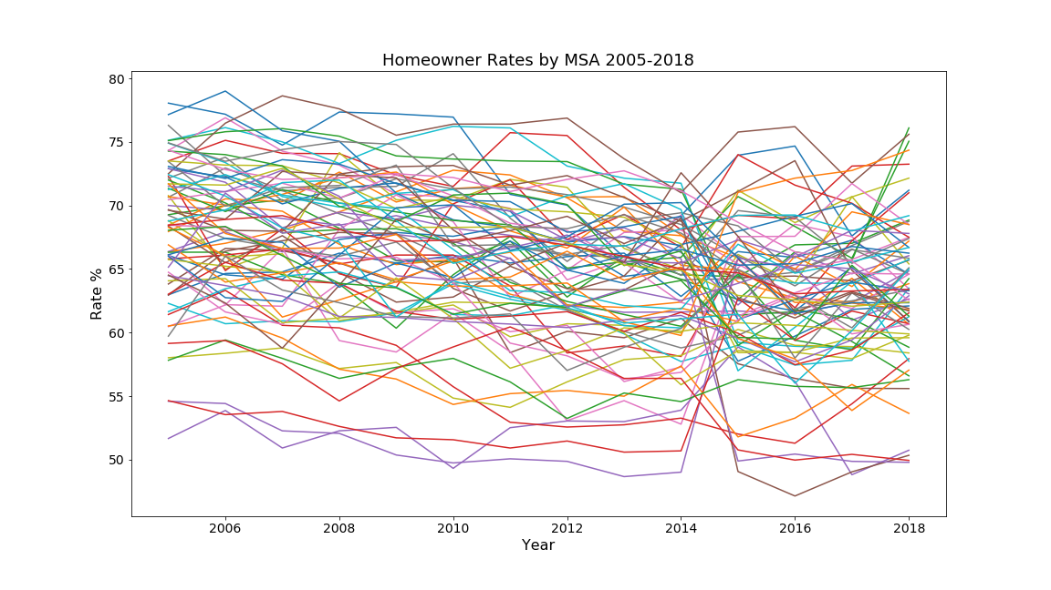

Slide 29
Index

Slide 30
