Slide 1
Austin Housing Bubble Analysis
Or, To Buy or Not To Buy
Shweta Banerjee
Yedidya Erque
Bowie Hand
Jessica Serna
Lu

Slide 2
Approach
Define “Market Bubble”
Establish postulates
Evaluate 2007/2008 housing market crash to confirm or reject postulates based on:
National indicators – Household Debt, Mortgage Originations, Foreclosures, Delinquency Trends
Metropolitan Statistical Areas (MSA) – Housing Price Index, Homeownership Rates, Vacancy Rates, Affordable Housing
Determine cities most impacted by subprime crisis and compare to Austin 2018 environment

Slide 3
Bubble Definition per Investopedia
A bubble is a type of investing phenomenon that demonstrates the most basic type of "emotional investing." A bubble occurs when investors put so much demand on a asset that they drive the price beyond any accurate or rational reflection of its actual worth.
5 steps to a bubble
Displacement – introduction of a new paradigm (tech, interest rates, etc.)
Boom – large scale growth, i.e. ‘fear of missing out.’
Euphoria – buy regardless of price
Profit Taking – institution investors (banks, lenders, etc.) exit the market
Panic – massive liquidation

Slide 4
Postulates of a Market Bubble
During expansion
Housing prices increase
Mortgage rates increase
Occupancy rates increase and vacancy rates decrease
House hold debt increases
Affordable housing decreases
During deflation
Housing prices decrease
Mortgage rates decrease
Occupancy rates decrease and vacancy rates increase
Mortgage defaults and delinquencies increase
Affordable housing increases

Slide 5
National Indicators

Slide 6
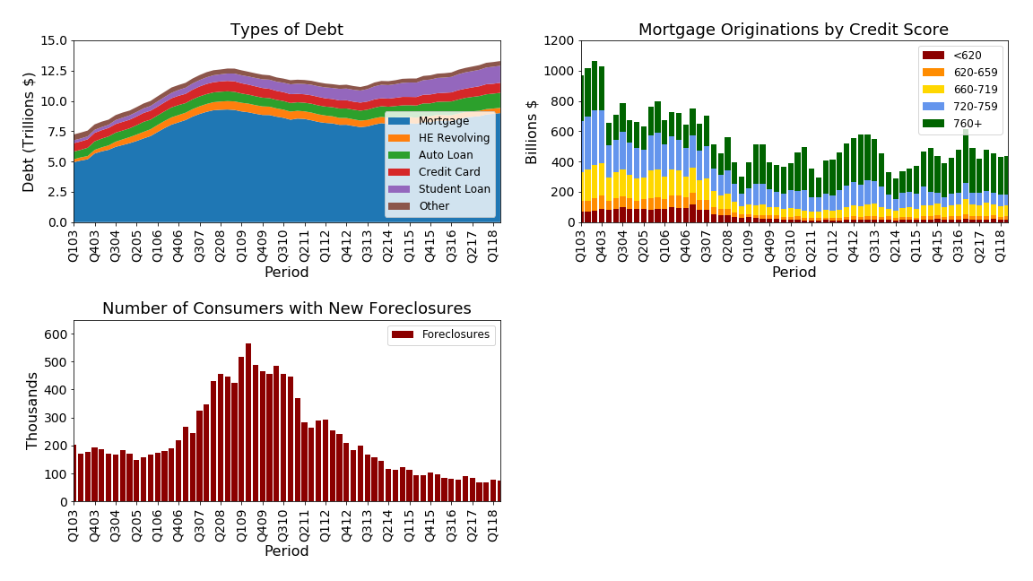
Warning signs of the mortgage crisis
Increased household debt
Lending to consumers with poor credit scores
Increasing rate of foreclosures
Increased delinquencies

Slide 7
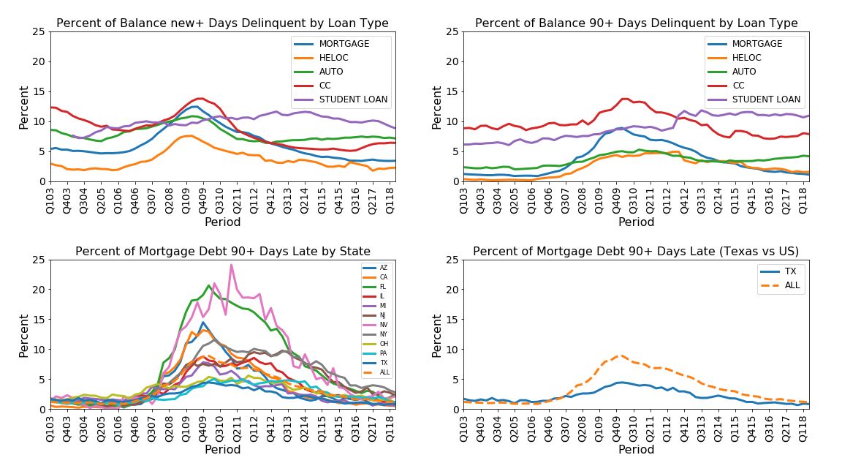

Slide 8
Housing Price Index

Slide 9
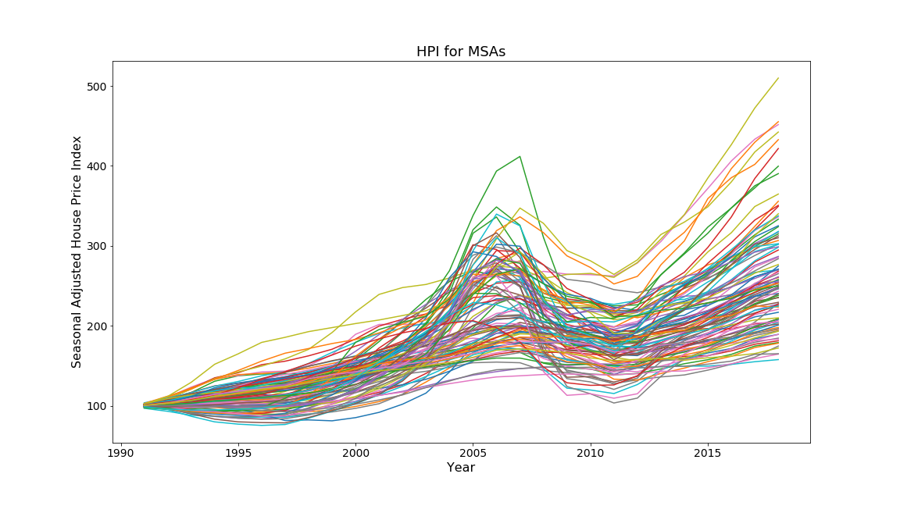

Slide 10
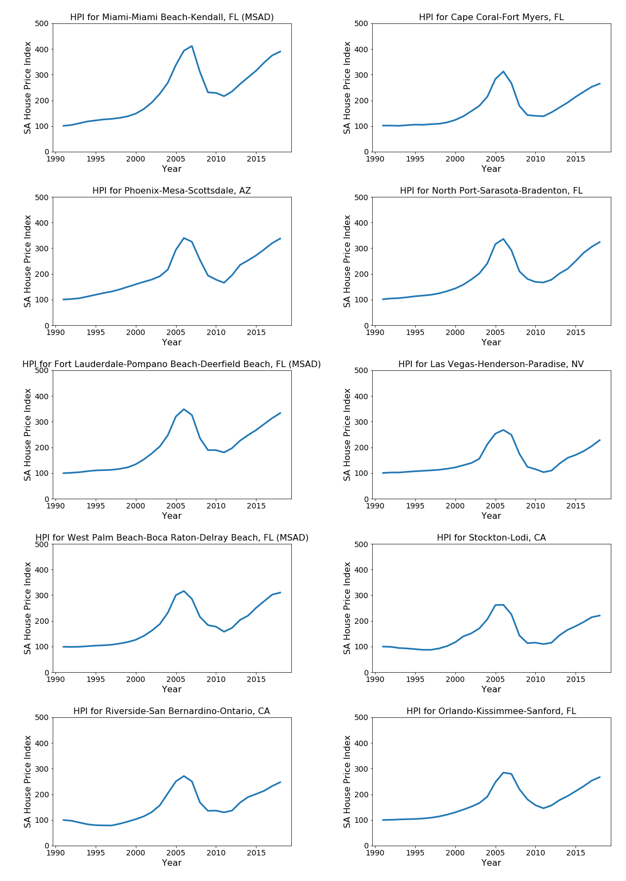

Slide 11
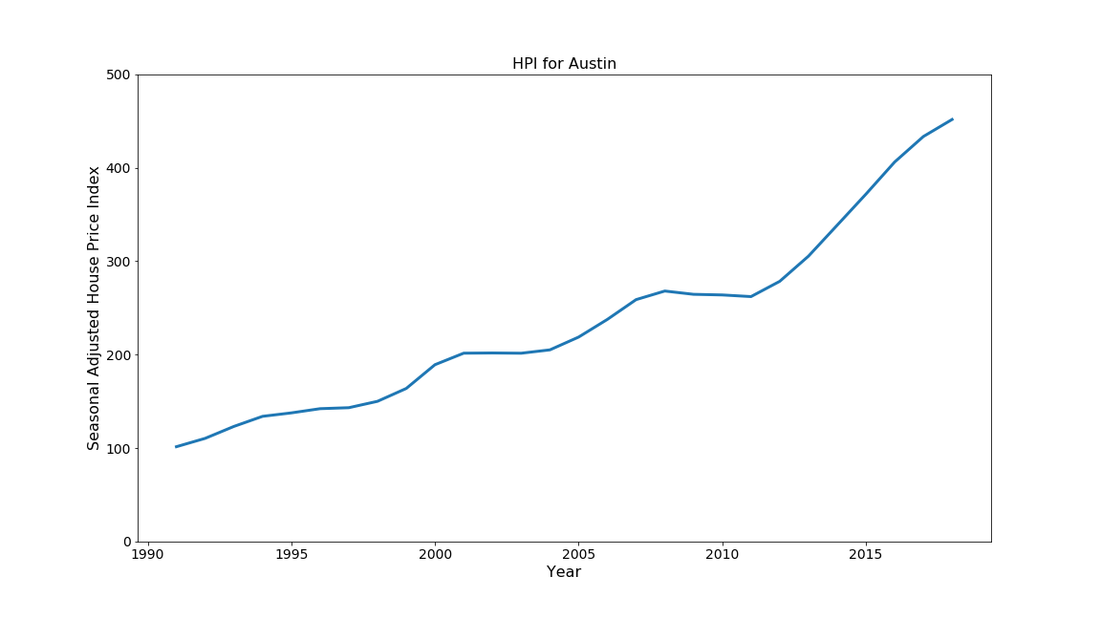

Slide 12
Homeownership Rates

Slide 13
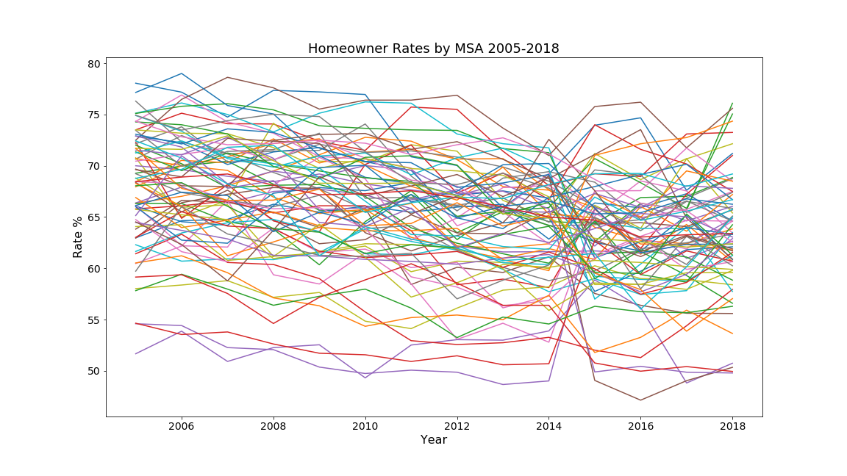

Slide 14
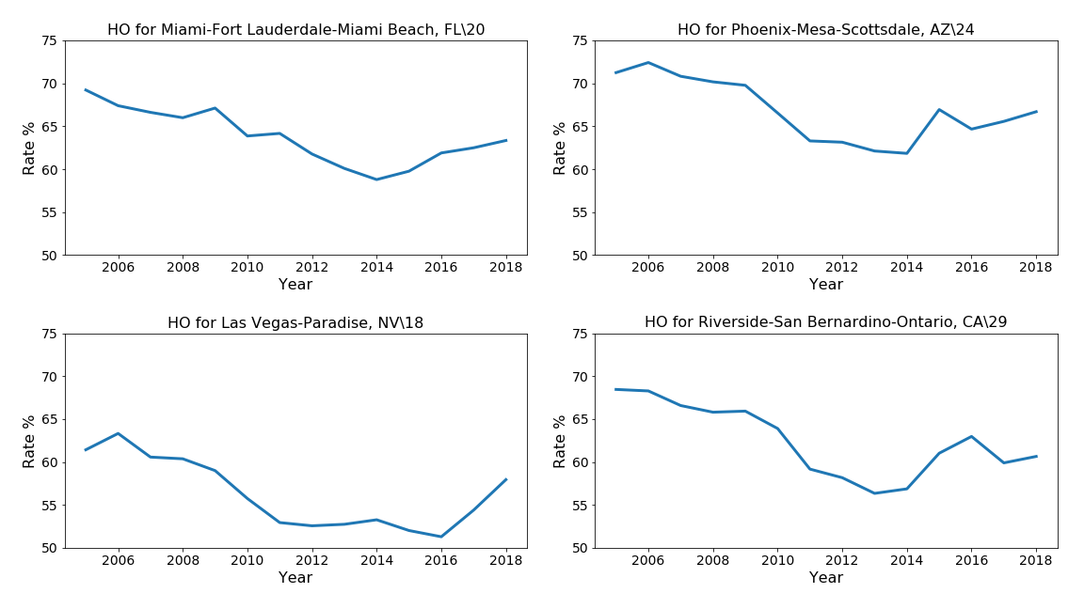

Slide 15
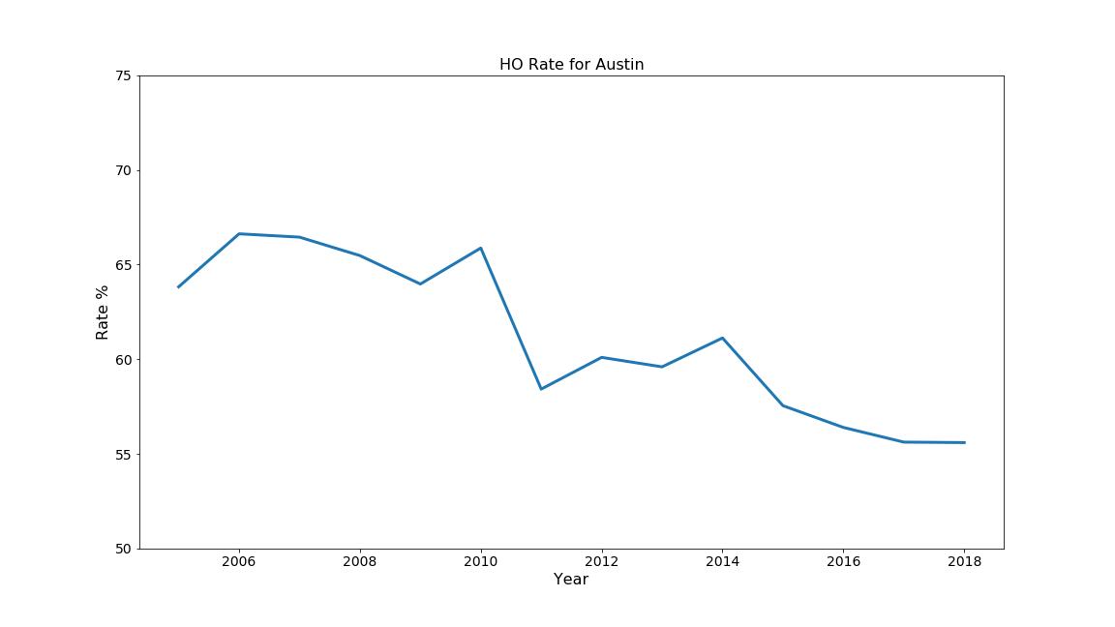

Slide 16
Vacancy Rates

Slide 17
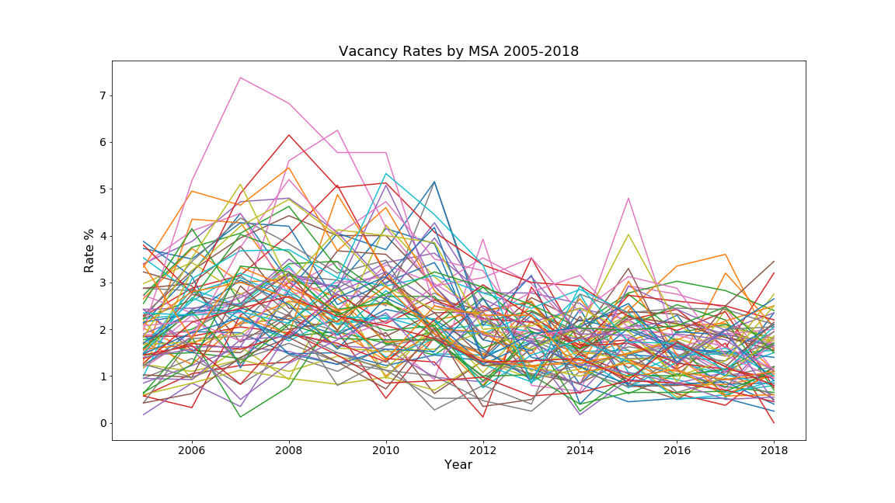

Slide 18
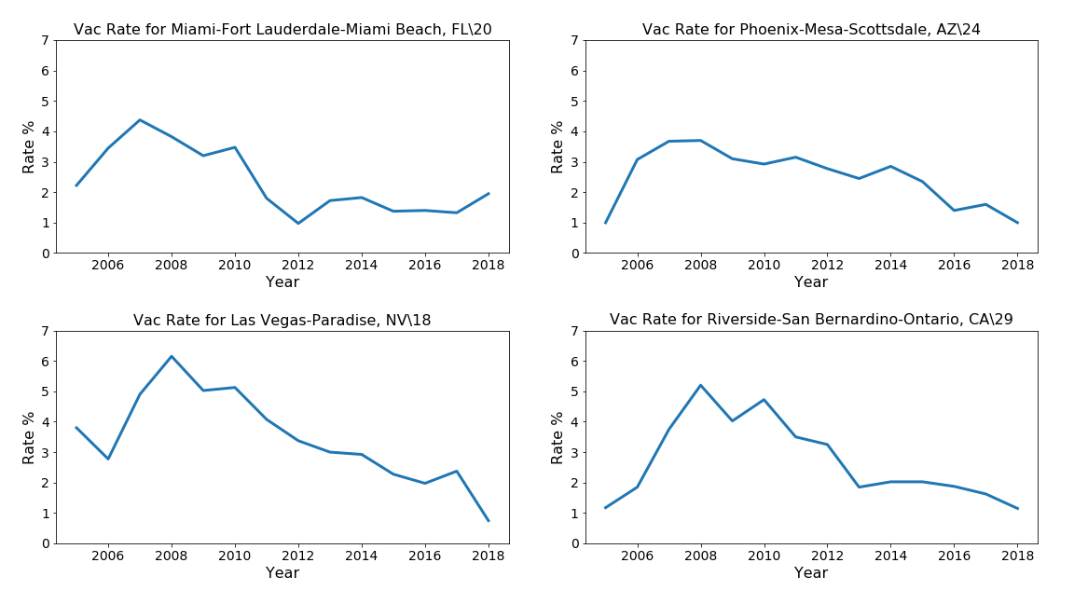

Slide 19
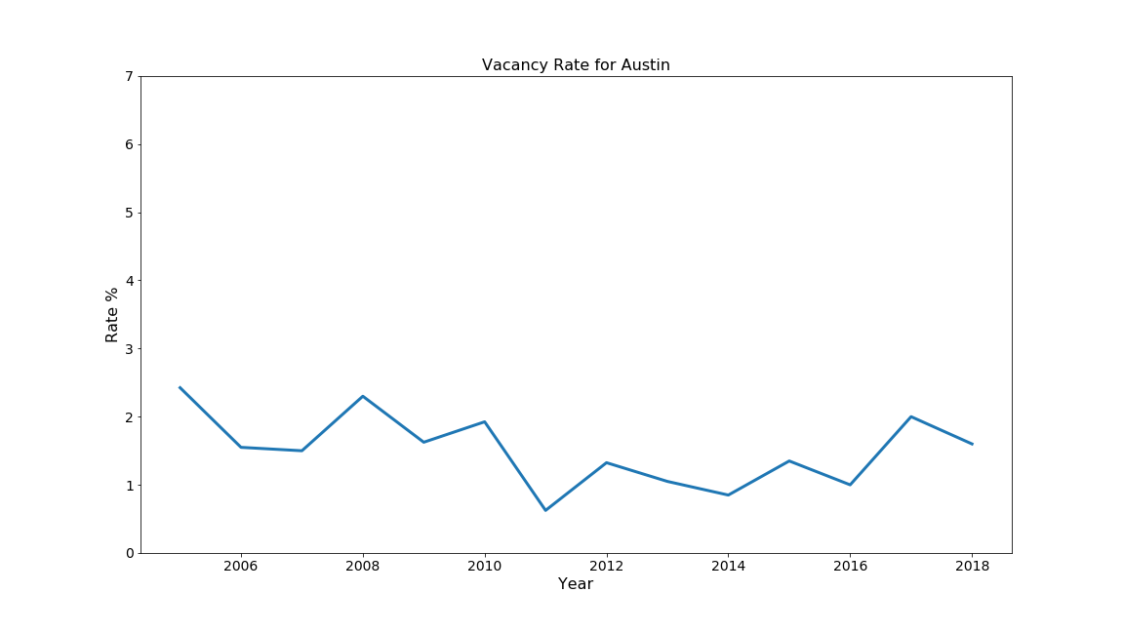

Slide 20
Affordable Housing Inventory

Slide 23
Postulates of a Market Bubble - Revisited
During expansion
Housing prices increase - confirmed
Mortgage rates increase – insufficient data
Occupancy rates increase and vacancy rates decrease - undetermined
House hold debt increases - confirmed
Affordable housing decreases -
During deflation
Housing prices decrease - confirmed
Mortgage rates decrease – insufficient data
Occupancy rates decrease and vacancy rates increase - undetermined
Mortgage defaults and delinquencies increase
Affordable housing increases

Slide 24
Conclusions
Current national indicators (mortgage rates, household debt, foreclosure rates) shows no signs of a repeat of the 2007/2008 event.
Although the subprime mortgage crisis of 2007/2008 wrecked the overall US economy, based on the HPI and delinquency data, Austin housing was only minorly affected.
Based on current data, there are no indicators that suggest Austin is in a housing market bubble.

Slide 25
Lessons Learned
Data wrangling; the collection and alignment of data consumed a majority of group work
MSAs defined differently
Timelines mis-aligned
Survey vs. Census
National vs. Regional vs. State
Stumbled learning and using Git and Github for collaboration.
Leave more time for statistical analysis

Slide 26
Useful Code Tidbits
df3 = pd.read_excel(xls, 'Page 3 Data', skiprows = [0,1], nrows = 7)
axcredit = plt.subplot(2,2,2); plt.tight_layout(pad = 2.5)

Slide 27
Sources
Household Debt and Credit Report – NY Fed
Homeownership and Vacancy Rates –
Housing Price Index – Federal Housing Finance Agency
Affordable Housing Inventory

Slide 28
Index

Slide 29
