Slide 1
Austin Housing Bubble Analysis
Or, To Buy or Not To Buy

Slide 2
Bubble Definition per Investopedia
A bubble is a type of investing phenomenon that demonstrates the most basic type of "emotional investing." A bubble occurs when investors put so much demand on a asset that they drive the price beyond any accurate or rational reflection of its actual worth. In the case of a stock, the actual worth would ideally be determined by the performance of the underlying company. Like the soap bubbles a child likes to blow, investing bubbles often appear as though they will rise forever, but since they are not formed from anything substantial, they eventually pop. And when they do, the money that was invested into them dissipates into the wind.
5 steps to a bubble
Displacement – introduction of a new paradigm (tech, interest rates, etc.)
Boom – large scale growth, i.e. ‘fear of missing out.’
Euphoria – buy regardless of price
Profit Taking – institution investors exit the market
Panic – massive liquidation

Slide 3
Approach
Evaluate 2007/2008 housing market crash
National indicators – Household Debt, Mortgage Originations, Foreclosures, Delinquency Trends
Metropolitan Statistical Areas – Housing Price Index, Homeownership Rates, Vacancy Rates
Determine cities most impacted by subprime crisis and compare to Austin current environment

Slide 4
National Indicators

Slide 5
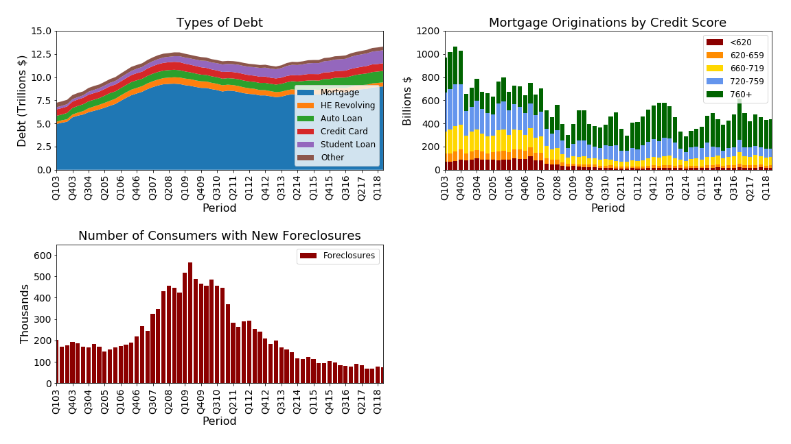

Slide 6
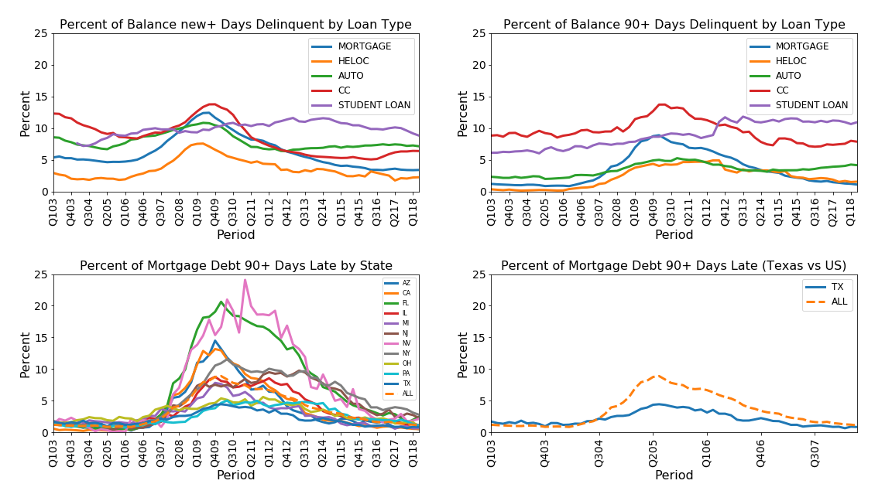

Slide 7
Housing Price Index

Slide 8
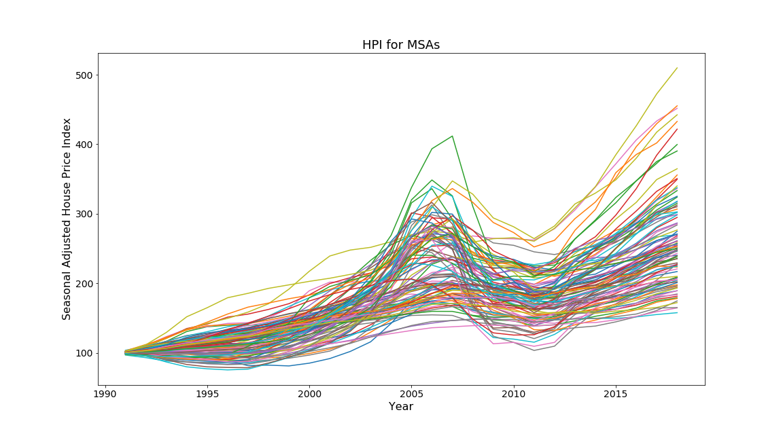

Slide 9
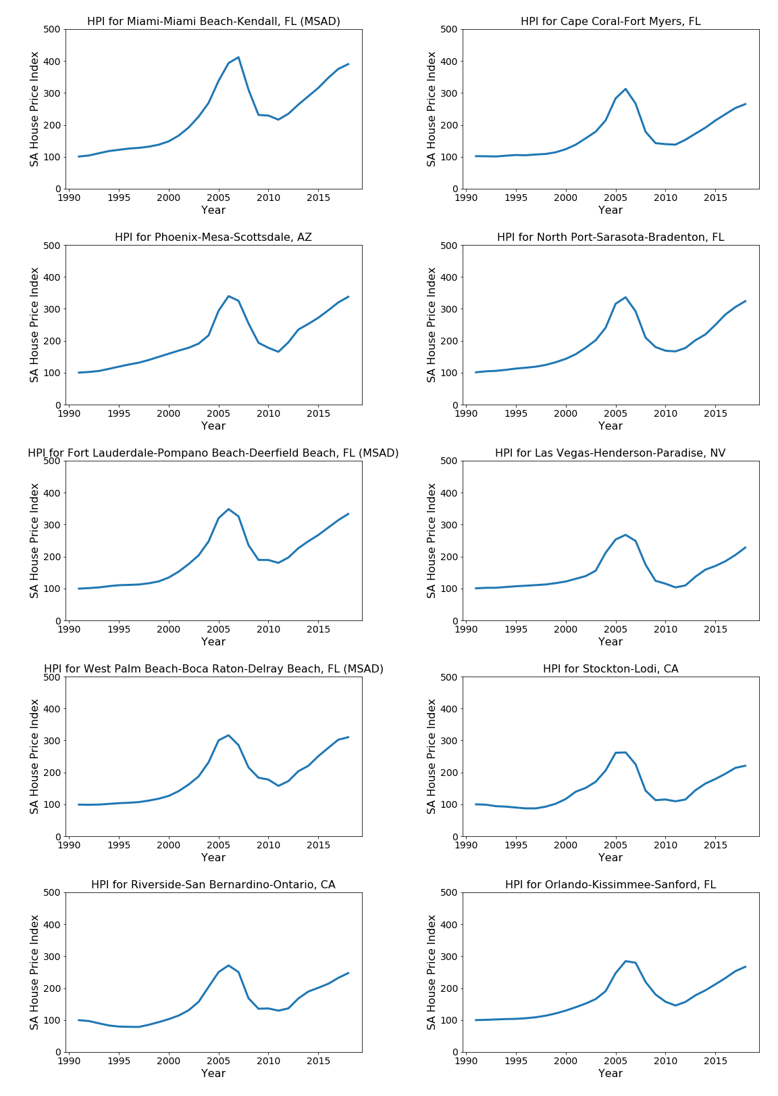

Slide 10
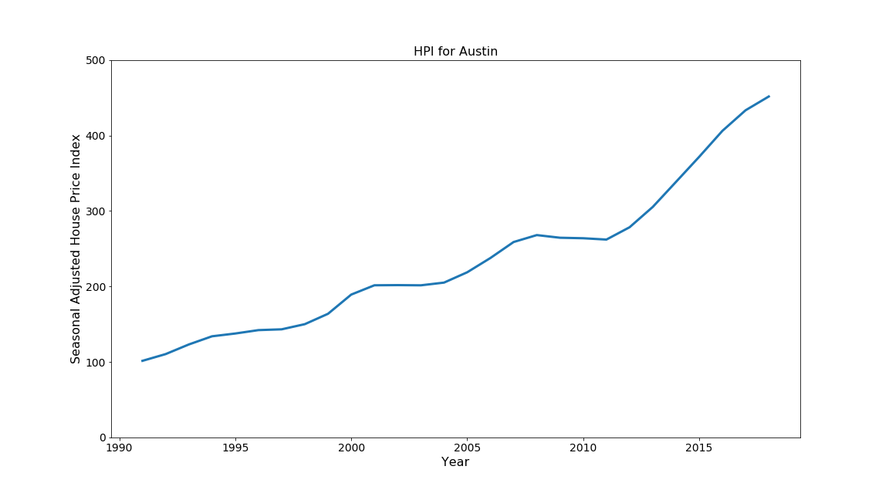

Slide 11
Homeownership Rates

Slide 12
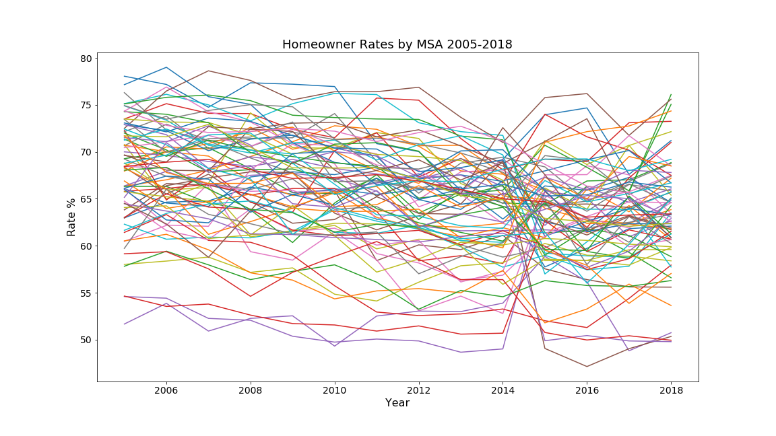

Slide 13
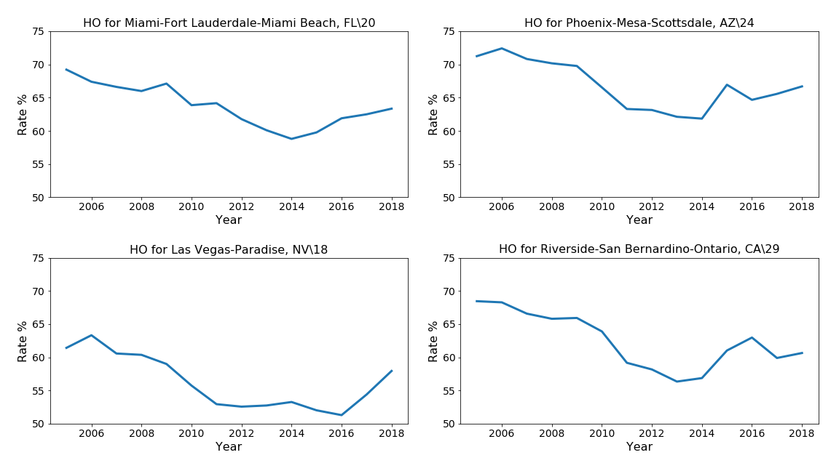

Slide 14
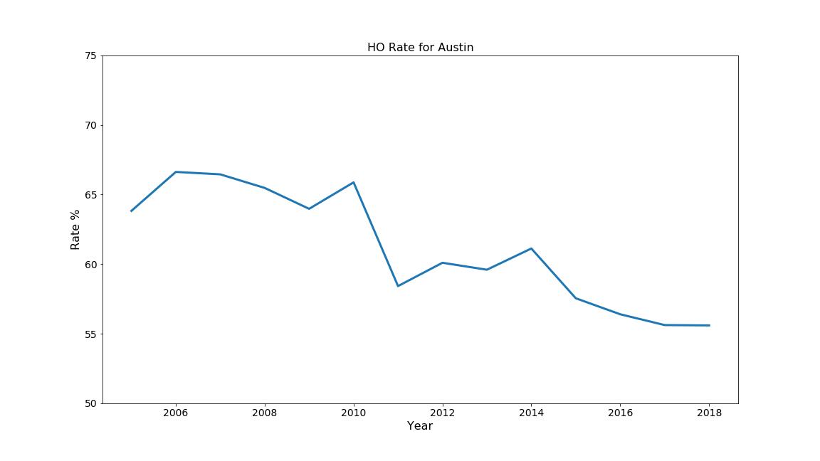

Slide 15
Vacancy Rates

Slide 16
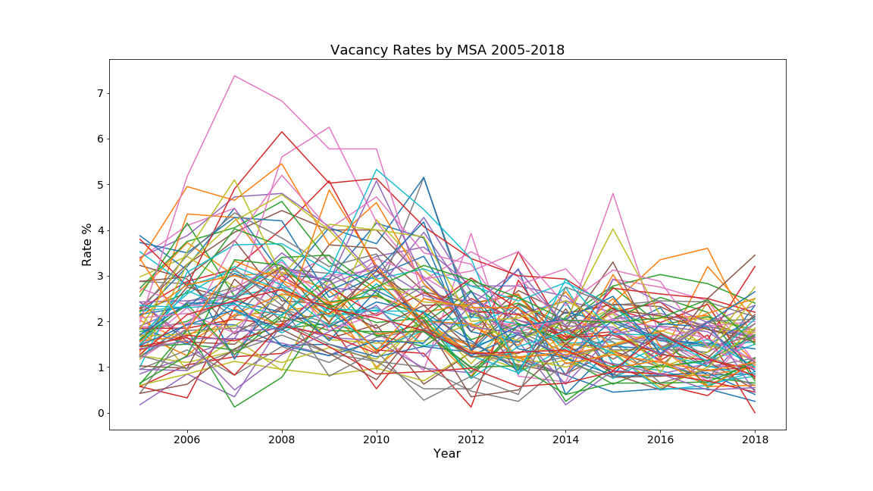

Slide 17
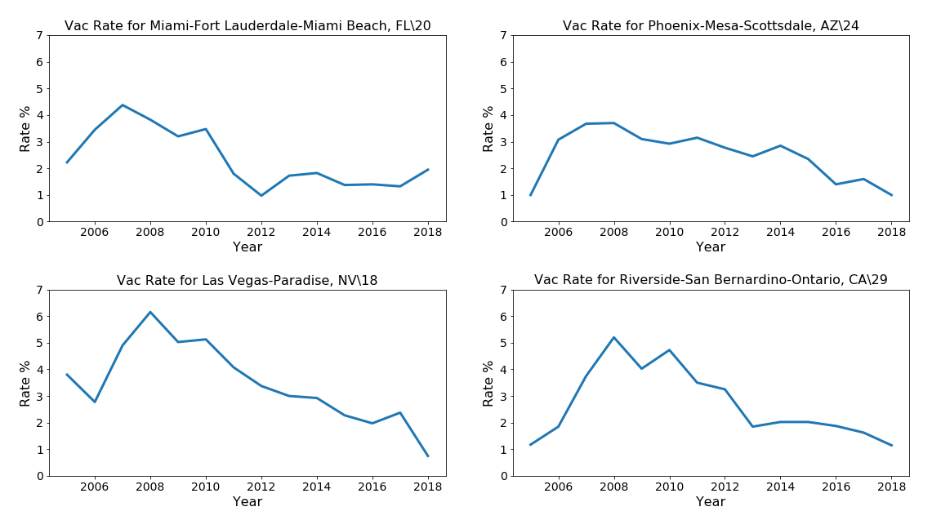

Slide 18
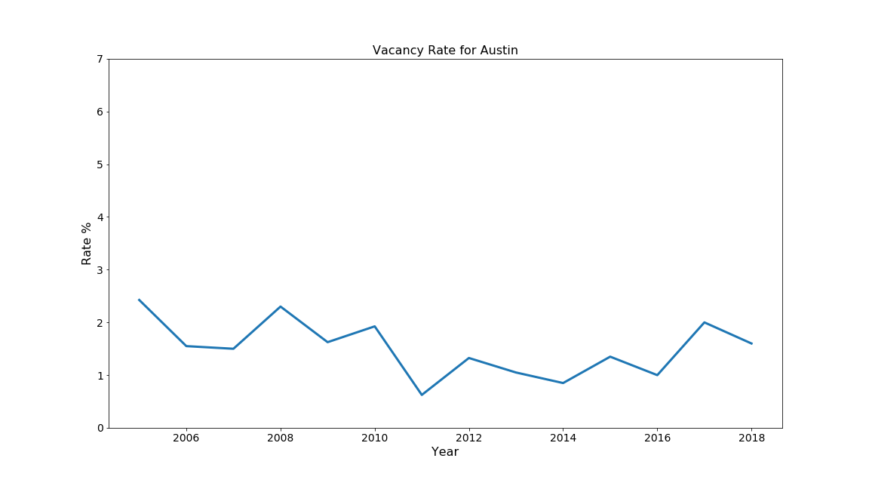

Slide 19
Affordable Housing Inventory

Slide 22
Conclusions
Based on current data, there are no indicators that suggest Austin is in a housing market bubble.
Although subprime mortgage crisis of 2007/2008 wrecked the overall US economy, based on the HPI and delinquency data, Austin was only minorly affected.
Current national indicators (mortgage rates, household debt, foreclosure rates) shows no signs of a repeat of the 2007/2008 event.

Slide 23
Lessons Learned
Data collection is time consuming

Slide 24
Index

Slide 25
