Slide 1

Engineering Ethics and Societal Impact
Nael Barakat, Ph.D. P.Eng. FASME,
ABET-PEV, Fulbright Specialist
Professor and Chair of Mechanical Engineering
University of Texas at Tyler
Department of
Mechanical Engineering

Slide 2





Agenda
Engineering Context
Fundamentals
Impact
Professional Ethics
Conclusion

Slide 3
Do we know something about professions?
Name a TV show about lawyers.
Name a TV show about CSI.
If you see a police-person would you recognize him or her?
Do you get to meet the MD if you are sick and need medication?
So…You probably can say something about what these professionals do.

Slide 4
What about Engineering?
Name a TV show about engineers !!!

Slide 5
What Do Engineers Really Do?
How many of us have used a:
Cell phones?
Car? Plane? Train?
Computer?
How long can you survive without these?

Slide 6
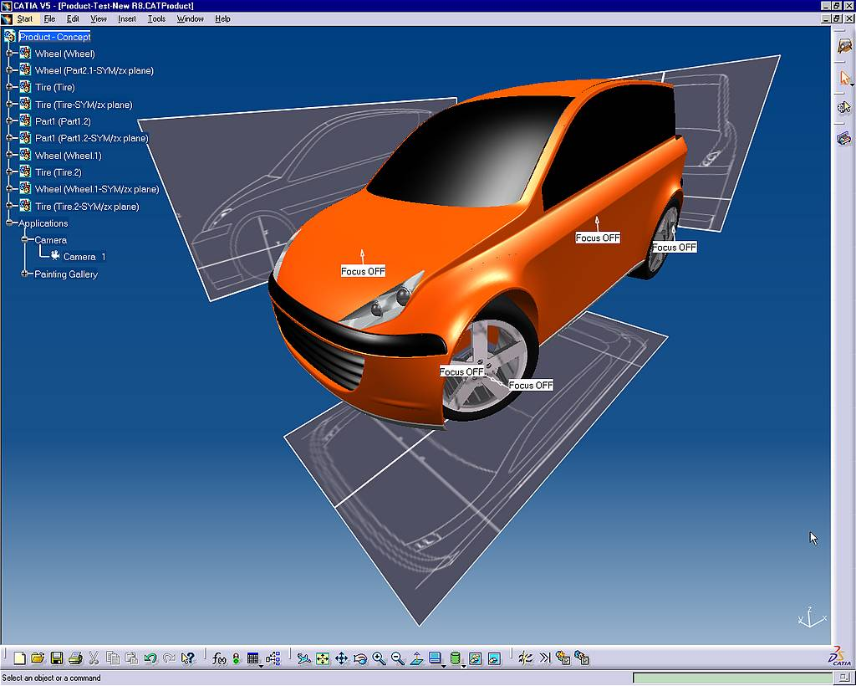
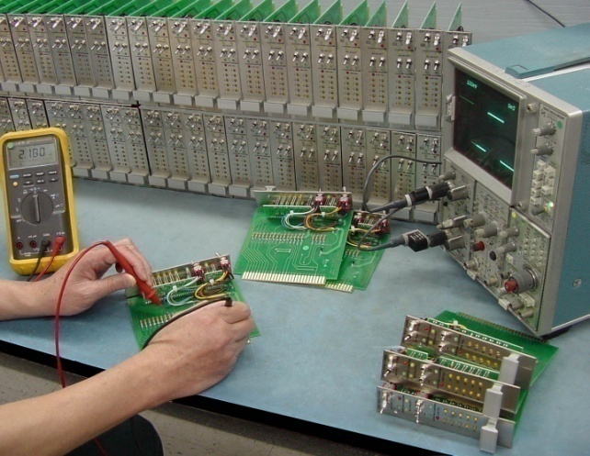
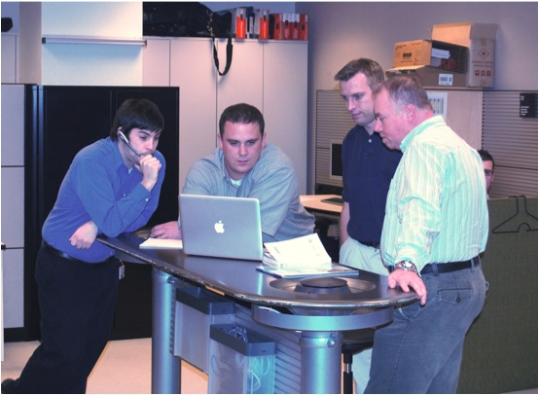
Engineering ?
Putting scientific knowledge to practical human use.
Solving humanity problems and satisfying their needs.
Designing and building systems/devices that did not exist before for a practical use.

Slide 7
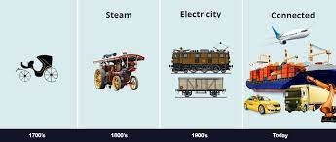
Definition of Engineering
Engineering is the application of science and math to improve human life and society.
Imagination &
ingenuity to improve life
through technology.
Engineering through Time

Slide 8

Why become an Engineer?
Change the world, make a positive difference
Never be bored, be creative
Work with great people
Make a big salary
Travel
Enjoy job flexibility
Solve problems, design things that matter
Love your work, AND live your life too!
Every project has something new and unique…

Slide 9
Context of Engineering
Globe
Society
Human
Engineering& Technology

Slide 10
Impact?
Why do we need professional (engineering) ethics?
What are:
Professional (engineering) ethics?
Professional responsibility?

Slide 11
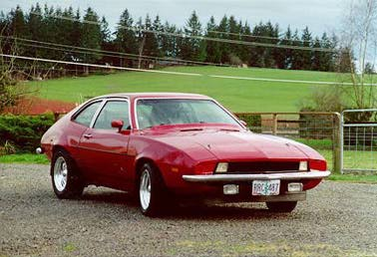

Example: The “FORD PINTO”
Early 1970s - Ford, under Lee Iacocca as president introduced the Ford Pinto …!
The goal was:
“not to weigh an ounce over 2,000 pounds and not to cost a cent over $2,000”

Slide 12
The “FORD PINTO” Case
In a rear end collision, the gas tank ruptured causing a fire or explosion (1978) killing three.
This was not the first time … There were several previous lawsuits.
This time: FORD was charged in a criminal court...Results will be different!

Slide 13
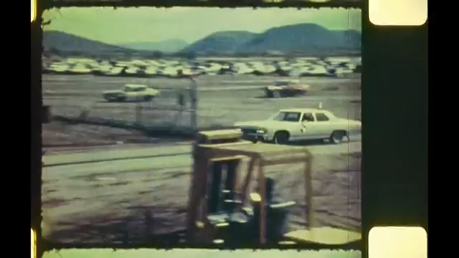
Ford Pinto Tests

Slide 14
The “FORD PINTO” Case
The Pinto PASSED Federal safety standards
but
FAILED all of Ford’s crash tests!
Engineers were aware of the flaws, but management wanted the product rapidly!

Slide 15
The FORD PINTO Case
Fix Every Car
Do Nothing
Cost – Benefit Analysis With estimated projections
Cost – Benefit Analysis With estimated projections
Following are records which were subpoenaed by courts and later published…!
Solution:
$ 11 per car → $ 137,000,000
Average repair cost = $700 per car (2100 burned vehicles)
Each major burn injury cost = $ 67,000 (180 serious burns)
Each death cost = $ 200,000 (180 burn death)
Not to make changes → $49,500,000

Slide 16
Reaction … !
So, after hearing this story, what are your thoughts?
If you were receiving this info from the media, on which party would you place the blame?

Slide 17
The dilemma of The Ford Pinto Case
Engineers had to Balance
their duty to the public
against
their duty to the employer!
Hold on a minute… What duty to the public?!?!

Slide 18

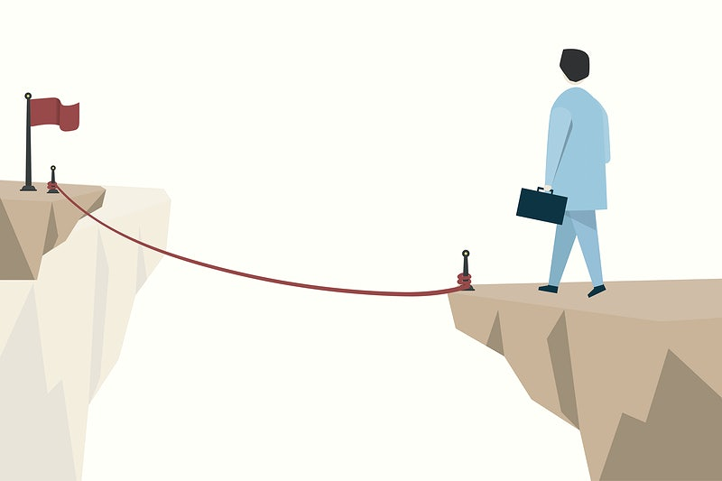
The Engineering Profession - I
Nature - membership requires:
Extensive formal education and training of intellectual character.
Sophisticated skills, autonomy, and use of judgment; not routine.
Requires managing the complex unknown with high uncertainty and risk.

Slide 19
The Engineering Profession - II
Impact - public and society:
Vitally need the knowledge and skills of the members for society well-being.
Hence … allow professional organizations to self control/set/enforce the practice.
Professionals are normally regulated by ethical standards, embodied in a Code of Ethics.

Slide 20
Engineering Nature
Complexity and Interaction Unknowns
Managing the unknown through innovation
Automatically involves a risk factor
Liability issues

Slide 21


Does Technology Really influence human life & society?
You woke up this morning and found no electricity and no cell tower functional. What is your reaction?
There was no cooking gas!
The vehicle that transports you every
morning did not start!
How long can you survive without these?

Slide 22
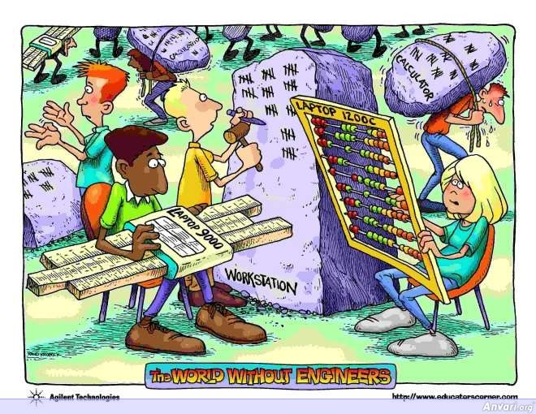
Reality: Here is the World without Engineering Computers!

Slide 23
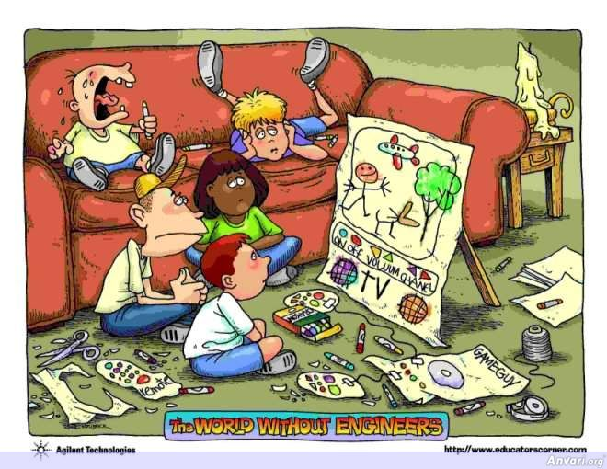
Reality: Here is the World without Engineering Entertainment!

Slide 24
RESULTS
Engineering projects are social experiments requiring morally responsible engineering behavior
Engineers have a responsibility for protecting the safety and well-being of the public
(Implicit Social Contract)
Engineers have also the responsibility for guarding and advancing their profession

Slide 25
Consequences? Sobering Historical Lessons!
Previous disasters: Asbestos was a technological product that inflicted harm on humans!
Uninformed decisions: The promising Genetically Modified Organisms (GMO) technology was rejected by the public in Europe because of poor public knowledge of its benefits!

Slide 26
RECIPROCAL INFLUENCE
Public perception influences engineering and technology advancement (e.g. Power production in Germany after Fukushima).
Because of history, any technological development will raise many questions regarding its societal impact and ethics.
Engineering professional ethics provide assurance to the public in exchange for autonomy.

Slide 27
Conclusion – I Engineering ethics are needed because:
Engineering Nature: is a profession involving managing the unknown for the betterment of human life.
Engineering Impact: Engineering projects are social experiments with high risk factors.

Slide 28
What are Engineering Ethics? Working Definitions - I
Ethics: Standards of proper conduct.
Morality: Set of ideals, values, and beliefs, presumably guiding behavior.
Common Morality: The set of moral ideals shared by most members of a culture or society.

Slide 29
Working Definitions - II
Personal Ethics: The set of ones own ethical commitments, and conduct towards others, acquired during upbringing and later modified.
Professional Ethics: The set of standards of conduct adopted by professionals.
Profession Laws: Many laws governing the practice of engineering are ethically based.

Slide 30
Engineering Ethics
The set of common standards of conduct, & professional dimensions, shared by engineering professionals.
A framework for ethical judgment and critical analysis for a professional gathered in a “Code of Ethics” document.

Slide 31
Common Attributes of Engineering Codes of Ethics
A primary obligation to protect the safety and respect the right of consent of human subjects.
A constant awareness of the experimental nature of any project, imaginative forecasting of its possible side effects, and a reasonable effort to monitor them.
A personal involvement in all steps of a project and accepting accountability for the results of a project.
A framework for evolving professional issues particularly those with societal & human dimensions.
For any professional engineering code of ethics, there are common attributes

Slide 32
Engineering Code of Ethics Functions - I
An agreement among professionals to abide.
An agreement between professionals and the public to promote public well-being, gain public trust, and stay competent.
A framework to integrate societal impact and humanity dimensions into engineering activities.

Slide 33
Engineering Code of Ethics Functions - II
A medium providing focus for debate on professional ethics evolution
A base to provide rationale for professionals to adhere to professional standards.

Slide 34
Therefore: ENGINEERING RESPONSIBILITY
Is to conform to
professional standards
(Technical & Ethical)

Slide 35
Conclusion – II: Definitions and Concepts
Engineering Code of Ethics: Is the shared code of conduct for engineers to protect the public and the profession.
Engineering responsibility: Is to conform to technical and ethical standards.
Engineering Code of Ethics is different than personal morality, personal ethics, and religious beliefs.

Slide 36

Goal of Engineering Ethics
To establish moral responsibility.
Is not to stop technology, but ...
To educate stakeholders (including Engineers):
Technology development (engineering) is a social experiment that incorporates many unknowns
Awareness of ethical, societal, and human related issues impacted by the profession
Professionals’ role and responsibility.

Slide 37
Engineers’ Professional Responsibility
To include ethical considerations in their work at early stages
To inform the public and the decision makers
To participate in policy making regarding technology – dual duty of informed citizens
To protect and advance the profession
To protect the public health and welfare at all stages

Slide 38
Conclusion
Engineering is a profession that is vital for human life and society.
Public trust in exchange for self-regulation.
Professional responsibility is embedded in engineering ethics.
Public and societal interaction with engineering and technology is reciprocal.
Engineering ethics provides a larger framework than just doing the right thing.

Slide 39
Top 5 signs you are an engineer in the making
Your dream is to build a robot to solve your homework
You know what “www” and/or “http” means
You can’t quite find out what math is made for but you are good at it
Your family wont let you near electricity, devices, or car engines
At a younger age, all the toys in your toy box were in whole separate pieces

Slide 40
Questions?

