Slide 1
Regional training in Genomics and Plant Breeding
Genetics, Biotechnology and Seed Science Center
Sequence Signature Databases
Ange Zoclanclounon, PhD
angez9914@gmail.com
November, 2024

Slide 2

The Library of Life: A Story of Sequence Signature Databases
Imagine you are visiting a vast library unlike any other—a library that holds the secrets of life itself. This library is called the "Sequence Vault." Instead of books, it stores DNA sequences—the unique "texts" that make up every living organism.

Slide 3

The Detective and the Sequence Vault
One day, a curious detective named Ange arrives at the Sequence Vault. Ange’s mission? To identify the origins of a mysterious scrap of paper with a peculiar sentence written on it: "ACTGACGTAGC..."
Ange approaches the librarian, a wise AI named Geneva, and asks for help. Geneva smiles and says: "This is a task for our Sequence Signature Database! It works like a fingerprint system for DNA."

Slide 4
How It Works: The Signature Shelves
Geneva leads Ange to a series of shelves, each dedicated to a different species, traits, or functions. These shelves are filled with signature pages—unique patterns of letters (A, T, C, G) that act as "signatures" for specific organisms, genes, or traits.
One shelf is labeled "Plants" and includes rice, wheat, and maize sequences.
Another shelf, "Bacteria," has drawers for helpful microbes and disease-causing pathogens.
There’s even a shelf called "Cancer Biomarkers," filled with pages that help diagnose diseases.

Slide 5
The Process
Geneva feeds the mysterious scrap into a scanner that reads the sequence. The database begins searching its shelves. "Aha!" Geneva exclaims. "This fragment matches a unique signature from the E. coli drawer! This bacterium is commonly found in the gut."
But Ange isn’t done yet. The fragment is too generic, and Ange suspects it might be related to a disease-causing strain. Geneva refines the search, scanning against more specialized sub-databases. "Here it is—your sequence belongs to a rare pathogenic strain of E. coli."

Slide 6
Metaphor: Sequence Signatures as Barcodes
Geneva explains: "Think of every DNA sequence as a product in a supermarket. Sequence signatures are like the barcodes on these products. The database helps us scan these barcodes to identify exactly what we’re dealing with."

Slide 7
The Takeaway
Sequence signature databases are the ultimate detective tool, helping us make sense of life's codes.
They empower us to identify, classify, and understand the diversity of organisms and their functions, unlocking the mysteries hidden in their genetic texts.

Slide 8
Relatable Applications
Ange learns that sequence signature databases are used for many purposes:
Crime Scene Investigations Just as fingerprints are used to identify suspects, scientists use sequence databases to trace organisms in crime scenes, like tracking pathogens in food outbreaks.
Treasure Maps Researchers studying biodiversity use the databases to discover new species by matching unknown DNA sequences with existing entries.
Medical Diagnoses Doctors use sequence databases to find genetic mutations linked to diseases, just like Ange found the pathogenic E. coli strain.

Slide 9

Relatable Applications
Meet Jamal, a hardworking farmer who cultivates watermelons on his lush fields. One day, Jamal notices something troubling—his ripe watermelons are developing soft, rotting spots, and their sweet aroma is replaced by a foul smell. The fruits become unmarketable, and Jamal’s profits are at risk.

Slide 10
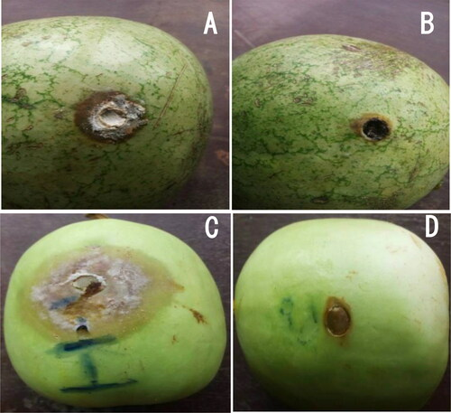
Relatable Applications
Worried, he takes a sample of the infected watermelon to the Agricultural Pathology Lab, where scientists use a Sequence Signature Database to uncover the culprit.
©Oyededji et al. (2021)

Slide 11
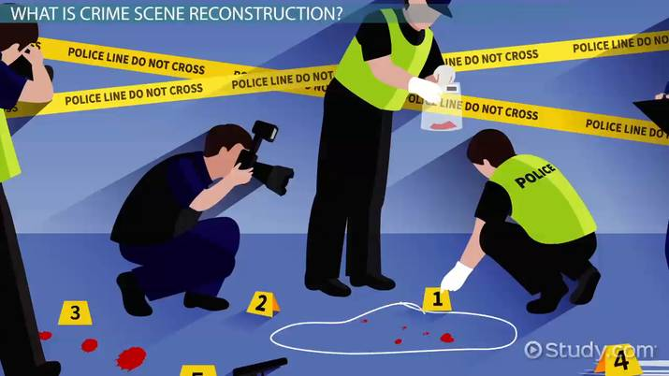
Step 1. Collecting evidence
The lab technicians isolate fungi from the rotting watermelon. They extract the DNA from these samples, preparing to compare it with known sequences in their database.
This is like gathering clues at a crime scene.

Slide 12
Step 2: Searching for a Match
The DNA is fed into the Sequence Signature Database, a comprehensive collection of genetic barcodes for pathogens affecting crops worldwide.
After a quick search, the database flags a match: "The DNA belongs to Fusarium chlamydosporum, a fungus known to cause watermelon fruit rot disease!"

Slide 13
Step 3 : Finding a solution
Now that the culprit is identified, the scientists recommend specific steps for Jamal:
Crop Rotation They advise Jamal to rotate his watermelon crop with non-host plants like maize or sorghum, breaking the life cycle of the fungus.
Soil Treatment They suggest treating the soil with biocontrol agents such as Trichoderma species, which suppress fungal growth.
Resistant Varieties The database also highlights watermelon varieties resistant to Fusarium chlamydosporum. Planting these varieties can minimize future losses.
Post-Harvest Hygiene Proper cleaning of storage areas and transportation crates is recommended to prevent fungal spread.

Slide 14
How Sequence Signature Databases Save the Day ?
Quick Diagnosis
Without the database, it might take weeks or months of trial and error to identify the pathogen. The database delivers answers in hours.
Precise Interventions
Jamal avoids using broad-spectrum fungicides, which are costly and harmful to beneficial microbes. Instead, he uses targeted biocontrol methods.
Sustainable Farming
By using resistant varieties and crop rotation, Jamal can protect his watermelon crop for future seasons without relying on excessive chemical treatments.

Slide 15
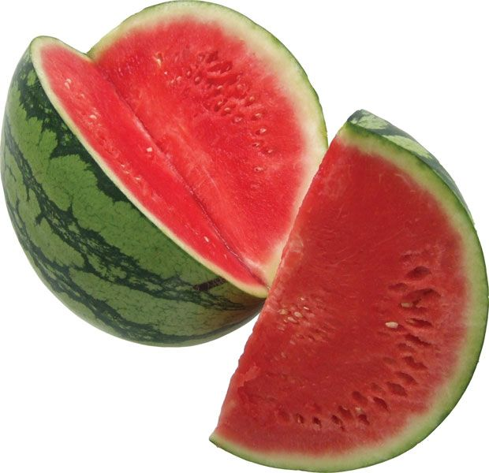
The Big Picture
For farmers like Jamal, Sequence Signature Databases act as an early warning system and a toolbox for solutions. By identifying pathogens like Fusarium chlamydosporum, these databases help safeguard yields, reduce waste, and ensure sustainable watermelon production.

Slide 16

How can the second step be conducted ?

Slide 17

How can the second be conducted ?
01. Do a blast search against NCBI
02. Do a multiple sequence alignment
03. Construct a phylogenetic tree

Slide 18
How can the second be conducted ?
01. Do a blast search against NCBI database
NCBI BLAST (Basic Local Alignment Search Tool) is a powerful bioinformatics tool used to compare a query sequence (e.g., a DNA or protein sequence) against a database of sequences to find similar sequences.
Here are the steps to use NCBI BLAST:
Access the NCBI BLAST website: Visit the NCBI BLAST homepage at
https://blast.ncbi.nlm.nih.gov/Blast.cgi

Slide 19
How can the second be conducted ?
01. Do a blast search against NCBI database
02. Select the BLAST program: Choose the appropriate BLAST program based on your query sequence
(e.g., BLASTn for DNA/RNA sequences, BLASTx or BLASTp for protein sequences).
03. Enter the query sequence: Copy and paste your query sequence into the search box.

Slide 20
How can the second be conducted ?
01. Do a blast search against NCBI database
04. Select the database: Choose the appropriate database to search, such as the non-redundant (nr) database for a comprehensive search.
05. Customize search parameters: Adjust search parameters such as the expected threshold, word size, and scoring matrix according to your specific needs.

Slide 21
How can the second be conducted ?
01. Do a blast search against NCBI database
06. Run the BLAST search: Click the "BLAST" button to start the search.
07. Analyze the results: The BLAST results will display a list of similar sequences along with their alignment scores,
e-values, and other relevant information. You can further analyze the results to identify potential homologs,
functional domains, or evolutionary relationships.

Slide 22
How can the second be conducted ?
01. Do a blast search against NCBI database
Your turn !!!

Slide 23
How can the second be conducted ?
02. Do a multiple sequence alignment
MAFFT (Multiple Alignment using Fast Fourier Transform)
https://mafft.cbrc.jp/alignment/server/index.html
https://www.ebi.ac.uk/jdispatcher/msa/mafft?stype=dna

Slide 24
How can the second be conducted ?
03. Construct a phylogenetic tree
http://iqtree.cibiv.univie.ac.at/

Slide 25
Bonus
03. How to visualise your phylogenetic tree
http://etetoolkit.org/treeview/
http://tree.bio.ed.ac.uk/software/figtree/
https://itol.embl.de/
http://evolgenius.info/index.html#/

Slide 26
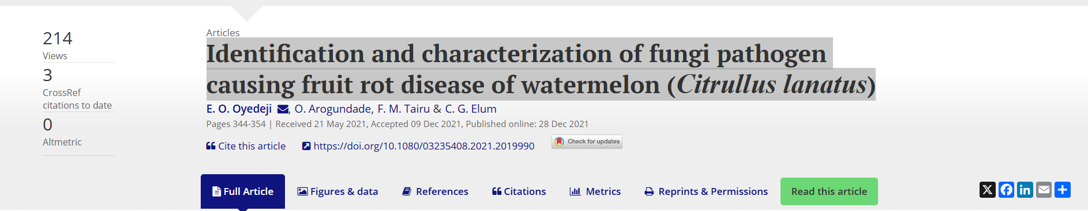
Study case
https://www.tandfonline.com/doi/full/10.1080/03235408.2021.2019990
Grab the PDF here >> https://github.com/Yedomon/GBioS_Training_Genomics_Plant_Breeding_2024/blob/main/Section04/Article.pdf

Slide 27
Study case
>FR671158.1
>HQ671187.1
>HQ696878.1
>JK747246.1
>JX003859.1
>KJ584541.1
>KX463025.1
>KX463032.1
>MG734215.1
>MG938643.1
>MT196795.1
>MT408911.1
>MT447505.1
Grab the sequence MT408911
Look for similar sequences in NCBI
Do the MSA
Do the tree
Visualize the tree

Slide 28
Additional resources
MEGA https://www.megasoftware.net/downloads/dload_win_gui
PhyloSuite https://dongzhang0725.github.io/installation/

Slide 29
Thank you

