Slide 1
GBIOS Training
Section 4
Dr Ange Zoclanclounon
angez9914@gmail.com

Slide 2
Hands-on session
Plan
01. How to do a blast using NCBI
02. How to do a multiple sequence alignment
03. How to do a phylogenetic tree

Slide 3
Hands-on session
01. How to use NCBI BLAST
NCBI BLAST (Basic Local Alignment Search Tool) is a powerful bioinformatics tool used to compare a query sequence (e.g., a DNA or protein sequence) against a database of sequences to find similar sequences.
Here are the steps to use NCBI BLAST:
Access the NCBI BLAST website: Visit the NCBI BLAST homepage at
https://blast.ncbi.nlm.nih.gov/Blast.cgi

Slide 4
Hands-on session
01. How to use NCBI BLAST
02. Select the BLAST program: Choose the appropriate BLAST program based on your query sequence
(e.g., BLASTn for DNA/RNA sequences, BLASTx or BLASTp for protein sequences).
03. Enter the query sequence: Copy and paste your query sequence into the search box.

Slide 5
Hands-on session
01. How to use NCBI BLAST
04. Select the database: Choose the appropriate database to search, such as the non-redundant (nr) database for a comprehensive search.
05. Customize search parameters: Adjust search parameters such as the expected threshold, word size, and scoring matrix according to your specific needs.

Slide 6
Hands-on session
01. How to use NCBI BLAST
06. Run the BLAST search: Click the "BLAST" button to start the search.
07. Analyze the results: The BLAST results will display a list of similar sequences along with their alignment scores,
e-values, and other relevant information. You can further analyze the results to identify potential homologs,
functional domains, or evolutionary relationships.

Slide 7
Hands-on session
How to use NCBI BLAST
Your turn !!!

Slide 8
Hands-on session
02. How to do a multiple sequence alignment ?
MAFFT (Multiple Alignment using Fast Fourier Transform)
https://www.ebi.ac.uk/jdispatcher/msa/mafft?stype=protein
or
https://mafft.cbrc.jp/alignment/server/index.html

Slide 9
Hands-on session
03. How to generate a phylogenetic tree
http://www.iqtree.org/
http://iqtree.cibiv.univie.ac.at/

Slide 10
Hands-on session
03. How to visualise your phylogenetic tree
http://etetoolkit.org/treeview/
http://tree.bio.ed.ac.uk/software/figtree/

Slide 11
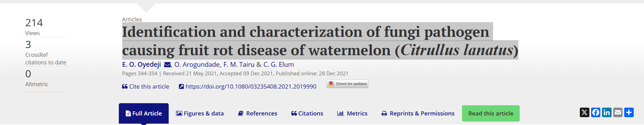
Study case
https://www.tandfonline.com/doi/full/10.1080/03235408.2021.2019990

Slide 12
Study case
>FR671158.1
>HQ671187.1
>HQ696878.1
>JK747246.1
>JX003859.1
>KJ584541.1
>KX463025.1
>KX463032.1
>MG734215.1
>MG938643.1
>MT196795.1
>MT408911.1
>MT447505.1
Grab the sequence MT408911
Look for similar sequences in NCBI
Do the MSA
Do the tree
Visualize the tree

Slide 13
Additional resources
MEGA https://www.megasoftware.net/downloads/dload_win_gui
PhyloSuite https://dongzhang0725.github.io/installation/

