Slide 1


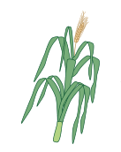
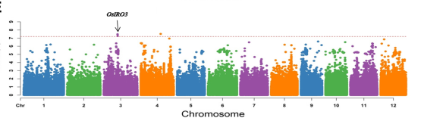
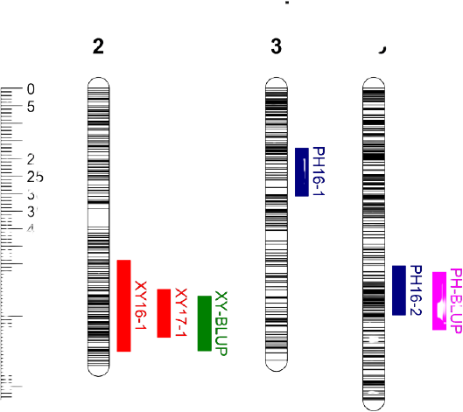
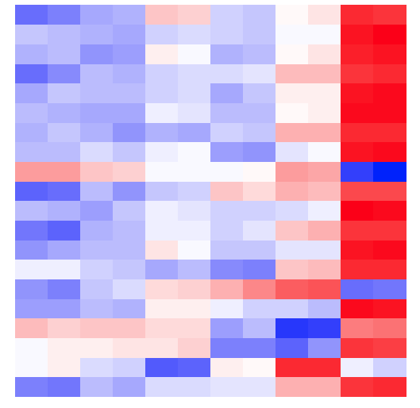



Genomic resources
Development of populations
Diversity panel
PHS Tolerant Material
PHS Susceptible
Material
Wild Relatives
GWAS
QTLs detection
Transcriptomics
Locus
Comparative genomics and genome-wide identification of PHS-related genes
Functional validation of genes
Release of designed PHS-tolerant materials

