Slide 1


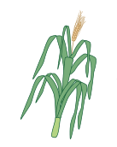
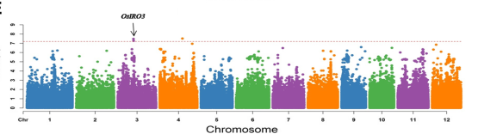
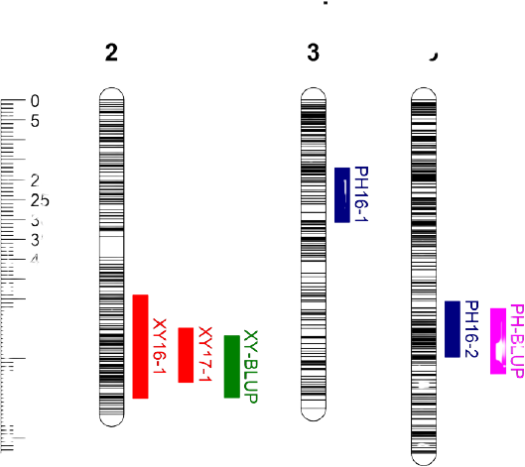
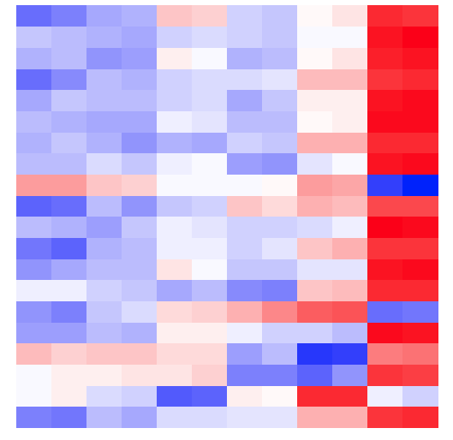

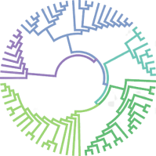
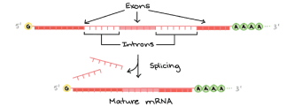


Genomic resources
Development of populations
[RILs, BILs, CSSLs, Three-Way Cross hybrids, Double haploidy]
Diversity panel
PHS Tolerant Material
PHS Susceptible
Material
Wild Relatives
GWAS
QTLs detection
Transcriptional Regulation
Locus
Post-transcriptional Regulation
RNA splicing
Epigenetics
Comparative genomics and
genome-wide identification of
PHS-related genes
Functional validation of candidate genes
[CRISPR-Cas9, RNAi, Agrobacterium tumefaciens...]
Release of designed PHS-tolerant materials

