Slide 1
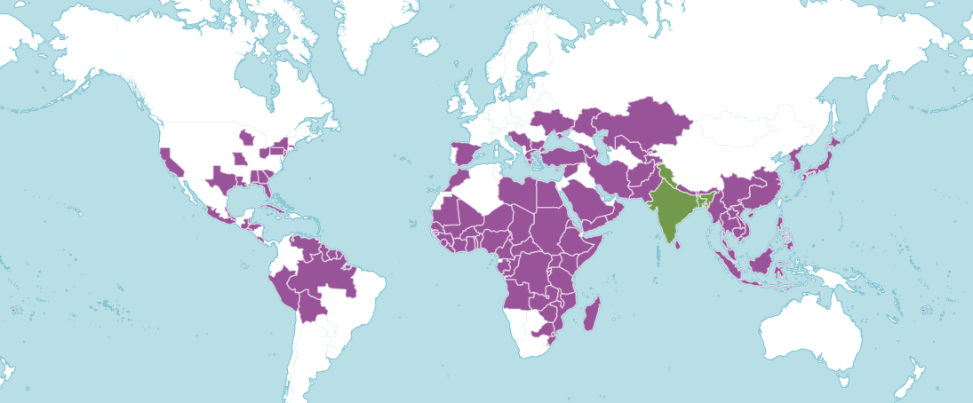
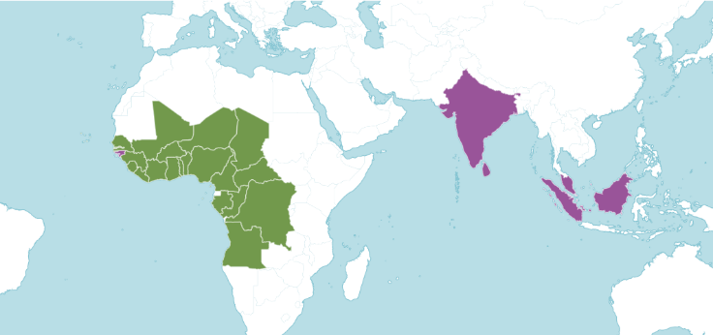
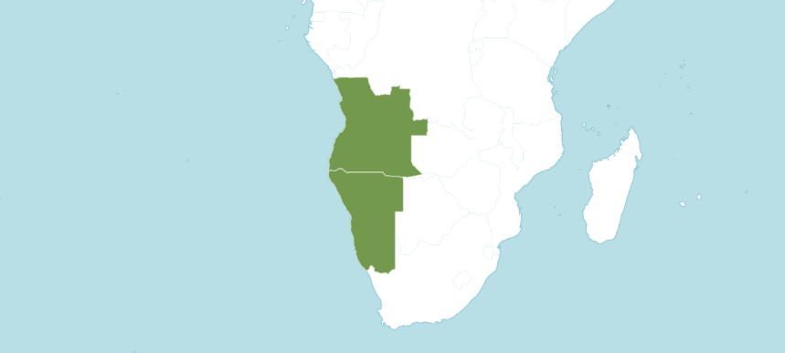
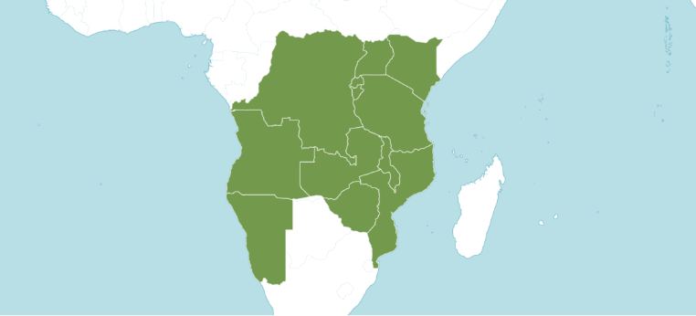
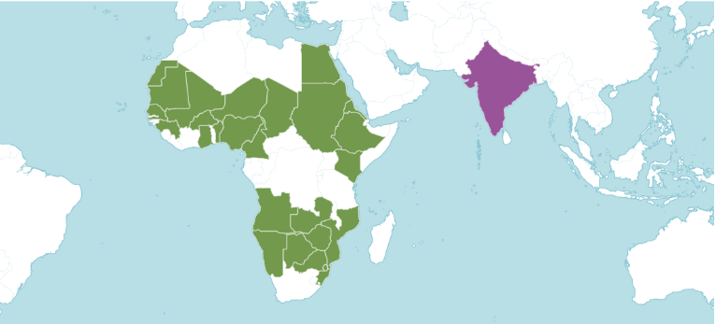
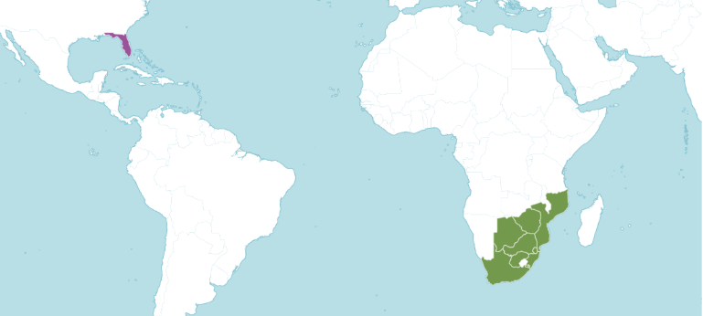
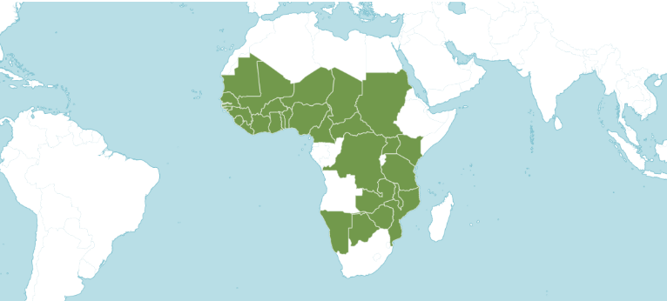
(A) Sesamum indicum
(B) Sesamum radiatum
(C) Sesamum pedaloides
(D) Sesamum angolense
(E) Sesamum alatum
(F) Ceratotheca triloba
(G) Ceratotheca sesamoides
Native
Introduced

