Slide 1
Online Gadgets Reselling Application

Slide 2
Team Members
PROJECT GUIDE : MR.JACOB ZACHARIA
Anjana Santhosh
Jayasree J
Vineetha U Prabhu
Yedu Krishnan T Y

Slide 3
Abstract
Gadget Reselling Application is an online application to sell and buy Gadgets of various categories.
A person can either be a seller or customer in order to perform the selling or buying process of used items when using this application.
This mobile application will let a customer view and purchase used items online.
The anticipated outcome of reselling application is to make a user friendly ecommerce where process of selling and buying used Gadgets are much easier and more convenient.

Slide 4
INTRODUCTION
One of the most significant developments in the corporate world is E-Commerce.
E-Commerce (Electronic Commerce) refers to the purchasing and selling of goods and services, as well as the transmission of payments and data, over an electronic network, most commonly the internet.
People can sell their electronics items and get cash instantly and safely. Gadgets is said to take an active part in the customer's daily life. Any goods from any shop can be purchased in a variety of ways. Naturally people prefer to do online shopping.
The aim of this Online Gadgets Reselling Application development is to ease the selling and buying process of people who wants to cash in a dignified and hassle-free manner.

Slide 5
Modules
Admin Module
Admin can manage the other two modules.
Admin can add products and remove products.
Merchant Module
Merchant can post their products and can sell them.
User Module
User can view and purchase the product that are posted by the Seller Module.

Slide 6
TECHNOLOGIES USED

Slide 7
Front End:
HTML : HTML, in full hypertext markup language, a formatting system for displaying material retrieved over the Internet. Each retrieval unit is known as a Web page (from World Wide Web), and such pages frequently contain hypertext links that allow related pages to be retrieved.
CSS : Cascading Style Sheets (CSS) is a style sheet language used for describing the presentation of a document written in a markup language such as HTML. CSS is a technology of the World Wide Web, alongside HTML and JavaScript.
JAVASCRIPT :JavaScript is a scripting or programming language that allows you to implement complex features on web pages.

Slide 8
Back End:
PYTHON 3.9 : Python is general-purpose, interpreted, high-level programming language use different programming styles to create simple or complex programs.
DJANGO 4: Django is an advanced Web framework written in Python that makes use of the model view controller (MVC) architectural pattern.

Slide 9
DATABASE:
SQLITE 3 : SQLite is a C library that provides a lightweight disk-based database that doesn't require a separate server process and allows accessing the database using a nonstandard variant of the SQL query language.

Slide 10
TABLES

Slide 11
Auth_USER_ID TABLE
NAME | TYPE | CONSTRAINT | DESC
Auth_USER_ID | INT | P_KEY
FIRST_NAME | VARCHAR(16)
LAST_NAME | VARCHAR(16)
EMAIL_ID | VARCHAR(16)
USERNAME | VARCHAR(16)
PASSWORD | VARCHAR(16)
USER_TYPE | BOOL |  | ROLES

Slide 12
ADMIN TABLE
NAME | TYPE | CONSTRAINT | DESC
Auth_USER_ID | INT | F_KEY
PROFILE_PIC | BLOB |  | IMAGE

Slide 13
MERCHANT TABLE
NAME | TYPE | CONSRAINT | DESC
Auth_USER_ID | INT | F_KEY
ID_PROOF | BLOB |  | IMAGE
ADDRESS | VARCHAR(100)
IS_ADDED_BY_ADMIN | BOOLEAN |  | DEFAULT=“FALSE”

Slide 14
USER TABLE
NAME | TYPE | CONSTRAINT | DESC
Auth_USER_ID | INT | F_KEY
PROFILE_PIC | BLOB |  | IMAGE

Slide 15
CATEGORIES
NAME | TYPE | CONSTRAINT | DESC
CID | INT | P_KEY
TITLE | VARCHAR(25)
THUMBNAIL | BLOB |  | IMAGE
DESC | VARCHAR(250)
IS_ACTIVE | INT |  | DEFAULT=“1”

Slide 16
PRODUCT
NAME | TYPE | CONSTRAINT | DESC
PID | INT | P_KEY
PROD_NAME | VARCHAR(25)
PROD_PRICE | INT
PROD_DESC | VARCHAR(250)
IS_ACTIVE | INT
ADDED_BY_MER | INT | F_KEY

Slide 17
CUSTOMER ORDERS
NAME | TYPE | CONSTRAINT | DESC
ID | INT | P_KEY
PROD_ID | VARCHAR(25)
PUR_PRICE | INT
PROD_STATUS | VARCHAR(250)

Slide 18
SCREENSHOTS(FORMS)

Slide 19
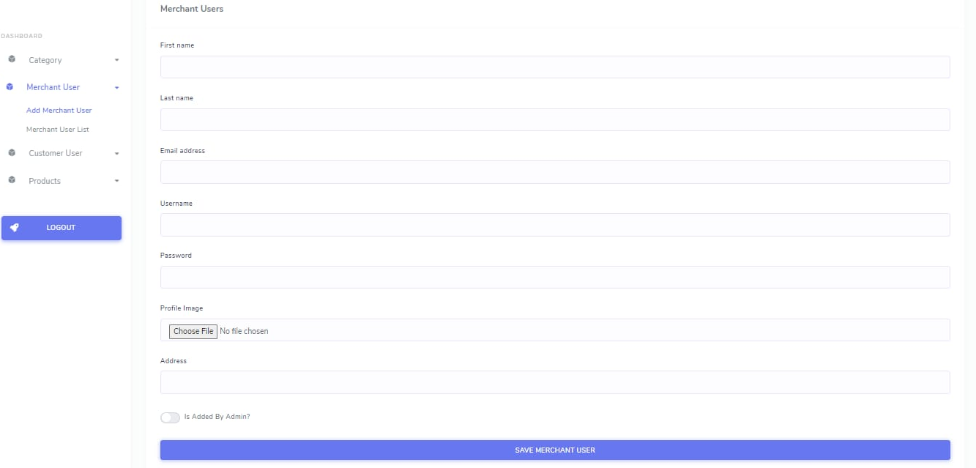
Merchant Registration

Slide 20
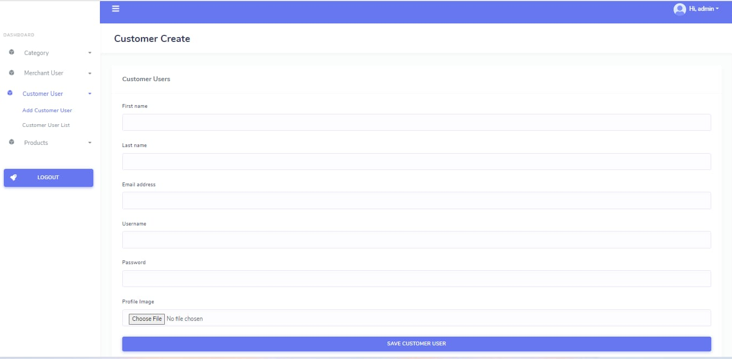
Customer Registration

Slide 21
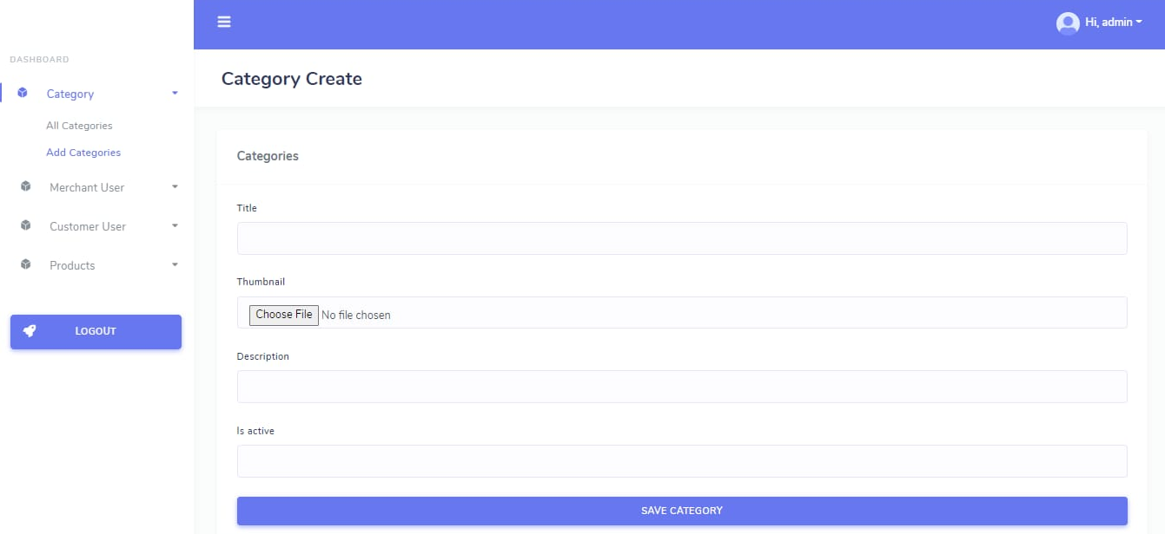
Category Form

Slide 22
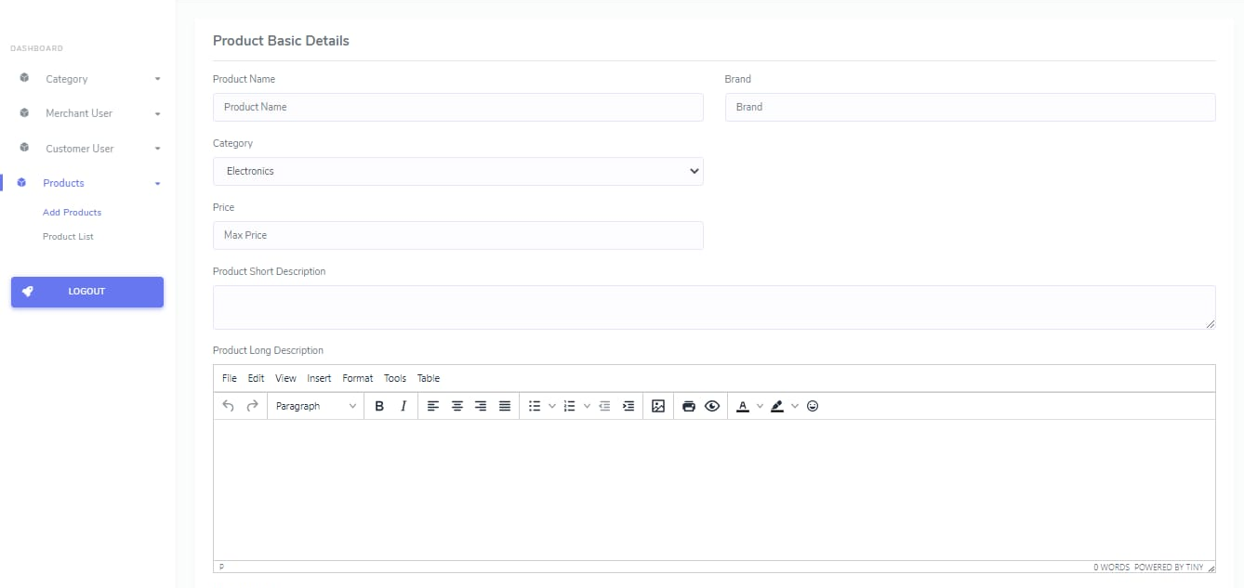
Product Form

Slide 23
CURRENT STATUS
WORKING ON USER & MERCHANT REGISTRATION FORM.
ALSO ON THE MERCHANT MODULE.

Slide 24
CONCLUSION
Technology has made significant progress over the years to provide consumers a better online shopping experience and will continue to do so for years to come.
With the rapid growth of products and brands, people have speculated that online shopping will overtake in-store shopping.
However, the availability of online shopping has produced a more educated consumer that can shop around with relative ease without having to spend a large amount of time.
In exchange, online shopping has opened up doors to many small retailers that would never be in business if they had to incur the high cost of owning a brick and mortar store.
At the end, it has been a win-win situation for both consumer and sellers.

