Slide 1
ARIMA

Slide 2
RECAP - ARIMA
ARIMA is a method for forecasting or predicting future outcomes based on a historical time series. It is based on the statistical concept of serial correlation, where past data points influence future data points.
How ARIMA works - Autoregression: Uses the correlation between current and past observations - Integrated: Uses differencing to make the time series stationary - Moving Average: Uses the relationship between current observations and residual errors from past observations

Slide 3
ARIMA modelling in R
The auto.arima() function in R uses a variation of the Hyndman-Khandakar algorithm (Hyndman & Khandakar, 2008), which combines unit root tests, minimisation of the AICc and MLE to obtain an ARIMA model. The arguments to auto.arima() provide for many variations on the algorithm.
AICc (Corrected Akaike Information Criterion) - AICc is a measure used to compare different statistical models and choose the best one. It's like a score that tells you how well a model fits your data while considering the number of parameters it uses
MLE (Maximum Likelihood Estimation) - MLE is a method used to estimate the parameters of a statistical model. It finds the values of the parameters that make the observed data most likely.
Summary
AICc helps you choose between different models by considering both fit and complexity.
MLE helps you find the best parameters for a given model to make accurate predictions.

Slide 4
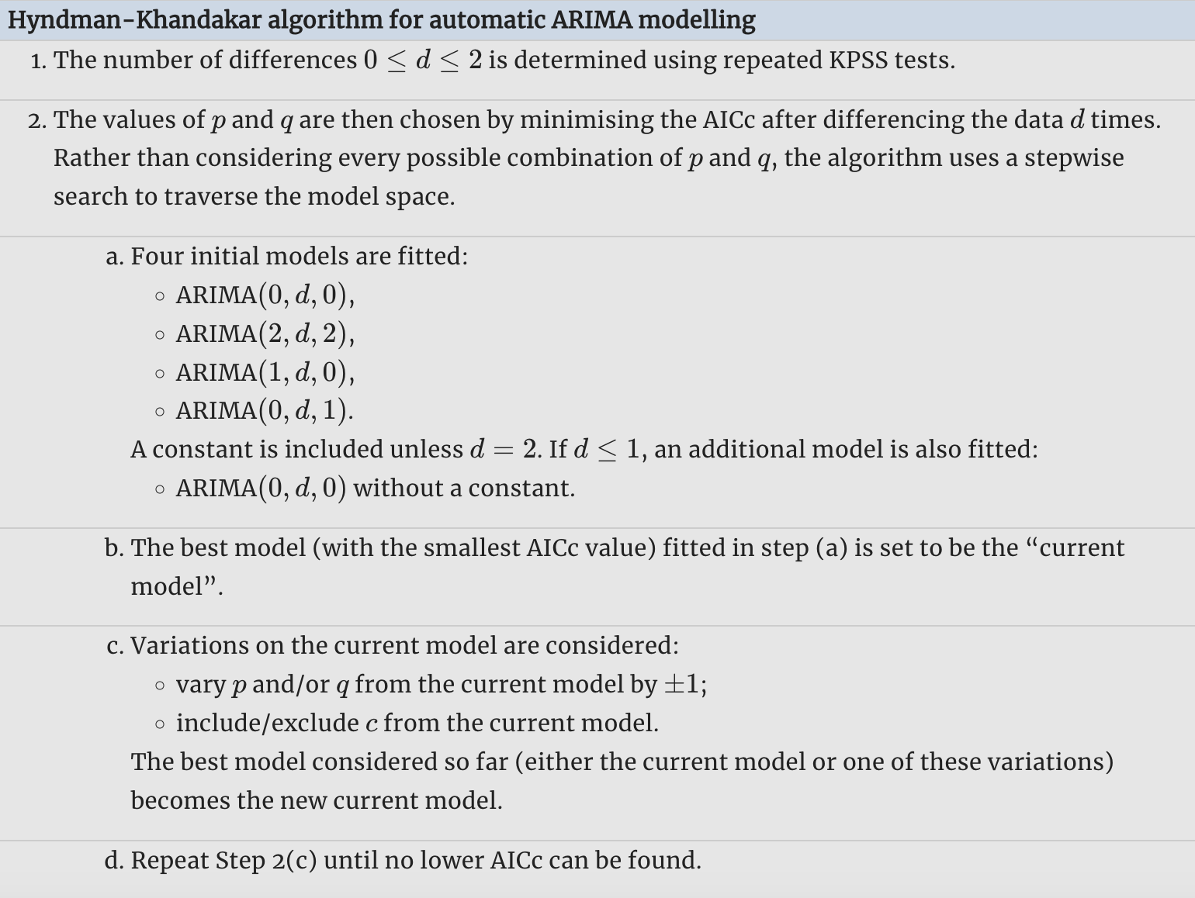

Slide 5
Choosing your own model
If you want to choose the model yourself, use the Arima() function in R. There is another function arima() in R which also fits an ARIMA model. However, it does not allow for the constant cc unless d = 0, and it does not return everything required for other functions in the forecast package to work. Finally, it does not allow the estimated model to be applied to new data (which is useful for checking forecast accuracy). Consequently, it is recommended that Arima() be used instead.

Slide 6
Modelling procedure
When fitting an ARIMA model to a set of (non-seasonal) time series data, the following procedure provides a useful general approach.
Plot the data and identify any unusual observations.
If necessary, transform the data (using a Box-Cox transformation) to stabilise the variance.
If the data are non-stationary, take first differences of the data until the data are stationary.
Examine the ACF/PACF: Is an ARIMA(p,d,0) or ARIMA(0,d,p) model appropriate?
Try your chosen model(s), and use the AICc to search for a better model.
Check the residuals from your chosen model by plotting the ACF of the residuals, and doing a portmanteau test of the residuals. If they do not look like white noise, try a modified model.
Once the residuals look like white noise, calculate forecasts.
The Hyndman-Khandakar algorithm only takes care of steps 3–5. So even if you use it, you will still need to take care of the other steps yourself.

Slide 7


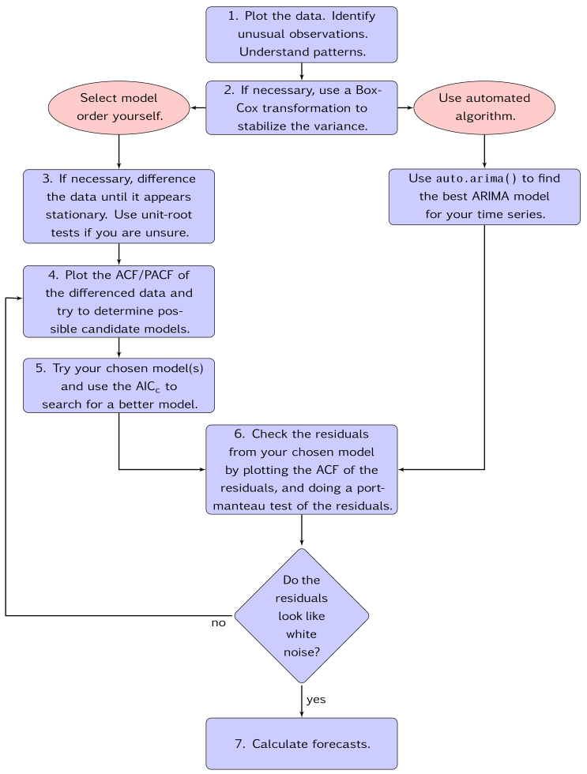




Slide 8
Portmanteau tests of residuals for ARIMA models
What it is: A Portmanteau test checks if the residuals (errors) from an ARIMA model are random. If they are random, it means the model fits the data well.
Why it's important: It helps you determine if your ARIMA model has captured all the patterns in the data. If the residuals are not random, it suggests the model might be missing some important information.
Example: Imagine you have an ARIMA model predicting monthly sales for a store. After fitting the model, you want to check if the residuals are random.
Fit the ARIMA model: You create an ARIMA model to predict sales.
Calculate residuals: You find the differences between the actual sales and the predicted sales (these are the residuals).
Perform the Portmanteau test: You use a statistical test to check if the residuals are random.
Analysis:
if the test shows residuals are random: Your model is good at capturing the patterns in the data.
If the test shows residuals are not random: Your model might need improvement, as it hasn't captured all the patterns.

Slide 9
Understanding constants in R
In statistical modeling, a constant (or intercept) is a term that represents a fixed value added to the model. It helps account for the baseline level of the data.
No Differencing (I=0): When there is no differencing, including a constant allows the model to account for any non-zero mean in the data.
One Differencing (I=1): Including a constant can help model a linear trend in the data.
Two or More Differencing (I≥2): A constant is usually not necessary because the differencing already removes trends.
Example:
# Fit an ARIMA model with a constant fit_with_constant <- Arima(wmurders, order=c(1, 1, 0), include.mean=TRUE)
# Fit an ARIMA model without a constant fit_without_constant <- Arima(wmurders, order=c(1, 1, 0), include.mean=FALSE)

Slide 10
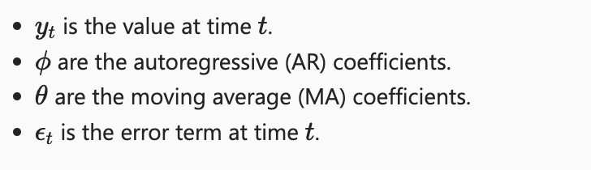
8.8 Forecasting
Point forecasts
STEP 1. Expand the ARIMA equation so that yt is on the left hand side and all other terms are on the right.
the ARIMA equation generally looks like this:
where:

Slide 11
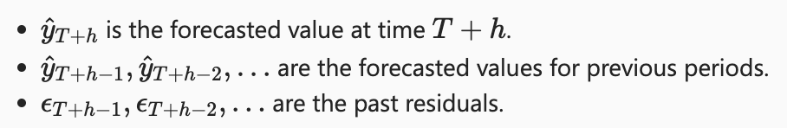
8.8 Forecasting
Point forecasts STEP 2. Step 2: Rewrite the Equation for Future Time (T + h)
Replace t with T + h
STEP 3. Replace Future Observations and Errors
Future Observations: Replace yT+h−1,yT+h−2,…yT+h−1​,yT+h−2​,… with their forecasts.
Future Errors: Replace ϵT+h−1,ϵT+h−2,…ϵT+h−1​,ϵT+h−2​,… with zero (since we don't know future errors, we assume them to be zero).
Past Errors: Use the actual residuals (errors) from the past data.
So, the equation becomes:
Where:

Slide 12
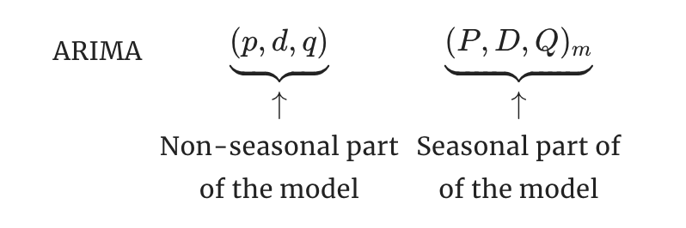
Seasonal ARIMA models
A seasonal ARIMA model is formed by including additional seasonal terms in the ARIMA models
It is written as follows:
where m=m= number of observations per year. We use uppercase notation for the seasonal parts of the model, and lowercase notation for the non-seasonal parts of the model.

Slide 13
ARIMA vs ETS
ARIMA (AutoRegressive Integrated Moving Average)
Purpose: ARIMA models are used for forecasting time series data by capturing patterns like trends and seasonality.
Components:
AR (AutoRegressive): Uses past values to predict future values.
I (Integrated): Differencing the data to make it stationary (removing trends).
MA (Moving Average): Uses past errors to predict future values.
When to Use: ARIMA is great for data with clear trends and patterns but no strong seasonal effects.
ETS (Error, Trend, Seasonality)
Purpose: ETS models are used for forecasting time series data by explicitly modeling error, trend, and seasonality components.
Components:
Error (E): The randomness in the data.
Trend (T): The long-term direction of the data.
Seasonality (S): Regular patterns that repeat over time (e.g., monthly sales spikes).
When to Use: ETS is ideal for data with strong seasonal patterns and trends.

