Slide 1
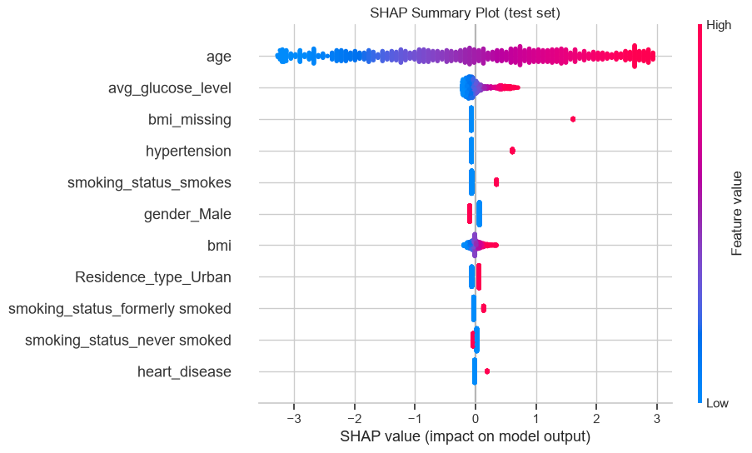
AUDIENCE 1 OF 3 · DATA SCIENTIST
Age drives the model, and the SHAP explanation is exact and stable
1
MODEL AND DATA
Logistic regression (white box), 11 features, balanced class weights, threshold 0.5 chosen on out-of-fold training predictions. 5,110 patients, 4.9% stroke, stratified 80/20 split.
Global view: which features matter across all patients
2
PERFORMANCE (TEST, 50 STROKES)
ROC-AUC 0.84 · PR-AUC 0.22 (baseline 0.05) · recall 0.80 · precision 0.14
3
EXPLANATION
LinearExplainer, full training set as background, log-odds: f(x) = −1.32 + Σφⱼ, verified for all 1,022 test patients. Age holds 64% of mean |SHAP|; the top 5 hold with another background.
4
LIMITS AND NEXT STEPS
Recall 0.17 under age 60; scores are not calibrated; ever_married and work_type dropped as age proxies. Next: external validation and a calibration check.
Each dot is a test patient; position = SHAP value (log-odds), colour = feature value (red high, blue low).
LANGUAGE technical terms
NUMBERS exact metrics and SHAP values
VISUAL global summary plot
Notes:
Global SHAP summary plot of the logistic regression on the 1,022 test patients (log-odds). Source: 02_logistic_regression.ipynb, section f.

Slide 2
AUDIENCE 2 OF 3 · DOCTOR
Patient 8213 is flagged as high risk, mainly because of age and missing BMI
1
PREDICTION
Risk score 0.97, above the 0.5 flag threshold. The score ranks patients by risk; it is not a calibrated probability.
Why this score: contributions (log-odds)
2
WHAT DROVE IT
Age 78 (largest effect), BMI not recorded, glucose 219.8 mg/dL and heart disease raised the score; the other 7 factors lowered it slightly.
3
HOW RELIABLE
Flags 80% of strokes, but about 6 in 7 flags are false alarms. Misses 10 of 12 strokes in patients under 60.
4
CLINICAL USE
Shows how the model scored, not what caused the stroke. Missing BMI reflects record-keeping, not biology. Use alongside history and examination.
pushes it up
pushes it down
Average patient −1.32 → this patient 3.44
LANGUAGE clinical terms
NUMBERS one score, key rates, SHAP values
VISUAL one patient's contributions
Notes:
Bars are patient 8213's SHAP values from the logistic regression (log-odds), the same values as the force plot in Task 3 (report Figure 6). Average patient −1.32, this patient 3.44. 'Other 7 factors' is the remaining features combined. Source: 02_logistic_regression.ipynb, section e.

Slide 3
AUDIENCE 3 OF 3 · PATIENT
What the computer's result means for you
1
YOUR RESULT
The computer's result for you was high. It is an estimate, not a diagnosis.
What pushed your result up or down
2
WHY
Mostly because of your age (78). Your weight-for-height (BMI) was not recorded, your blood sugar was high, and you have heart disease.
3
HOW SURE IT IS
It can be wrong. It misses some people who have had a stroke and warns about many who have not.
4
WHAT HAPPENS NEXT
Your doctor will look at this together with your history and check-ups, and talk it through with you.
pushes it up
pushes it down
Longer bar = bigger effect
LANGUAGE everyday words
NUMBERS none, only your own readings
VISUAL simple up and down bars
Notes:
Same patient and SHAP values as the doctor slide, shown without numbers for a lay audience. No medical advice is given; the doctor discusses the result.

