Slide 1
DATABASE
Distractors
by
1. MOHAMAD SYAFIEQ BIN MOHAMED (AI160010)
2. TOONG YEE KHEI (AI160181)
3. NG XIAO ZHEN (AI160197)
4. SITI UMATUSSHOLIKHAH BINTI DARSONO (AI160015)
5. KHALPHANADEVE A/P P.RAMACHANDRAN (AI160217)

Slide 2

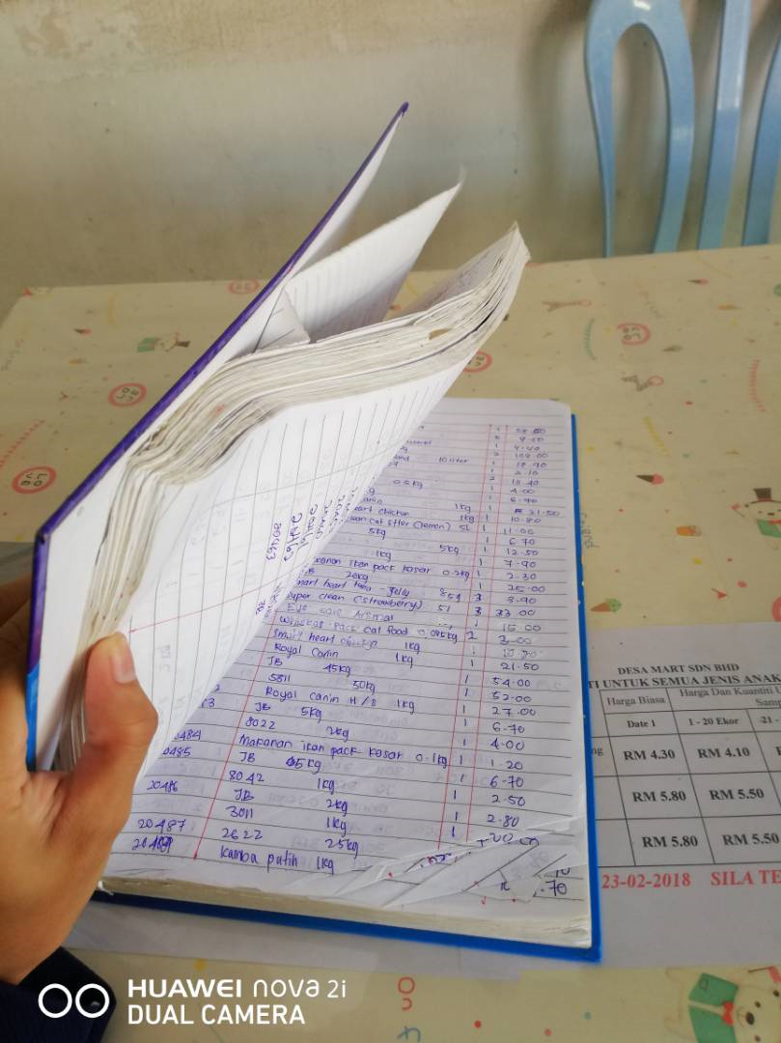
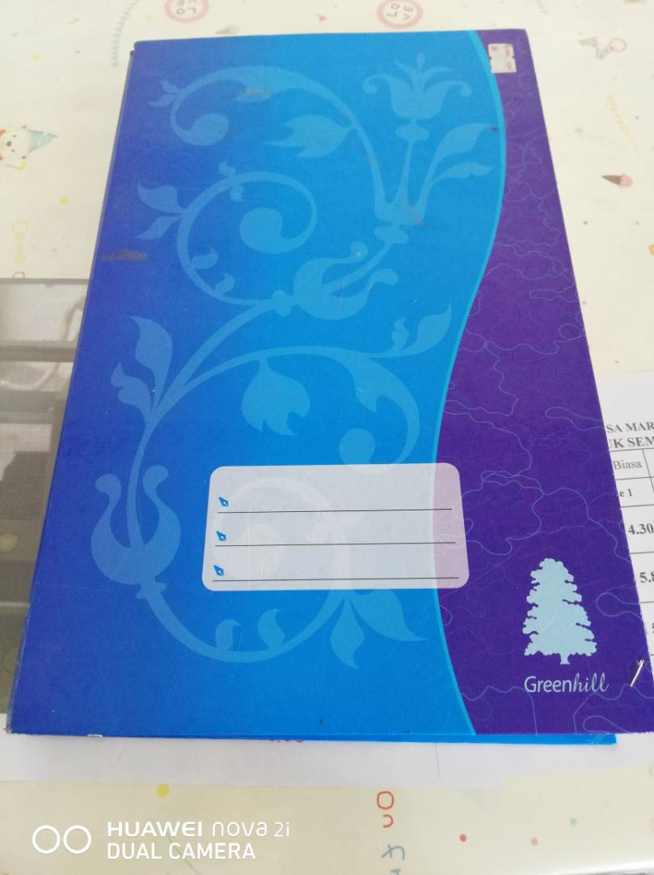
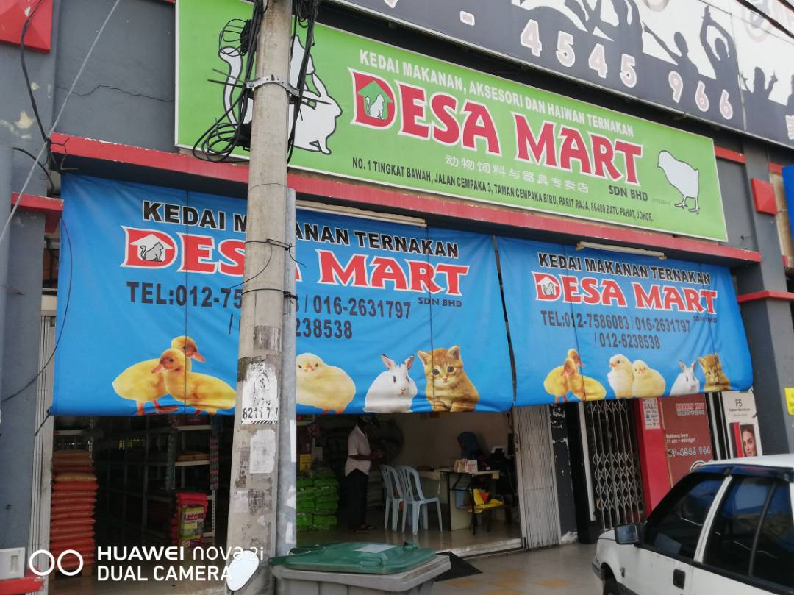
1.0 PLANNING
PLANNING
DESA MART SDN BHD
The main product sold in this store is animal feeds for live stocks and they sell products in bulks and also in retails.
It is found that the store does not have any information recorded digitally.
manually record their inventory and sales

Slide 3
LOGO
WHAT the system do?
keep all the information and records of the store more secure as it has improved backup and recovery services.
create a computer based business system which will help to safe-keep it's records.
able to find past year records easily by using the system’s search engine.
help boost the effectiveness and in turn help the store keep their information more organized.

Slide 4
PROBLEM
Problem Definition
The store does not have any database system specially to keep their information and records.
This may cause less effectiveness and less secure to the store and the owner.
The lack of digital records will make it hard for the owner to search for a particular record.
It might increase security risks as manual records have a higher chance of getting stolen.
It will also cause high costs for the owner due to buying books to record the sales reports.
The management will be affected and this will lead to a decrease in performance for the store.

Slide 5

OBJECTIVE
OBJECTIVE
Create a system which can keep the sales records and inventory information organized.
Built a system which can search appropriate information about the sales and inventory.
Help in increasing data security.
Help the owner to check on the available stock before selling.
Improve the effectiveness in searching the sales report of the product.
Minimize data inconsistency in the sales records and inventory.

Slide 6
Scope of the project
SCOPE
The system is computer-based
because is more reliable in storing large data.
easily create, read, update and delete the data. The system is offline to increase data security.
The system will have the database to keep the sales and inventory records.
The designed system will show the sales records of the store.
It will have a clear list of sales, product name, product ID, product sales dates, product price, suppliers and receipt number.
For the inventory, it will have a clear list of product name, product ID,category, number of stock and suppliers.
The owner can search any characteristics of the product and the system will list it out.
The system will also list out the store’s inventory alphabetically.
This system will also sort the sales report by date which will allow the owner to search for a particular report easily.

Slide 7

Significant
Significance of the project
We will learn how to create a database and discuss the techniques used to implement the system of the program.
Study the importance of analyzing the current system’s database and implement a database system which can improve the effectiveness in management.
The analysis of this information leads to the development of a concept for a new database system.
The system is designed and built based on the issues.
Since it is generally known that the database can be search and retrieved very quickly without having to manually check the list to see because it shares collection of logically related data and a description of this data, designed to meet the information needs of an organization.

Slide 8
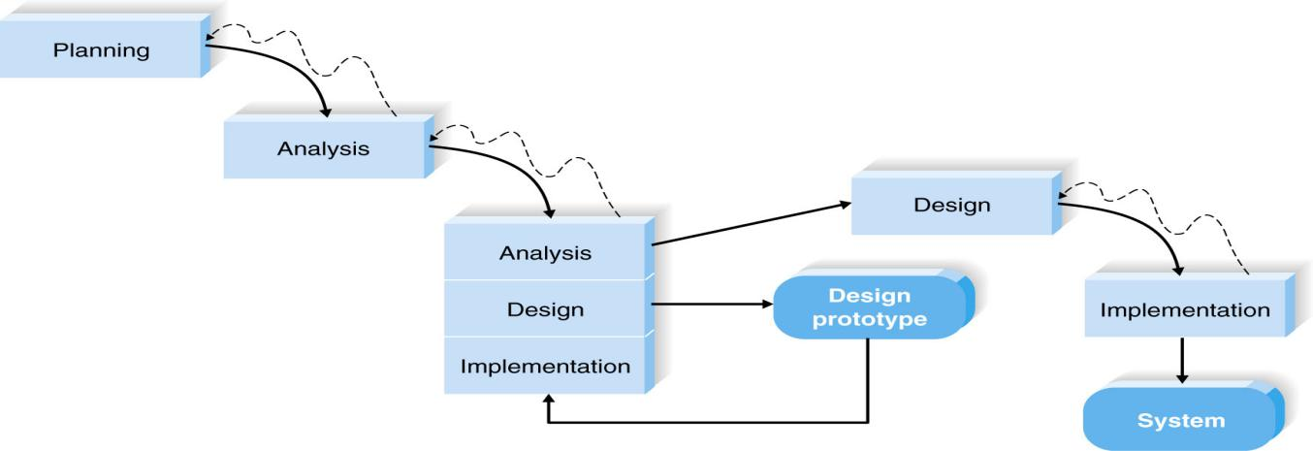
Model
Chosen software process model
The chosen process model is Throwaway Prototyping.
It is suitable for project with unclear user requirement and unfamiliar technology.
It functions by providing proof that something can indeed be done in terms of systems and strategies.
it can prevent these from taking place as soon as the product or service is introduced to the user.

Slide 9
planning
Project Planning
A database system to keep the sales records of Desa Mart Sdn Bhd is designed after conducting initial research.
Decided to conduct an interview with the owner of Desa Mart to understand fully the issues that they face.
We have provided the owner with a few selections of dates for the interview.
Design the interview question
The team will analyze the interview and create a post interview follow-up.
By using the report, each team members will set on analyzing and creating the design.

Slide 10
interview
Interview question
What is the current business system used by Desa Mart Sdn Bhd？
Does the current business system work effectively in management?
What are the problems that Desa Mart Sdn Bhd is facing currently with the as-is system that you are using?
What is your opinion on the computer-based business system? Is it effective?
Does the company’s manager consider manage the business digitally?
Refer to question 5, if yes, what kind of business system the company needs? If no, why?
What is your opinion about the risk of managing computer-based business system?

Slide 11
LOGO
Interview
Desa Mart Sdn Bhd is still using normal physical books which consist of recording the sales by handwriting.
It take a hard time to search for the sales record one by one in the books.
The owner considered for a computer-based business system to improve their effectiveness in business management.
The system can help user to search the full information about the product and sales by using the searching function in the system.
They think there is a high risk for using modern technology.
It helps the user to improved backup and recovery services.
Staff they hire are in the ages that are not experienced well in using computer.

Slide 12
OBSERVATION
Observation
The company does not have effective management.
The staff will check the stock left every day and report to the owner. The owner then orders the stocks from suppliers for restock if needed.
Most of the records are kept manually and by observing, it is concluded this way is not secure.
Through observation also it was found out that there might be 2-3 customers who usually come by to return the product they bought and the owner had to search the sales record book.
It will be a waste of time and it may affect the customer’s impression towards the company.

Slide 13
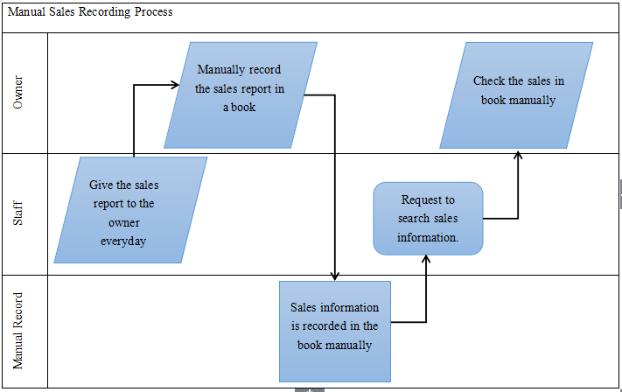
AS-IS
Existing System Investigation
Desa Mart Sdn Bhd - As-Is Process

Slide 14





DESIGN
Based on the initial research, Desa Mart currently does not use any digital platform as a means of recording their sales. So, it is believed that Desa Mart will have an increase in management effectiveness by using computer-based business system. This system will mainly be used by the owner who needs to keep the sales records and search for a particular record. The main purpose of this system is to keep all the records in the store secure and obtain a particular record easily. This system cannot be accessed by anyone except the owner. The design of the system was created by keeping in mind the requirement and accessibility of user.
DESIGN

Slide 15
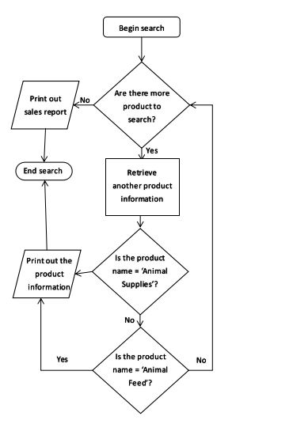
System Flowchart (Proposed System)
search engine

Slide 16
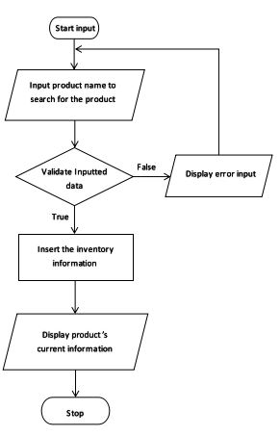
System Flowchart (Proposed System)
input inventory

Slide 17
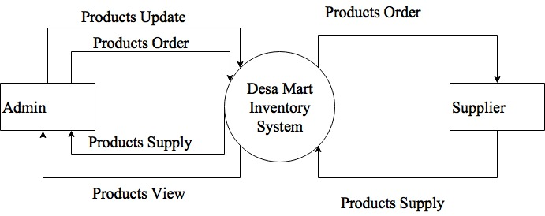
CONTEXT
CONTEXT DIAGRAM

Slide 18
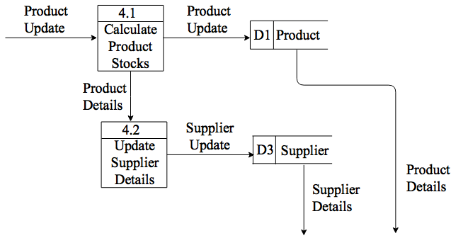
DFD level 1
DFD

Slide 19
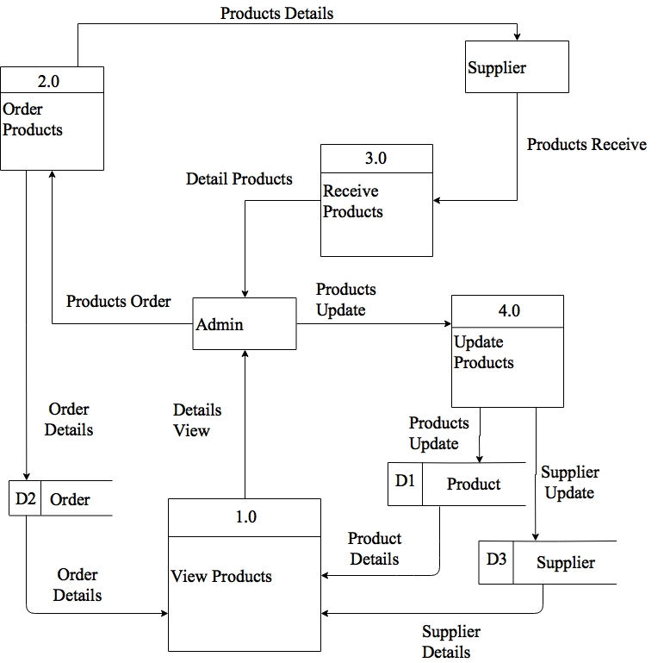
DFD level 0
DFD

Slide 20
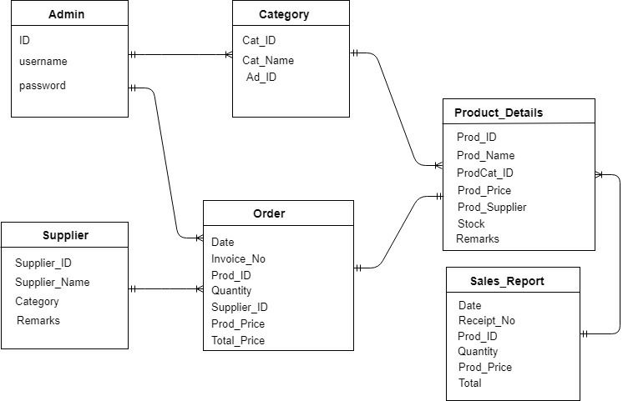
ERD
EFD

Slide 21
REQUIREMENT
Software | Usage
Operating System: Windows 10 | To control the all of the process and application software in computer
Oracle | To make the database system
Snipping Tools | To get certain part of figures
Windows Media Player | To hear the interview recorded
Windows Image Viewer | To see the picture taken in the company
Google Chrome | To search additional information from the internet
Acrobat Reader | To read PDF files
Microsoft Word 2016 | To make proposal and final report
Microsoft Project 2013 | To create Gantt Chart

Slide 22
REQUIREMENT
Hardware | Usage
Desktop | To finish the project and store all of the data
Keyboard | To input the words to make proposal and final report
Printer | To print out the report and proposal
Speaker | To hear the recorded interview session
Mouse | To navigate the mouse pointer

Slide 23
CONCLUSION
Conclusion
Since the company we choose is using the traditional way to record the sales records by handwriting in a book. It seems like not secure and will had a hard time to search for a particular sales records. So we plan to create a computer-based business management system which consists of database.

Slide 24
Thank You!
LOGO

