Slide 1


个人介绍
王奕童
11910104
计算机科学与工程系

Slide 2


Homework 05
Construct Your New“OR” MCP (McCulloch and Pitts) Neuron and Prove It
Submit Your Project Survey Draft/Design Draft

Slide 3
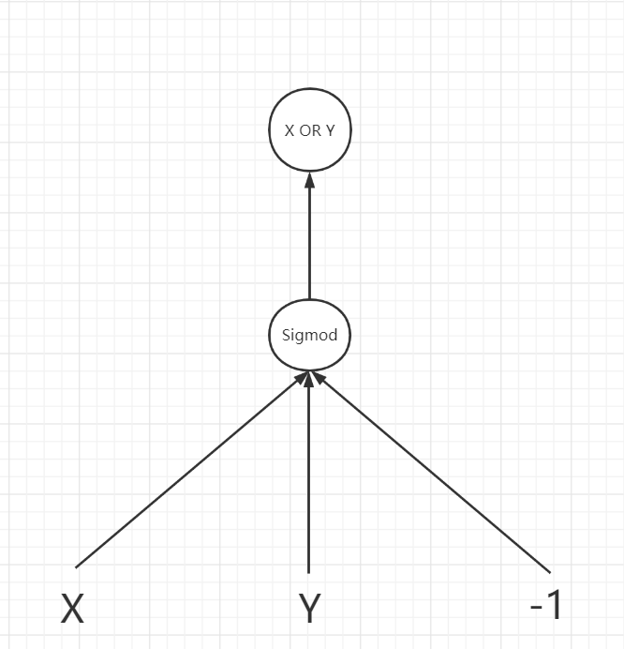
New ”OR” MCP Design
W1=W2=200, W3=100, Bias=-1
Transfer function: Sigmod G(x) = 1 / (1 + e^(-x))
Proof:
X | Y | Bias | W1 | W2 | W3 | Z=X*W1+Y*W2+Bias*W3 | G(Z)
1 | 1 | -1 | 200 | 200 | 100 | 300 | 1
1 | 0 | -1 | 200 | 200 | 100 | 100 | 1
0 | 1 | -1 | 200 | 200 | 100 | 100 | 1
0 | 0 | -1 | 200 | 200 | 100 | -100 | 0

Slide 4
Survey Outline
Introduction
Related Work
Skin Disease Dataset
Different CNN Design
Results and Discussion
Conclusion

