Slide 1


个人介绍
王奕童
11910104
计算机科学与工程系

Slide 2
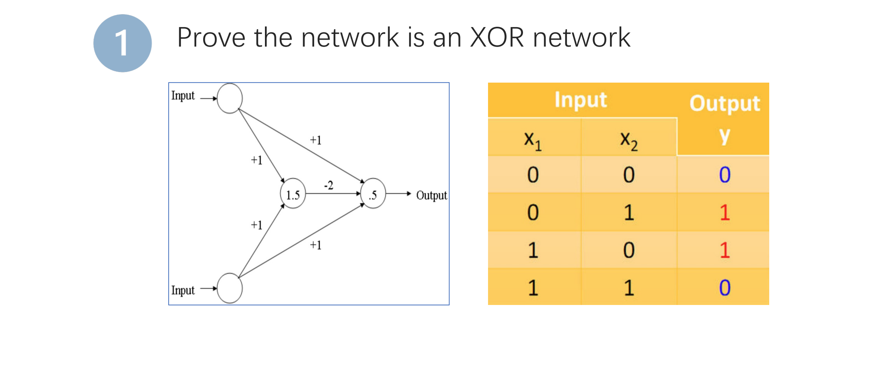
Homework 07

Slide 3

XOR Network Proof
There are 2 activation functions in this problem:
$f1(x) = \left\{\begin{aligned}1, x≥1.5 \\ 0, x < 1.5\end{aligned}\right.$
$f2(x) = \left\{\begin{aligned}1, x≥0.5 \\ 0, x < 0.5\end{aligned}\right.$

Slide 4
XOR Network Proof
X1 | X2 | W1 | W2 | W1X1+W2X2 | Y=f1(W1*X1+W2*X2)
0 | 0 | 1 | 1 | 0 | 0
0 | 1 | 1 | 1 | 1 | 0
1 | 0 | 1 | 1 | 1 | 0
1 | 1 | 1 | 1 | 2 | 1
X1 | X2 | Y | W3 | W4 | W5 | W3*X1+W4*X2+W5*Y | Z=f2(W3*X1+W4*X2+W5*Y)
0 | 0 | 0 | 1 | 1 | -2 | 0 | 0
0 | 1 | 0 | 1 | 1 | -2 | 1 | 1
1 | 0 | 0 | 1 | 1 | -2 | 1 | 1
1 | 1 | 1 | 1 | 1 | -2 | 0 | 0
It meets the requirement of XOR function, so it is an XOR network.

