Slide 1

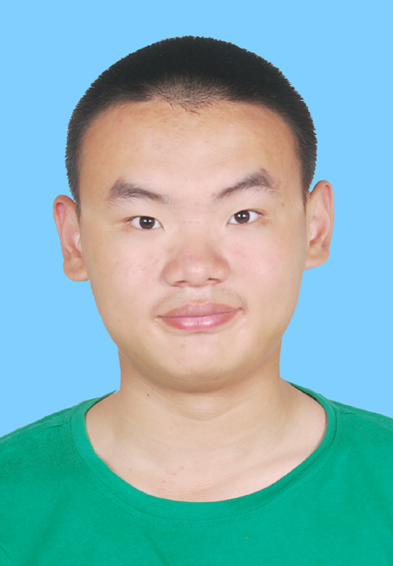
个人介绍
王奕童
11910104
计算机科学与工程系

Slide 2
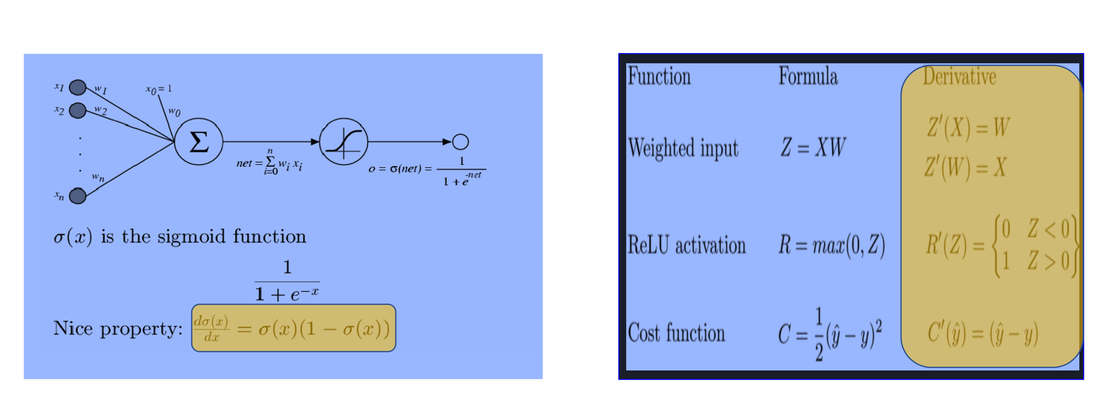
Homework 08:Prove the derivative formula (in yellow box) of Sigmoid and ReLU Transfer Functions

Slide 3
