Slide 1


个人介绍
王奕童
11910104
计算机科学与工程系

Slide 2
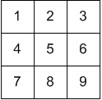
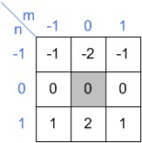
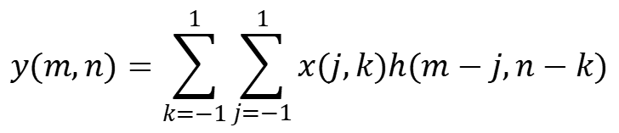
Homework 9
Given the Image X and the Convolution operator H.
The 2D discrete convolution of Y = X*H is here is defined as:
Please use the zero-padding to extend th image during calculation
Please calculate Y
$$y(m,n)=\sum_{k=−1}^{1}{\sum_{j=−1}^{1}{x(j,k)h(m−j,n−k)}}$$

Slide 3
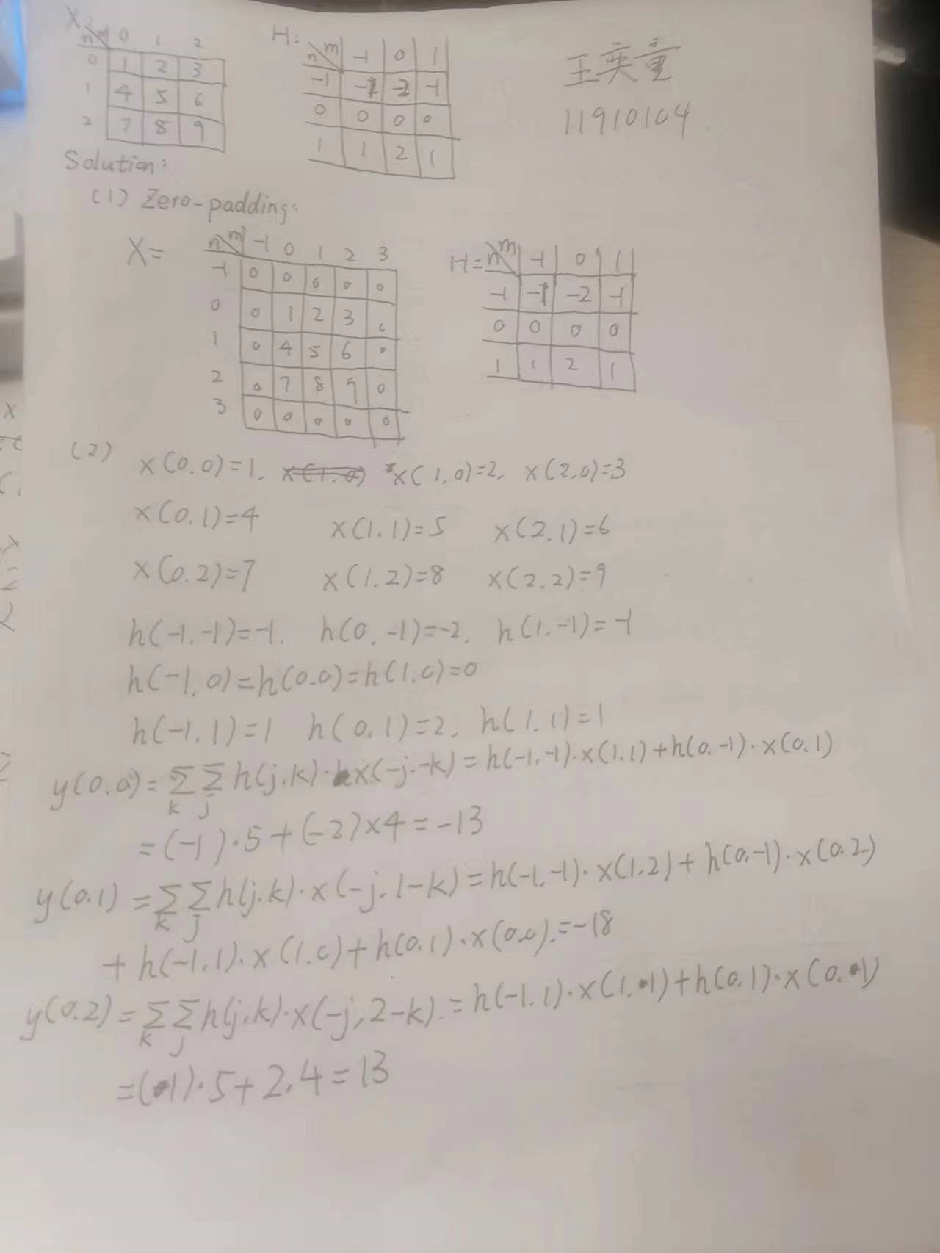
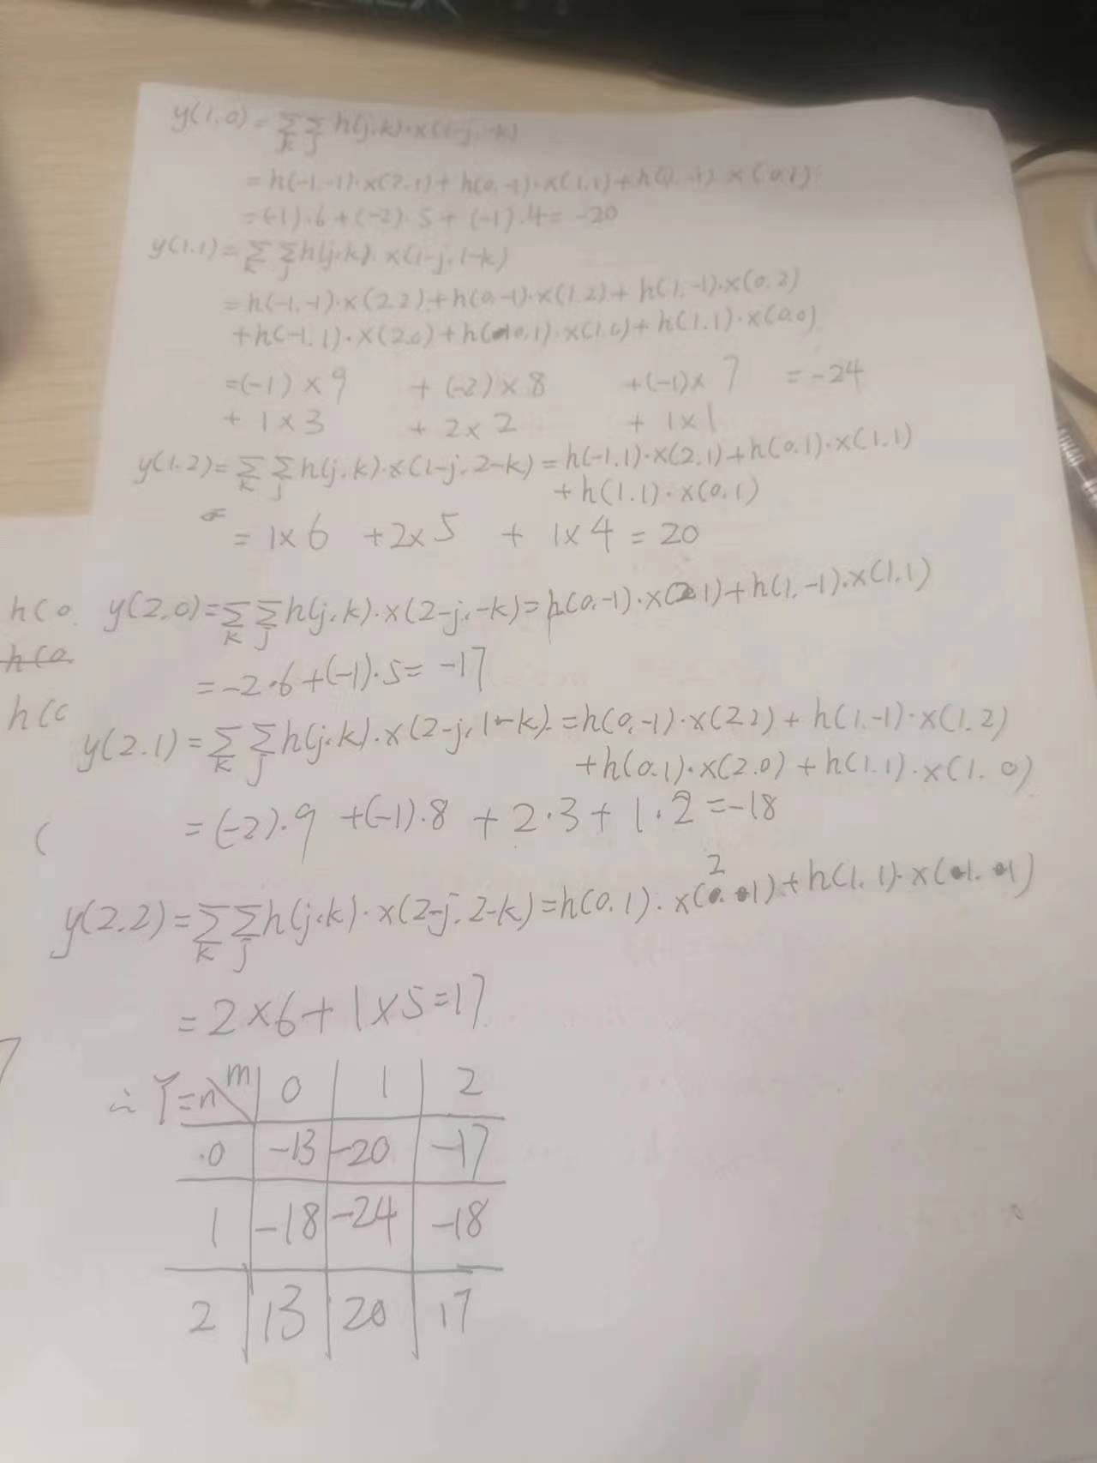

Slide 4
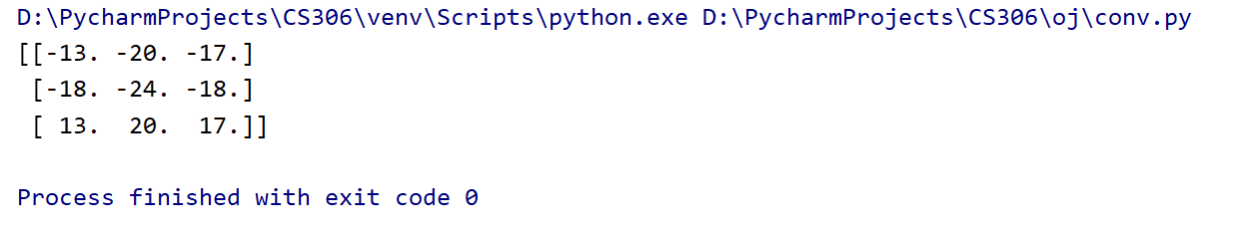
Acknowledgement
Thanks Ziyue ZHANG provides python to check the answer

