Slide 1

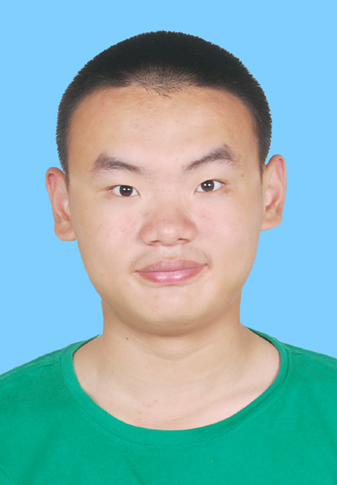
个人介绍
王奕童
11910104
计算机科学与工程系

Slide 2


Homework 01 (PPT) – By Next Wednesday
What you like to learn from the class
Tell me about yourself and suggestion
to my class to make it YOURS

Slide 3
What you like to learn from the class
Some basic AI algorithms and models, like Neural Network, Alpha-Beta Pruning etc.
Current AI application
Some basic AI concepts

Slide 4
Tell me about yourself and suggestion to my class to make it YOURS
About me:
Mainly focus on Software Engineering, and not good at AI design. Moreover, I am not good at math.
Suggestions:
Hope the course could be less competitive(卷)
Hope the course could be more interesting and I could learn more applicable materials from this course by Jimmy LIU
Hope the course could be less hard-core

