Slide 1

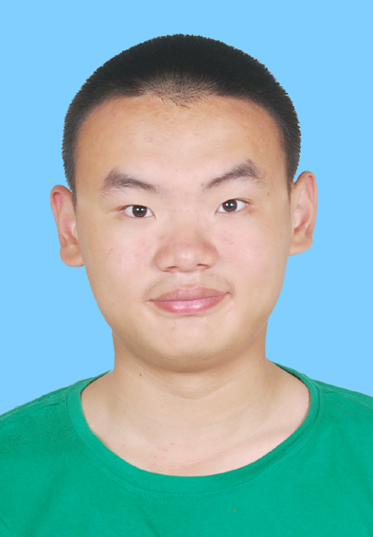
个人介绍
王奕童
11910104
计算机科学与工程系

Slide 2


Homework 02 (PPT)
From The Topics Listed, Choose a Project and Start to Form a Project Team
Write a Survey (2 Students) or
Do a Project (4-5 Students), Select a Group Head
Or Set Your Own Topic, and Form a Team, Sent to US for Approval.

Slide 3
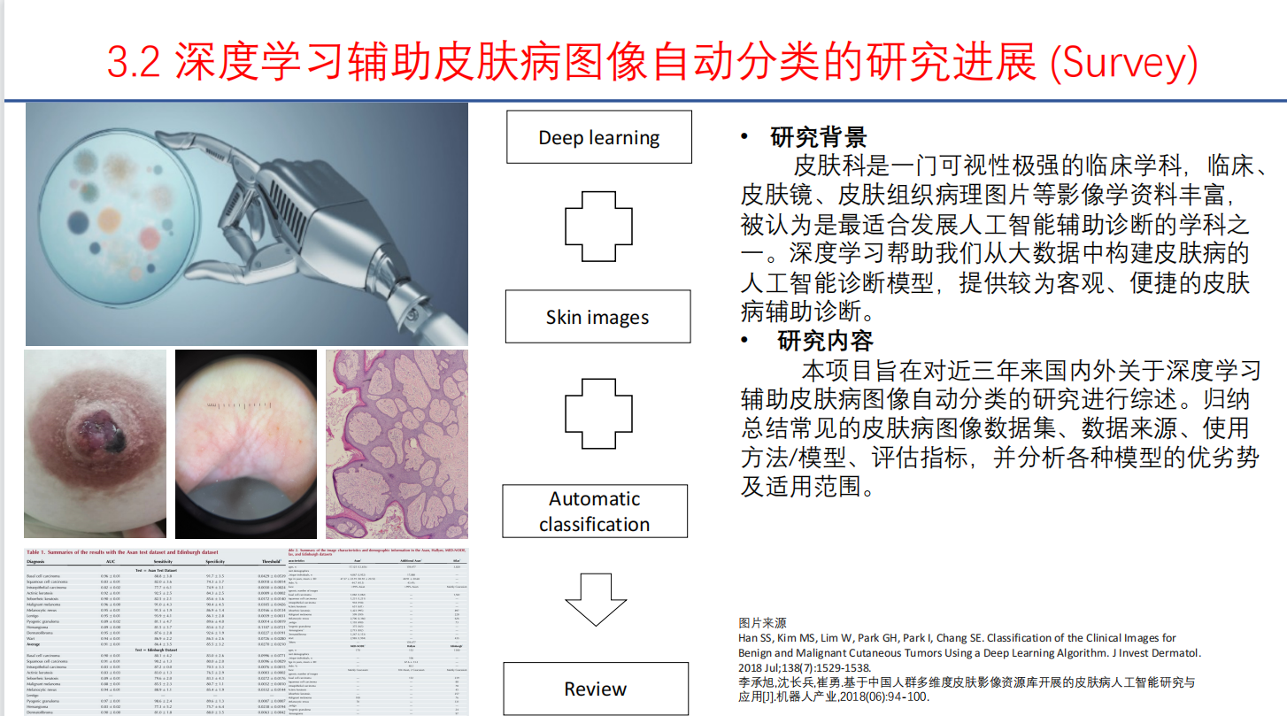
Homework 02
Survey, with Tong LIU
Topic:

