Slide 1

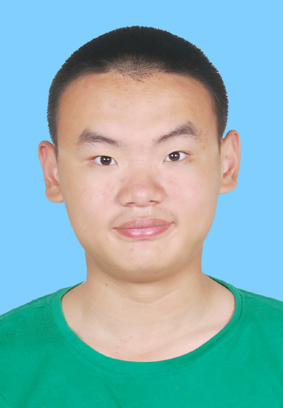
个人介绍
王奕童
11910104
计算机科学与工程系

Slide 2



Homework 03
Finalize your Project Title. Team Leaders are To Arrange Meetings with TA and Industrial Supervisors. Record Why You Choose Such Topic for Your Project? Write a Preliminary Project Plan Describing How You Want to Do the Project?
Define Your Version of AI
Think about the AI principle behind ALPHAGO by Watching
https://www.bilibili.com/video/av456221765/

Slide 3
Homework 03
Topic: 卷积神经网络在皮肤病相关的研究进展
We select this topic because we would like to write a survey and complete some programming about this topic
Plan: Write an survey first, average work-division; Next write some code to reproduce the model
AI definition: A computer program making decision similar to human-beings

