Slide 1
libmpk: Software Abstraction for Intel Memory Protection Keys (Intel MPK)
Notes:
1. introduction: advantages, structure, how work (hit case)
2. 2 ways

Slide 2
CHALLENGES
Potential Security Problem： protection-key-use-after-free
pkey_free() just removes a protection key from a key bitmap
and does not update the corresponding PTEs
The developer community also recognized the problem
and recommends not to free the protection keys
Handling this problem superfificially (i.e., wiping protection keys in PTE) will introduce huge performance overhead

Slide 3

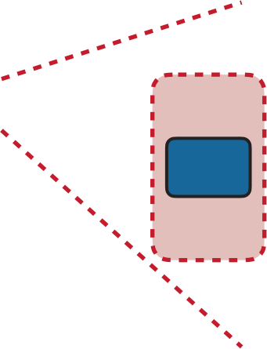
















CHALLENGES
NON-SCALABLE HARDWARE RESOURCE
▸ Only 16 keys are provided
Process
pkey
1
pkey
16
pkey ?
W
W
Write code cache 16
R
W
Write code cache 17
R
Write code cache 1
R
pkey
1
pkey
2
pkey
3
pkey
4
1 | 2 | 3 | 4
 | …
pkey ⁵ ₅
pke 16 16
y
17

Slide 4







CHALLENGES
ASYNCHRONOUS PERMISSION CHANGE - PROS
▸ Permission change with MPK is per-thread intrinsically
Process
RX
RX
W
RX
RX
Write
Semantic Differences
mprotect() semantically guarantees synchronization.
But mprotect() supporting executable-only memory relying on MPK does not consider synchronization.
W
pkey
Write Code Cache
R
Code Cache

Slide 5
mpk_begin() <-> mpk_end()
libmpk provides two policies to determine the mappings between virtual and hardware keys
If a page group isn’t used by any thread, libmpk will change its protection key to 0 (default) and revoking its page permission to disallow subsequent accesses
protect the key which has been freed from accessed the page that associated with some pages(protection key set to 0)

Slide 6
mpk_mprotect()
map virtual key -> hardware key
unmap the hardware key to protect
libmpk cannot find avaliable hardware key => use LRU to unmap to get vacancy
the evicted page group’s hardware key turns to 0 => protect from being accessed agin

Slide 7
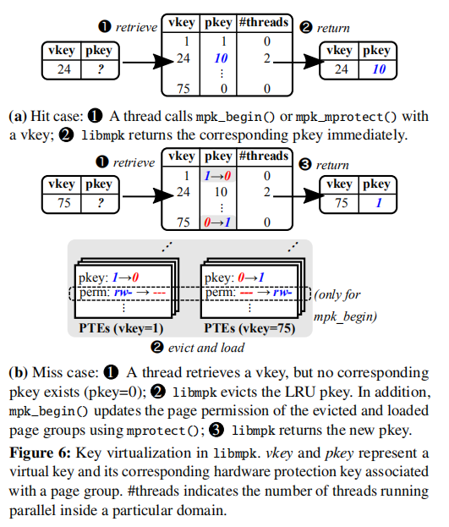
Protection Key Virtualization
create more than 16 page groups
a cache-like structure
2 ways for mapping:
thread-local
mpk_begin() & mpk_end() by a calling thread
sleep when fail
page not be used -> evict and disable permission
global
mpk_mprotect() for all threads
LRU for replacement
reserves one key for execute-only pages
merge execute-only pages group
evicted when execute-only pages
Notes:
1. introduction: advantages, structure, how work (hit case)
2. 2 ways

Slide 8
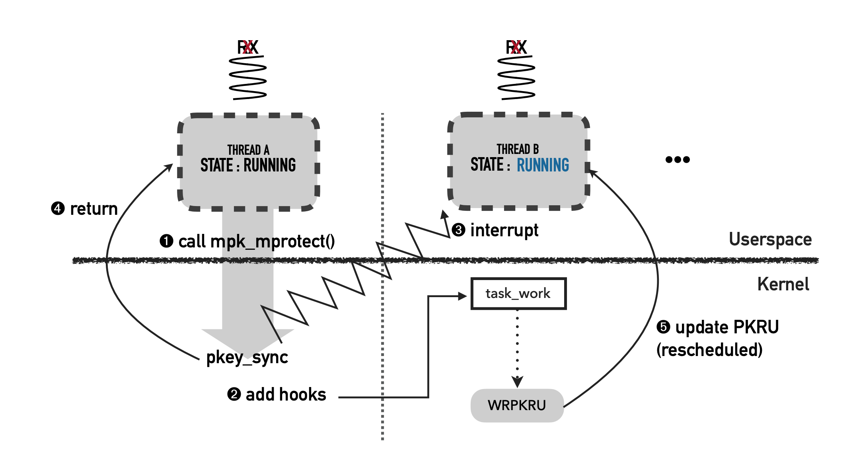
Inter-thread Key Synchronization
One thread calls mpk_mprotect()
mpk_mprotect() calls do_pkey_sync(pkey)
do_pkey_sync(key) sends interrupt to other threads
When other threads are scheduled, update PKRU by calling registered callback functions (callback functions are added by task_work_add())
Notes:
1. introduction: advantages, structure, how work (hit case)
2. 2 ways

Slide 9
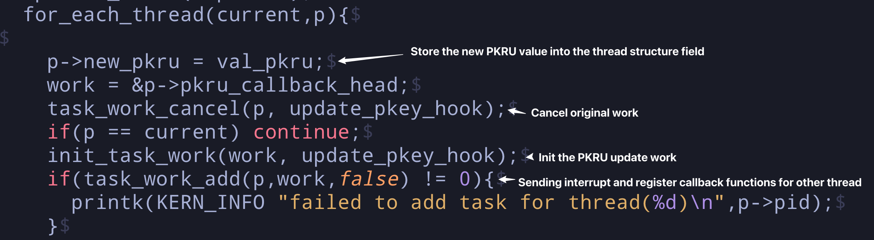
Source Code
In /libmpk/kernel/mm/mprotect.c/do_pkey_sync(val_pkru)
Notes:
1. introduction: advantages, structure, how work (hit case)
2. 2 ways

Slide 10
Applications & Benchmark

Slide 11
Applications
OpenSSL Library: protecting private key
3 JavaScript JIT Compilation Engine: protecting JIT pages
In-Memory Key-Value Store: protecting slabs

Slide 12
OpenSSL Library
A popular open-source library implementing SSL and TLS
Manage sensitive information -> information leak bugs
Solution: Storing keys in isolated memory pages
Isolated memory pages are protected by single pkey or multiple pkeys

Slide 13
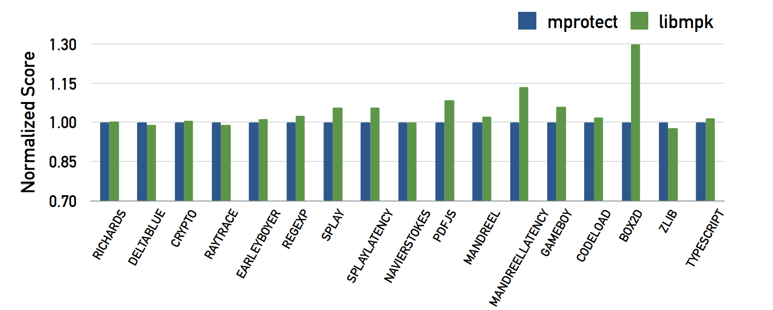
JIT Compilation Engine
JIT: dynamic interpreted script -> native machine code
JIT compilation thread: code cache writable and executable
-> coompromising thread can execute code provided by attackers
mprotect-based protection
One key per page
One key per process
Performance improvement

Slide 14
In-Memory Key-Value Store
Manage a large amount of data, ensuring low latency and high throughput
High performance requirement -> no using size-dependent security performance techniques
Arbitrary read or write vulnerabilities -> leak & corrupt sensitive information
Solution: assign 2 different keys to slabs and hash tables
Independent of memory size -> Efficient

Slide 15
Benchmark
Microbenchmarks
Application Benchmarks

Slide 16
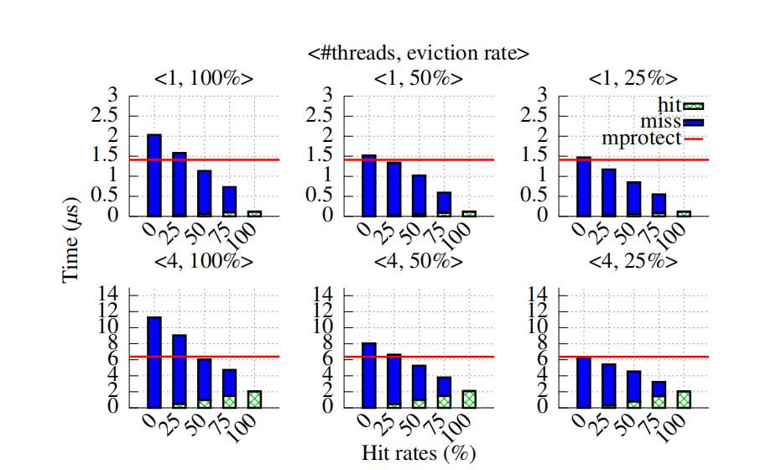
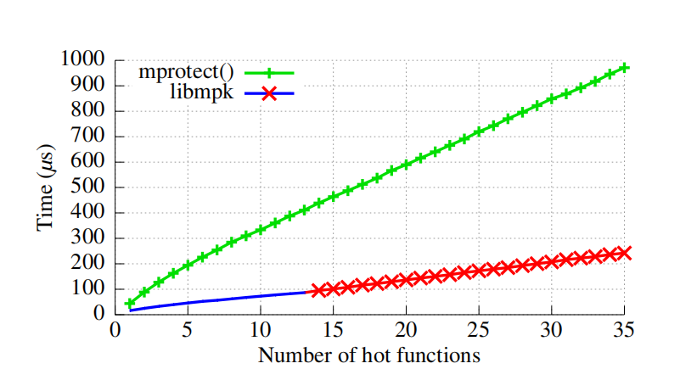
Microbenchmarks
Cache performance
Green box: cache hit cost
Blue box: cache miss cost
mpk_mprotect() outperforms mprotect() except when the cache hit rate is below 25% with an eviction rate above 50%

Slide 17
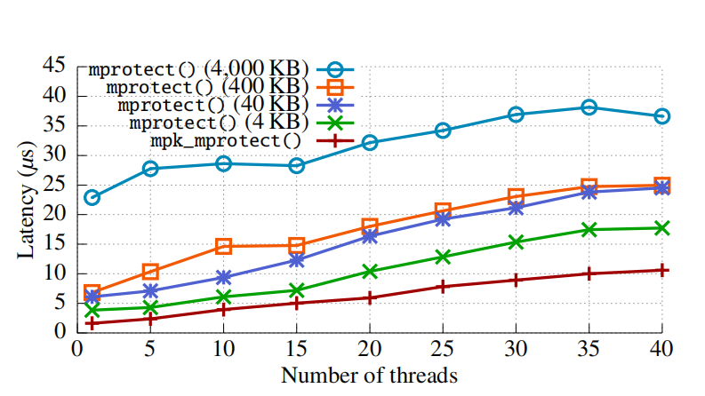
Microbenchmarks
Synchronization latency
mpk_mprotect() is 1.73× faster than mprotect()
independent of # pages whose permission has been updated

Slide 18
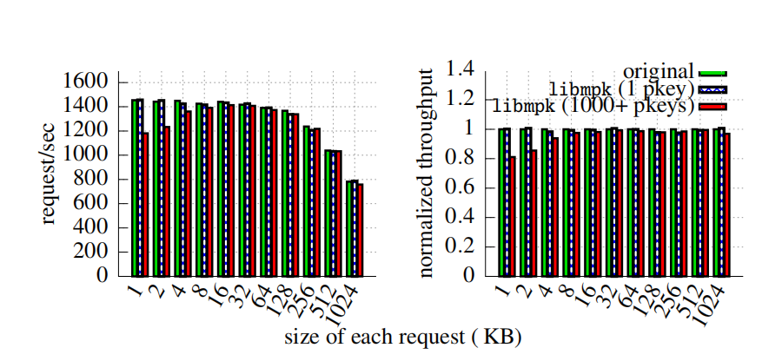
Application Benchmarks
OpenSSL
0.58% and 4.82% performance overhead
overhead: multiple pkeys > single pkey

Slide 19
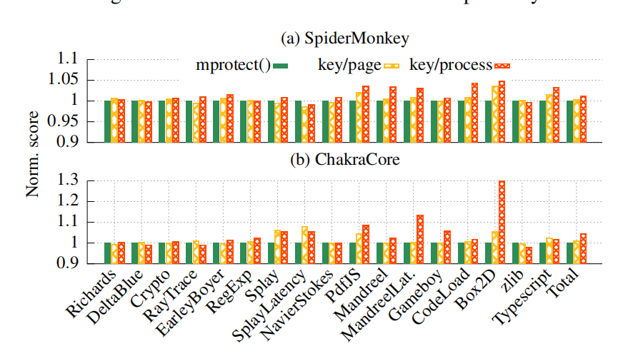
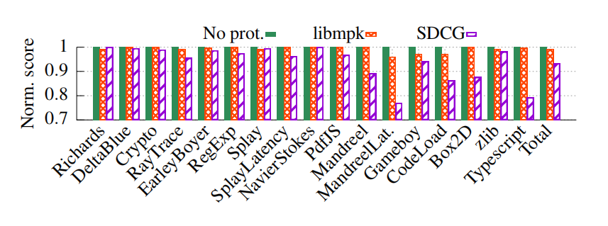
Application Benchmarks
JIT compilation
libmpk-based approaches out_x0002_perform the mprotect()-based approach on the total score, 0.38% and 1.26%
libmpk introduced 0.81% overall performance loss, compared with 6.68% caused by SDCG
outperform the mprotect()-based approach

Slide 20
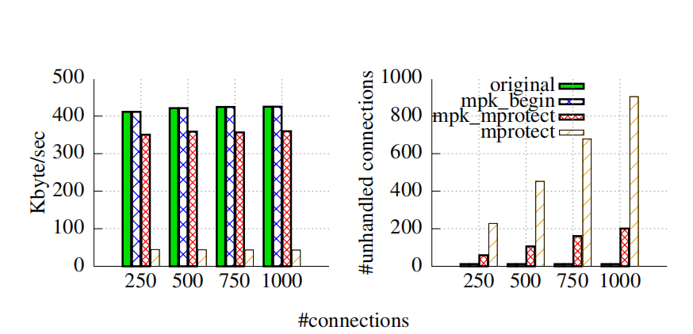
Application Benchmarks
In-memory key-value store
libmpk only has 0.01% overhead while mprotect() has 89.56%
libmpk has better performance when protecting huge memory

