Slide 1
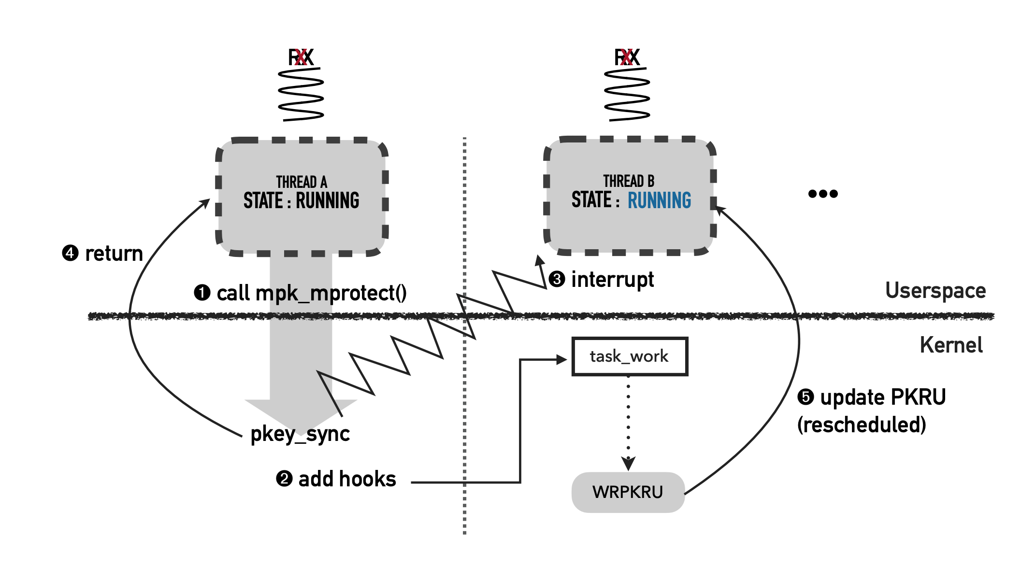
Inter-thread Key Synchronization
One thread calls mpk_mprotect()
mpk_mprotect() calls do_pkey_sync(pkey)
do_pkey_sync(key) sends interrupt to other threads
When other threads are scheduled, update PKRU by calling registered callback functions (callback functions are added by task_work_add())
Notes:
1. introduction: advantages, structure, how work (hit case)
2. 2 ways

Slide 2
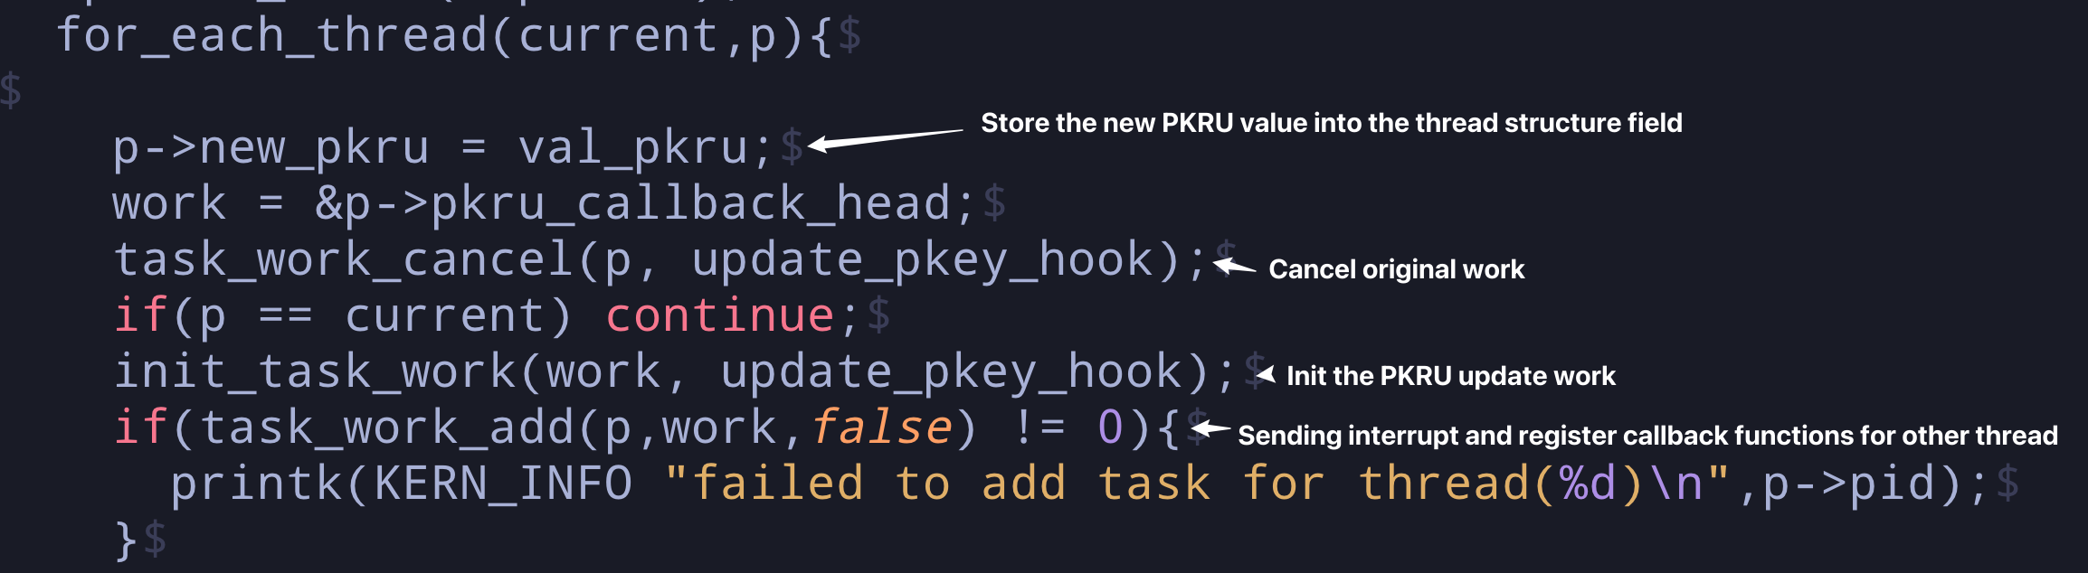
Source Code
In /libmpk/kernel/mm/mprotect.c/do_pkey_sync(val_pkru)
Notes:
1. introduction: advantages, structure, how work (hit case)
2. 2 ways

