Slide 1
Applications & Benchmark

Slide 2
Applications
OpenSSL Library: protecting private key
3 JavaScript JIT Compilation Engine: protecting JIT pages
In-Memory Key-Value Store: protecting slabs

Slide 3
OpenSSL Library
A popular open-source library implementing SSL and TLS
Manage sensitive information -> information leak bugs
Solution: Storing keys in isolated memory pages
Isolated memory pages are protected by single pkey or multiple pkeys

Slide 4
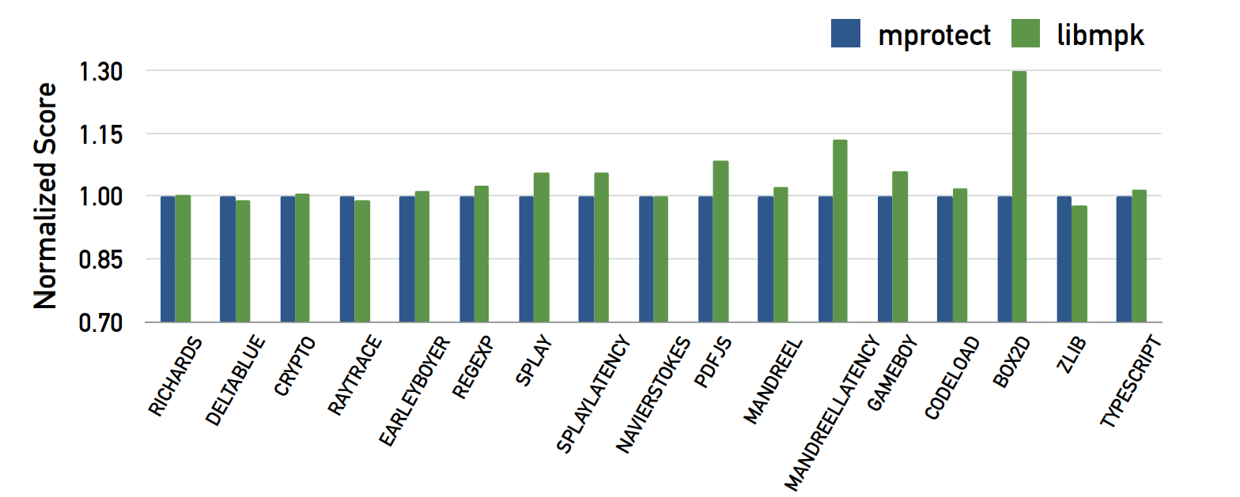
JIT Compilation Engine
JIT: dynamic interpreted script -> native machine code
JIT compilation thread: code cache writable and executable
-> coompromising thread can execute code provided by attackers
mprotect-based protection
One key per page
One key per process
Performance improvement

Slide 5
In-Memory Key-Value Store
Manage a large amount of data, ensuring low latency and high throughput
High performance requirement -> no using size-dependent security performance techniques
Arbitrary read or write vulnerabilities -> leak & corrupt sensitive information
Solution: assign 2 different keys to slabs and hash tables
Independent of memory size -> Efficient

Slide 6
Benchmark
Microbenchmarks
Application Benchmarks

Slide 7
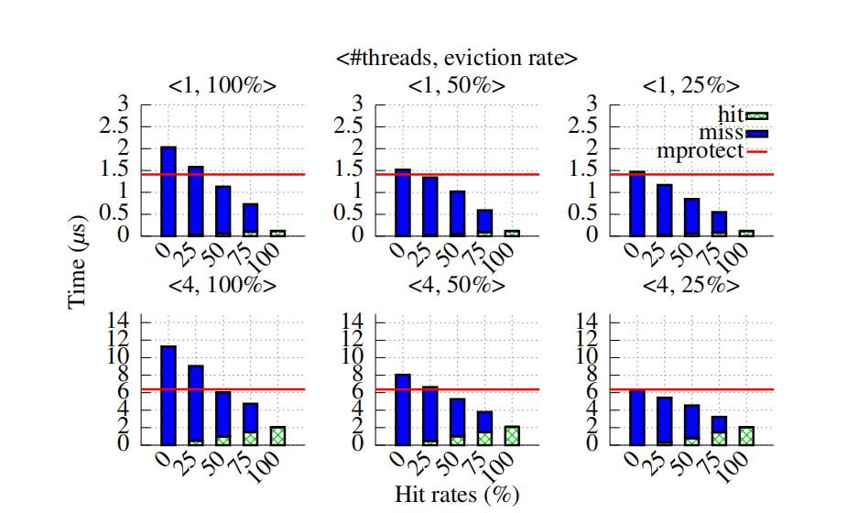
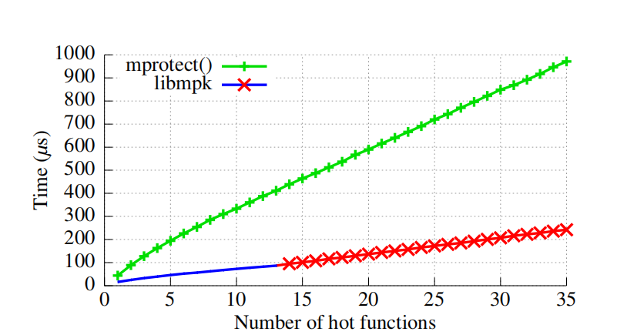
Microbenchmarks
Cache performance
Green box: cache hit cost
Blue box: cache miss cost
mpk_mprotect() outperforms mprotect() except when the cache hit rate is below 25% with an eviction rate above 50%

Slide 8
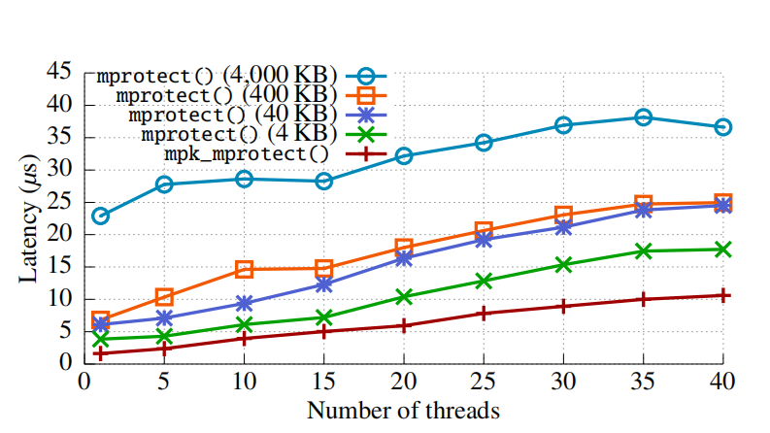
Microbenchmarks
Synchronization latency
mpk_mprotect() is 1.73× faster than mprotect()
independent of # pages whose permission has been updated

Slide 9
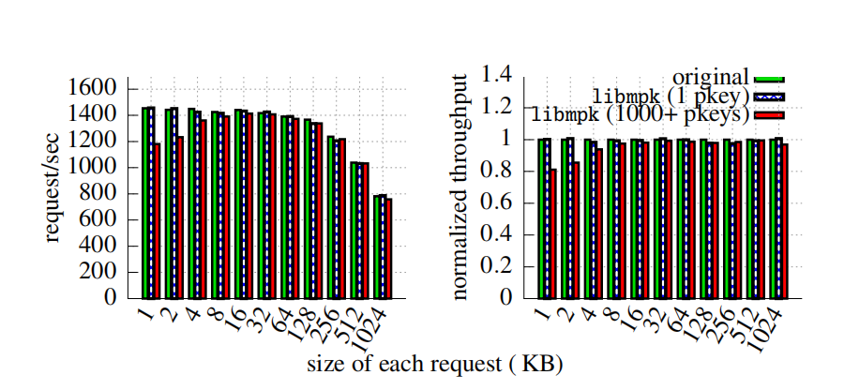
Application Benchmarks
OpenSSL
0.58% and 4.82% performance overhead
overhead: multiple pkeys > single pkey

Slide 10
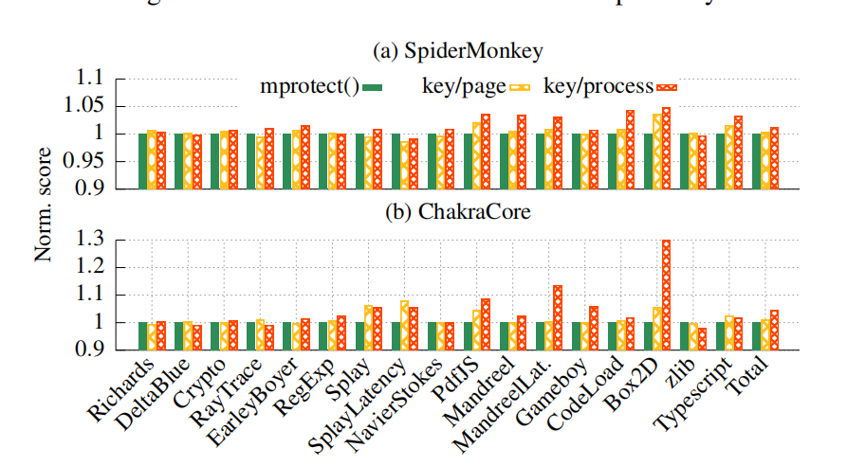
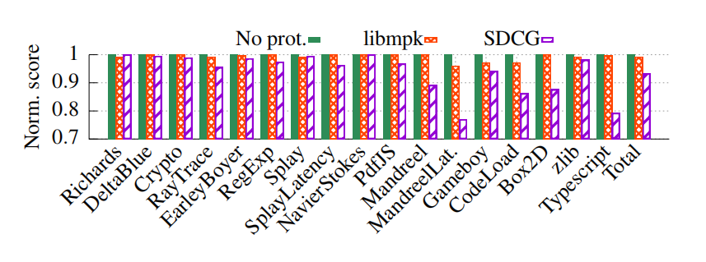
Application Benchmarks
JIT compilation
libmpk-based approaches out_x0002_perform the mprotect()-based approach on the total score, 0.38% and 1.26%
libmpk introduced 0.81% overall performance loss, compared with 6.68% caused by SDCG
outperform the mprotect()-based approach

Slide 11
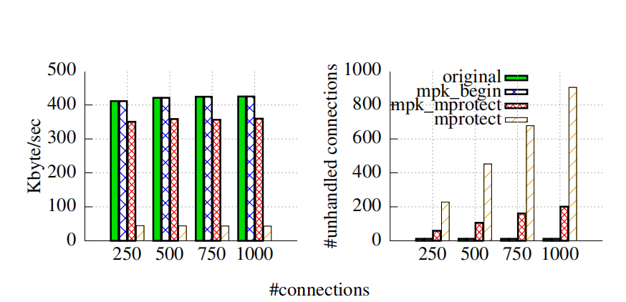
Application Benchmarks
In-memory key-value store
libmpk only has 0.01% overhead while mprotect() has 89.56%
libmpk has better performance when protecting huge memory

