Slide 1
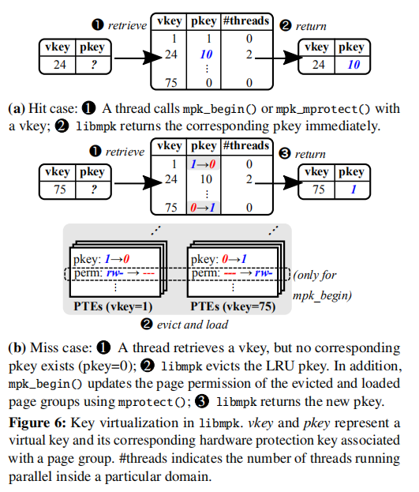
Protection Key Virtualization
create more than 16 page groups
a cache-like structure
2 ways for mapping:
thread-local
mpk_begin() & mpk_end() by a calling thread
sleep when fail
page not be used -> evict and disable permission
global
mpk_mprotect() for all threads
LRU for replacement
reserves one key for execute-only pages
merge execute-only pages group
evicted when execute-only pages
Notes:
1. introduction: advantages, structure, how work (hit case)
2. 2 ways

