Slide 1
Pascal compiler in python
Compiler - Project
Group 20 - June 19th, 2019 李易非 陈俊儒 王丹尧

Slide 2

Introduction

Slide 3
Introduction
—— language?
—— Pascal compiler in Python
—— lex and yacc?
—— ply (implementation of lex and yacc in Python)
—— Experiment environment?
—— 待补充

Slide 4
Process
Source code
Lexical
analysis
Grammar
analysis
Symbol table
Semantic analysis
Error handling
Code generate
optimaize
Notes:
这个我随便画的，还能改

Slide 5
Algorithm Details
Notes:
讲实现过程的细节

Slide 6
Lexical analysis
TOKEN
t_ASSIGN = r':=‘
t_EQUAL = r'=‘
t_UNEQUAL = r'<>’
...
interger = r'\d+’
@TOKEN(interger)
def t_INTEGER(t):
t.value = int(t.value)
return t
...
TOKEN
t_ASSIGN = r':=‘
t_EQUAL = r'=‘
t_UNEQUAL = r'<>’
...
interger = r'\d+’
@TOKEN(interger)
def t_INTEGER(t):
t.value = int(t.value)
return t
...
Reserved word
reserved = {
'if' : 'IF',
'then' : 'THEN',
'else' : 'ELSE',
...
}

Slide 7
Grammar analysis
Grammar
def p_program(p):
'program : program_head routine DOT'
p[0] = Node('program', p[1], p[2])
def p_term(p):
'''term : term MUL factor
| factor'''
if len(p) == 2:
p[0] = p[1]
elif p[2] == '*':
p[0] = Node("term-MUL", p[1], p[3])
Tree Node
class Node(object):
def __init__(self, t, *args):
self._type = t
self._children = args
Ambiguity
precedence = (
('left', 'ADD', 'SUBTRACT'),
('left', 'MUL', 'DIV', 'kDIV', 'kMOD')
)

Slide 8
Grammar analysis
Error handling
Panic mode
def p_error(p):
if p:
SemanticLogger.error(p.lineno,
"syntax error at token {}".format(p.value))
# Just discard the token and tell the parser it's okay.
parser.errok()
else:
print("Syntax error at EOF")

Slide 9
Grammar analysis
Error handling
resynchronization
def p_const_expr(p):
'const_expr : ID EQUAL const_value SEMICON'
p[0] = Node('const_expr', p.lexer.lineno, p[1], p[3])
def p_const_expr_error(p):
'const_expr : error SEMICON'
SemanticLogger.error(p[1].lineno,
f"Syntax error at token `{p[1].value}`in const expression.")

Slide 10
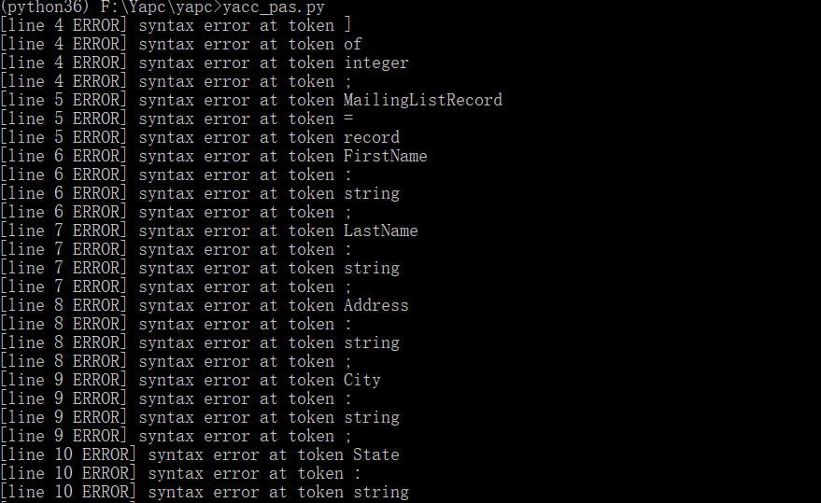
Grammar analysis
Error handling Example
type
arr = array [050] of integer;
MailingListRecord = record
FirstName: string;
LastName: string;
Address: string;
Panic mode

Slide 11

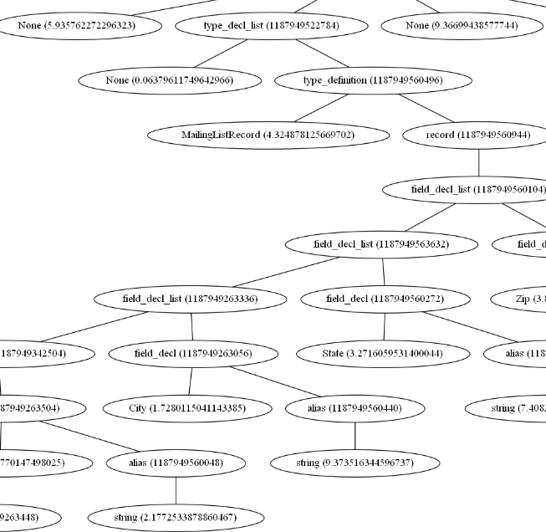
Grammar analysis
Error handling Example
resynchronization

Slide 12
Semantic analysis
More

Slide 13
About Test
Notes:
测试样例

Slide 14
Test

Slide 15
Thank you for your listening
and time for Q&A

