Slide 1
Pascal compiler in python
Compiler - Project
Group 20 - June 19th, 2019 李易非 陈俊儒 王丹尧

Slide 2

Introduction

Slide 3
Introduction
—— language?
—— Pascal compiler in Python
—— lex and yacc?
—— ply (implementation of lex and yacc in Python)

Slide 4
Process
Source code
Lexical
analysis
Grammar
analysis
Symbol table
Semantic analysis
Error handling
Code generate
optimaize
Notes:
这个我随便画的，还能改

Slide 5
Algorithm Details
Notes:
讲实现过程的细节

Slide 6
1、Lexical analysis
TOKEN
t_ASSIGN = r':=‘
t_EQUAL = r'=‘
t_UNEQUAL = r'<>’
...
interger = r'\d+’
@TOKEN(interger)
def t_INTEGER(t):
t.value = int(t.value)
return t
...
TOKEN
t_ASSIGN = r':=‘
t_EQUAL = r'=‘
t_UNEQUAL = r'<>’
...
interger = r'\d+’
@TOKEN(interger)
def t_INTEGER(t):
t.value = int(t.value)
return t
...
Reserved word
reserved = {
'if' : 'IF',
'then' : 'THEN',
'else' : 'ELSE',
...
}

Slide 7
2、Grammar analysis
Grammar
def p_program(p):
'program : program_head routine DOT'
p[0] = Node('program', p[1], p[2])
def p_term(p):
'''term : term MUL factor
| factor'''
if len(p) == 2:
p[0] = p[1]
elif p[2] == '*':
p[0] = Node("term-MUL", p[1], p[3])
Tree Node
class Node(object):
def __init__(self, t, *args):
self._type = t
self._children = args
Ambiguity
precedence = (
('left', 'ADD', 'SUBTRACT'),
('left', 'MUL', 'DIV', 'kDIV', 'kMOD')
)

Slide 8
2、Grammar analysis
Error handling
Panic mode
def p_error(p):
if p:
SemanticLogger.error(p.lineno,
"syntax error at token {}".format(p.value))
# Just discard the token and tell the parser it's okay.
parser.errok()
else:
print("Syntax error at EOF")

Slide 9
2、Grammar analysis
Error handling
resynchronization
def p_const_expr(p):
'const_expr : ID EQUAL const_value SEMICON'
p[0] = Node('const_expr', p.lexer.lineno, p[1], p[3])
def p_const_expr_error(p):
'const_expr : error SEMICON'
SemanticLogger.error(p[1].lineno,
f"Syntax error at token `{p[1].value}`in const expression.")

Slide 10
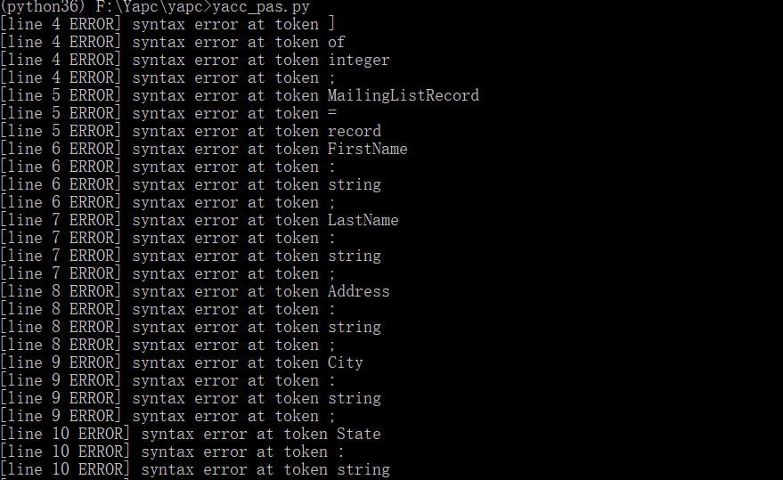
2、Grammar analysis
Error handling Example
type
arr = array [050] of integer;
MailingListRecord = record
FirstName: string;
LastName: string;
Address: string;
Panic mode

Slide 11

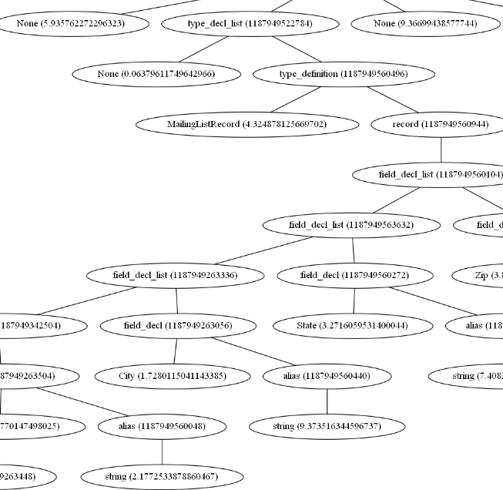
2、Grammar analysis
Error handling Example
resynchronization

Slide 12
3、Semantic analysis
Source code
Lexical
analysis
构建 symbol table
Type inference
type checking
Constant folding
Semantic checking
Grammar
analysis
Symbol table
Semantic analysis
Error handling
Code generate
optimize

Slide 13
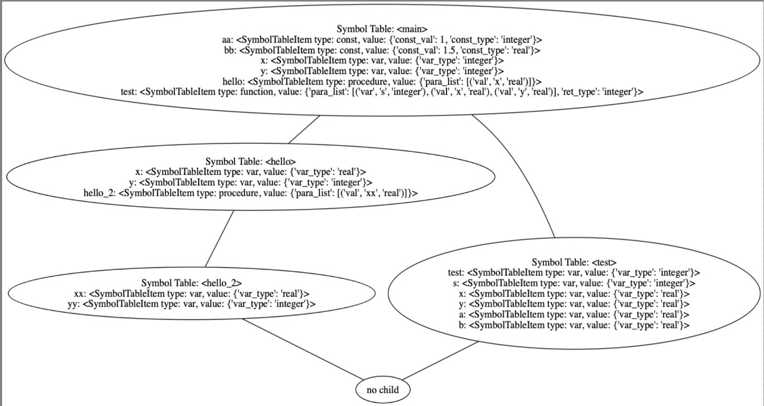
3.1 构建 symbol table
inherited attribute
nested scopes

Slide 14
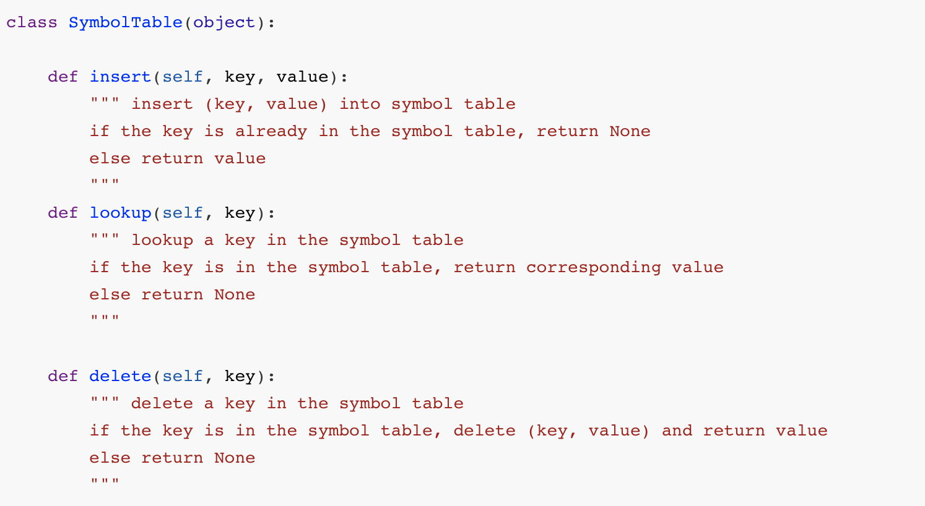
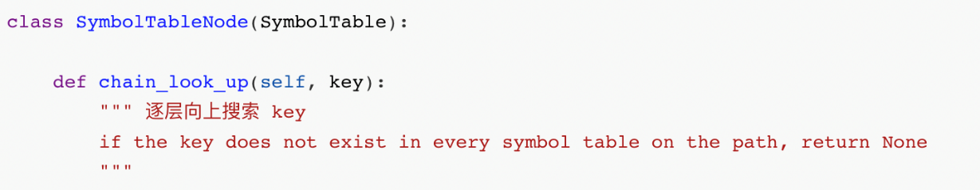
3.1 symbol table 数据结构
Symbol Table
Symbol Table Node

Slide 15
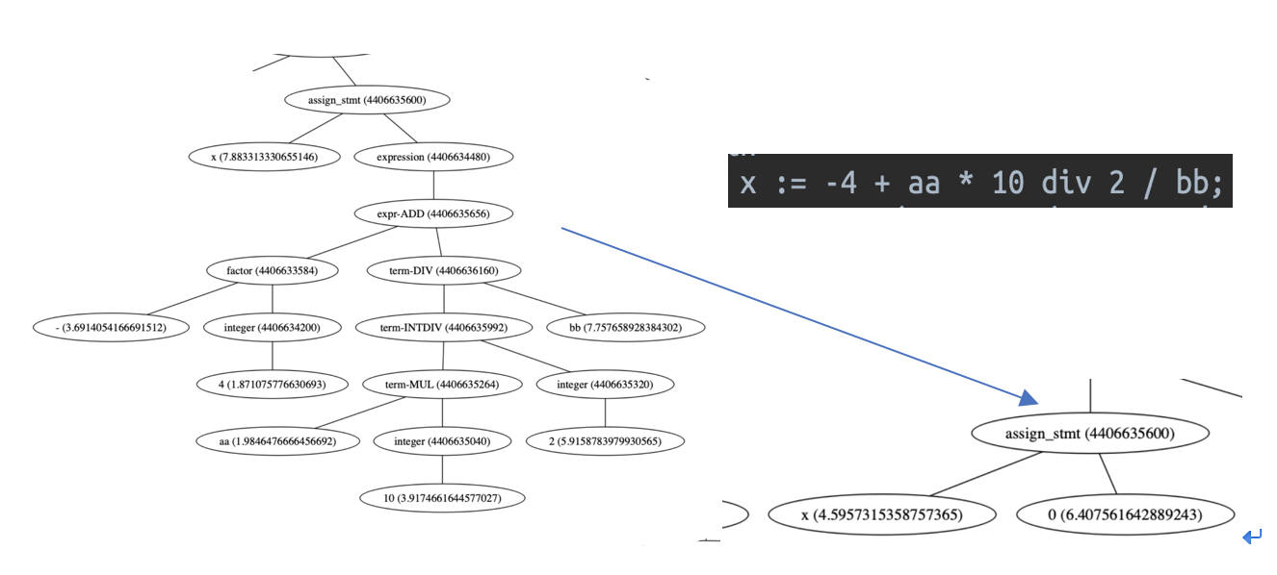
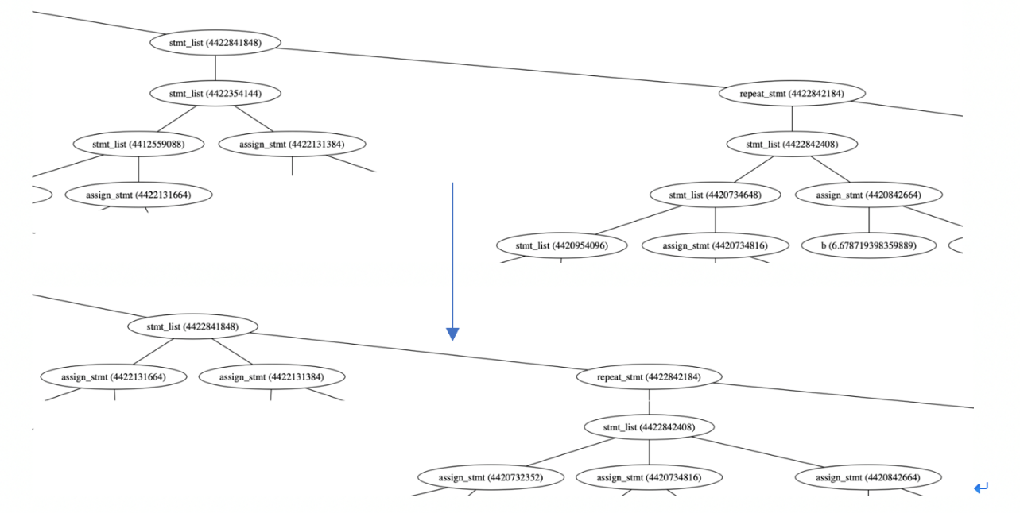
3.2 语义分析中对 AST 的缩减
Constant folding
Type inference
Take type as synthesized attribute
压平语法树
大量左递归语法

Slide 16
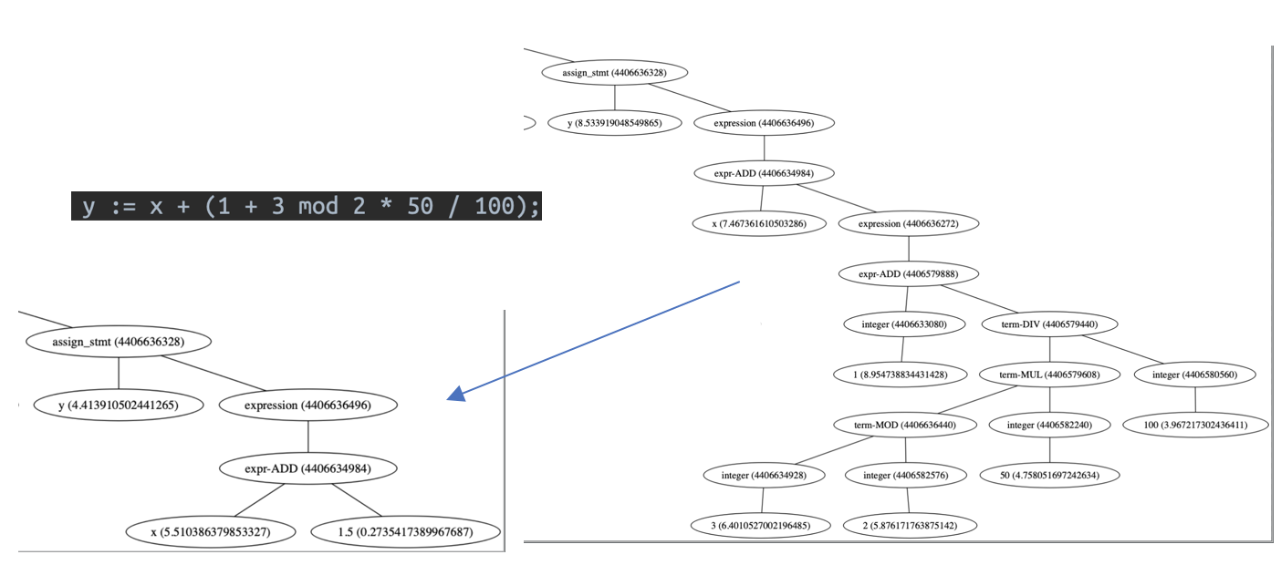
3.2 two more examples

Slide 17
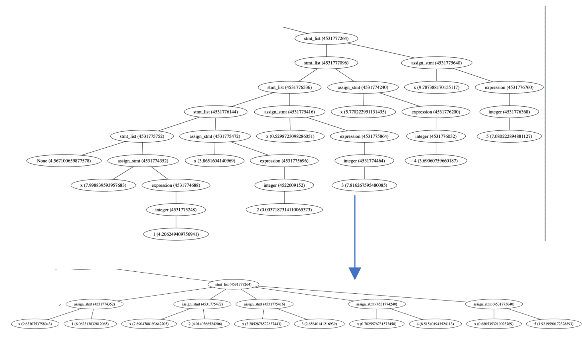
3.2 two more examples

Slide 18
3.3 语义分析中的各类检查
类型声明检查
变量声明检查
赋值语句类型检查
if / while / repeat / for / case 语句语义分析与检查

Slide 19
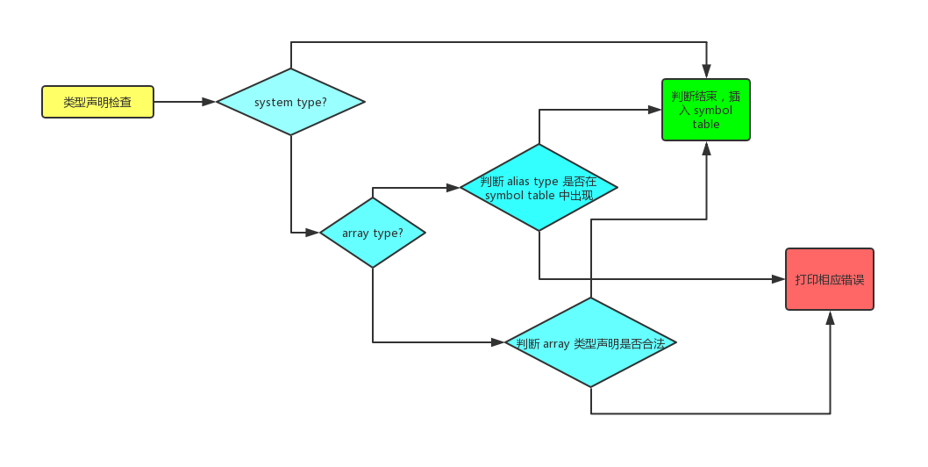
3.3.1 类型声明检查
基于 symbol table，并不断插入新项
look up / chain look up
Insert

Slide 20
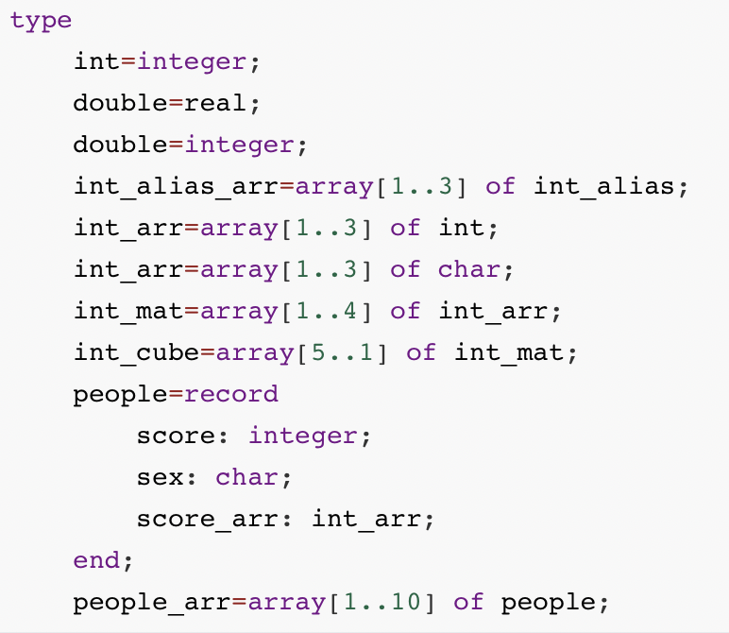
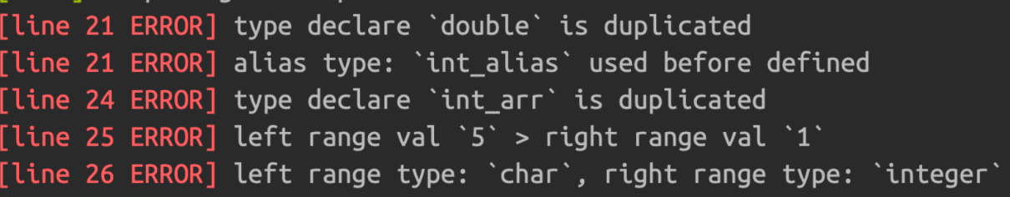
3.3.1 类型声明检查 example

Slide 21
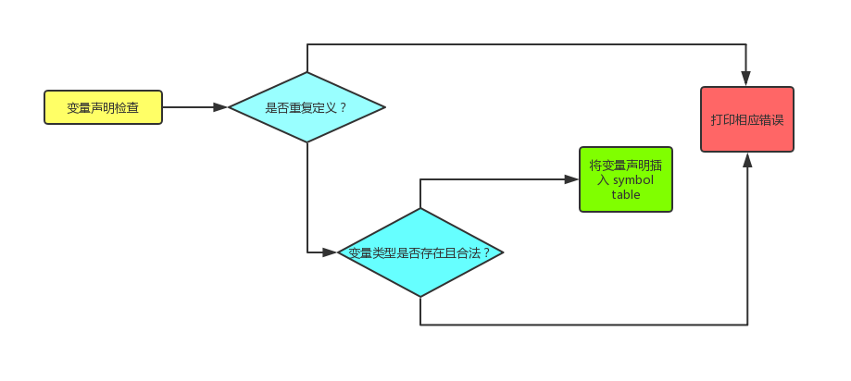
3.3.2 变量声明检查
基于 symbol table，并不断插入新项
look up / chain look up, 判断类型是否存在
Insert

Slide 22
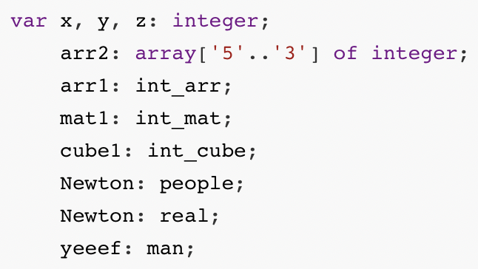
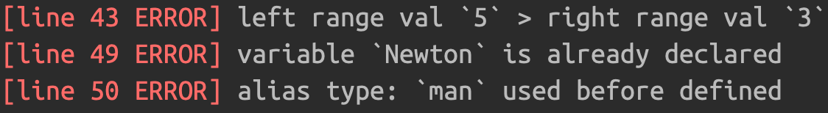
3.3.2 变量声明检查 example

Slide 23
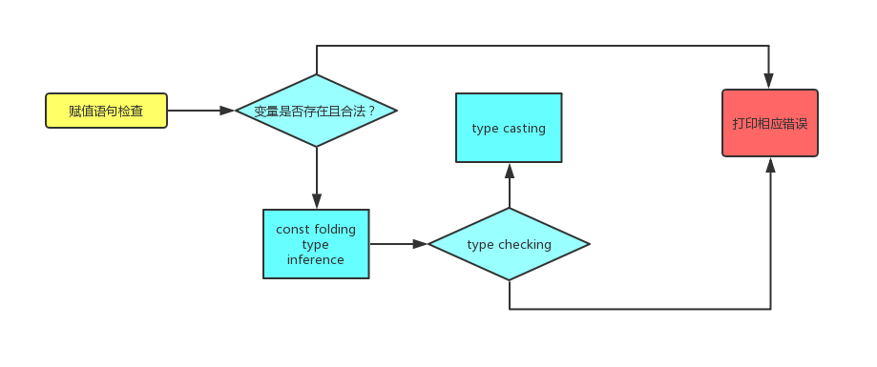
3.3.3 赋值语句检查
基于 symbol table，并不断插入新项
look up / chain look up, 判断变量是否存在
结合之前 const folding 结果与 type inference 结果做 type checking and type casting

Slide 24
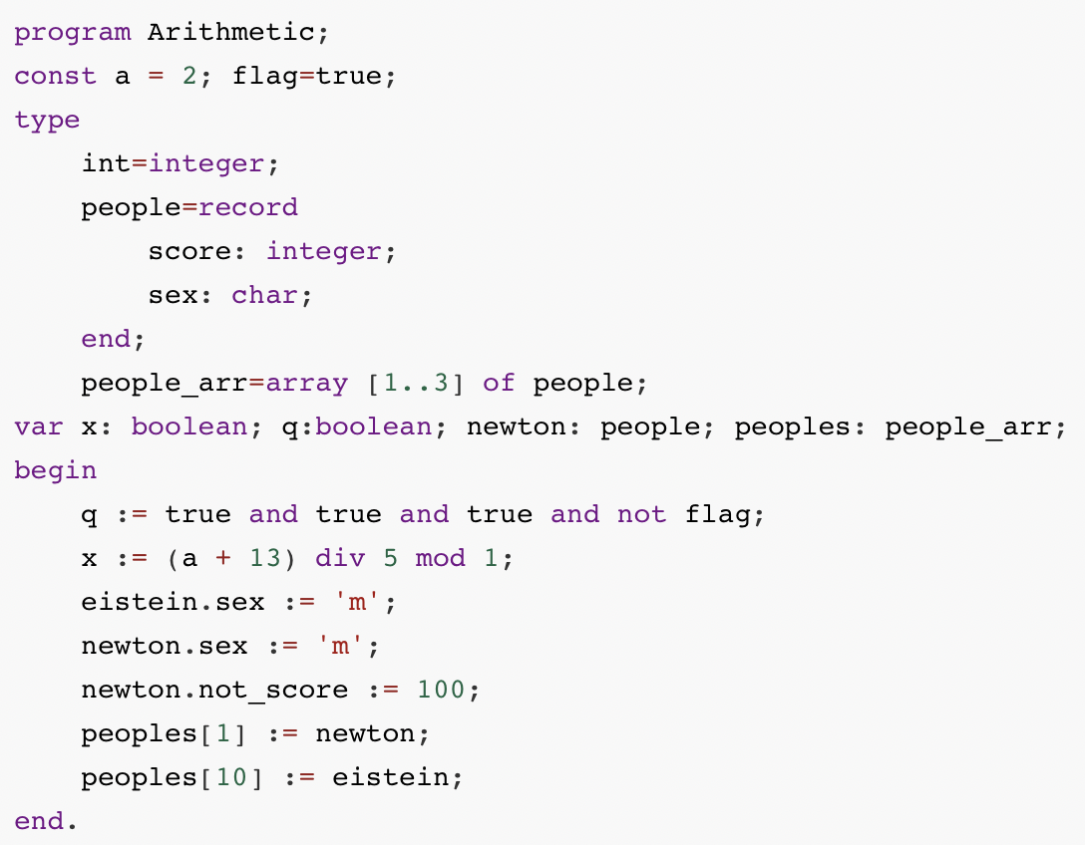
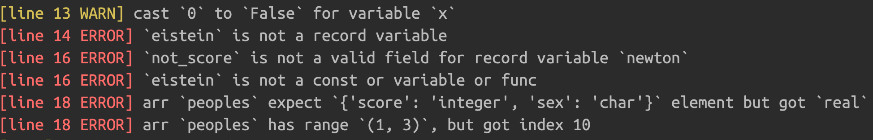
3.3.3 赋值语句检查 example

Slide 25
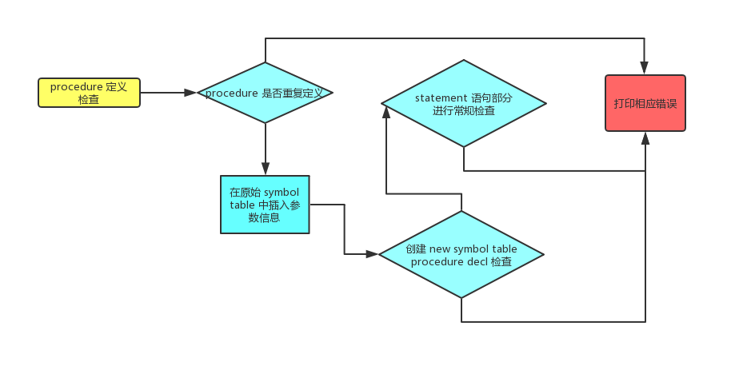
3.3.4 procedure / function 定义检查
在原始 symbol table 中插入 procedure 定义信息（参数）
创建新的 symbol table，插入 procedure 内部的各类声明（检查过程如之前所述）
在 statement 部分，出现的 variable 需要进行 chain look up

Slide 26
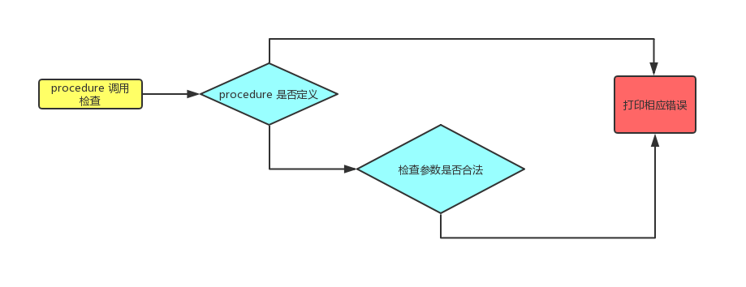
3.3.4 procedure / function 调用检查
Chain lookup 判断 procedure 是否存在
参数是否合法

Slide 27
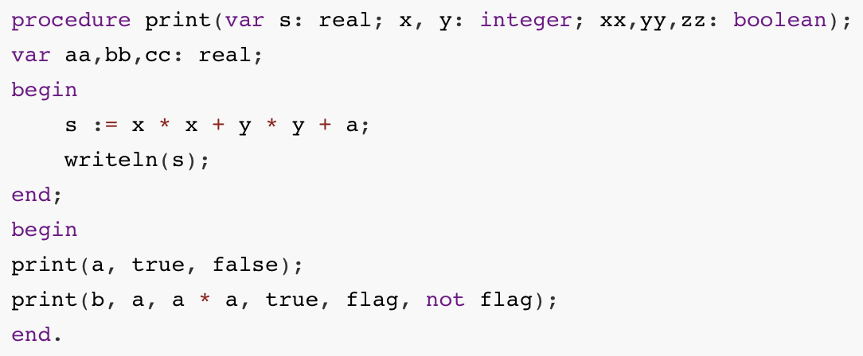
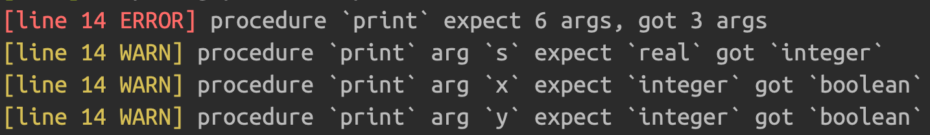
3.3.4 procedure / function 调用检查 example

Slide 28
4、Code Generation
Routine Statement
Assignment
Control Statement
Expression Statement
Optimization

Slide 29
4.1 Routine Statement
定义部分
# routine : routine_head routine_body
if root_node.type == 'routine':
self._traverse_ast_gen_code(root_node.children[0])
self._traverse_ast_gen_code(root_node.children[1])
if len(self._routine_stack) > 0:
if self._routine_stack[-1][1]:
self._add_new_quad('return', self._routine_stack[-1][0])
self._add_new_quad('end_define', self._routine_stack[-1][0])
self._routine_stack.pop()
# function_head : kFUNCTION ID parameters COLON simple_type_decl
# procedure_head : kPROCEDURE ID parameters

Slide 30
4.1 Routine Statement
调用部分
# proc_stmt : ID
# | SYS_PROC
if root_node.type == 'proc_stmt-simple':
self._add_new_quad('call', children[0])
# proc_stmt : ID LP args_list RP
# | SYS_PROC LP expression_list RP
# | kREAD LP factor RP
if children[0] == 'read':
self._add_new_quad('begin_args', None)
args_val = self.gen_quad_list_from_expression_node(children[1])
self._add_new_quad('read', args_val)
# expression_list : expression_list COMMA expression
# | expression

Slide 31
4.2 Assignment Statement
record
# assign_stmt : ID DOT ID ASSIGN expression
else:
record_name, field_name, val_expression = root_node.children
address_var = self.new_tmp_var
self._add_new_quad('address', address_var, record_name, field_name)
ret_val = self.gen_quad_list_in_expression_node(val_expression)
self._add_new_quad(None, '*' + address_var, ret_val)
t = &x + field_offset(x, field_name)

Slide 32
4.3 Control Statement
Case statement
# case_stmt : kCASE expression kOF case_expr_list kEND
# case_expr_list : case_expr_list case_expr
| case_expr
# case_expr : const_value COLON stmt SEMICON
| ID COLON stmt SEMICON
| kELSE COLON stmt SEMICON

Slide 33
4.3 Control Statement
Case statement
choose_var <- case_expression
case_list <- flatten the case_expr_list tree
for case_expr in case_list
{judge_value <- case_expr.children[0]
next_label <- new_label
t <- choose_var == judge_value
if_false t goto next_label
{case_expr_stmt}
goto exit_label
next_label}
exit_label

Slide 34
4.4 Expression Statement
expr-OR node
# expr : expr kOR term else:
if expression_node.type == 'expr-OR':
bool_list = traverse_skew_tree_bool(expression_node, 'term', 'expr-OR')
jump_label = self.new_label
for or_node in bool_list:
condition_value = self.gen_quad_list_from_expression_node(or_node)
self._add_new_quad('goto', jump_label, 'if', condition_value)
target = self.new_tmp_var
self._add_new_quad(None, target, 0)
exit_label = self.new_label
self._add_new_quad('goto', exit_label)
self._add_new_quad(jump_label, None)
self._add_new_quad(None, target, 1)
self._add_new_quad(exit_label, None)
return target
def traverse_skew_tree_bool(node, stop_node_type, target_node_type)

Slide 35
4.5 optimization
·省略不可到达语句
针对bool条件判断，即if/while/repeat/case/for语句
·识别尾递归
去除频繁调用小过程。

Slide 36
About Test
Notes:
展示时会现场演示程序运行过程

Slide 37
Thank you for your listening
and time for Q&A

