Slide 1


A Thesis Proposal
Presented to the Faculty of the
Department of Computer, Information Sciences and Mathematics
University of San Carlos
INSIDE-OUT: Emotion Recognition through Handwriting Analysis using Hybrid Approach
(CNN and HMM)
Proposed By
CYREL JANE A. EDAÑO
Bachelor of Science in Computer Science
University of San Carlos
CHRISTIAN V. MADERAZO, MEng
Faculty Adviser
GLENN G. GLARINO, PhD
Co-Faculty Adviser

Slide 2

What are Emotions and Handwriting?

Slide 3



Rationale of the Study
Understanding how emotions affect handwriting is really important. Emotions play a key role in how we think, decide, and behave. And how emotions show up in handwriting can tell us a lot about someone's feelings. Looking at handwriting has been used in fields like forensics, psychology, and even solving crimes. But now, with better technology, we can learn even more about how emotions and handwriting are linked.
If we can understand this connection, we can make new tools that could be really useful. For example, in schools, looking at how students write could help see if they're having a hard time or feeling stressed. Then, we could help them sooner. In healthcare, changes in handwriting could help spot brain or mood issues tied to how emotions are handled. And in crime work, checking handwriting for emotions could boost how we check documents and see lies.

Slide 4

STATEMENT OF THE PROBLEM
Addressing the Need for Emotion Recognition
1
The Problem
2
The Proposed Solution
Despite advancements in emotion recognition, there remains a gap in integrating handwriting analysis with machine learning to accurately classify emotional states.
This study aims to develop and evaluate a system that can analyze handwriting samples and determine the writer's emotional state with high accuracy, addressing the need for an effective emotion recognition system.

Slide 5
Objectives of the Study
General Objective
Specific Objectives
The general objective of this study is to develop and evaluate a machine learning system capable of classifying emotional states from student handwriting samples, leveraging advanced image processing techniques.
Data Collection: Gather diverse handwriting samples from participants.
Data Preprocessing: Clean and preprocess the data.
Model Design and Development: Design and develop a hybrid model combining Convolutional Neural Networks (CNNs) and Hidden Markov Models (HMMs).
Model Testing and Evaluation: Test the model and determine its accuracy.

Slide 6

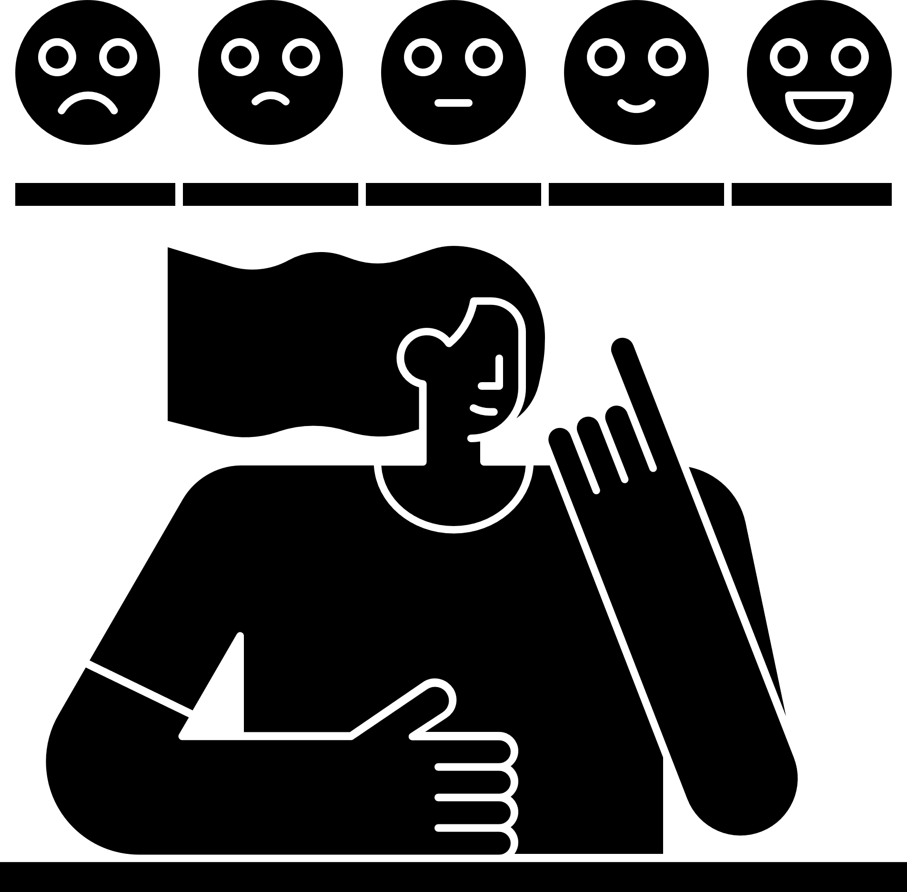


Significance of the Study
Human-Computer Interaction (HCI)
Emotional Intelligence
Psychology and Education
Healthcare
By developing a novel emotion recognition system from handwriting, this research enhances how humans interact with technology. It offers the potential for more emotionally sensitive interfaces and adaptive systems that personalize user experiences.
Understanding the link between handwriting and emotions helps unravel the complexities of human emotional expression. This study could inform future development of tools that assist individuals in understanding their own emotions and potentially augment emotional self-regulation.
This study could provide valuable insights for psychologists seeking supplementary methods for assessing emotional states. Within education, emotion-aware technologies could help tailor learning experiences and create supportive environments for students.
This study could lay the groundwork for future exploration of handwriting-based emotion detection as a potential supplementary tool in mental health screening or monitoring.

Slide 7



Scope and Limitations
Scope
Limitations
Developing a new emotion recognition system from handwriting data that can identify emotions like happiness and sadness, using an approach that integrates CNNs, HMMs, and image processing techniques.
The system's accuracy will depend on the quality and diversity of the handwriting samples, as well as the reliability of the emotional annotations. Factors like real-world deployment, noise, and ethical concerns will also need to be carefully considered.

Slide 8
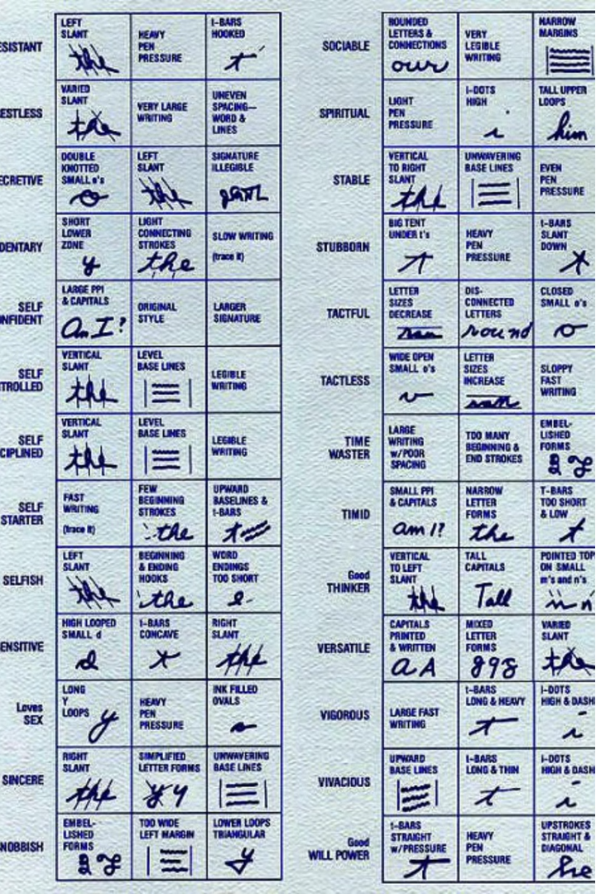
Review of Related Literature

Slide 9
Related Studies
Title & Publication Year | Description | Method | Results
EMOTHAW: A Novel Database for Emotional State Recognition From Handwriting and Drawing by Likforman-Sulem et al. (2017) | Developed a database for emotion recognition from handwriting and drawing samples, exploring connections between handwriting features and anxiety, depression, and stress measures. | Used random forests machine learning on timing and pen pressure features extracted from handwriting from a tablet. | Achieved promising results in classifying anxiety and stress emotional states from handwriting cues.
Automatic Emotion Recognition through Handwriting Analysis: A Review by Kedar et al. (2015) | Comprehensive review examining the potential of handwriting analysis for automatic emotion recognition, highlighting handwriting characteristics like baseline, slant, pen pressure, size, etc. as potential emotional cues. | Review of existing methodologies and machine learning techniques applied to handwriting analysis for emotion recognition. | Highlighted the potential of handwriting analysis as a tool for identifying individuals in emotional distress who may require psychological support.
Unveiling Emotions through Handwriting: A Data Analysis Approach by Azmi et al. (2023) | Explored the feasibility of detecting emotions from handwriting using a dataset of 129 users, analyzing relationships between handwriting features and emotional states. | Employed correlation analysis, dimensionality reduction, and a Random Forest model for emotion classification from handwriting. | Demonstrated promising accuracy in classifying emotions from handwriting, indicating the potential of handwriting analysis as a non-invasive emotional detection tool.
TEmoDec: Emotion Detection from Handwritten Text using Agglomerative Clustering by Bhattacharya et al. (2022) | Proposed an unsupervised approach to detect emotions like anger, sadness, depression, happiness, and excitement from handwritten text samples using agglomerative hierarchical clustering. | Clustered image pixels based on intra-cluster distances, bypassing the need for expert interpretation of handwriting. | Achieved promising accuracy rates in emotion classification, suggesting potential applications in mental health assessment, human resources, and criminal investigations.
Handwriting and Drawing Features for Detecting Personality Traits by Esposito et al. (2019) | Explored the relationship between quantitative handwriting and drawing features and personality traits measured by the Big Five Personality questionnaire (BFQ). | Analyzed data from 78 participants, examining differences in features like pressure, speed, and spacing between individuals scoring low, typical, and high on BFQ dimensions. | Found significant differences in handwriting features across BFQ dimensions, suggesting a connection between graphology and personality measurement.

Slide 10
Title & Publication Year | Description | Method | Results
EMOTHAW: A Novel Database for Emotional State Recognition From Handwriting and Drawing by Likforman-Sulem et al. (2017) | Developed a database for emotion recognition from handwriting and drawing samples, exploring connections between handwriting features and anxiety, depression, and stress measures. | Used random forests machine learning on timing and pen pressure features extracted from handwriting from a tablet. | Achieved promising results in classifying anxiety and stress emotional states from handwriting cues.
Automatic Emotion Recognition through Handwriting Analysis: A Review by Kedar et al. (2015) | Comprehensive review examining the potential of handwriting analysis for automatic emotion recognition, highlighting handwriting characteristics like baseline, slant, pen pressure, size, etc. as potential emotional cues. | Review of existing methodologies and machine learning techniques applied to handwriting analysis for emotion recognition. | Highlighted the potential of handwriting analysis as a tool for identifying individuals in emotional distress who may require psychological support.
Unveiling Emotions through Handwriting: A Data Analysis Approach by Azmi et al. (2023) | Explored the feasibility of detecting emotions from handwriting using a dataset of 129 users, analyzing relationships between handwriting features and emotional states. | Employed correlation analysis, dimensionality reduction, and a Random Forest model for emotion classification from handwriting. | Demonstrated promising accuracy in classifying emotions from handwriting, indicating the potential of handwriting analysis as a non-invasive emotional detection tool.
TEmoDec: Emotion Detection from Handwritten Text using Agglomerative Clustering by Bhattacharya et al. (2022) | Proposed an unsupervised approach to detect emotions like anger, sadness, depression, happiness, and excitement from handwritten text samples using agglomerative hierarchical clustering. | Clustered image pixels based on intra-cluster distances, bypassing the need for expert interpretation of handwriting. | Achieved promising accuracy rates in emotion classification, suggesting potential applications in mental health assessment, human resources, and criminal investigations.
Handwriting and Drawing Features for Detecting Personality Traits by Esposito et al. (2019) | Explored the relationship between quantitative handwriting and drawing features and personality traits measured by the Big Five Personality questionnaire (BFQ). | Analyzed data from 78 participants, examining differences in features like pressure, speed, and spacing between individuals scoring low, typical, and high on BFQ dimensions. | Found significant differences in handwriting features across BFQ dimensions, suggesting a connection between graphology and personality measurement.

Slide 11
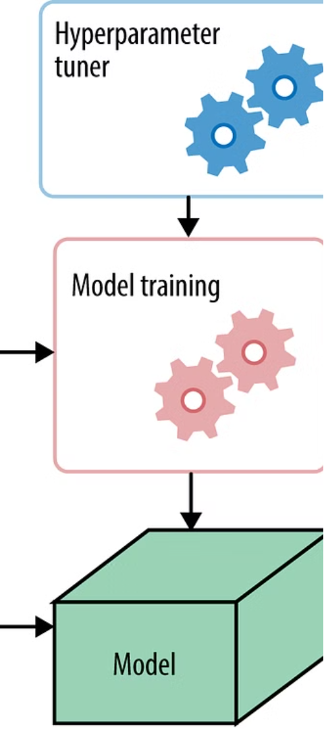
Emotion Recognition Models
Model
Approach
Accuracy
EMOTHAW
Random Forests on handwriting/drawing features
71.6% for anxiety, 70.8% for stress
Fuzzy Model
Fuzzy Inference System on handwriting features
82% for anger, fear, happiness, sadness
HMM-Model
Hidden Markov Models on online handwriting
81% for anger, happiness, sadness
TEmoDec
Agglomerative Hierarchical Clustering on handwritten text
71.6% for anger, sadness, depression, happiness, excitement
SVM-Based
Support Vector Machines on handwriting features
70-75% for extraversion and neuroticism

Slide 12
Technical Background
Emotion Recognition
Handwriting Analysis
Image Processing
Machine Learning
This involves identifying and interpreting human emotions, which can be influenced by factors like knowledge and experience.
This focuses on understanding personality traits and emotional states through handwriting features like slant, spacing, and letterforms.
This involves transforming input images into output images or extracting image characteristics for further analysis.
This branch of computer science uses existing data to make predictions about future data, employing techniques like mathematical optimization, statistics, and algorithm design.
Convolutional Neural Networks
Hidden Markov Models
These are deep learning algorithms specifically designed for image processing and recognition tasks.
These model the relationship between hidden states and observations using transition and emission probabilities.

Slide 13

Design and Methodology
Research Environment and Respondents
The research will be conducted in a controlled university setting. Respondents/Participants will be required from the general population, with a focus on right-handed young adults of a specific age range(e.g., 18-23 years old) who have a cursive handwriting style to reduce variability due to age differences and handwriting style.

Slide 14
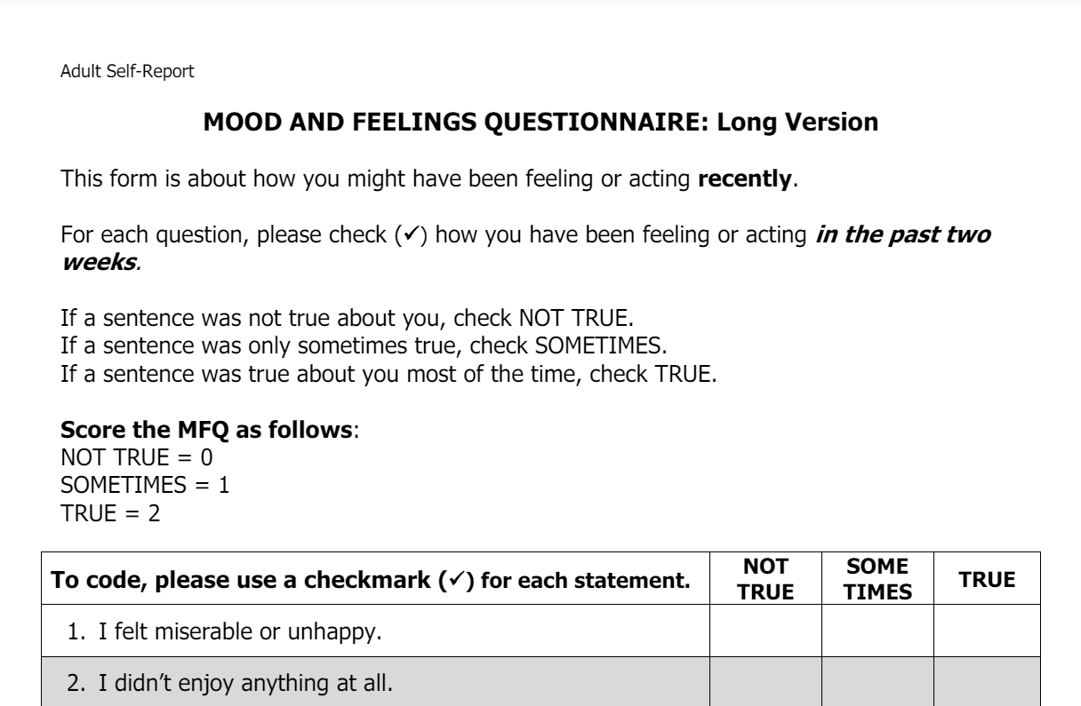
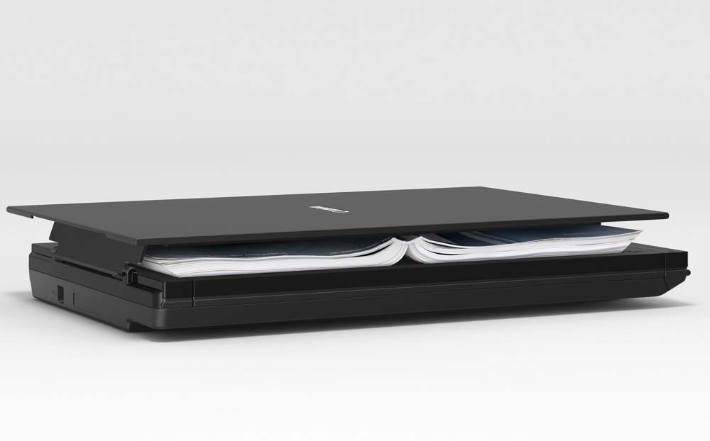
Design and Methodology
Research Instrument or Source of Data
The research instrument will consist of a 3-paged assessment handout, that consist 1st page the instructions, 2nd page the self –report questionnaire, and the 3rd page the rewriting words and sentences. A Flatbed Scanner will be used to scan the assessment filled out by the participants on A4 paper using a 0.3 black pen which will be provided by the researcher.

Slide 15
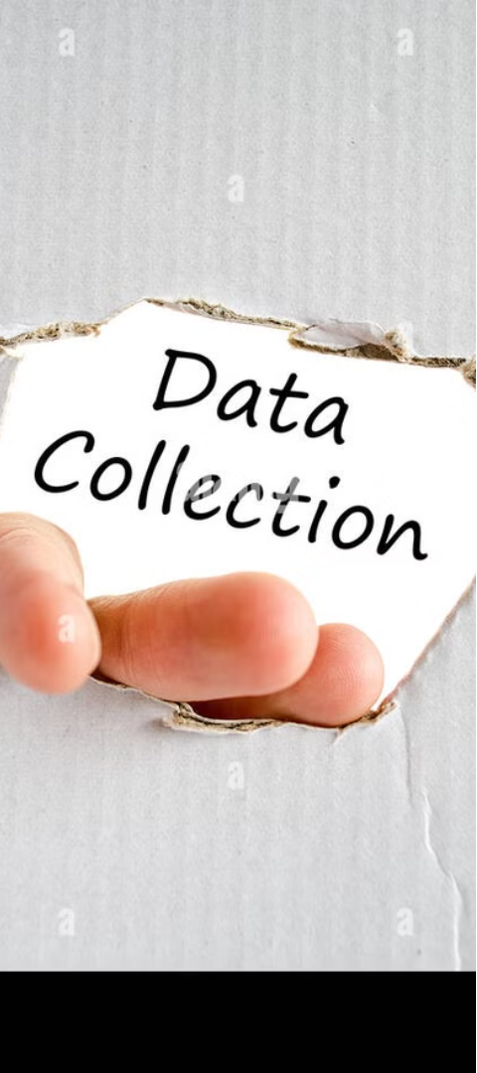
Research Procedure
1
Gathering of Data
Provide participants with the 3-page assessment handout. On page 1, provide instructions for the participants to follow. On page 2, have the participants complete the self-report questionnaire to assess their emotional state. On page 3, have the participants rewrite words and sentences in cursive handwriting style. Scan the completed 3-page assessment using the Flatbed Scanner to capture handwriting data. Then store the handwriting data in an appropriate file formats.
2
Treatment of Data
We'll preprocess the handwriting data, filter out irrelevant or erroneous data points, and extract relevant features like timing-based and ductus-based features. The data will be labeled with the corresponding emotional states based on the results verified by a psychologist.

Slide 16
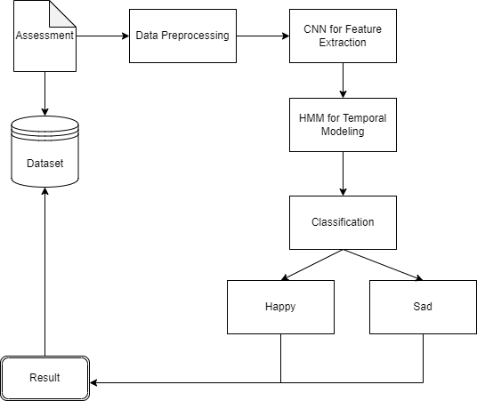
Conceptual Framework
  Preliminary Assessment: Participant will answer an assessment regarding to his/her current emotion.
  Data Collection: Varied and representative handwriting samples are gathered from participants.
  Data Preprocessing: Collected data is cleaned, normalized, and preprocessed for further analysis.
  Feature Extraction: Image processing techniques are applied to extract relevant features from preprocessed data.
  Model Design: CNNs are developed for feature extraction and HMMs for emotion classification.
  Model Testing: The combined CNN-HMM model is tested using cross-validation and performance metrics to establish its accuracy and effectiveness.
  Results and Discussion: Model performance is interpreted to provide implications and insights into potential applications or improvements.

Slide 17
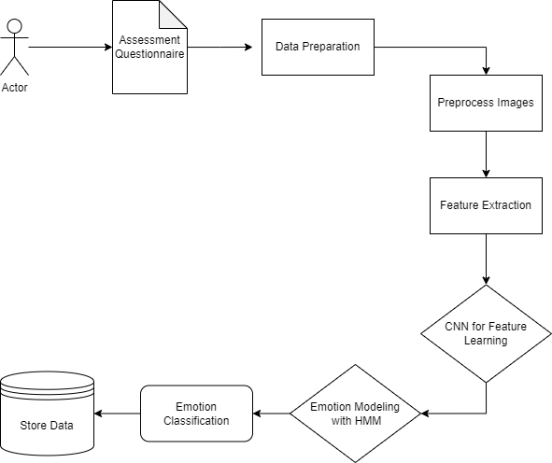
Analysis and Design Framework
  Preliminary Assessment and Data Preparation: The process commences with assessment analysis and data preparation.
  Feature Extraction using CNN: Pre-processed image data is fed into a CNN to extract features.
  Dynamic Modelling using HMM: Emotions are modelled as time-series using a Hidden Markov Model.
  Feature Combination and Classification: Extracted features and dynamic modelling are combined for the classification of emotions into two categories such as happiness, and sadness.
  Result: The system identifies and classifies emotions and could be useful in human-computer interaction and emotional intelligence analysis.

Slide 18
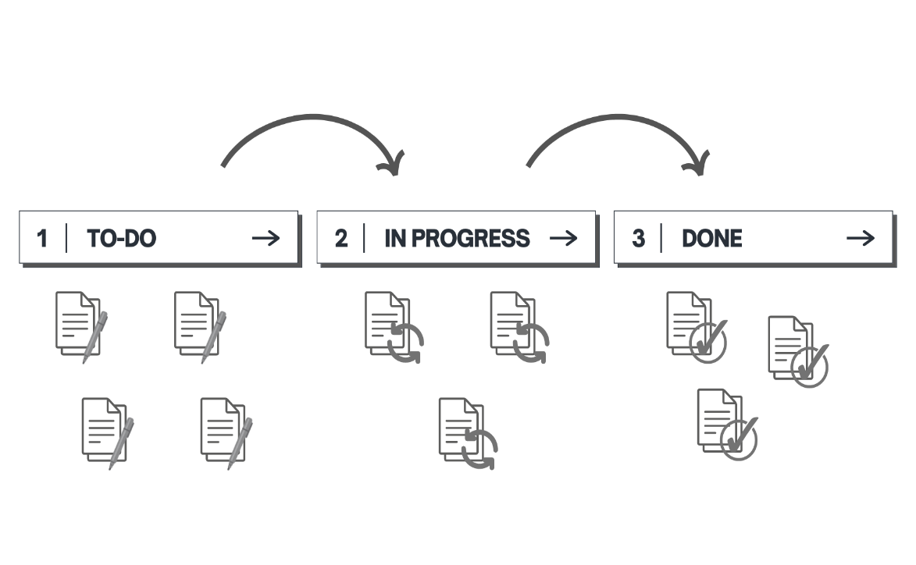
Development Model
KANBAN
Flexible and adaptable to individual pace.
Effective in continuous-flow environments like research.
Promotes self-organization, reflection, and focus.
Provides project visibility and low-cost implementation.
KANBAN for Research Management
To Do: Holds all tasks and requirements for planning and prioritization.
Visualizes tasks and progress in a structured way.
Breaks down projects into manageable units.
In Progress: Tracks actively worked-on tasks and revisions.
Allows for custom columns to fit research needs.
Done: Provides a sense of accomplishment and displays completed milestones.
Benefits for Solo Researcher
Easy progress tracking and bottleneck identification.
Informed decision-making throughout the research lifecycle.
Enhanced productivity and structured project approach.

Slide 19
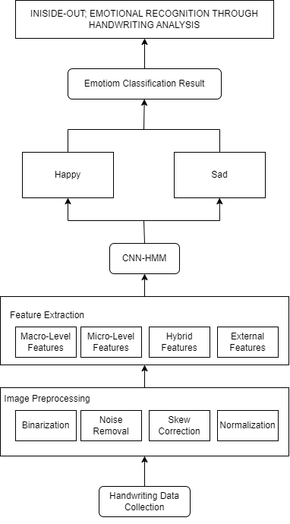
Development Approach Framework
  Data Collection: Handwriting samples are gathered with the annotation of self-reported emotions and controlled emotion induction experiments.
  Data Pre-processing: Raw data is pre-processed using image processing techniques to help in feature extraction.
  Feature Extraction: Macro-level (slant, spacing), micro-level (letterforms, strokes) and hybrid features are extracted from pre-processed data along with self-reported emotions or induced emotions.
  Feature Training and Testing: Features are fed into a CNN-HMM model for training and testing to understand the relationship between handwriting characteristics and emotional states.
  Emotion Classification: The trained model classifies handwriting samples into five categories such as happiness and sadness.

Slide 20




Software Development Tools
Web Browsing
Coding and Version Control
Using Google Chrome as primary web browser for research, testing, and accessing online resources during the development process.
For coding, using Visual Studio Code for utilizing a powerful and versatile code editor. Also using GitHub for version control, allowing us to collaborate effectively and track changes throughout the project.
Machine Learning and Image Processing
Python Development and Machine Learning
To support our machine learning and deep learning efforts, I'll be leveraging TensorFlow. Additionally, I'll be using OpenCV for image processing tasks. These tools will be crucial for the computer vision aspects of the project.
For Python programming needs, I'll be using PyCharm, an integrated development environment (IDE) that provides a comprehensive set of tools and features. I'll also be utilizing Scikit-learn for our machine learning tasks.

Slide 21

Project Management
Gantt Chart of Activities, Second Semester, A.Y. 2023 – 2024

Slide 22

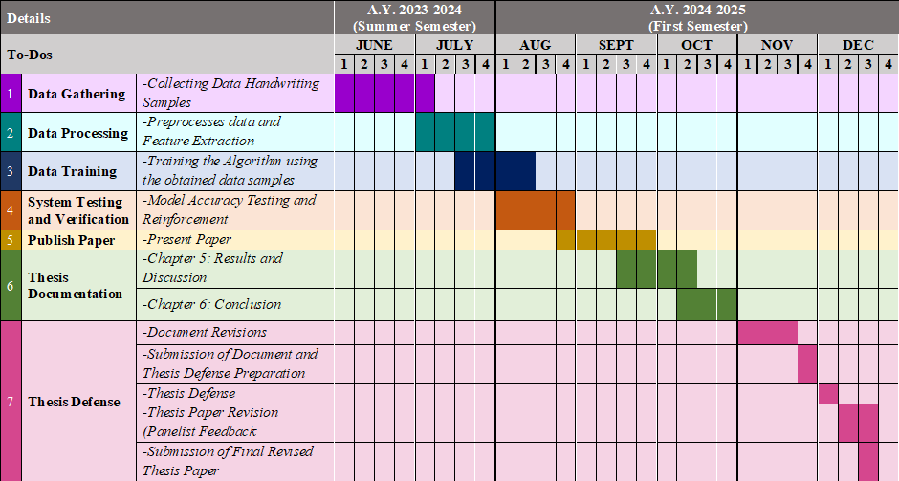
Gantt Chart of Activities, Summer Term, A.Y. 2023-2024 and First Semester, A.Y. 2024 – 2025

Slide 23
Budget and Cost Management
Items | Cost
Laptop (LENOVO ideapad 310S) | 32,000.00
Scanner (CANON Flatbed Scanner LiDE 300) | 4,000.00
Conference Fees (includes the Conference Registration Fee, Airfare, Accommodation, etc.) | 50,000.00
Miscellaneous | 10,000.00
TOTAL | 96,000.00
Table of Expenses

Slide 24
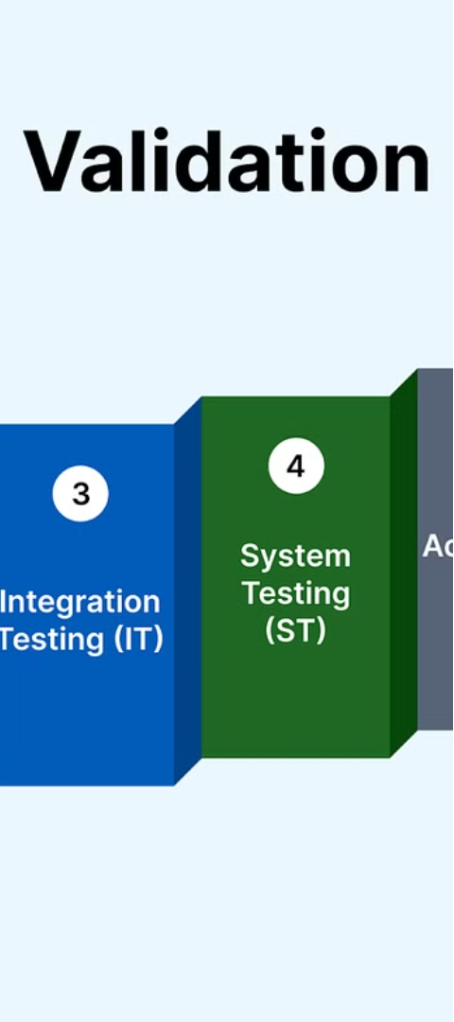
Verification, Validation, and Testing
Accuracy and Reliability
Psychological Validation
Validating and verifying the system's performance using benchmarks and metrics acknowledged in previous work like EMOTHAW, TEmoDec, and others. Test the emotion classification accuracy on a large dataset of handwriting samples from different demographics, handwriting styles, and emotional states.
Involving a professional psychologist to validate the psychological underpinnings and real-world applicability of the system. They'll review the emotion induction techniques, self-report measures, and assess the system's performance in recognizing emotions accurately.
Cross-Validation
We'll use stratified k-fold cross-validation to evaluate the performance of the hybrid CNN-HMM algorithm, splitting the dataset into k folds and iteratively training and testing on different folds. We'll calculate evaluation metrics like the F1-score for individual emotion classes, macro-averaged F1-score, and classification accuracy.

Slide 25
T H A N K Y O U
For Listening!

