Slide 1

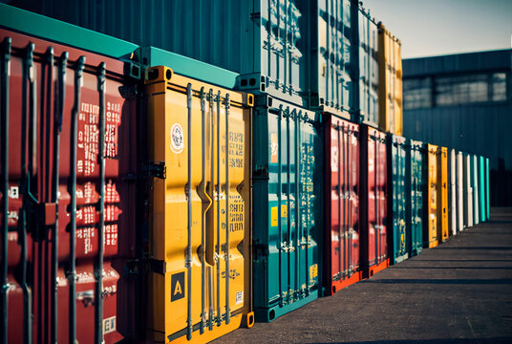

Byte Me
Gay Ming Kai, Chin Wei Hao, Christopher Lim Wai Ming

Slide 2









Byte Me’s Executive Summary
Theme 1
Problem
Relevancy to PSA
An AI-driven solution to enhance port resilience and efficiency, reinforcing PSA’s role as a reliable partner in global supply chain amidst increasing volatility.
Singapore's port is experiencing increased delays and longer vessel stays, causing supply chain disruptions and potential financial losses.
Enhance port effiency
Enhance port resilience
Ensure high system uptime
In the rare event of system downtime
PSA Operation remain unaffected
Contingency plans ensure functionality without disruption
Our Team
Solution
Ming Kai
Front End:
An UI developed in Pygame to showcase the algorithm developed for route planning.
Wei Hao
ML models & algorithms to predict the route and the congestion of the ports
Back End:
Chris
Data:
Open source-data from PSA website & naval topology
Notes:
This is the our executive summary of our solution for Code Sprint. As previously mentioned, we are doing theme 1 to come up with an AI-Driven solution to enhance port resilience and efficiency to reinforce PSA's role as a reliable partner in global supply chain.
The issue we are trying to solve is the issue with increased delays and longer vessel stays in our port causing chain disruptions and financial losses.
Our solution will be shown in an UI developed in Pygame while being driven by ML models & algorithms in the backend with open-source-data obtains from PSA Website & Naval topology.
This solution would help PSA by enhancing port effeciency and resilience alongside ensuring high system uptime.
Without further a do let us delve deeper into the project.

Slide 3
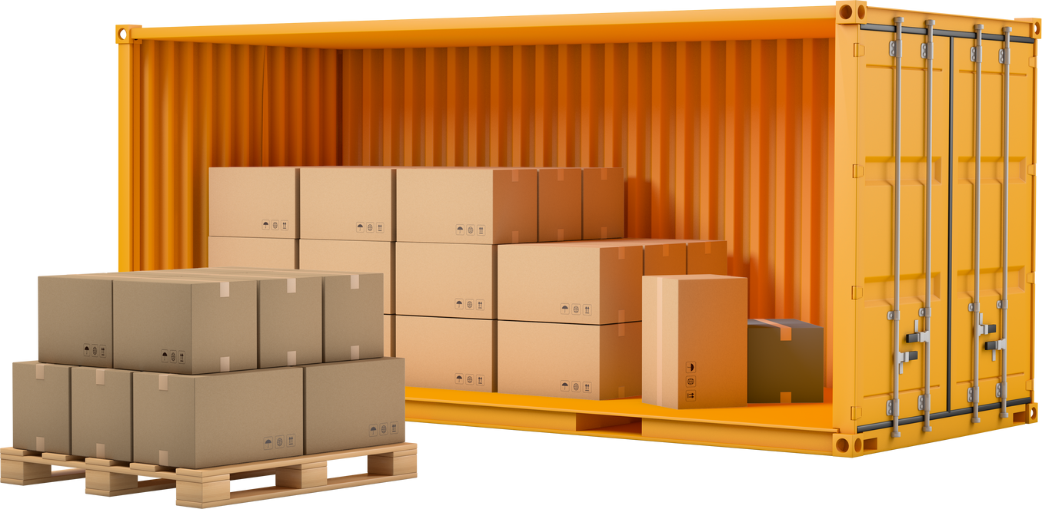
01. Problem statement
Singapore’s port has experienced significant delays, with 90% of container vessels arriving off-schedule, compared to an average of about 77% in 2023
Vessel port stays at PSA have also increased by 22% compared to the same period last year
These disruptions have a cascading effect on our supply chains which can lead to increased costs, inefficiencies and potential revenue losses for shareholders
Notes:
Starting with the problem statement.
Singapore's port has experienced significant delays with almost 90% of container vessels arriving off-schedule as of current data in 2024 compared to 77% last year.
Vessel ports that stays at PSA also have been reported to have increased by 22% compared to last year.
As such these disruptions will have a cascading effect on our supply chains which can lead to increased costs, inefficiencies and potential revenue losses for shareholders as such we decided to come up with a solution to tackle this.

Slide 4


Problem vs. solution
Problem
Solution
Vessels that come off schedule due to increase in demand and container re-handling
An algorithm which suggest container management using other ports for effective resource utilization

Slide 5

PSA Network
Connectivity
Reliabitity
PSA has established itself all over the world
PSA maintains delays through automation and AI-driven optimization.
Multimodal Services
Resilience
PSA uses multiple modes of transportation and channels
Node-To-Network enhances the flexibility of their global port network

Slide 6


PSA Process
01
02
03
04
Request
Pick-up
Process
Suggest
Submits a request for shipping services
Arranges for container pick-up from client’s facility
Process shipment details & calculate optimal shipping routes
Provide the client with optimal route and delivery schedule

Slide 7
Our Solution (Prototype)
Components | Language | Description
Front-End | Python (Pygame) | Interactive UI showcasing the algorithm
Back-End | Python (Scikit Learn) | Logistic Regression predicting the weights
Data | Excel Spreadsheet | Obtained open source data of PSA Ports and Naval Topology

Slide 8
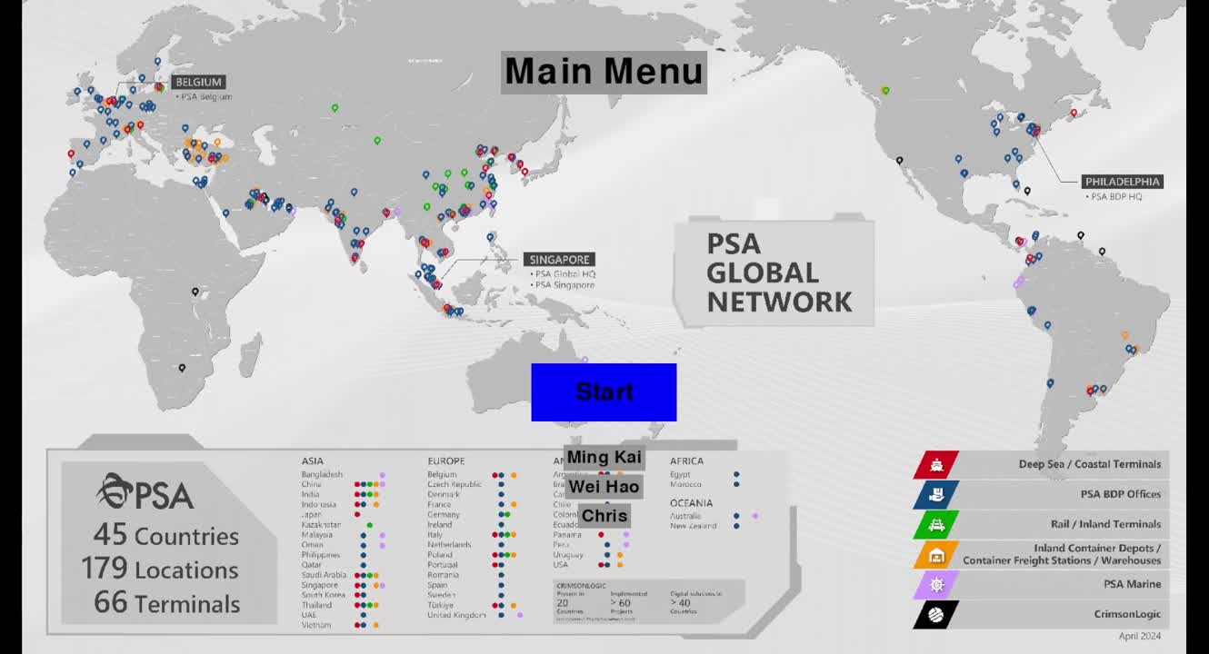
Working Example

Slide 9
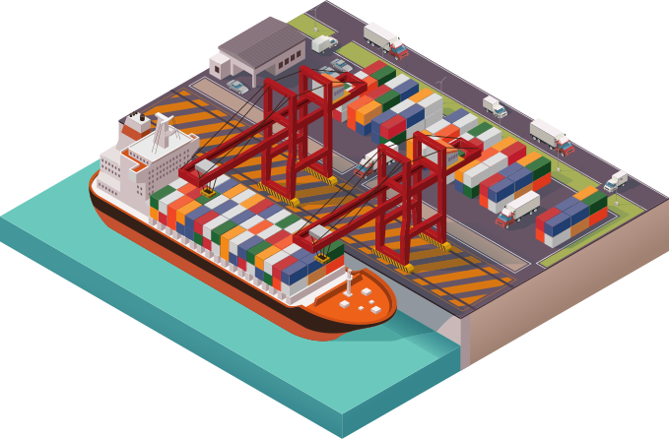
Relevancy To PSA
Accurate: Real time data instead of Arbitrary data
Efficient: Allows for ports to be utilized to their fullest potential
Resilient: During crisis that can disrupt operations, the algorithm mitigates the damage

Slide 10




Future Timeline
Phase 1: Integration & Data Expansion
Phase 2:
Advance Predictive Analytics
Phase 3:
PSA Leadership and Global Influence
Phase 4: Predictive Maintenance and Ecosystem Expansion
Integrate with global ports
More data collections and analysis
Enhancing predictive accuracy
Algorithm Optimization
PSA as the leading innovator in AI-driven port management
Setting industry standards
Expansion into predictive maintenance
Global Port Network Ecosystem
PSA as a hub

Slide 11
References
https://www.globalpsa.com/global-network/#ports
https://mykn.kuehne-nagel.com/news/article/psa-establishes-joint-venture-for-middle-corr-31-May-2023
https://psabdp.com/what-we-do/transportation-services/rail-multimodal-solutions
https://www.channelnewsasia.com/singapore/shipping-delays-freight-rates-containers-ports-asia-singapore-congestion-e-commerce-4371021
https://www.psaannualreport.com/chapter-page/#global-footprint

