Slide 1
The Technology Value Stream
By Noah McCarthy

Slide 2

What is the Technology Value Stream
Value Stream Mapping is charting the path of information, materials, and other resources throughout the process of creating and delivering a product.
It focuses on this essential information:
Time spent working and waiting at each step
Labor required for each step
Error rates at each step
Downtime experienced along the value stream
Bottlenecks and process delays at each step
What are the Steps?
Define Scope
Map the steps in the value stream
Map information flow
Collect Data
Create a Timeline

Slide 3
Common value stream metrics
Flow velocity
Flow load
Flow time
Flow efficiency
Lead time
Mean time to remediation (MTTR)
Change failure rate (CFR)
Deployment Frequency

Slide 4

Processing time
This is the amount of time working on a request
This is only what the developer experiences
This does not include the time spent in queues
This is more so a drop in the bucket of the entire process

Slide 5
Lead Time
This is the total amount of time from when a request is made until it is fulfilled
This is the time that the customer experiences
It also includes time spent waiting in queues
How to decrease this?
Reduce Batch sizes
Automation
Fast feedback
Frequent deployments
No chains of approvals

Slide 6
The Common scenario
The average large company can take months to deploy software
The main reasons for this are due to these scenarios: Large batches of changes
Little integration test environments
Heavy reliance on manual testing
Poor team communication
Chains of approval

Slide 7
The ideal scenario
The ideal scenario is that your change goes from the development phase to production in minutes with the bad scenario taking hours.
The process looks like this:
Design small change
Add it into version control
Use automation tools to build and test it
Deploy it
Observe result in production
Adjust any problems if they arise
The practices to follow look like this:
Automation
Version Control
Small batches of code
Continuous integration

Slide 8
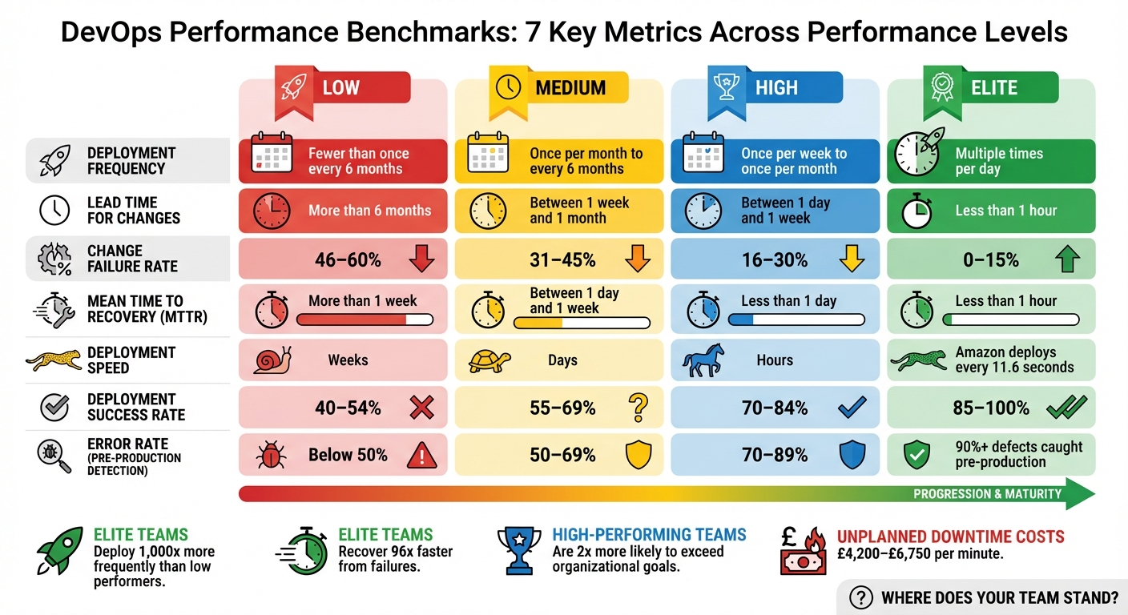
Months vs Minutes

Slide 9
Sources
Kim, G., Humble, J., Debois, P., & Willis, J. (2021). The DevOps Handbook: How to Create World-Class Agility, Reliability, & Security in Technology Organizations (2nd ed.). IT Revolution.
Quiroz-Vázquez, C. (n.d.). What is value stream management? IBM. https://www.ibm.com/think/topics/value-stream-management

