Slide 1

Hadoop Basic Components
• Hadoop Common - libs and utilities
• Hadoop Distributed File System (HDFS)
• Hadoop MapReduce - a programming model for large data set processing
• Hadoop YARN - a resource management platform, scheduling

Slide 2

HDFS Design Concept
• Scalable distributed file system
• Distribute data on local disks on several nodes
• Low cost commodity hardware
Node 1
Node 2
Node n
B1
B2
Bn

Slide 3
HDFS Design Factors
• Hundreds/Thousands of nodes =>
• Need to handle node/disk failures
• Portability across heterogeneous hardware/software
• Handle large data sets
• High throughput

Slide 4
Approach to meet HDFS design goals
• Simplified coherency model - write once read many.
• Data Replication - helps handle hardware failures
• Move computation close to data
• Relax POSIX requirements - increase throughput

Slide 5
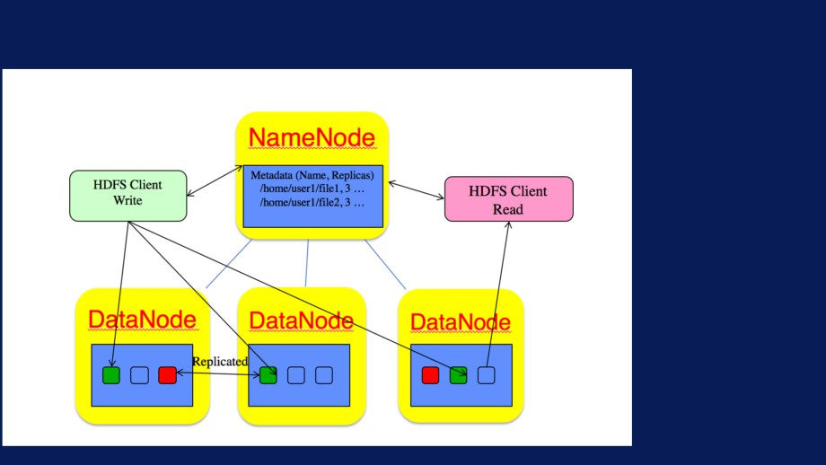
HDFS Architecture

Slide 6

HDFS block size
• Default block size is 64MB
• Good for large files!
• So a 10GB file will be broken into: 10x1024/64 = 160 blocks.
Node 1
Node 2
Node n
B1
B2
Bn

Slide 7
Large #small files: Impact on NameNode
• Memory usage ~ 150 bytes per object
1 billion objects => 300GB memory!
• Network load - Number of checks with data nodes proportional to number of blocks.

Slide 8
HDFS optimized for large files
• Key takeaway - lots of small files is bad!
• Solutions:
• Merge/Concatenate files
• Sequence files

Slide 9
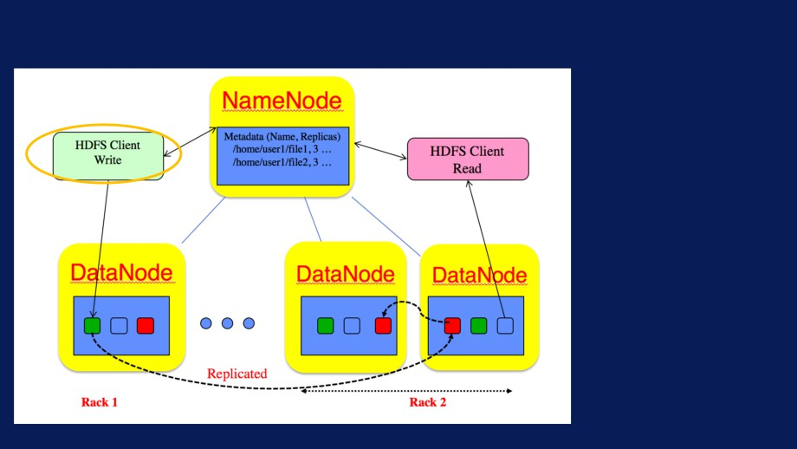
Write Process in HDFS
Client request
to create file

Slide 10
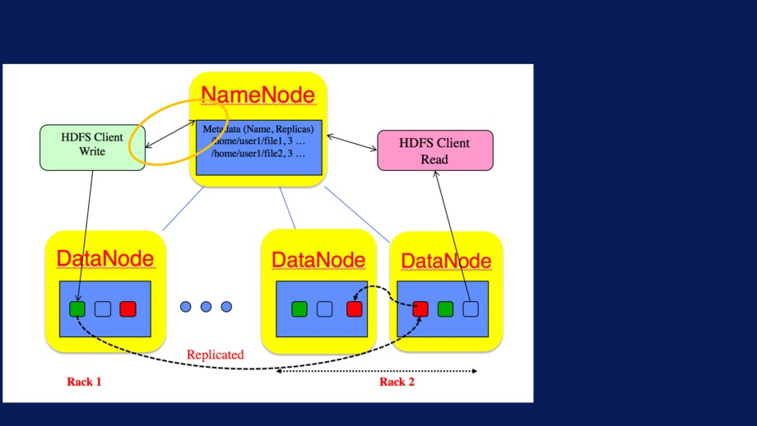
Write Process in HDFS
NameNode
contacted
once a block of data is
accumulated

Slide 11
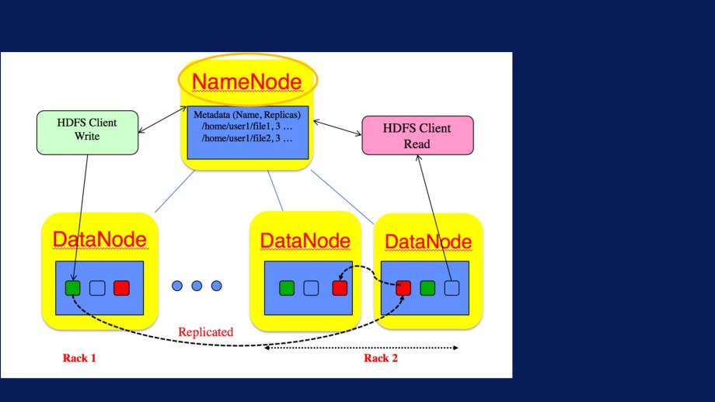
Write Process in HDFS
• NameNode
responds with list of
DataNodes
• Rack aware

Slide 12

Write Process in HDFS
• First DataNode
receives data, writes to local and forwards to second
DataNode

Slide 13

Write Process in HDFS
• First DataNode
receives data, writes to local and forwards to second
DataNode

Slide 14

Write Process in HDFS
• NameNode
commits file creation into persistent store.
• Receives
heartbeat and block reports

Slide 15

Read Process in HDFS
• Client gets
DataNode list from
NameNode
• Read from
replica closest to reader.

Slide 16

HDFS Commands
• Invoked via /usr/bin/hdfs script.
• User commands - filesystem shell commands for routine operations.
• Details at:
https://hadoop.apache.org/docs/current /hadoop-project-dist/hadoop-hdfs/HDFSCommands.html

Slide 17

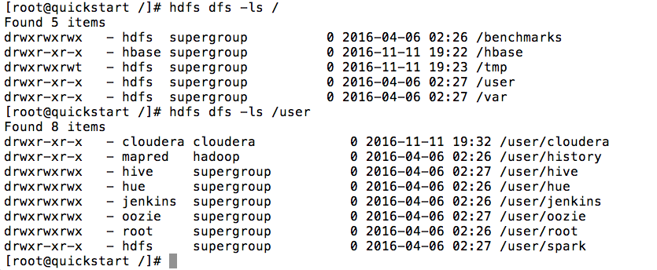
HDFS Commands
• hdfs dfs -ls /...

Slide 18
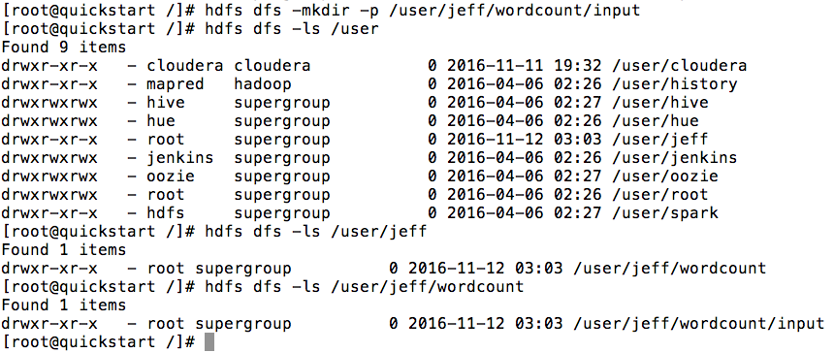
HDFS Commands
• hdfs dfs -mkdir -p /user/jeff/wc/input

Slide 19
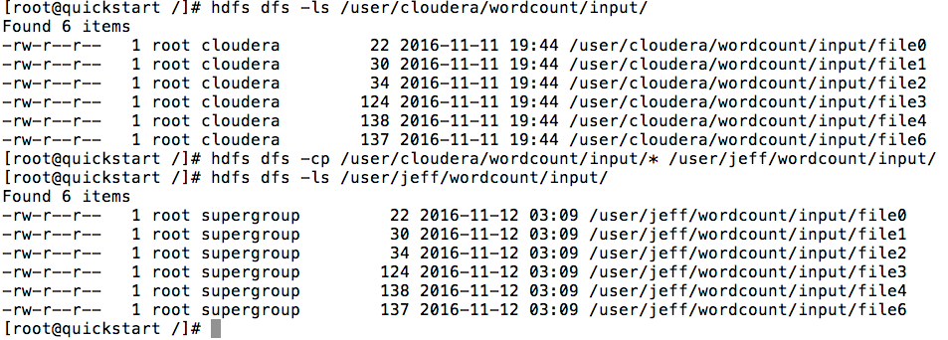
HDFS Commands
• hdfs dfs -cp source target

Slide 20
HDFS Commands
• hdfs dfs -cp source target

Slide 21
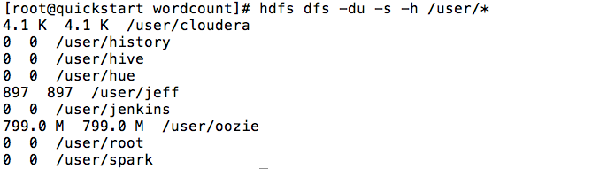
HDFS Commands
• hdfs dfs -du -s -h path

Slide 22
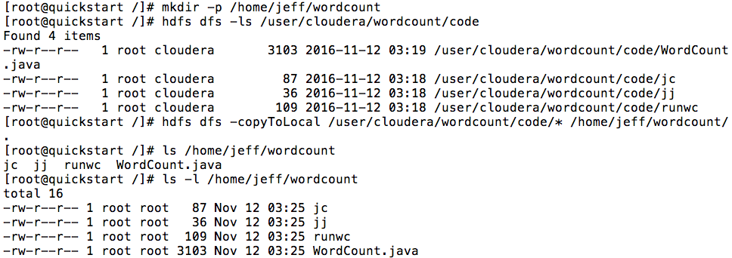
HDFS Commands
• hdfs dfs -copyToLocal source target

Slide 23
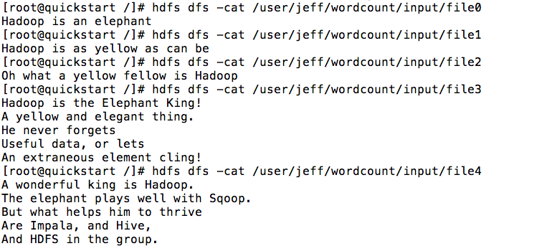
HDFS Commands
• hdfs dfs -cat path-to-file

Slide 24

HDFS User Commands
Command
Description
Command
Description
-ls path Lists contents of directory
-get src localDest Copy from HDFS to local
filesystem
-lsr path Recursive display of
contents
-cat filename Display contents of HDFS
file
-du path Shows disk usage in bytes
-tail file Shows the last 1KB of
-dus path Summary of disk usage
HDFS file on stdout
-chmod [-R] Change file permissions in
-mv src dest Move files or directories
HDFS
within HDFS
-chown [-R] Change ownership in HDFS
-cp src dest Copy files or directories
within HDFS
-help Returns usage info
-rm path
Removes the file or empty
directory in HDFS
-rmr path
Recursively removes file
or directory
-put localSrc dest
Copy file from local
(Also -copyFromLocal)
filesystem into HDFS

Slide 25
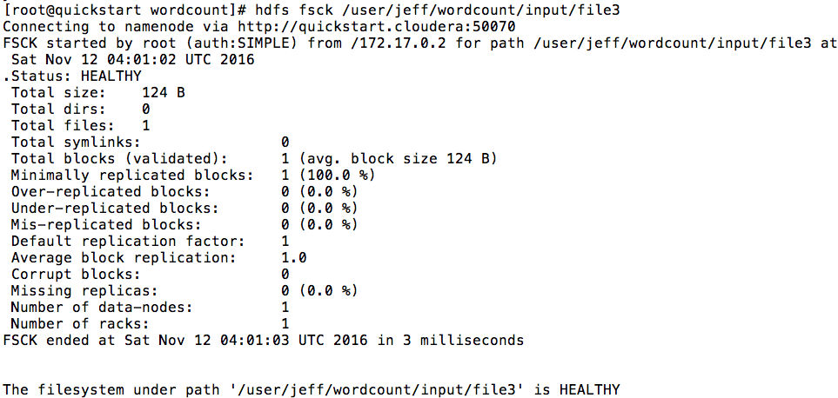
hdfs fsck path-to-file

Slide 26
Overview
• Base class:
org.apache.hadoop.fs.FileSystem
• Important classes:
FSDataInputStream FSDataOutputStream
• Methods:
get, open, create

Slide 27
FSDataInputStream Methods
• read : read bytes
• readFully : read from stream to buffer
• seek: seek to given offset
• getPos: get current position in stream

Slide 28
FSDataOutputStream Methods
• getPos: get current position in stream
• sync: flush out the data in client's user buffer.
• close: close the underlying output stream.

Slide 29
Reading from HDFS using API
• get an instance of FileSystem
FileSystem fs = FileSystem.get(URI.create(uri),conf);
• Open an input stream
in = fs.open(new Path(uri));
• Use IO utilities to copy from input stream
IOUtils.copyBytes(in, System.out,4096,false);
• Close the stream
IOUtils.closeStream(in);

Slide 30
Writing to HDFS using API
• get an instance of FileSystem
FileSystem fs = FileSystem.get(URI.create(outuri),conf);
• Create a file
out = fs.create(new Path(outuri));
• Write to output stream
out.write(buffer, 0, nbytes);
• Close the file
out.close();

Slide 31
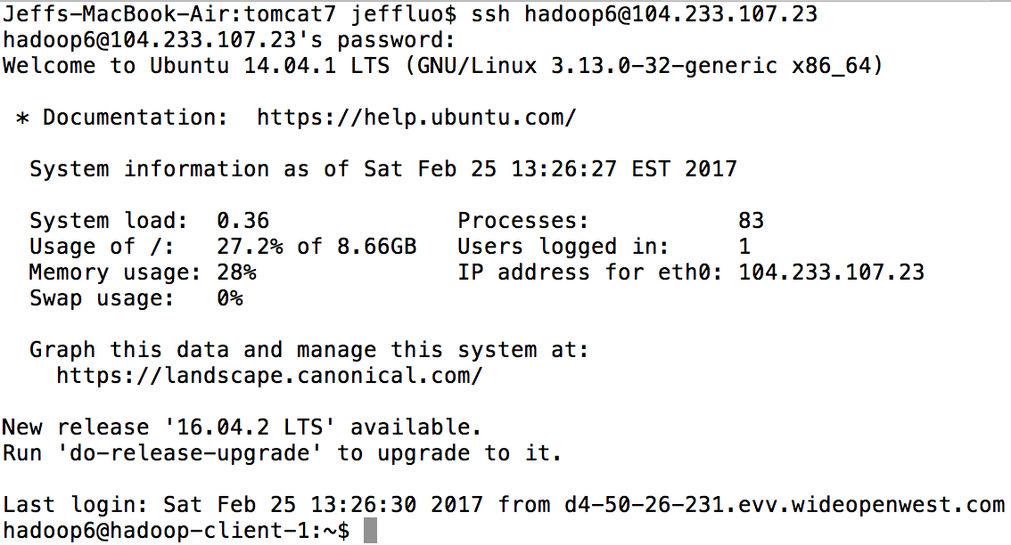

Slide 32
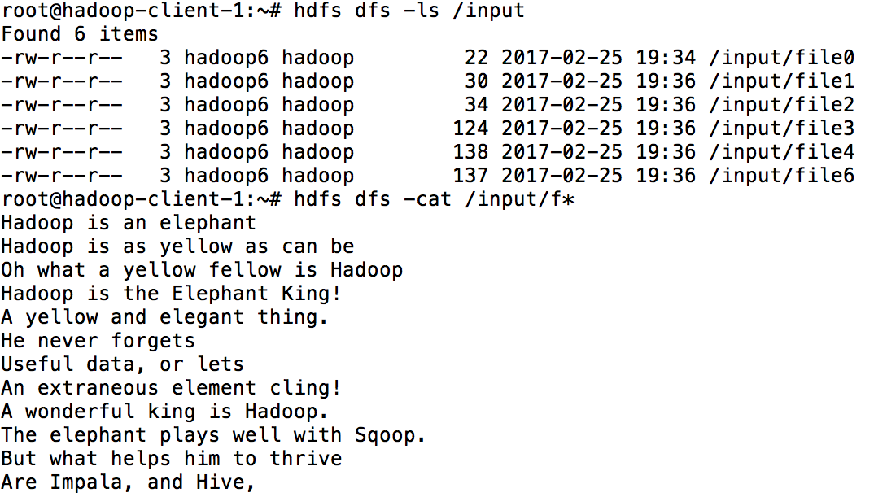

Slide 33
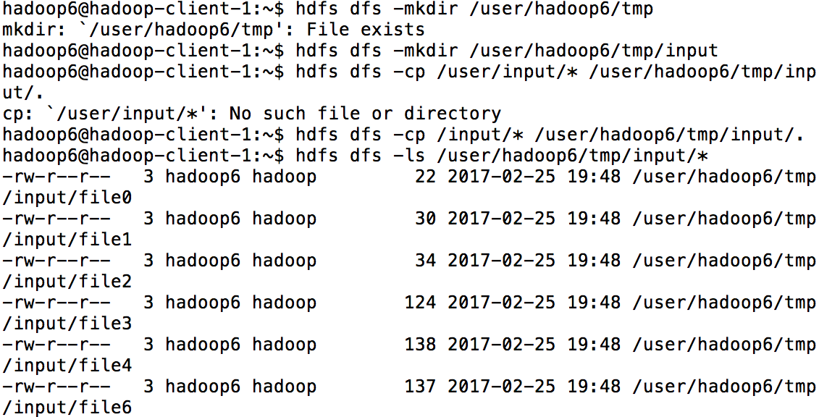

Slide 34
