Slide 1

Original HDFS Design
• Single NameNode - a master server that manages the file system namespace and regulates access to files by clients.
• Multiple DataNodes - typically one per node in the cluster. Functions:
• Manage storage
• Serving read/write requests from clients
• Block creation, deletion, replication
based on instructions from NameNode

Slide 2
HDFS Federation
• Multiple Namenode servers
• Multiple namespaces
• Block pools
• High Availability - redundant NameNodes
• Heterogeneous Storage and Archival Storage
• ARCHIVE, DISK, SSD, RAM_DISK

Slide 3
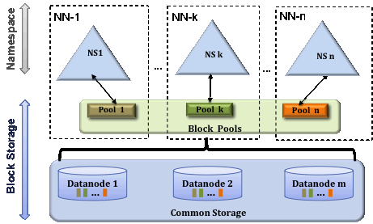

Slide 4
Federation: Benefits
• Allows namespace scaling
• Scales up filesystem read/write throughput
• Isolation

Slide 5

Application programming interfaces
• Native Java API : Base class
org.apache.hadoop.fs.FileSystem
• C API for HDFS: libhdfs, header file (hdfs.h)
• WebHDFS REST API: HTTP Get, Put, Post, and Delete operations

Slide 6
Enabling WebHDFS
In hdfs-site.xml
• dfs.webhdfs.enabled
• dfs.web.authentication.kerberos.principal
• dfs.web.authentication.kerberos.keytab

Slide 7
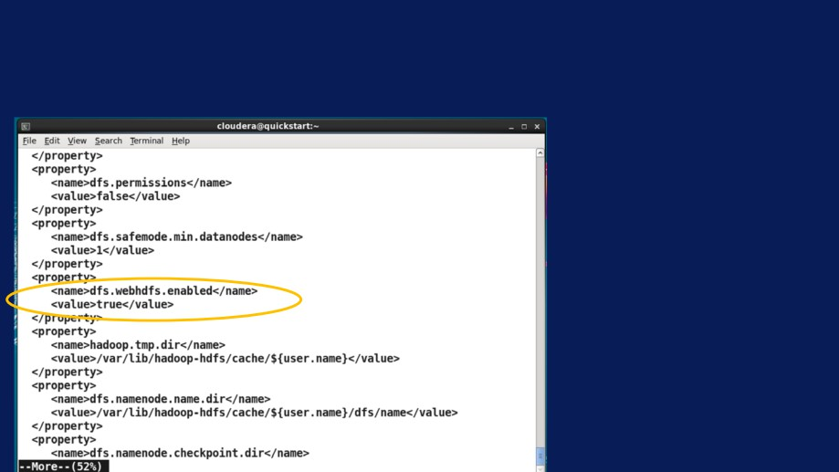
hdfs-site.xml
Command: more /etc/hadoop/conf/hdfs-site.xml

Slide 8
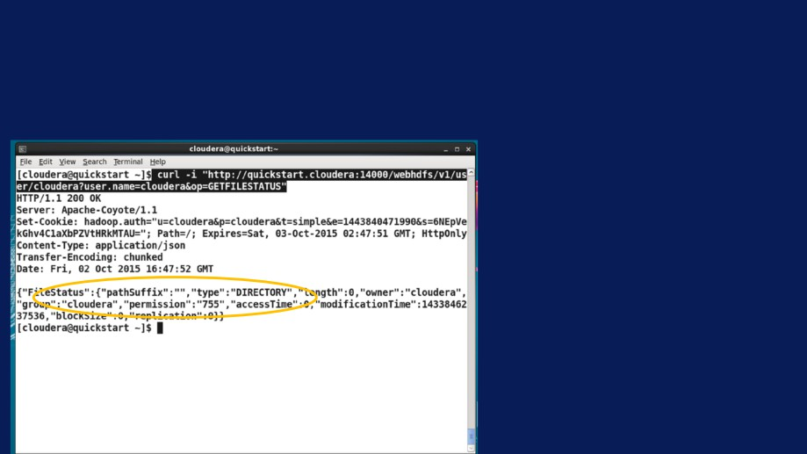
HTTP GET requests
curl -i
"http://quickstart.cloudera:14000/webhdfs/v1/user/cloudera?user.name =cloudera&op=GETFILESTATUS"

Slide 9
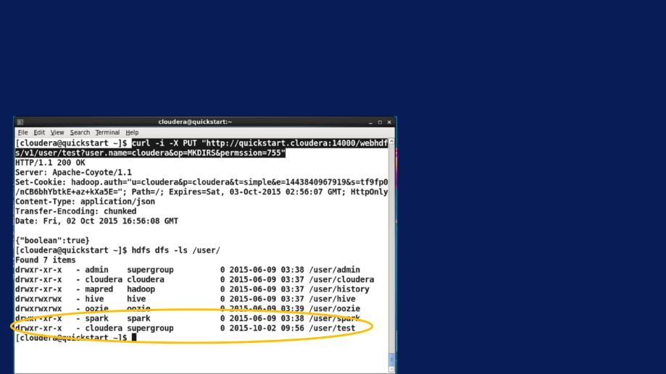
HTTP PUT requests
curl -i -X PUT
"http://quickstart.cloudera:14000/webhdfs/v1/user/test?user.name=clou dera&op=MKDIRS&permssion=755"

Slide 10
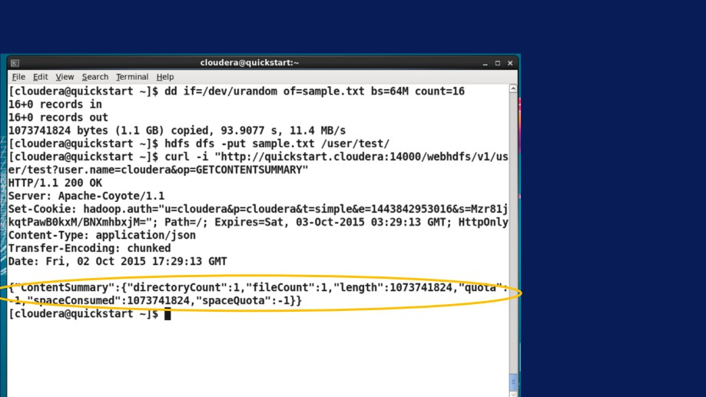
HTTP GET request on status

Slide 11
HTTP Operations
• HTTP GET: file status, checksums, attributes
• HTTP PUT: create, change ownership, rename, permissions,snapshot
• HTTP POST: append, concat
• HTTP DELETE: Delete files, snapshot

Slide 12
Several other options!
• Apache Flume - collecting,
aggregating streaming data and moving into HDFS
• Apache Sqoop - Bulk transfers between Hadoop and datastores.

Slide 13
Applications using HDFS
• Can use APIs to interact with HDFS
• Core component of Hadoop stack - used by all applications
• HBase is a good example of an
application that runs on top of HDFS with good integration
• Spark can run directly on HDFS without other Hadoop components

Slide 14
Overview of HDFS Tuning
• Tuning parameters
• DFS Block Size
• NameNode, DataNode system/dfs parameters.

Slide 15
HDFS Block Size
• impacts NameNode memory,
number of maps tasks, and hence performance.
• 64MB is the default. Can be changed based on workloads. Typically bumped up to 128MB.
• dfs.blocksize, dfs.block.size

Slide 16
HDFS Replication
• Default replication is 3.
• Parameter: dfs.replication
• Tradeoffs:
• Lower it to reduce replication cost
• Less robust
• Higher replication can make data local to more workers
• Lower replication => more space

Slide 17

Lot of other parameters!
• Various tunables for datanode, namenode. Examples:
• dfs.datanode.handler.count (10): Sets the
number of server threads on each datanode.
• dfs.namenode.fs-limits.max-blocks-per-file: Maximum number of blocks per file.
Full list:
http://hadoop.apache.org/docs/current/hadoop-project- dist/hadoop-hdfs/hdfs-default.xml

Slide 18
Performance & Robustness
• How robustness is achieved
• Performance improvement and possible impact on robustness

Slide 19
Common Failures
• DataNode Failures: Server can fail, disk can crash, data corruption.
• Network Failures
• NameNode Failures: Disk failure, node failure

Slide 20
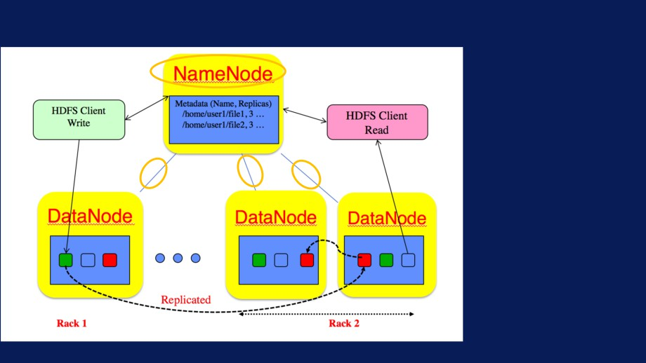
HDFS Robustness
• NameNode
receives
heartbeat and block reports from
DataNodes

Slide 21
Mitigation of common failures
• Periodic heartbeat: from
DataNode to NameNode.
• DataNodes without recent heartbeat:
• Marked dead, no new IO sent
• Blocks below replication factor re-replicated on other nodes.

Slide 22
Mitigation of common failures
• Checksum computed on file creation
• Checksums stored in HDFS namespace.
• Used to check retrieved data, re-read from alternate replica if need.

Slide 23
Mitigation of common failures
• Multiple copies of central
meta data structures.
• Failover to standby
NameNode - manual by default.

Slide 24
Example: Distributed copy
• Hadoop distcp allows parallel transfer of files.
• This example is from one of SDSC’s systems called Gordon.
• Copy 32 files and 512GB of data.
• Vary map and node counts, replication.

Slide 25

Distributed Copy, Replication=3
Nodes
#Map Tasks
Copy Rate
(MB/s)
8
2
183.64
16
2
220.57
16
4
276.09
16
8
387.51
32
8
618.99
32
16
779.03

Slide 26

Distributed Copy, Replication=1
Nodes
#Map Tasks
Copy Rate
(MB/s)
8
4
530.66
8
8
1018.03
16
8
793.17
16
16
1814.15
32
32
2995.93

Slide 27
Replication trade off w.r.t robustness.
• Reducing replication has a trade off w.r.t robustness:
• Might lose a node or local disk during the run - cannot recover if there is no replication.
• If there is data corruption of a block from one of the datanodes - again cannot recover without replication.
• Just one example. Other parameter changes can have similar effects. For example we saw with block size changes you can impact Namenode

