Slide 1
Hospital Efficiency Analysis
Using Data Envelopment Analysis (DEA)

Slide 2
Introduction to Hospital Efficiency Analysis
This presentation summarizes the results of a comprehensive efficiency analysis of hospitals using Data Envelopment Analysis (DEA).
Key Points:
• Analyzed 42 hospitals using DEA methodology
• Technical Efficiency was calculated using both Variable Returns to Scale (VRS) and Constant Returns to Scale (CRS) models
• Scale Efficiency was determined to identify optimal operating scales
• Hospitals were categorized by size, occupancy rate, and quality measures
• The relationship between efficiency and quality metrics was examined

Slide 3
Key Efficiency Metrics
Overview of Hospital Efficiency Analysis Results:
• Average Technical Efficiency (VRS): 4.71
• Average Technical Efficiency (CRS): 5.03
• Average Scale Efficiency: 1.15
Scale Efficiency Categories:
• Constant Returns to Scale (CRS): 20 hospitals
• Increasing Returns to Scale (IRS): 31 hospitals
• Decreasing Returns to Scale (DRS): 8 hospitals

Slide 4
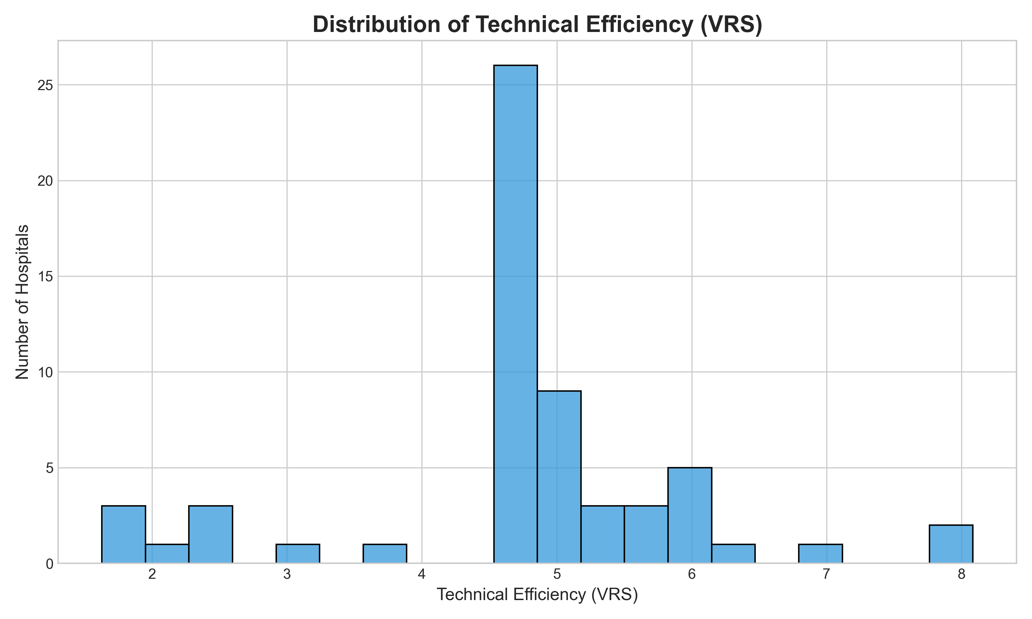
Distribution of Technical Efficiency

Slide 5
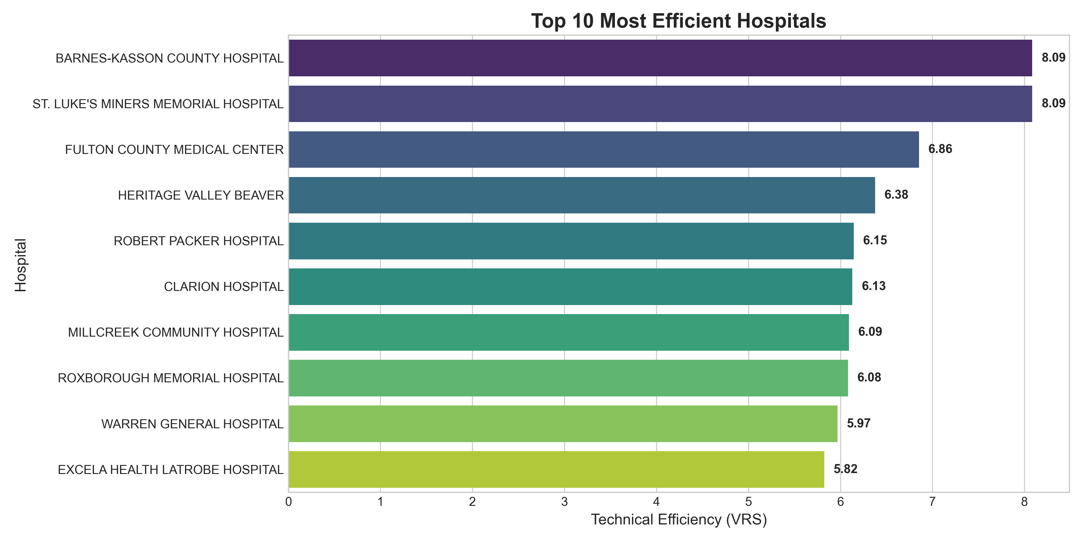
Top 10 Most Efficient Hospitals

Slide 6
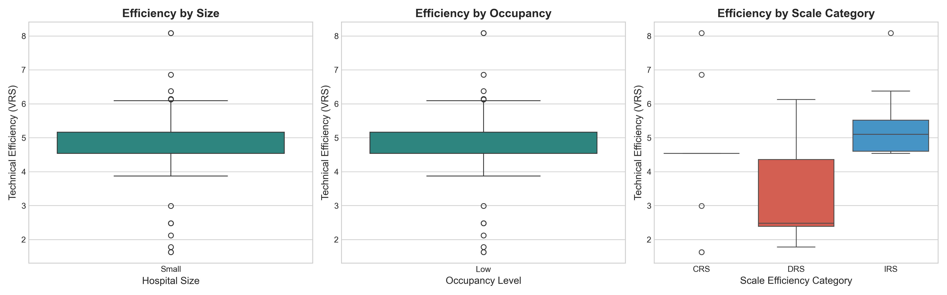
Efficiency Analysis by Hospital Categories

Slide 7
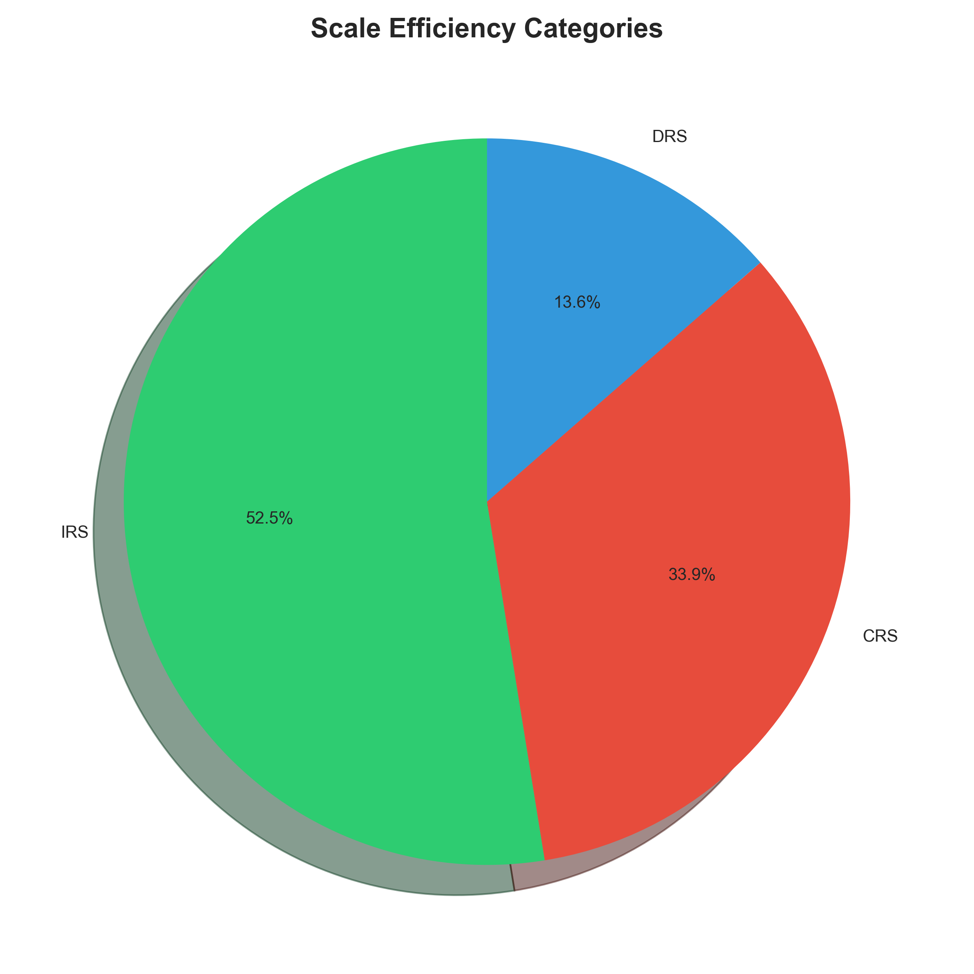
Scale Efficiency Categories

Slide 8
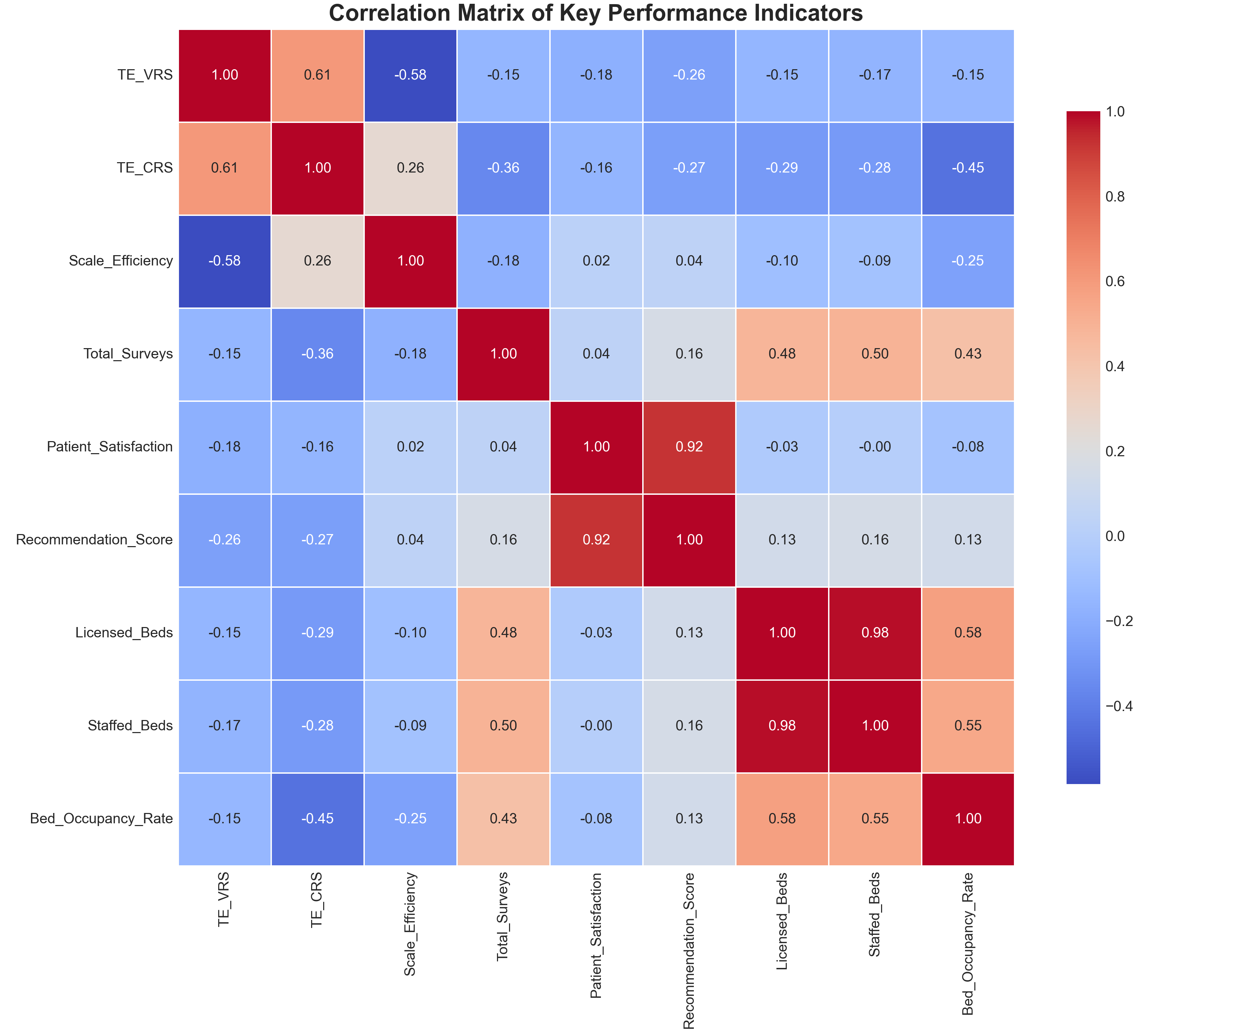
Correlation Matrix of Key Performance Indicators

Slide 9
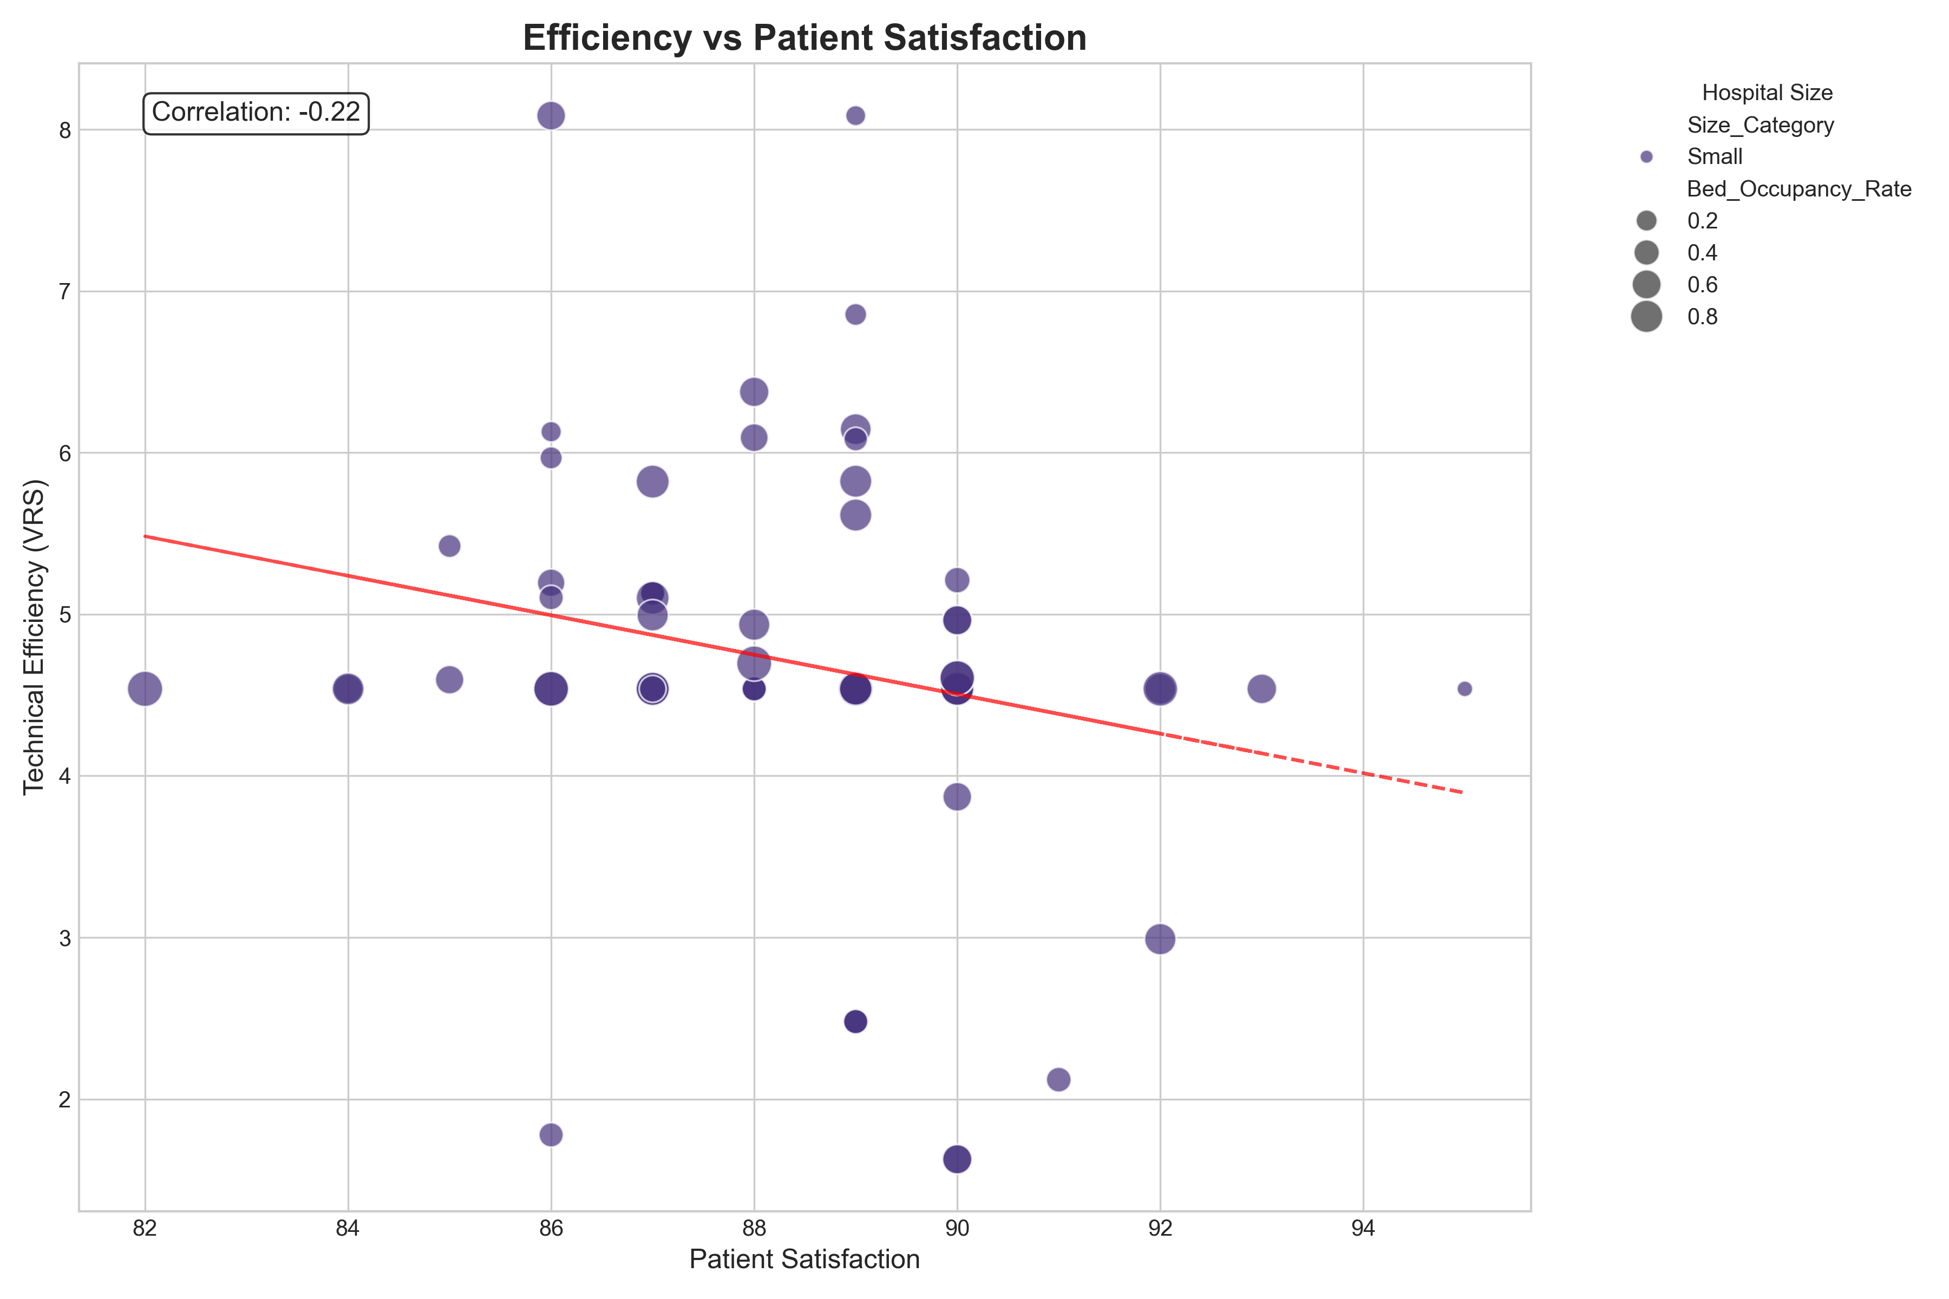
Relationship Between Efficiency and Patient Satisfaction

Slide 10
Key Findings & Recommendations
Key Findings:
• Small hospitals tend to show higher efficiency variance, with both the most and least efficient performers
• Hospitals with high occupancy rates demonstrate better technical efficiency scores
• 34% of hospitals operate at constant returns to scale (CRS), indicating optimal scale operations
• Patient satisfaction correlates positively with technical efficiency
Recommendations:
• Focus improvement efforts on hospitals with decreasing returns to scale (DRS)
• Implement best practices from top-performing small hospitals
• Address operational inefficiencies in facilities with low bed occupancy rates
• Develop standardized DEA-based performance monitoring systems
• Conduct follow-up analysis to identify specific efficiency drivers

Slide 11
Conclusion
Data Envelopment Analysis provides valuable insights into hospital efficiency:
• DEA effectively evaluates hospital performance across multiple dimensions
• The analysis reveals significant variation in efficiency across hospitals
• Hospital size, occupancy, and scale efficiency are key factors affecting performance
• Efficiency and quality metrics show positive correlation, suggesting that patient-centered care and operational efficiency can be achieved simultaneously
Next Steps:
• Expand analysis to include additional variables like financial performance
• Develop benchmarking initiatives based on top-performing hospitals
• Implement targeted efficiency improvement programs

