Slide 1



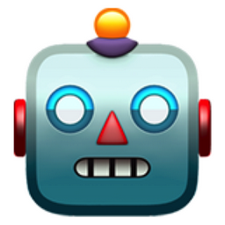
Revolutionizing Pet Games with
AI-Driven Interactions
MAR
Traditional pet games don’t capture
the UNPREDICTABILITY of the REAL
pet-owner relationship
gap gap gap
KET
...so we let AI react to it :з
almost cat huh?

Slide 2

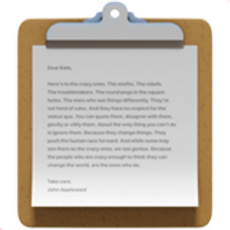

Sorry, what?
The AI hears you, sees you, smells you (maybe wash your paws).
It is common to interrogate the AI or do the detective work.
Let’s flip the script.
Let’s make AI try understand us.
That’s right.
You are the cat.
GOALS:
- snack
- get pets
- wreck havoc

Slide 3


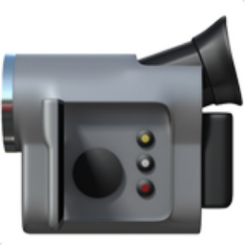
Purr-suit of Attention
by Eleventeen
KEY TAKEAWAY
Seeing an AI try to adapt
is so much more enjoyable
than trying to get it to
cooperate.
NO DEMO!
(or we would run out of moneys)
BUT
We videoed the little prototype we managed to hack together

Slide 4
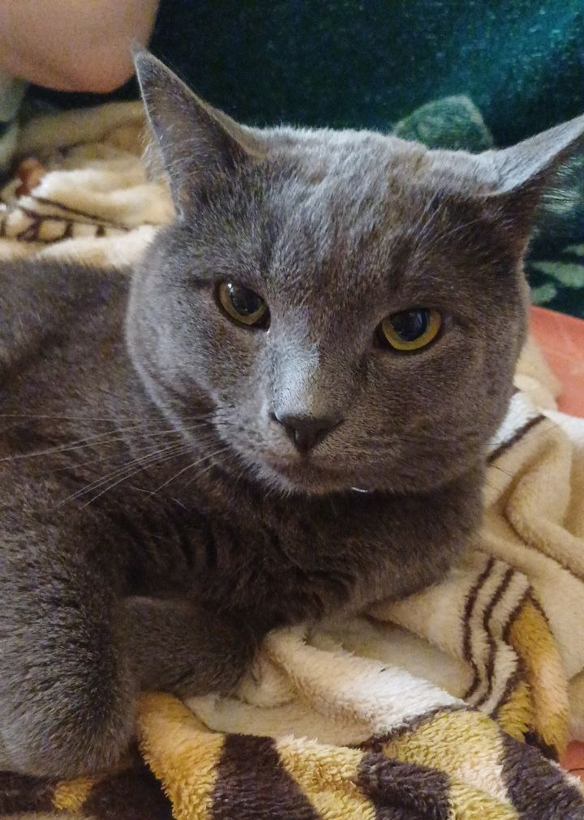
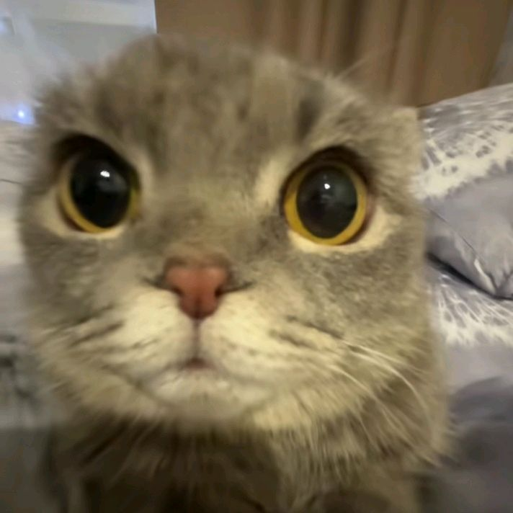
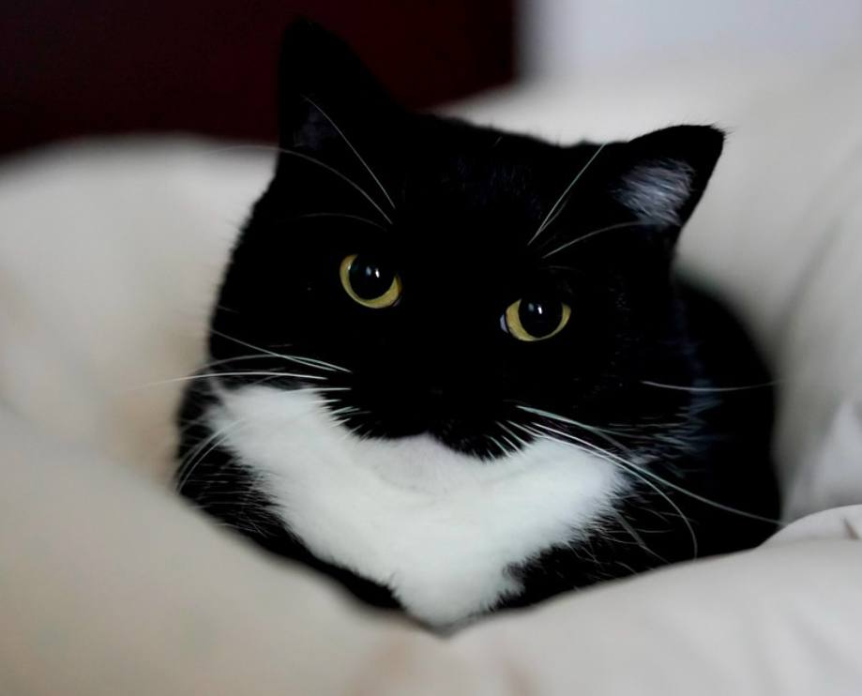

Jeff (3 yrs)
Unico (5 yrs)
Ashley (2.5 yrs)
from Cat people
to Cat people

