Slide 1

Data Engineering and Analysis of T-20 Cricket World cup
Creation of a new data set with the help of existing ones on
AWS Cloud

Slide 2

Meet our team: Team 2 Yegneshwar Rao Ginjupalli Sreeja Garlapati Srividhya Pasam Khalil Malik Muhammad

Slide 3
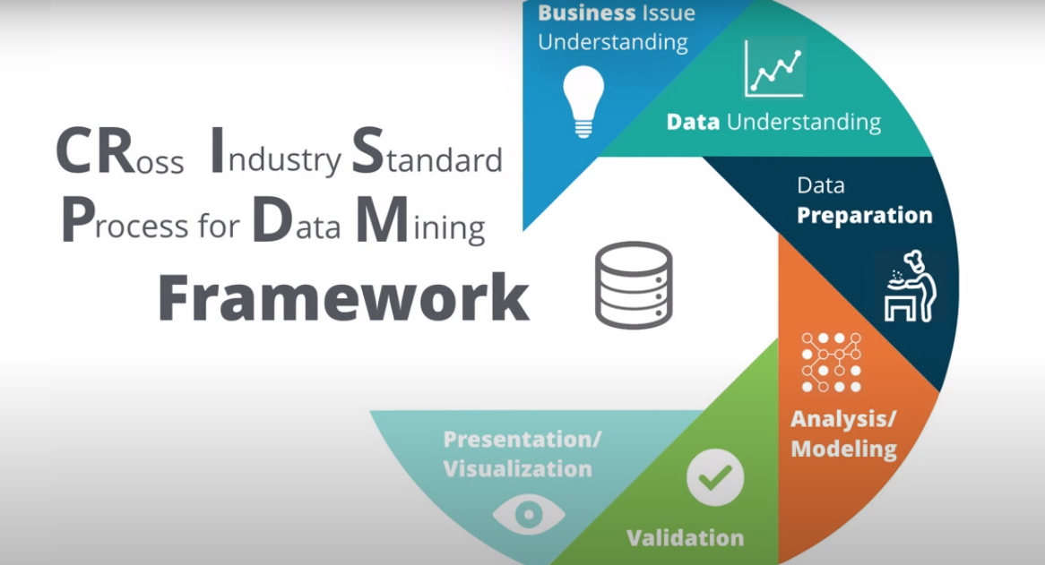
Methodology

Slide 4
Challenge:
To form a new cricket team for the Indian Premier League IPL.
From all the teams across the globe.
Based on the recent T-20 world cup performance data.
To win the IPL trophy.

Slide 5

Data Collection:
Data is obtained from web scrapping from the ESPN Cricinfo website.
Data is scrapped with the help of Bright Data Web Scrapping, a web application that uses AI for web scrapping the data.
Data Pre-processing:
Using python and Panda's library, the scrapped data is preprocessed so as to make the final data error-free.
Performed EDA to find the relation between the fields available in the data sets.
Data Model:
The processed data sets are then moved to AWS S3 (Simple Storage Service)
The Data Model is prepared using AWS Crawler.

Slide 6
Data Preparation:
The processed data which is in AWS S3 is then queried using AWS Athena to do with DDL (Data Definition Language) operations to create, alter and drop schema objects.
The final data set is then moved to AWS Redshift which is Amazon VPC which is a data lake.
Thus, done with the data engineering part.
Data Analysis and Visualization:
Data Analysis and Visualization are done using Power BI.
The performance of the players is analyzed and then visualized using the graphs and histograms to finalize the team of 11 members.

Slide 7



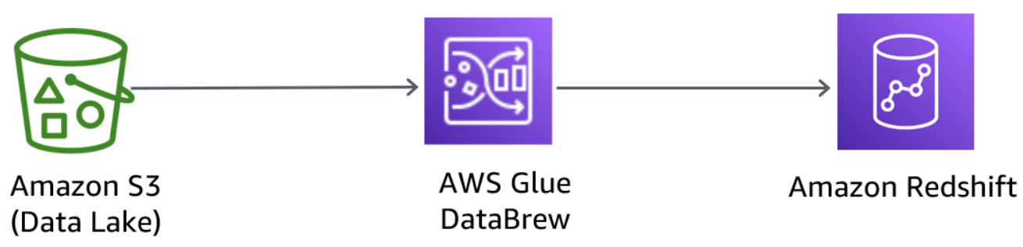



AWS Cloud:
Power BI
Crawler
Athena
Detailed Flow Chart

Slide 8
Out Put:
?
?
?
?
?
?
?
?
?
?
?

Slide 9

Thank You!!!

