Slide 1
Metrics for Searches air_cargo_p1
 |  | n of nodes expanded | n of goal tests | Time elapsed | Plan Length
Non-heuristic Search | Depth first graph search | 21 | 22 | 0.01441 | 20
 | Breadth first search | 43 | 56 | 0.03664 | 6
 | Uniform-cost search | 55 | 57 | 0.03923 | 6
 | Depth-limited search | 101 | 271 | 0.09571 | 50
 | Breadth first tree search | 1458 | 1459 | 0.97802 | 6
A* search with heuristics | h_1 | 55 | 57 | 0.0456 | 6
 | h_ignore_preconditions | 41 | 43 | 0.0483 | 6
 | h_pg_levelsum | 11 | 13 | 0.5853 | 6

Slide 2
Metrics for Searches air_cargo_p2
 |  | n of nodes expanded | n of goal tests | Time elapsed | Plan Length
Non-heuristic search | Depth first graph search | 624 | 625 | 3.68168 | 619
 | Breadth first search | 3343 | 4609 | 15.15613 | 9
 | Uniform-cost search | 4853 | 4855 | 12.46180 | 9
 | Depth-limited search | -- | -- | > 10 minutes | --
 | Breadth first tree search | -- | -- | > 10 minutes | --
A* search with heuristics | h_1 | 4853 | 4855 | 13.8454 | 9
 | h_ignore_preconditions | 1450 | 1452 | 5.1872 | 9
 | h_pg_levelsum | 86 | 88 | 51.4103 | 9

Slide 3
Metrics for Searches air_cargo_p3
 |  | n of nodes expanded | n of goal tests | Time elapsed | Plan Length
Non-heuristic search | Depth first graph search | 408 | 409 | 2.53954 | 392
 | Breadth first search | 14663 | 18098 | 111.04126 | 12
 | Uniform-cost search | 18235 | 18237 | 60.72423 | 12
 | Depth-limited search | -- | -- | > 10 minutes | --
 | Breadth first tree search | -- | -- | > 10 minutes | --
A* search with heuristics | h_1 | 18235 | 18237 | 61.2400 | 12
 | h_ignore_preconditions | 5040 | 5042 | 20.2001 | 12
 | h_pg_levelsum | 316 | 318 | 269.8408 | 12

Slide 4
Metrics for Searches air_cargo_p1
 | n of nodes expanded | n of goal tests | Time elapsed | Plan Length
Depth first graph search | 21 | 22 | 0.01441 | 20
Breadth first search | 43 | 56 | 0.03664 | 6
Uniform-cost search | 55 | 57 | 0.03923 | 6
Depth-limited search | 101 | 271 | 0.09571 | 50
Breadth first tree search | 1458 | 1459 | 0.97802 | 6

Slide 5
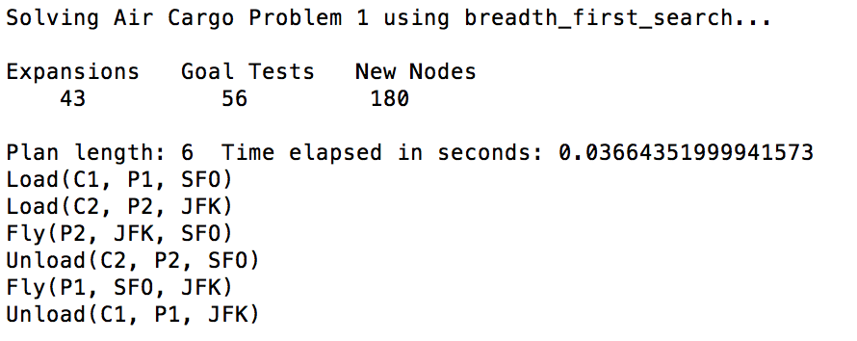
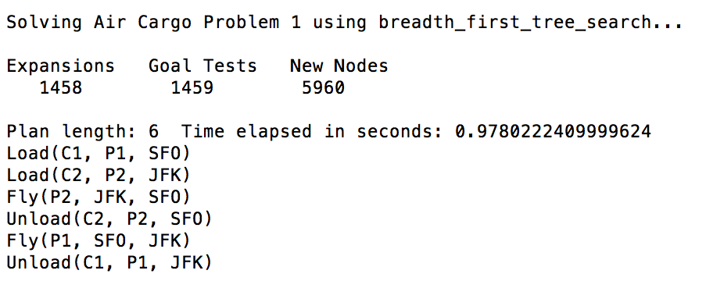
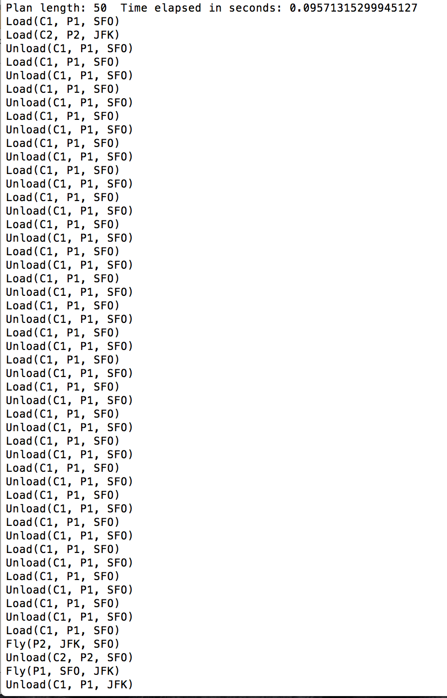
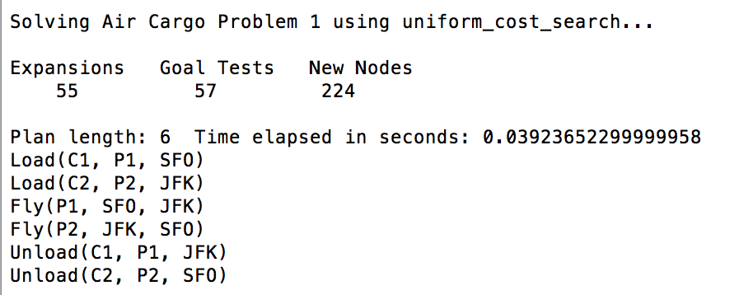
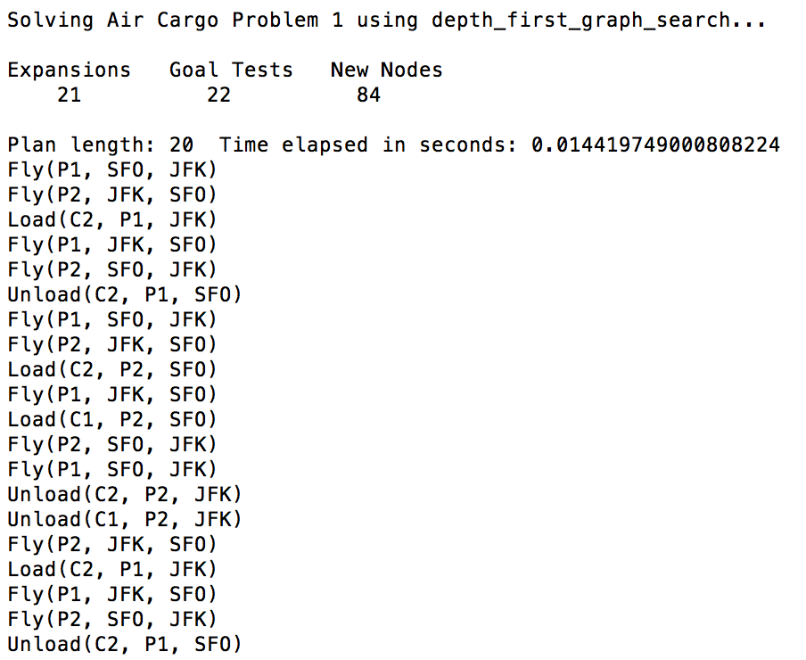

Slide 6
Metrics for Searches air_cargo_p2
 | n of nodes expanded | n of goal tests | Time elapsed | Plan Length
Depth first graph search | 624 | 625 | 3.68168 | 619
Breadth first search | 3343 | 4609 | 15.15613 | 9
Uniform-cost search | 4853 | 4855 | 12.46180 | 9
Depth-limited search | -- | -- | > 10 minutes | --
Breadth first tree search | -- | -- | > 10 minutes | --

Slide 7
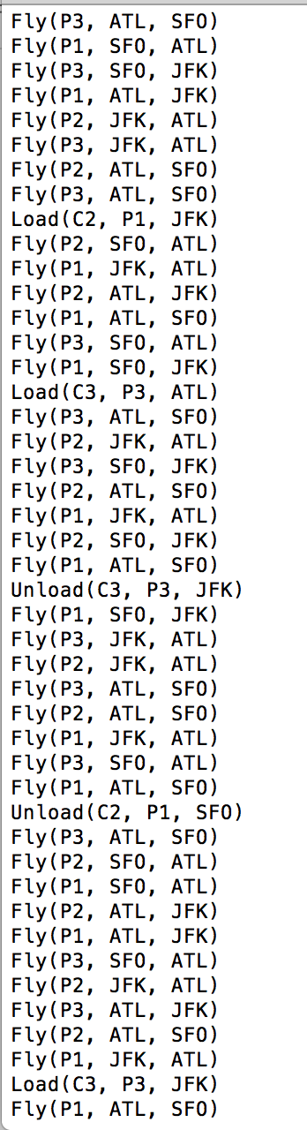
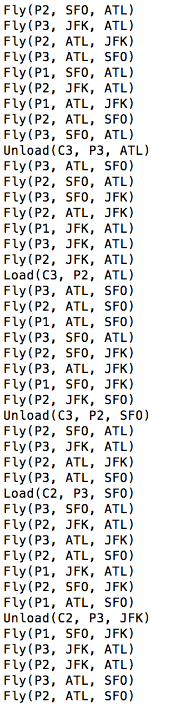
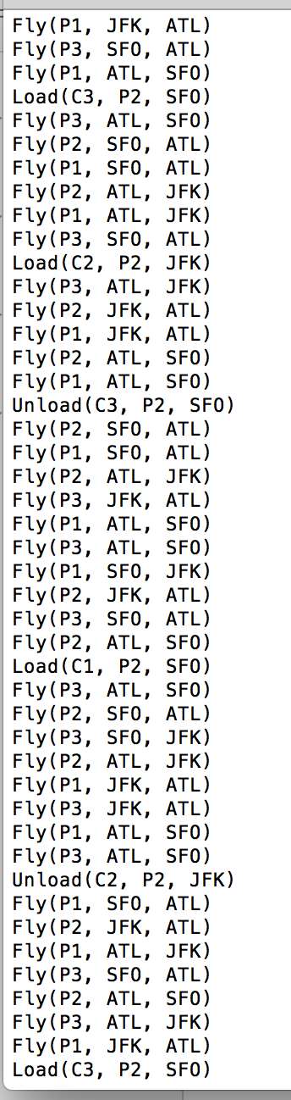
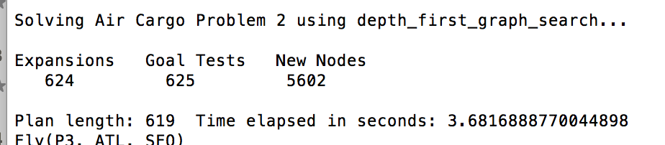
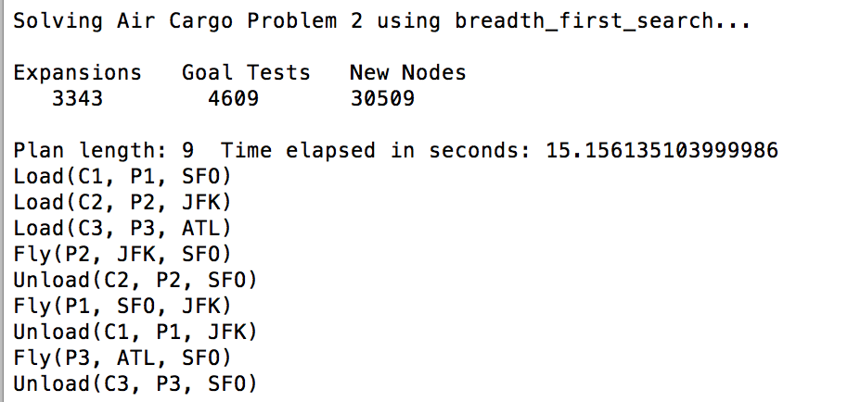
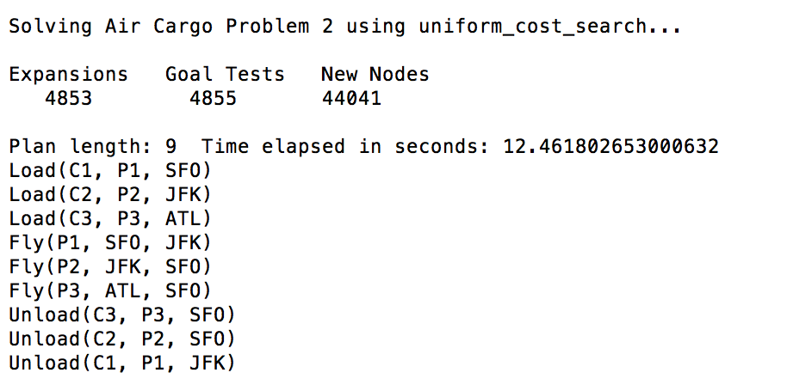

Slide 8
Metrics for Searches air_cargo_p3
 | n of nodes expanded | n of goal tests | Time elapsed | Plan Length
Depth first graph search | 408 | 409 | 2.53954 | 392
Breadth first search | 14663 | 18098 | 111.04126 | 12
Uniform-cost search | 18235 | 18237 | 60.72423 | 12
Depth-limited search | -- | -- | > 10 minutes | --
Breadth first tree search | -- | -- | > 10 minutes | --

Slide 9
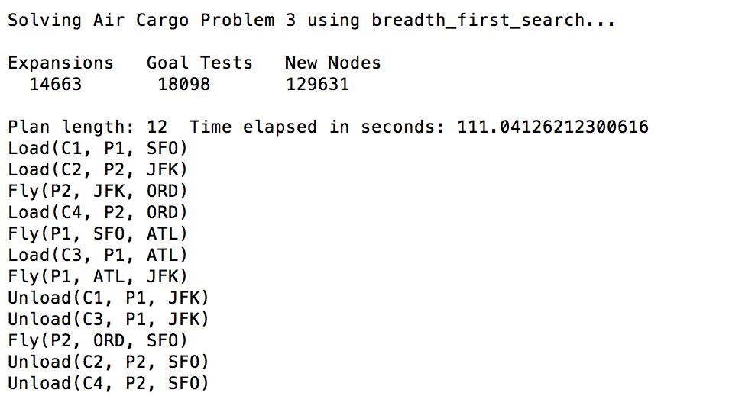
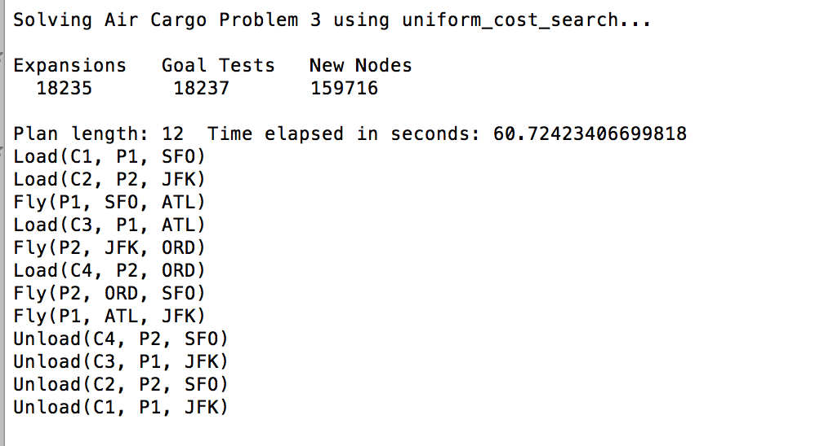
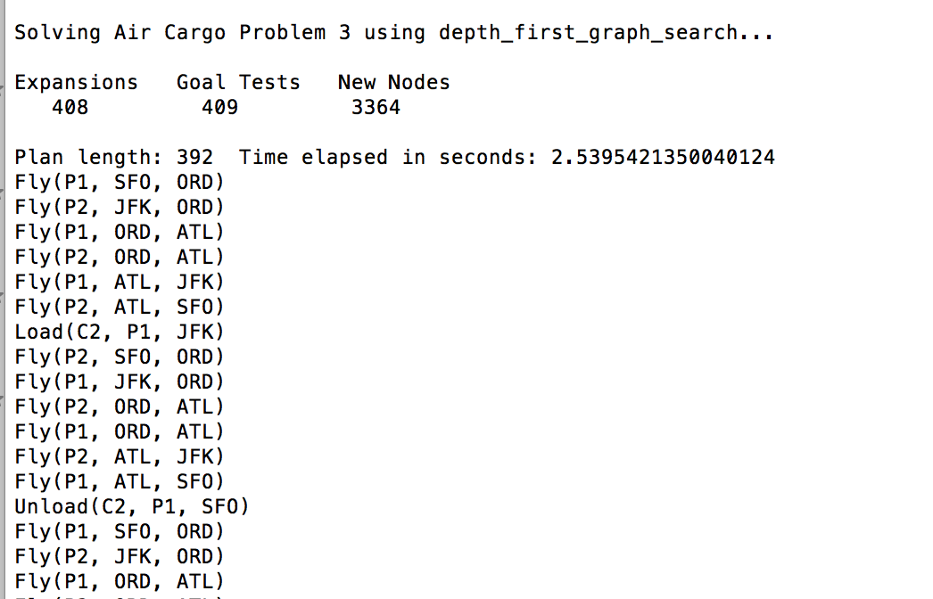

Slide 10
Metrics for A* Searches air_cargo_p1
heuristics | n of nodes expanded | n of goal tests | Time elapsed | Plan Length
h_1 | 55 | 57 | 0.0456 | 6
h_ignore_preconditions | 41 | 43 | 0.0483 | 6
h_pg_levelsum | 11 | 13 | 0.5853 | 6

Slide 11
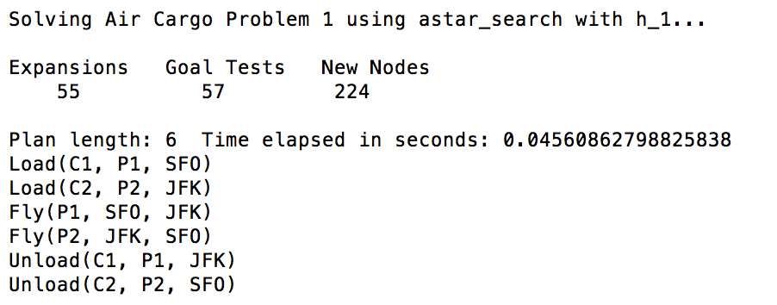
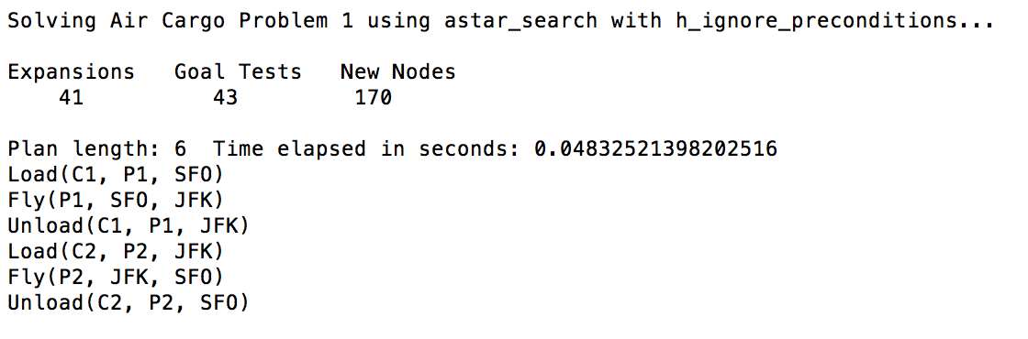
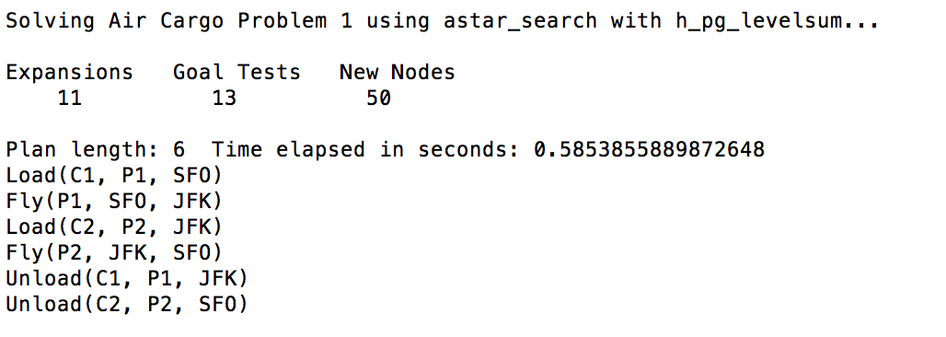

Slide 12
Metrics for A* Searches air_cargo_p2
heuristics | n of nodes expanded | n of goal tests | Time elapsed | Plan Length
h_1 | 4853 | 4855 | 13.8454 | 9
h_ignore_preconditions | 1450 | 1452 | 5.1872 | 9
h_pg_levelsum | 86 | 88 | 51.4103 | 9

Slide 13
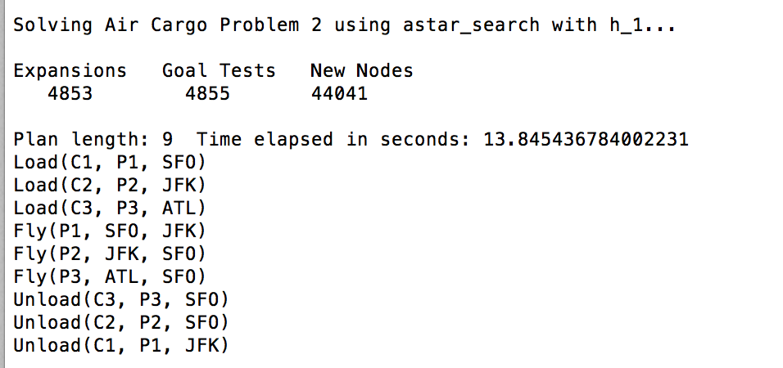
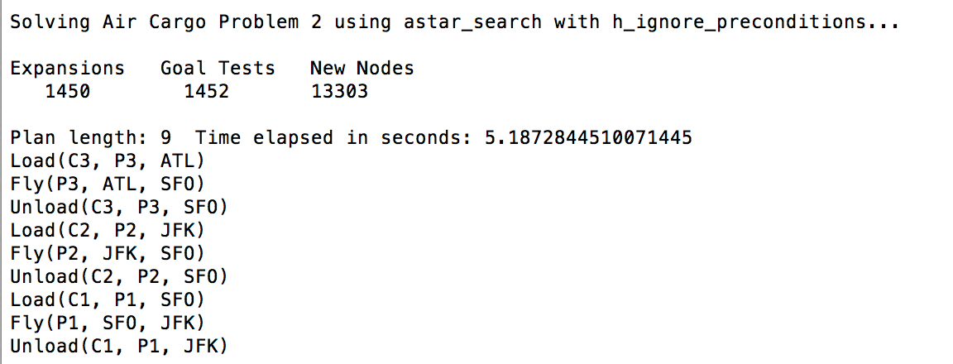
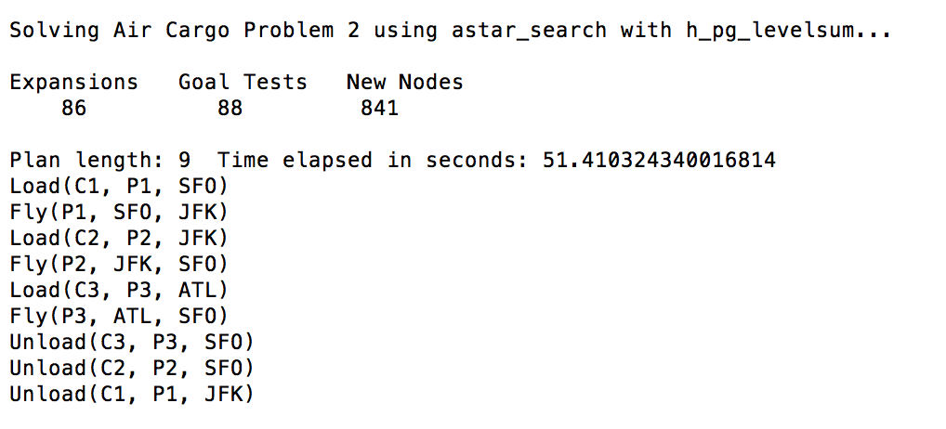

Slide 14
Metrics for A* Searches air_cargo_p3
heuristics | n of nodes expanded | n of goal tests | Time elapsed | Plan Length
h_1 | 18235 | 18237 | 61.2400 | 12
h_ignore_preconditions | 5040 | 5042 | 20.2001 | 12
h_pg_levelsum | 316 | 318 | 269.8408 | 12

Slide 15
