Slide 1
No TeamName
PROJECT PROPOSAL

Slide 2
PROBLEM
Investigating the open set audio classification problem.
Given an audio classification task, what is the best way to reject samples that are outside your target classes while still classifying between the target classes?
Notes:
Open-set classification is a problem of handling 'un- known' classes that are not contained in the training dataset, whereas traditional classifiers assume that only known classes appear in the test environment.

Slide 3
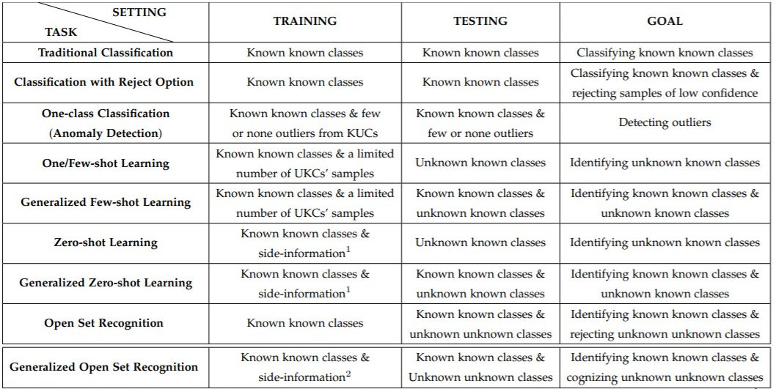
PROBLEM
https://arxiv.org/pdf/1811.08581.pdf
Notes:
Open-set classification is a problem of handling 'un- known' classes that are not contained in the training dataset, whereas traditional classifiers assume that only known classes appear in the test environment.

Slide 4
TABLE OF CONTENTS
1.
2.
3.
DATASET COLLECTED/ PREPROCESSING
CURRENT APPROACHES:
THRESHOLD VALUE USING SOFTMAX PROBABILITY
ONE CLASS CLASSIFICATION
OTHER POSSIBLE METHODS

Slide 5
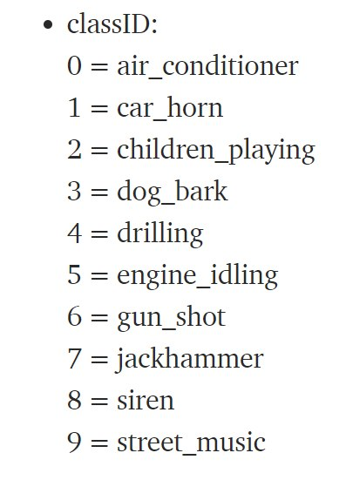
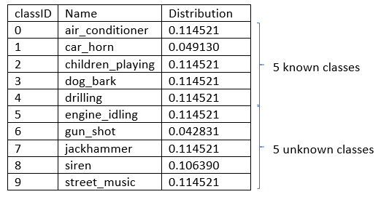
ABOUT THE DATASET
UrbanSound8K dataset (10 classes):
Notes:
We select 5 classes to build/train our models (known classes) and keep the remaining 5 classes as unknown classes.
Classes chosen to ensure that distribution for both known and unknown classes would approximately be equal to prevent skewed datasets

Slide 6
THE BASE MODEL
Solve the standard audio classification problem
Pretrained (ImageNet) DenseNet CNN
Transfer learning between Image and Audio classification
Change final dense layer (classifier) to match our number of classes
One of the state-of-the-art models on the UrbanSound8K dataset
Achieved > 94% test accuracy on our known test set for the 5 chosen classes
https://arxiv.org/pdf/2007.11154.pdf

Slide 7
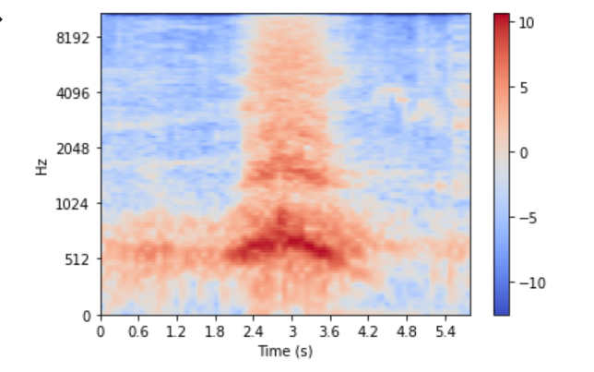
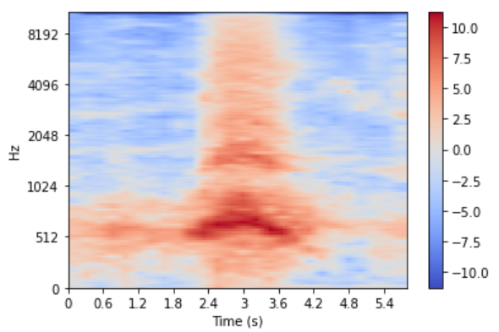
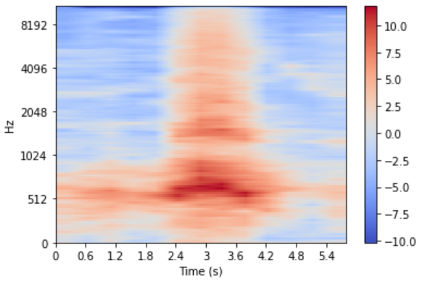
DATA PREPROCESSING
Log Mel Spectrogram
3 - channels, each with different window size and hop length
Pre-computed to save time during training
Saved as 3D numpy arrays in .npy format to be dynamically loaded using a data loader
https://arxiv.org/pdf/2007.11154.pdf
Notes:
We select 5 classes to build/train our models (known classes) and keep the remaining 5 classes as unknown classes.
Classes chosen to ensure that distribution for both known and unknown classes would approximately be equal to prevent skewed datasets

Slide 8
TRAIN TEST SPLIT
96%
Goals
Roughly an even number of data in each class
Enough unknown classes to avoid bias
Unknown
5 classes
4%
Test
20%
Test
5 classes
Known
Validation
20%
80%
80%
Training

Slide 9
CURRENT APPROACHES
Threshold Value for Softmax Probability
One Class SVM
Using original spectrograms as inputs
Using reduced features from NN

Slide 10
THRESHOLD VALUE FOR SOFTMAX PROBABILITY
Spectrogram Inputs
Base Classification Model
Threshold Check
Evaluation
Softmax activation function applied to the base model
A minimum threshold probability value will be determined for each class using the lowest predicted probability of the training data per class.
Predicted probability of the test data that falls below the threshold of the predicted class will be classified under the negative class.
Notes:
Softmax activation function will be applied on top of the base classification model to attain the prediction probability for each class.
A minimum threshold probability value will be determined for each class using the lowest predicted probability of the training data per class.
If the test data falls below the threshold of the predicted class, it will be classified under the negative class.

Slide 11
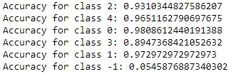
Result
High accuracy for positive classes
Low accuracy for negative class
When the model makes a wrong prediction, it does so with high confidence. Naively checking the softmax probability is probably not a good idea

Slide 12
ONE CLASS CLASSIFICATION
One Class SVM
Spectrogram Inputs
One Class SVM
Base Classification Model
Evaluation
Normal class: instances from all 5 known classes
Trained One Class SVM from sklearn using 4 different kernels
Recall: Test set contains spectrograms of completely new instances from unknown classes
Outliers: Instances from unknown classes
Tested the SVM models with the test set

Slide 13
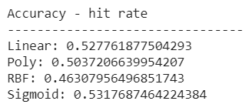
Result
All four kernels gave a low accuracy with only about 0.5 chance of differentiating whether it is the “normal” class or an outlier
SVM generally works better with lesser features.
In this case, our spectrogram inputs have a shape of (128, 250, 3) = ~ 96,000 features → One Class SVM might not work so well...

Slide 14
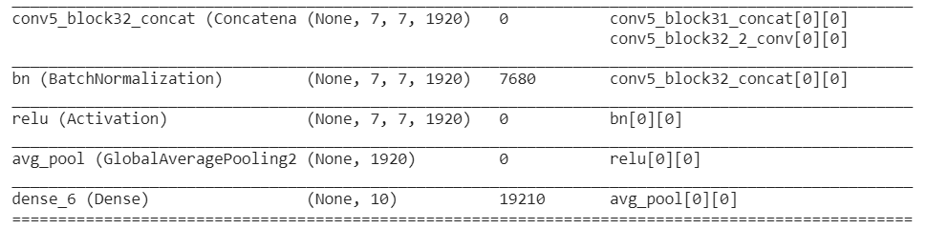
ONE CLASS CLASSIFICATION
NN then One Class SVM
Spectrogram Inputs
Base Classification Model
One Class SVM
Evaluation
Reduce the number of features using the base NN classification model.
Then, use these reduced features as input to One Class SVM

Slide 15
OTHER APPROACHES
Current Approaches:
Threshold Value for Softmax Probability
One Class SVM
Using original spectrograms as inputs
Using reduced features from NN
Future Approaches:
Comparing the similarity between the test data point and the training data centroid across multiple features
Notes:
We would then use the similarity to identify if the instance is an outlier or belongs to one of the known classes

Slide 16
THANKS!
DO YOU HAVE ANY QUESTION?

