Slide 1
No TeamName
FINAL PRESENTATION

Slide 2
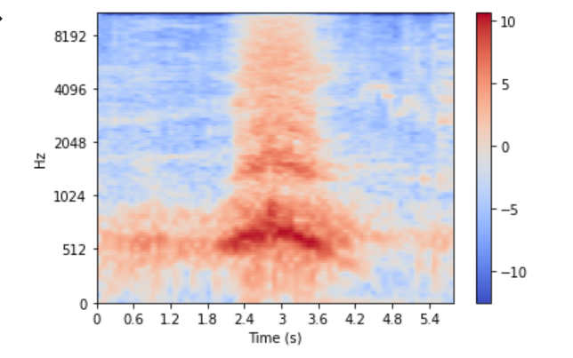
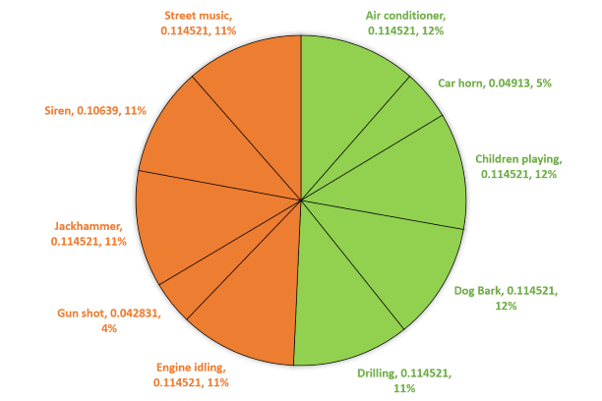
SUMMARY OF PRESENTATION 1
Dataset
UrbanSound8K
Log Mel-Spectrograms
5 known classes, 5 unknown classes
~ equal known and unknown in testset
Problem
Open set audio classification
Closed Set Base Model
Fine-tuned pretrained DenseNet-201 CNN
*NEW*
Feature Extraction
Base Model - 1920 dimensions
VGGish - 128 dimensions
Metrics
Overall accuracy
Per-class accuracy
Weighted f1 score
Notes:
Problem: Open set audio classification as opposed to the more traditional closed set problem
Dataset: UrbanSound8K, Log Mel-Spectrograms, 10 total classes we take 5 as known and 5 as unknown. We train on our known classes, and combine known and unknown as testset. Roughly equal number of known and unknown in test set.
Closed set model: DenseNet-201 pretrained on ImageNet, finetuned on our training set
Features: Base model as feature extractor. VGGish, pre-trained on AudioSet, not finetuned

Slide 3
APPROACHES
One Class SVM + Base Model
Thresholds
One Vs Rest
Synthetic Data
Notes:
4 different approaches

Slide 4
APPROACH 1 - ONE CLASS SVM
Inputs
One Class SVM
Base Classification Model
Evaluation
Trained on all five known classes, referred to as the “normal” or positive (1) class.
Testing includes unknown classes (referred to as the outliers or negative (-1) class).
The One Class SVM would predict either a positive 1 or a negative -1 class.
Instances with predicted labels of 1 would be passed into the base classification model for further classification into the 5 known classes, and finally evaluated.
Different inputs into the One Class SVM (for classification) were experimented with.

Slide 5
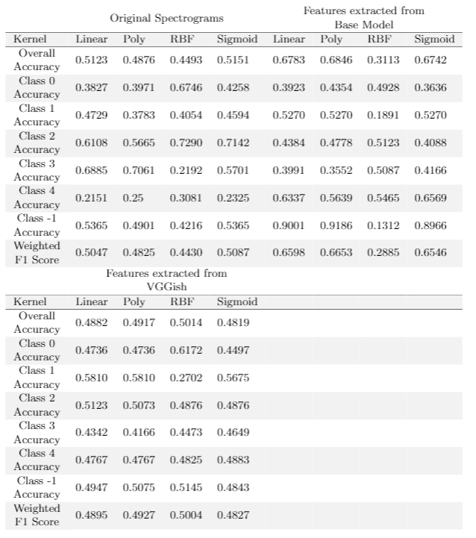
APPROACH 1 - ONE CLASS SVM
Findings
Original spectrograms had too many features.
Features extracted from the base model did slightly better than that from VGGish.
For this approach, it might be possible that the features extracted from VGGish were too little and not specific to the positive class.
Whereas, the base model was able to extract more useful and critical features
Features from Base Model: -1 class accuracy is significantly higher than the known classes → Possible overfit of positive class

Slide 6
APPROACH 2 - ONE VS REST
Intuition
Binary classifier trained for each class, with other classes as negative class
5 known classes, 5 classifiers
Models
Pre-trained DenseNet
Single Layer Perceptron (SLP) with features extracted from base model
SLP with features extracted from VGGish
Support Vector Machine (SVM) with features extracted from base model
SVM with features extracted from VGGish
Single Layer Perceptron (SLP)
x₁
x₂
Z₁
...
Pr(+1)
Pr(-1)
Z₂
Softmax
x_{n}
Notes:
Adapted OVR Multi-class classification to allow us to predict negative classes.
We have binary classifier that is trained for each class, with the other classes as negative class. Because of we have a total of 5 known classes, so in total there are 5 different classifiers being generated.
For this approach, we hope that each binary classifier would be able to identify the specified target class from other data, and in combining the classifies we would be able to identify all of the positive classes
We have tested multiple different models across different data representations.
For SLP, it consists of 2 nodes and a softmax activation.
For SVMs, we have trained on different kernels: Linear, Polynomial, RBF and Sigmoid. Grid search was also performed to find tune the hyperparameters, C and Gamma, of each SVMs.

Slide 7
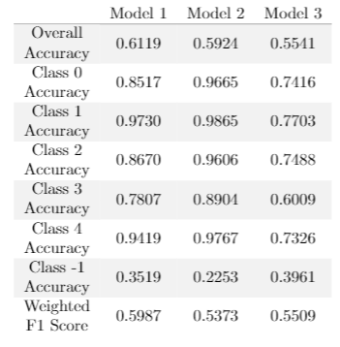
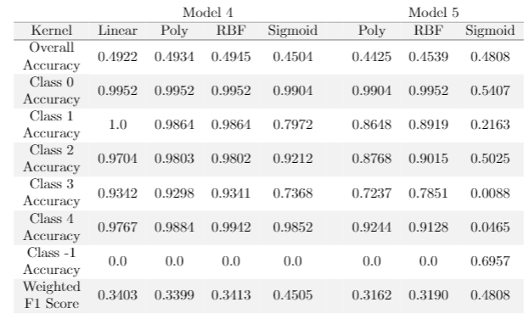
APPROACH 2 - ONE VS REST
Results
Neutral Net (NN)
Support Vector Classifier (SVC)
Findings
Similar performance with Model 3 and Model 5 sigmoid kernel as exception
NNs is superior in identifying negative classes in general, considerably better for open set problem
SVCs is better in solving closed set problem
Model should be chosen depending on the application and acceptance of false positive and false negatives
Notes:
For our prediction, anything that was not predicted to be positive by any of the binary classifiers would considered as unknown/negative class.
For NNs:
Able to identify negative classes in general but no one is particularly effective
For SVCs:
there is no correct negative classifications of the negative class for many of the SVCs
although, Model 5 Sigmoid kernel performs relatively well on the negative class, but positive class performance is significantly poorer. Might not be worth, depending on the application.

Slide 8
APPROACH 3 - THRESHOLDS CHECK
Spectrogram Inputs
Base Classification Model
Threshold Check
Evaluation
Threshold value for softmax probability
Threshold value set using Euclidean distance and cosine similarity

Slide 9
THRESHOLD VALUE FOR SOFTMAX PROBABILITY
Softmax activation function applied to the base model
A minimum threshold probability value will be determined for each class using the lowest predicted probability of the training data per class.
Predicted probability of the test data that falls below the threshold of the predicted class will be classified under the negative class.
Notes:
Softmax activation function will be applied on top of the base classification model to attain the prediction probability for each class.
A minimum threshold probability value will be determined for each class using the lowest predicted probability of the training data per class.
If the test data falls below the threshold of the predicted class, it will be classified under the negative class.

Slide 10
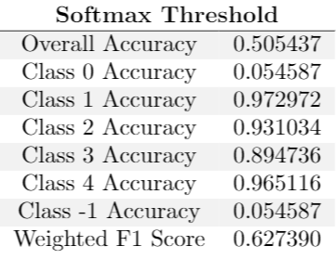
Result
High accuracy for positive classes
Low accuracy for negative class
When the model makes a wrong prediction, it does so with high confidence. Naively checking the softmax probability is probably not a good idea

Slide 11
THRESHOLD VALUE set using EUCLIDEAN DISTANCE and COSINE SIMILARITY
Using the extracted features from the base model and VGGish
Centroids for each of the known classes:
mean from the extracted features of the training and validation data sets per class.
we will use 2 metrics, euclidean distance and cosine similarity, to make a comparison between the extracted features of the test data point and the centroid of its predicted class.
We will set the minimum cosine similarity and maximum euclidean distance as the threshold for each class using the training and validation data set. If the test data point falls outside either of the thresholds of the predicted class, it will be classified under the unknown class.

Slide 12
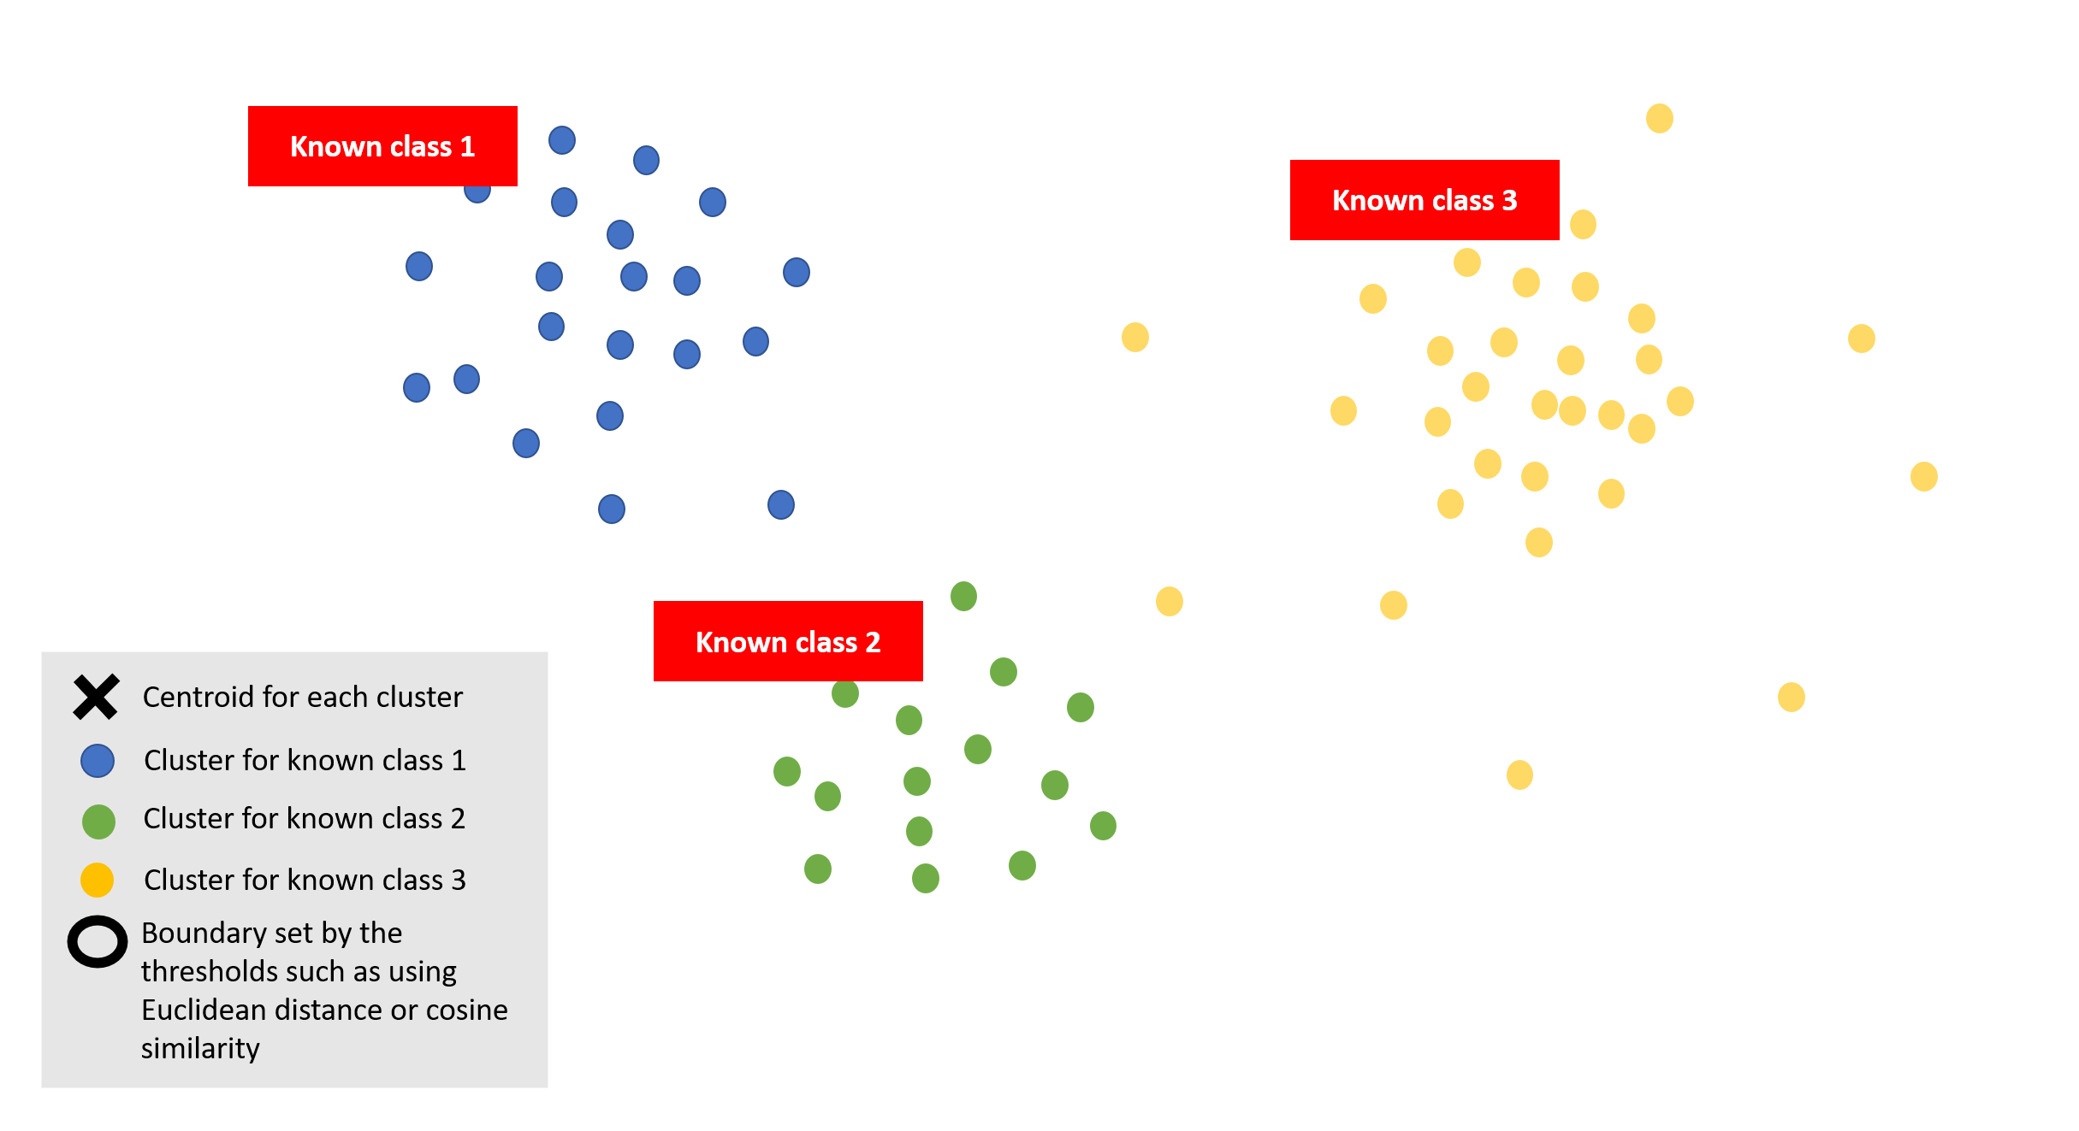
THRESHOLD VALUE set using EUCLIDEAN DISTANCE and COSINE SIMILARITY
Using the extracted features from the base model and VGGish for the data sets
Notes:
This model is inspired by k-means algorithm. As mentioned in the earlier slides, we will be using extracted features from the base model and VGGish for the data sets

Slide 13
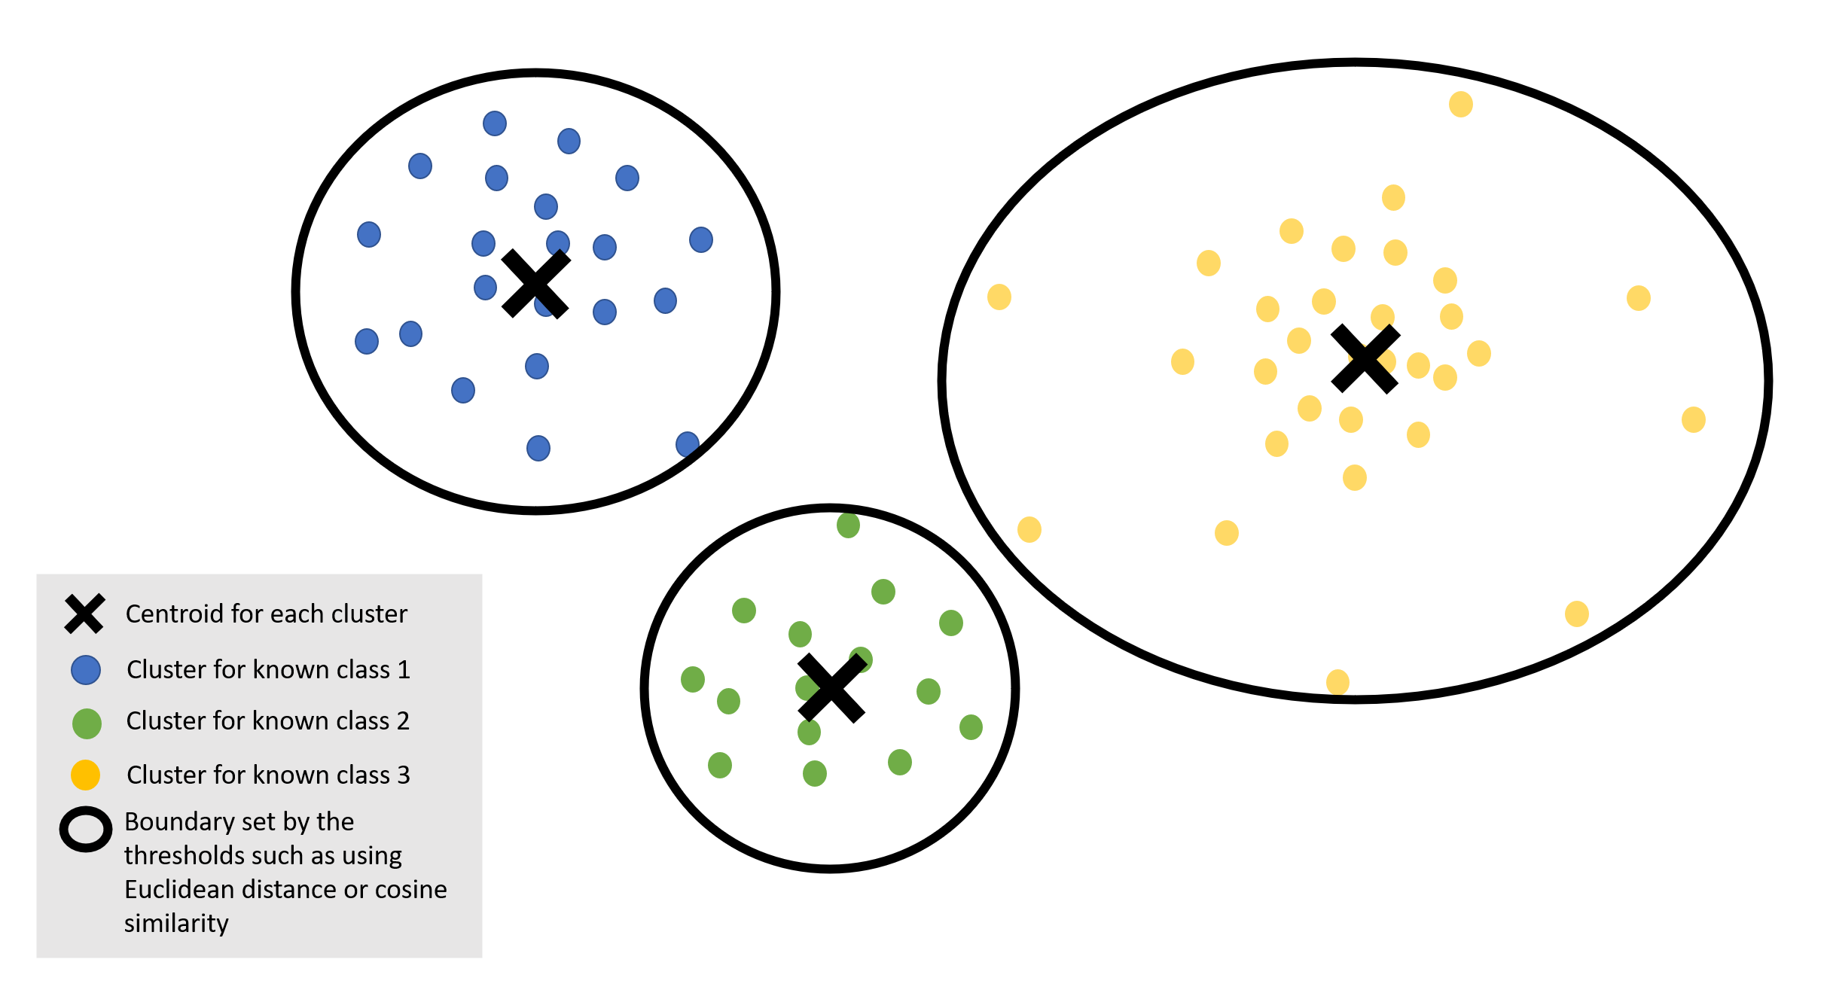
THRESHOLD VALUE set using EUCLIDEAN DISTANCE and COSINE SIMILARITY
Centroids for each of the known classes:
mean from the extracted features of the training and validation data sets per class.
Notes:
The centroids will be found for each known classes which is the mean value of the extracted features of all the data points within each class.

Slide 14
THRESHOLD VALUE set using EUCLIDEAN DISTANCE and COSINE SIMILARITY
We will set the minimum cosine similarity and maximum euclidean distance as the threshold for each class using the training and validation data set.
Notes:
We will use 2 metrics, euclidean distance and cosine similarity, to determine the boundary for each of the known classes. Between a data point and the centroid found, we will set the minimum cosine similarity and maximum euclidean distance that we can find to be the threshold for each class. Anything that falls outside either of the metrics’ boundary will be classified under the negative class.

Slide 15
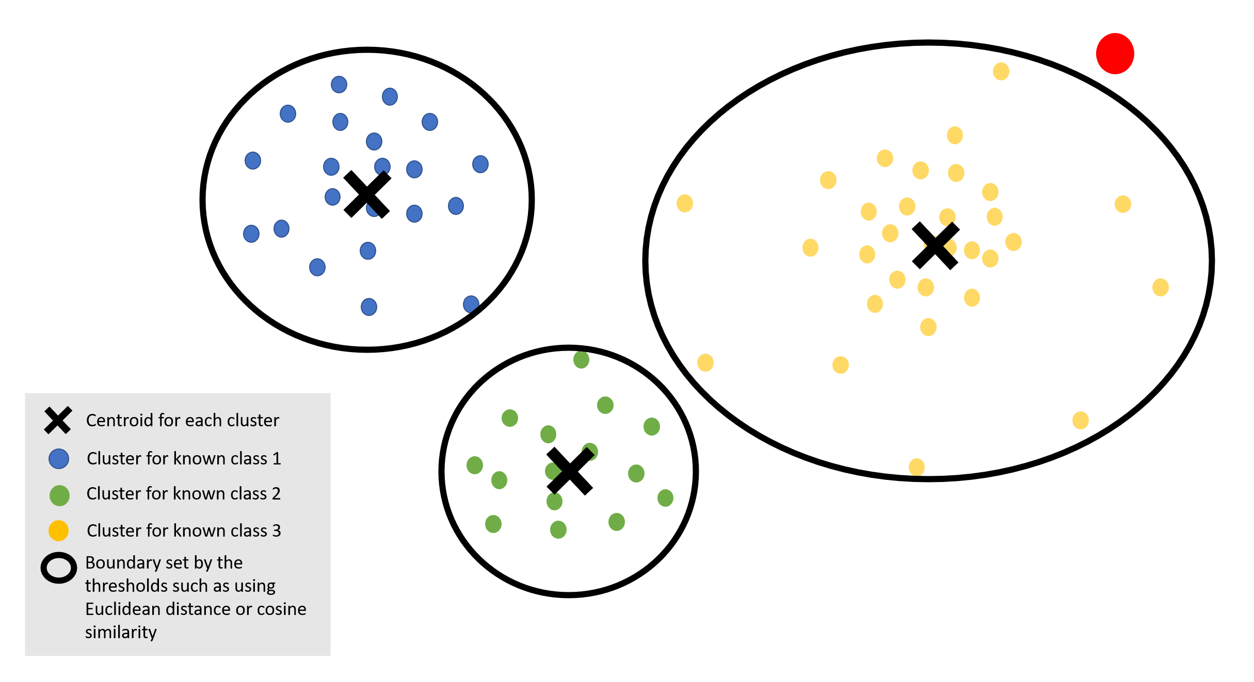
THRESHOLD VALUE set using EUCLIDEAN DISTANCE and COSINE SIMILARITY
If the test data point falls outside either of the thresholds of the predicted class, it will be classified under the unknown class.
Notes:
For each of the test data, it will have a predicted class from the base model. We will find the euclidean distance/cosine similarity between the test data point and the centroid of that predicted class.

Slide 16
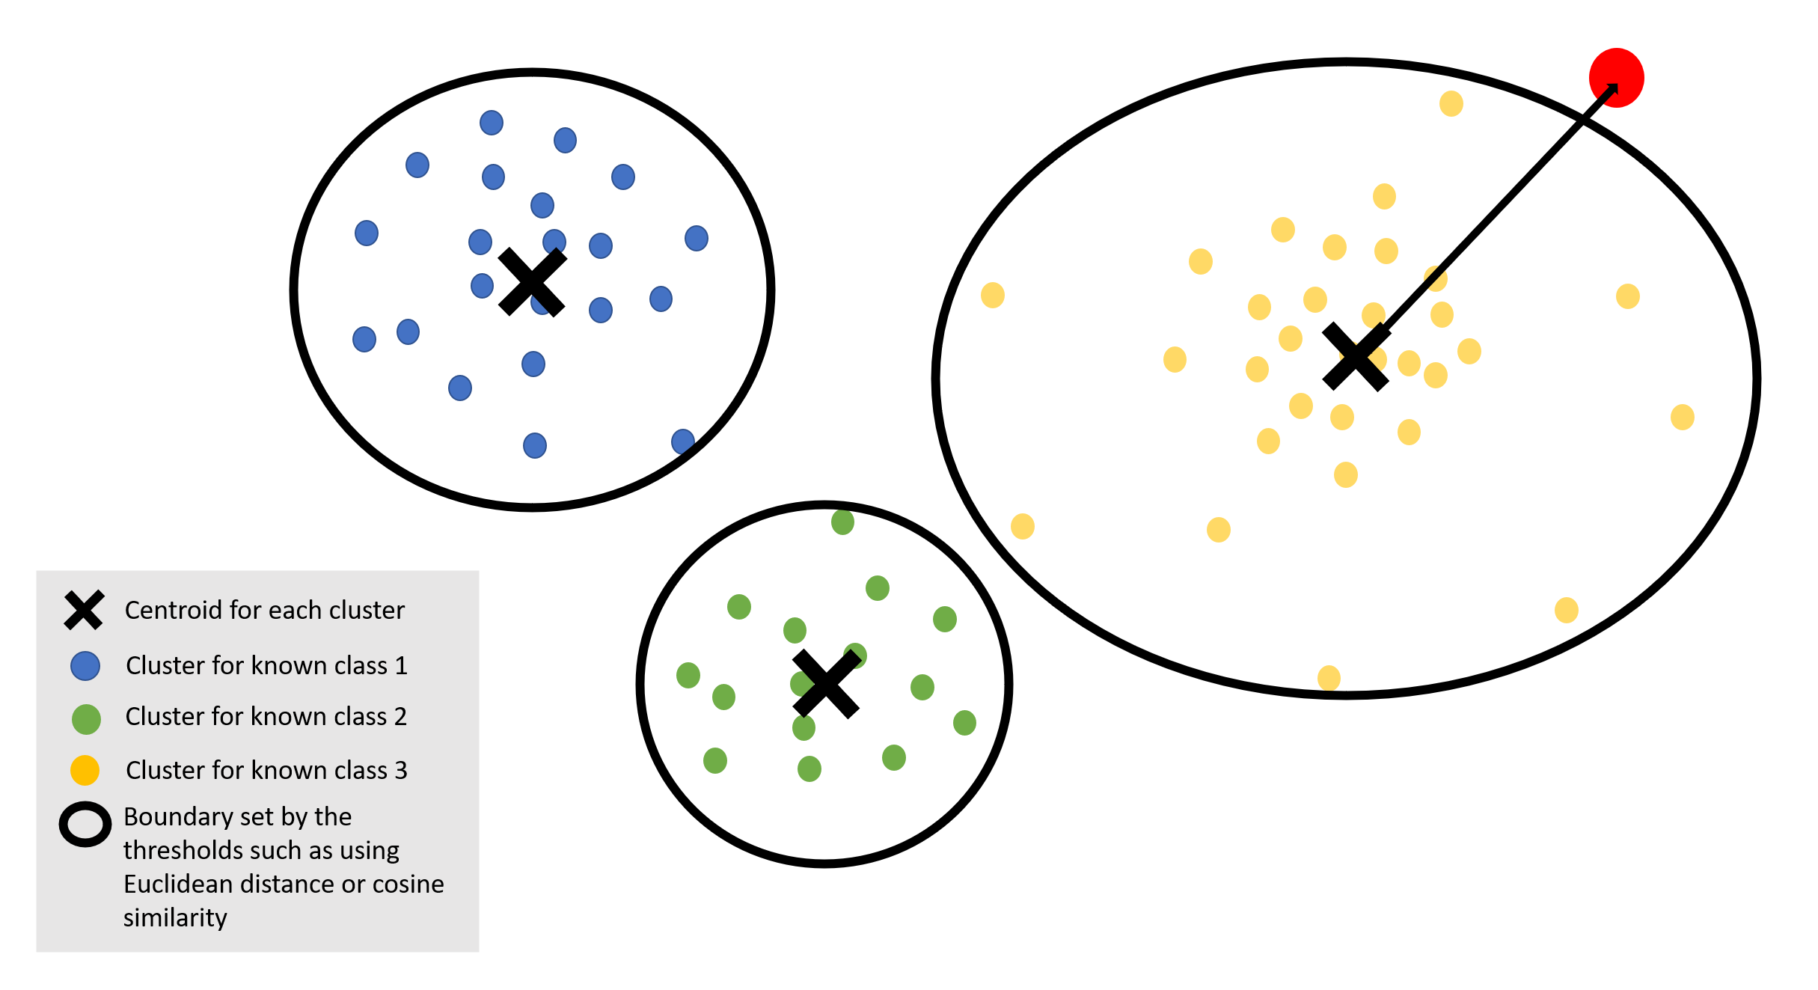
THRESHOLD VALUE set using EUCLIDEAN DISTANCE and COSINE SIMILARITY
If the test data point falls outside either of the thresholds of the predicted class, it will be classified under the unknown class.
Notes:
For each of the test data, it will have a predicted class from the base model. We will find the euclidean distance/cosine similarity between the test data point and the centroid of that predicted class. If the test data point falls outside either of the metrics’ boundary, it will be classified under the negative class.

Slide 17
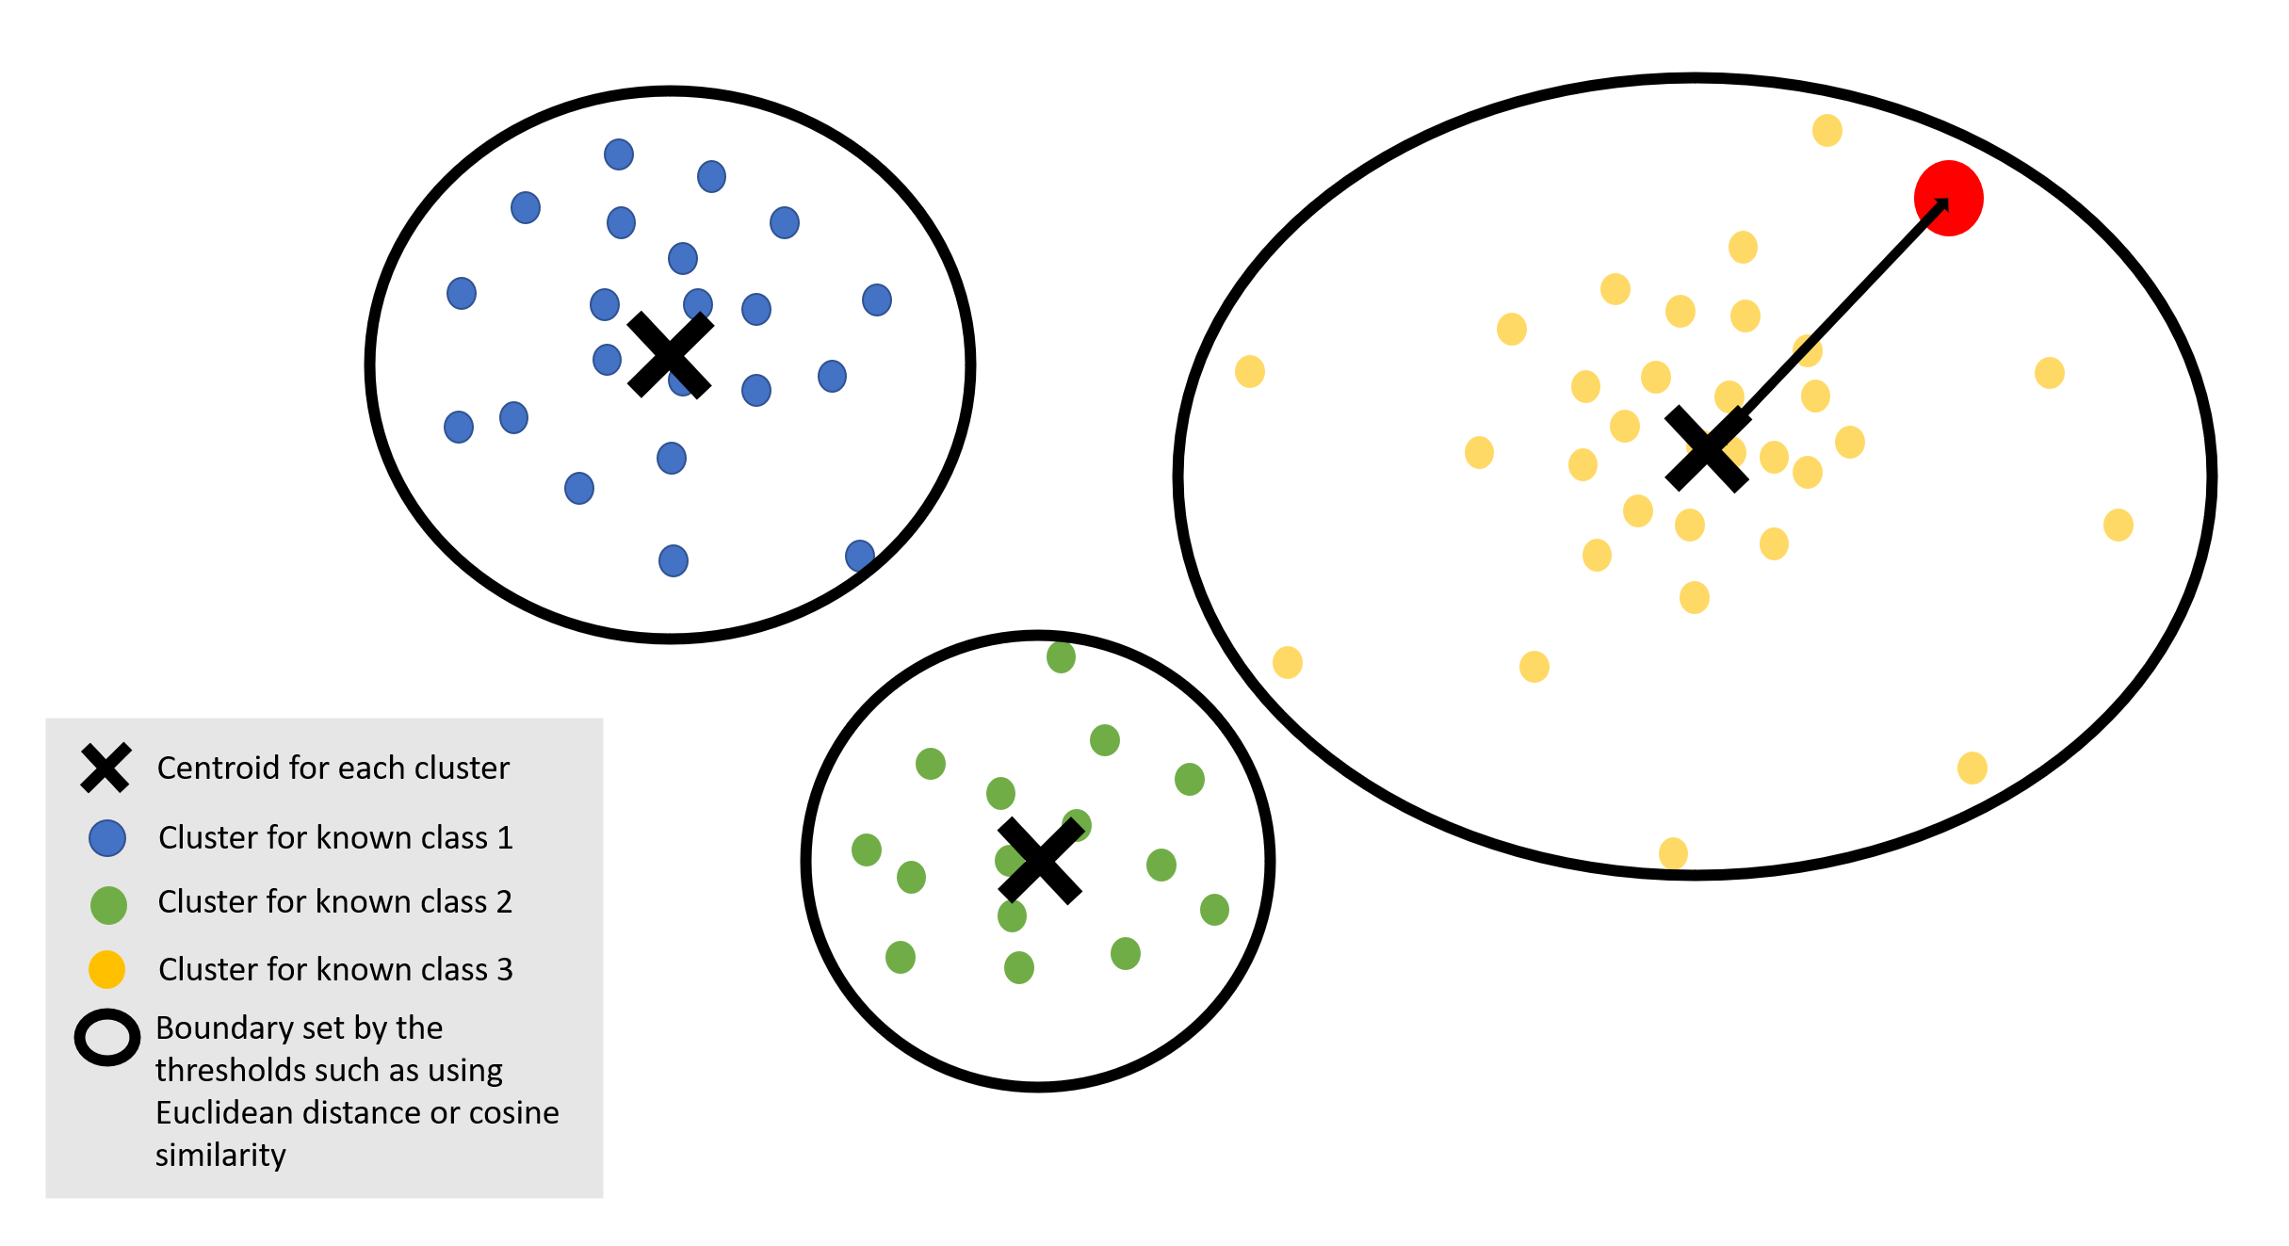
THRESHOLD VALUE set using EUCLIDEAN DISTANCE and COSINE SIMILARITY
Possibility of the negative test data point falling within one of the clusters
Notes:
There is a possibility that the threshold is not a good representation, causing the test data point to fall within the cluster since the threshold is determined by the extreme values between the training data points and centroid within a class.

Slide 18
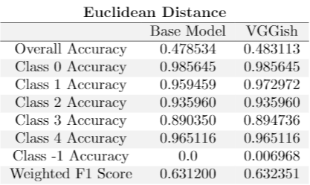
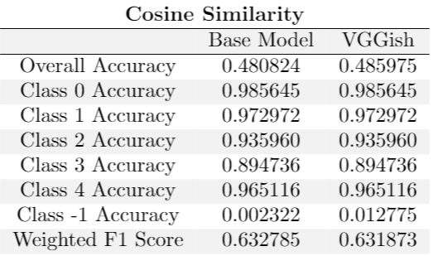
Result
Similar to the softmax threshold,
High accuracy for positive classes
Low accuracy for negative class
Cluster boundary created might not be a good representation of the known classes.
Possibility of negative data points to fall within the clusters of the known class.
Hence we might need a validation set to tune this boundary.
Notes:
Cluster boundary created is too big and hence not a good representation. We can tune to make the cluster tighter and more representative using a validation set. We can also see that overall, VGGish performs better at identifying the negative class compared to the base model as it might be more generalisable.

Slide 19
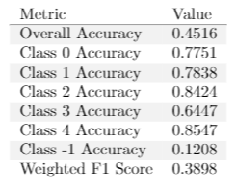
APPROACH 4 - SYNTHETIC DATA
Design Details
Add data with randomized features to training data 1:1
Label random data as negative
Results
Intuition
Use random data to emulate negative class
Negative class should be “everything else”
Findings
Random data is not representative of the negative class (high validation accuracy when training, low test accuracy)
Need to be more creative, cannot be fully random

Slide 20
DEMO! :D

Slide 21
IN THE END
Based On Current Approaches:
Poor performance
Not suitable for real-life applications
Tends towards naive classifier (either all positive or negative)
Negative data just as important as positive data
“Best” model will depend on class distribution
HARD!!!
Future Ideas:
Set aside some known classes as known-unknown for validation

Slide 22
THANKS!
DO YOU HAVE ANY QUESTIONS?

