Slide 1
HNDIT 4012-Software Engineering
Week 2: Software Process

Slide 2
Topics covered
Software process
Process flow
Software process models

Slide 3
The software process
A structured set of activities required to develop a software system.
Many different software processes but all involve:
  Specification – defining what the system should do;
  Design and implementation – defining the organization of the system and implementing the system;
  Validation – checking that it does what the customer wants;
  Evolution – changing the system in response to changing customer needs.

Slide 4
Plan-driven and agile processes
Plan-driven processes are processes where all of the process activities are planned in advance and progress is measured against this plan.
In agile processes, planning is incremental and it is easier to change the process to reflect changing customer requirements.
In practice, most practical processes include elements of both plan-driven and agile approaches.

Slide 5
Software specification
The process of establishing what services are required and the constraints on the system’s operation and development.
Requirements engineering process
  Feasibility study
    Is it technically and financially feasible to build the system?
  Requirements elicitation and analysis
    What do the system stakeholders require or expect from the system?
  Requirements specification
    Defining the requirements in detail
  Requirements validation
    Checking the validity of the requirements

Slide 6
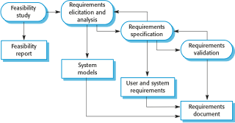
The requirements engineering process

Slide 7
Software design and implementation
The process of converting the system specification into an executable system.
Software design
  Design a software structure that realises the specification;
Implementation
  Translate this structure into an executable program;
The activities of design and implementation are closely related and may be inter-leaved.

Slide 8
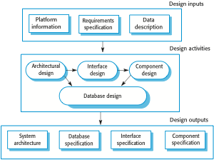
A general model of the design process

Slide 9
Design activities
Architectural design, where you identify the overall structure of the system, the principal components (sometimes called sub-systems or modules), their relationships and how they are distributed.
Interface design, where you define the interfaces between system components.
Component design, where you take each system component and design how it will operate.
Database design, where you design the system data structures and how these are to be represented in a database.

Slide 10
Software validation
Validation is intended to show that a system conforms to its specification and meets the requirements of the system customer.
Involves checking and review processes and system testing.
System testing involves executing the system with test cases that are derived from the specification of the real data to be processed by the system.

Slide 11

Stages of testing

Slide 12
Testing stages
Development or component testing
  Individual components are tested independently;
  Components may be functions or objects or coherent groupings of these entities.
System testing
  Testing of the system as a whole. Testing of emergent properties is particularly important.
Acceptance testing
  Testing with customer data to check that the system meets the customer’s needs.

Slide 13
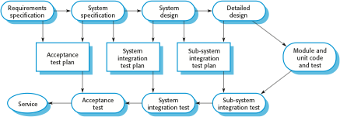
Testing phases in a plan-driven software process

Slide 14
Software evolution
Software is inherently flexible and can change.
As requirements change through changing business circumstances, the software that supports the business must also evolve and change.
Although there has been a demarcation between development and evolution (maintenance) this is increasingly irrelevant as fewer and fewer systems are completely new.

Slide 15

System evolution

Slide 16
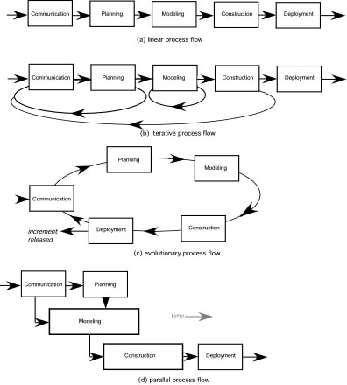
Types of Process Flow

Slide 17
Software process models
The waterfall model
  Plan-driven model. Separate and distinct phases of specification and development.
Incremental development(Evolutionary)
  Specification, development and validation are interleaved. May be plan-driven or agile.
Reuse-oriented software engineering
  The system is assembled from existing components. May be plan-driven or agile

Slide 18
The waterfall model
There are separate identified phases in the waterfall model:
  Requirements analysis and definition
  System and software design
  Implementation and unit testing
  Integration and system testing
  Operation and maintenance

Slide 19
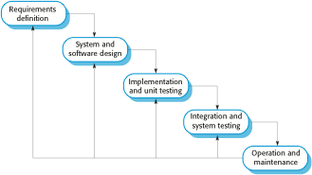
The waterfall model

Slide 20
The waterfall model
The main drawback of the waterfall model is the difficulty of accommodating change after the process is underway.
Inflexible partitioning of the project into distinct stages makes it difficult to respond to changing customer requirements.
  Therefore, this model is only appropriate when the requirements are well-understood and changes will be fairly limited during the design process.
  Few business systems have stable requirements.

Slide 21
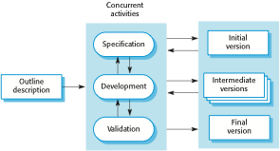
Incremental development(Evolutionary)

Slide 22
Incremental delivery
Rather than deliver the system as a single delivery, the development and delivery is broken down into increments with each increment delivering part of the required functionality.
User requirements are prioritised and the highest priority requirements are included in early increments.
Once the development of an increment is started, the requirements are frozen though requirements for later increments can continue to evolve.

Slide 23
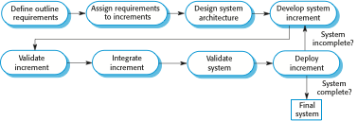
Incremental delivery

Slide 24
Incremental delivery advantages
Customer value can be delivered with each increment so system functionality is available earlier.
Early increments act as a prototype to help elicit requirements for later increments.
Lower risk of overall project failure.
The highest priority system services tend to receive the most testing.

Slide 25
Incremental delivery problems
Most systems require a set of basic facilities that are used by different parts of the system.
  As requirements are not defined in detail until an increment is to be implemented, it can be hard to identify common facilities that are needed by all increments.
The essence of iterative processes is that the specification is developed in conjunction with the software.

Slide 26
Incremental Development
Types
Type 1: Exploratory Development
  Spiral Model
Type 2: Throwaway Prototyping
  Rapid Prototyping

Slide 27
Boehm’s spiral model
Process is represented as a spiral rather than as a sequence of activities with backtracking.
Each loop in the spiral represents a phase in the process.
No fixed phases such as specification or design - loops in the spiral are chosen depending on what is required.
Risks are explicitly assessed and resolved throughout the process.

Slide 28
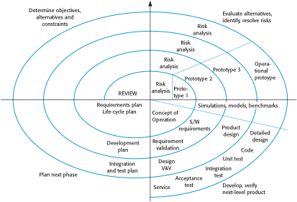
Boehm’s spiral model of the software process

Slide 29
Spiral model sectors
Objective setting
  Specific objectives for the phase are identified.
Risk assessment and reduction
  Risks are assessed and activities put in place to reduce the key risks.
Development and validation
  A development model for the system is chosen which can be any of the generic models.
Planning
  The project is reviewed and the next phase of the spiral is planned.

Slide 30
Spiral model usage
Spiral model has been very influential in helping people think about iteration in software processes and introducing the risk-driven approach to development.
In practice, however, the model is rarely used as published for practical software development.

Slide 31
Software prototyping
A prototype is an initial version of a system used to demonstrate concepts and try out design options.
A prototype can be used in:
  The requirements engineering process to help with requirements elicitation and validation;
  In design processes to explore options and develop a UI design;
  In the testing process to run back-to-back tests

Slide 32
Benefits of prototyping
Improved system usability.
A closer match to users’ real needs.
Improved design quality.
Improved maintainability.
Reduced development effort.

Slide 33

The process of prototype development

Slide 34
Prototype development
May be based on rapid prototyping languages or tools
May involve leaving out functionality
  Prototype should focus on areas of the product that are not well-understood;
  Error checking and recovery may not be included in the prototype;
  Focus on functional rather than non-functional requirements such as reliability and security

Slide 35
Throw-away prototypes
Prototypes should be discarded after development as they are not a good basis for a production system:
  It may be impossible to tune the system to meet non-functional requirements;
  Prototypes are normally undocumented;
  The prototype structure is usually degraded through rapid change;
  The prototype probably will not meet normal organisational quality standards.

Slide 36
Reuse-oriented software engineering
Based on systematic reuse where systems are integrated from existing components or COTS (Commercial-off-the-shelf) systems.
Process stages
  Component analysis;
  Requirements modification;
  System design with reuse;
  Development and integration.
Reuse is now the standard approach for building many types of business system

Slide 37

Reuse-oriented software engineering

Slide 38
Types of software component
Web services that are developed according to service standards and which are available for remote invocation.
Collections of objects that are developed as a package to be integrated with a component framework such as .NET or J2EE.
Stand-alone software systems (COTS) that are configured for use in a particular environment

Slide 39
Key points
Requirements engineering is the process of developing a software specification.
Design and implementation processes are concerned with transforming a requirements specification into an executable software system.
Software validation is the process of checking that the system conforms to its specification and that it meets the real needs of the users of the system.
Software evolution takes place when you change existing software systems to meet new requirements. The software must evolve to remain useful.

Slide 40
Key points
Software processes are the activities involved in producing a software system. Software process models are abstract representations of these processes.
General process models describe the organization of software processes. Examples of these general models include the ‘waterfall’ model, incremental development, and reuse-oriented development.

