Slide 1
HNDIT 4012 Software Engineering
Week 3: Agile Software Development

Slide 2
Topics covered
Explain what Agile software development?
Understand why Agile is needed?
Describe Agile principles
Identify key Agile methods such as Scrum and XP

Slide 3
Agile Software Development
Agile software development is a flexible and adaptive approach used to build software in environments where requirements are not fully known at the beginning.
It emerged to overcome the limitations of traditional models that assume stable and predictable requirements.

Slide 4
Problem with Traditional Models
Requirements are fixed
Development follows a strict sequence
Requirements are unclear at the beginning
Changes are costly if introduced late

Slide 5
Why Agile is Important?
In modern software development-
Requirements frequently change
Market conditions evolve quickly
Customer expectations increase
Agile helps teams respond effectively to these changes while maintaining productivity and quality.

Slide 6
Key Features of Agile
Agile development is characterized by-
Iterative development
Incremental delivery
Continuous feedback
Strong collaboration

Slide 7
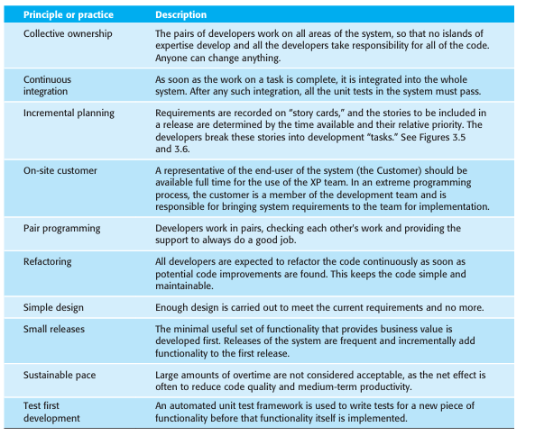
Agile Principles

Slide 8
Agile Process Framework
Agile still follows basic software engineering activities
Communication
Planning
Modeling
Construction
Deployment
However, these activities are lightweight and iterative.

Slide 9
Advantages of Agile
Faster delivery of usable software
Improved customer satisfaction
Better handling of changes
Continuous improvement through feedback

Slide 10
Limitations of Agile
Requires active customer involvement
Less emphasis on documentation
Difficult to scale for large systems
Needs experienced and collaborative teams

Slide 11
Agile Methods
Common Agile methods include:
Scrum
Extreme Programming (XP)
Adaptive Software Development (ASD)
Dynamic Systems Development Method (DSDM)
Each method follows Agile principles but differs in practices.

Slide 12
Scrum Overview
Scrum is one of the most widely used Agile methods.
It organizes work into short cycles called sprints, enabling teams to deliver software quickly and adapt to changes.

Slide 13
Scrum Process
Scrum includes:
Product backlog (list of features)
Sprint planning
Sprint execution
Product increment delivery
Each sprint results in a working product increment.

Slide 14
Scrum Roles
Scrum defines three main roles-
Product Owner (represents customer)
Scrum Master (facilitates process)
Development Team (builds product)

Slide 15
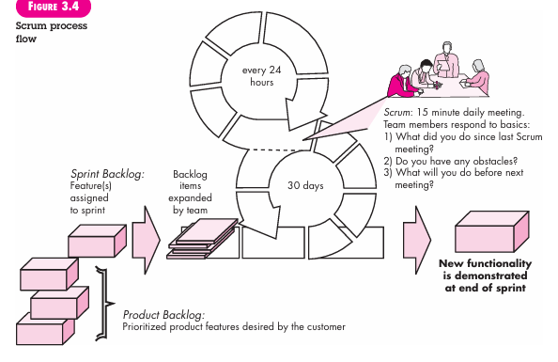
Scrum Process Flow

Slide 16
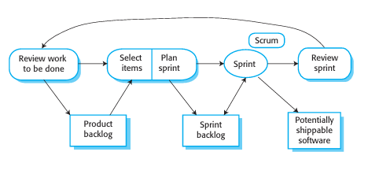
Sprint Concept
A sprint is a time-boxed period (usually 2–4 weeks).
During a sprint-
  Work is fixed
  No changes are introduced
  A working product is delivered at the end

Slide 17
Extreme Programming(XP)
Extreme Programming (XP) that emphasizes-
High-quality code
Continuous feedback
Close customer involvement
It is one of the most widely used Agile approaches and focuses heavily on engineering practices rather than just management.

Slide 18
Why “Extreme” Programming?
XP is called “extreme” because it takes good practices and applies them intensively-
Testing → Test all the time
Code review → Pair programming
Design → Keep it simple always
Idea: If a practice is good, do it extremely well and frequently.

Slide 19
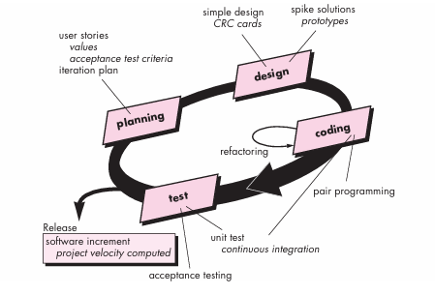
XP Process

Slide 20
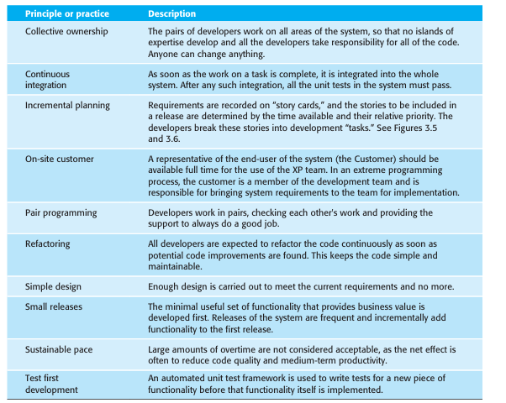
XP Key Practices

Slide 21
Advantages of XP
High-quality software
Early detection of errors
Strong teamwork
Continuous customer feedback

Slide 22
Limitations of XP
Requires experienced developers
Needs strong customer involvement
Not suitable for large distributed teams
Less documentation

Slide 23
Adaptive Software Development (ASD)
ASD follows three phases-
Speculation (planning)
Collaboration (development)
Learning (feedback and improvement)
It focuses on teamwork and continuous learning.

Slide 24
Dynamic Systems Development Method (DSDM)
Dynamic Systems Development Method (DSDM) is an Agile framework that focuses on-
Delivering systems quickly
Using incremental prototyping
Working within strict time constraints
It ensures that useful software is delivered even when time is limited.

Slide 25
Conclusion
Agile software development is a powerful approach that-
Supports change
Encourages collaboration
Delivers value quickly
It is widely used in modern software engineering to handle uncertainty and complexity.

