Slide 1
Software Engineering
IT4012
System Modeling

Slide 2
Learning Objectives
Define system modeling
Explain the importance of models
Identify different system modeling perspectives
Understand UML diagrams
Draw basic UML diagrams

Slide 3
What is System Modeling?
System modeling is the process of developing abstract models of a system.
Key Ideas
  Represents a system visually
  Simplifies complex systems
  Uses diagrams and graphical notation
  Commonly uses UML

Slide 4
Types of System Perspectives
There are four major perspectives-
  Context Perspective
  Interaction Perspective
  Structural Perspective
  Behavioral Perspective

Slide 5
What is UML?
UML is a standard modeling language used in software engineering.
UML Supports-
  Use Case Diagrams
  Sequence Diagrams
  Activity Diagrams
  Class Diagrams
  State Diagrams

Slide 6
Context Models
Context models show
  System boundaries
  External systems
  Environment of the system
Example
  ATM System
  Online Shopping System

Slide 7
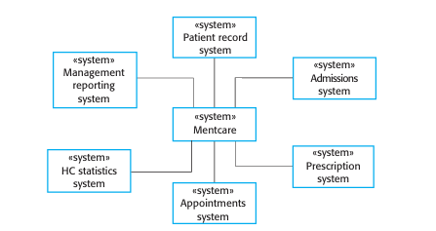
Example Context Models

Slide 8
Interaction Models
Interaction models describe-
  User interaction
  System-to-system interaction
  Component interaction
Main Diagrams
  Use Case Diagram
  Sequence Diagram

Slide 9
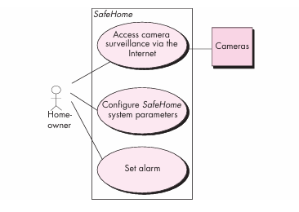
Use Case Diagram
Use case diagrams show-
  Actors
  System functions
  User interactions

Slide 10
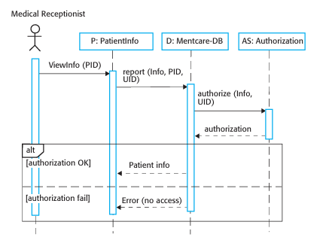
Sequence Diagrams
Sequence diagrams show-
  Object interactions
  Message flow
  Order of operations

Slide 11
Structural Models
Structural models show-
  Organization of the system
  Classes and relationships
Main Diagram
  Class Diagram

Slide 12
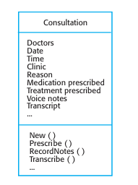
Class Diagram
Class Contains
  Class Name
  Attributes
  Methods
Relationships
  Association
  Inheritance
  Aggregation

Slide 13
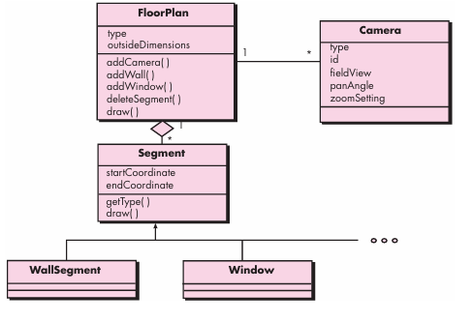
Example Class Diagram

Slide 14
Behavioral Models
Behavioral models describe-
  Dynamic behavior
  Event responses
  Data processing

Slide 15
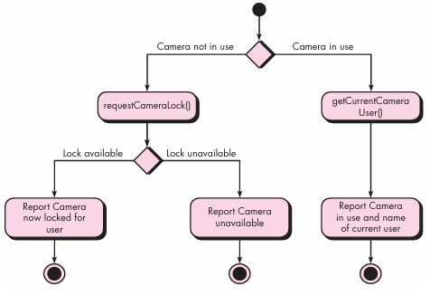
Activity Diagram
Activity diagrams show-
  Workflow
  Process steps
  Decision making

Slide 16
State Diagram
State diagrams show-
  System states
  Event-triggered transitions

Slide 17
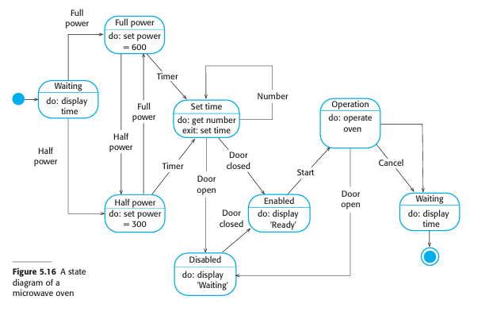
Example State Diagram

Slide 18
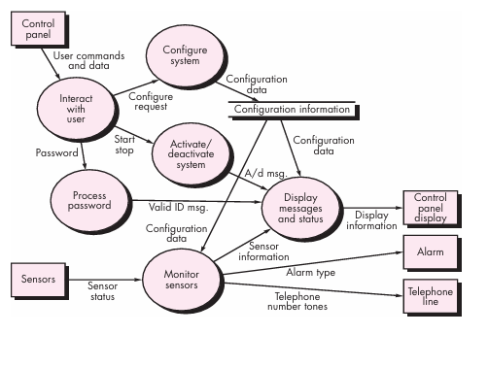
Data-Driven Modeling
Data flow diagrams show-
  Input data
  Processing steps
  Output data

Slide 19
Advantages of System Modeling
Better communication
Easier understanding
Improved documentation
Reduced development errors
Easier maintenance

Slide 20
Summary
System modeling concepts
UML diagrams
Context, interaction, structural, and behavioral models
Activity, use case, sequence, class, and state diagrams

