Slide 1
HNDIT 4012 Software Engineering
Software Architecture

Slide 2
Topics covered
Software Architectures
Software Patterns
MVC
Layered
Client Server
Repository
Pipe and Filter

Slide 3
What is Software Architecture?
Software architecture refers to the high-level structure or organization of a software system, which defines the components, relationships, and interactions that make up the system.

Slide 4
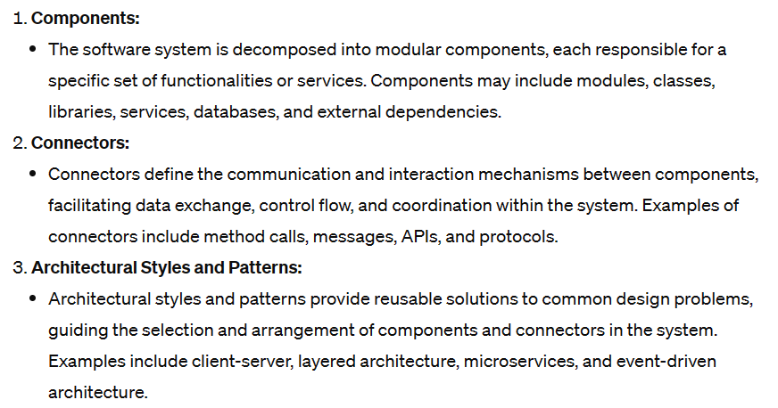
Key Aspects of Software Architecture

Slide 5
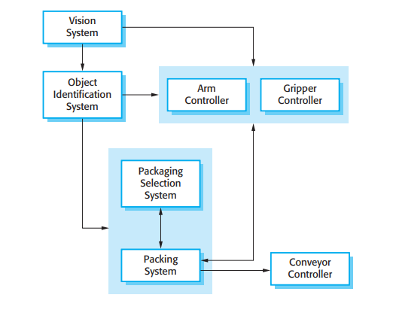
Example- Software Architecture
The architecture of a packing robot control system.

Slide 6
Architectural Patterns
You can think of an architectural pattern as a stylized, abstract description of good practice, which has been tried and tested in different systems and environments.

Slide 7
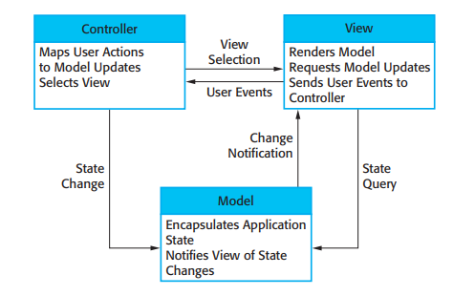
Model-View-Controller
This pattern is the basis of interaction management in many web-based systems.

Slide 8
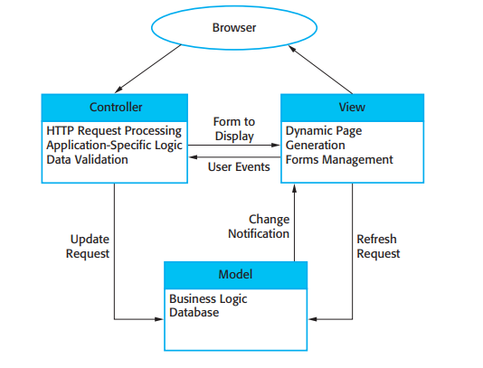
Example-MVC

Slide 9
Layered architecture
This layered approach supports the incremental development of systems.
As a layer is developed, some of the services provided by that layer may be made available to users.
The architecture is also changeable and portable.

Slide 10
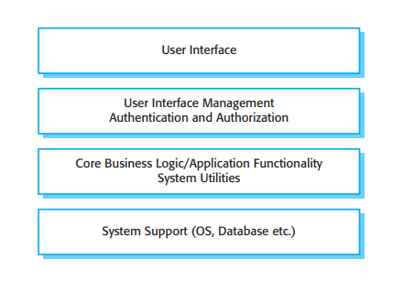
Generic Layers

Slide 11
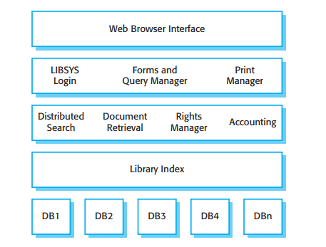
Example- Layered Architecture

Slide 12
Repository Architecture
All data in a system is managed in a central repository that is accessible to all system components. Components do not interact directly, only through the repository.

Slide 13
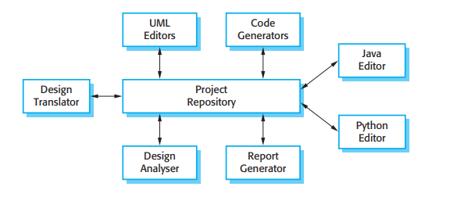
Example- Repository Architecture
A repository architecture for an IDE.

Slide 14
Client Server Architecture
In a client–server architecture, the functionality of the system is organized into services, with each service delivered from a separate server.
Clients are users of these services and access servers to make use of them.

Slide 15
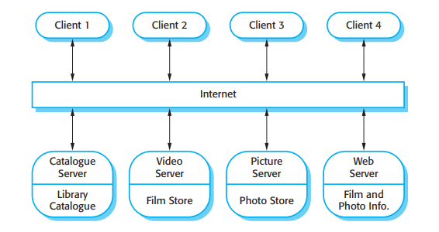
Example- Client Server Model
This is a multi-user, web-based system for providing a film and photograph library.

Slide 16
Pipe and Filter Architecture
This is a model of the run-time organization of a system where functional transformations process their inputs and produce outputs.
Data flows from one to another and is transformed as it moves through the sequence.

Slide 17
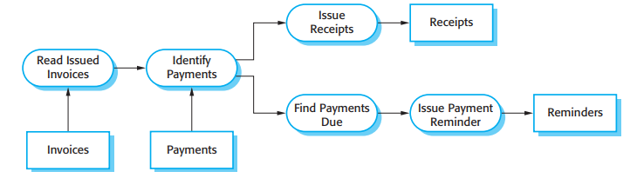
Example- Pipe & Filter

Slide 18
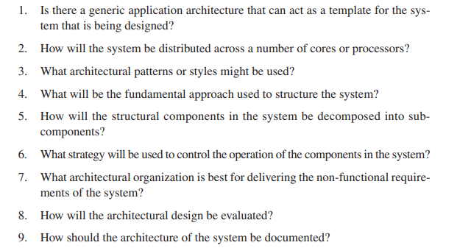
Architectural Design Decisions

Slide 19
Advantages
Stakeholder communication
System analysis
Large-scale reuse

Slide 20
Discussion
What is Service Oriented Architecture?
SOA decomposes the application into loosely coupled, reusable services that expose functionality via standardized interfaces (e.g., web services).
Services are designed to be independent, composable, and interoperable across different platforms and technologies.

