Slide 1
Software Engineering
IT4012
Software Implementation

Slide 2
Learning Objectives
Define software implementation
Explain implementation activities
Discuss software reuse
Explain host-target development
Identify the role of IDEs
Discuss open-source software development

Slide 3
What is Software Implementation?
Implementation is the process of converting software design into executable programs.
Includes-
  Writing source code
  Developing modules
  Integrating components
  Debugging
  Unit testing

Slide 4
Implementation Stage
Activities
  Coding
  Unit Testing
  Integration
  Debugging
  Deployment preparation

Slide 5
Coding Standards
Coding standards are rules used when writing programs.
Benefits
  Improve readability
  Reduce errors
  Simplify maintenance
  Support teamwork

Slide 6
Good Programming Practices
Meaningful variable names
Comments
Avoid duplication
Use meaningful names
Break programs into methods/functions
Handle errors properly

Slide 7
Debugging
Debugging is the process of finding and fixing errors.
Types of Errors
  Syntax errors
  Logical errors
  Runtime errors

Slide 8
Common Debugging Tools
Breakpoints
Logs
Console output

Slide 9
Software Reuse
Reuse means using existing software components instead of creating everything from scratch.
Examples
  Libraries
  APIs
  Frameworks
  Existing modules

Slide 10
Advantages of Reuse
Faster development
Reduced cost
Improved reliability
Less coding effort
Better productivity

Slide 11
Version Control Systems
Tracks changes in source code.
Popular Tools
  Git
  GitHub
  GitLab
  Bitbucket

Slide 12
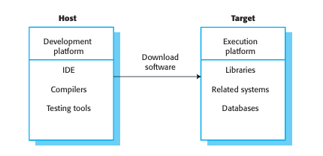
Host-Target Development
Host System-
  Computer used for development.
Target System-
  Device where software executes.

Slide 13
Integrated Development Environment (IDE)
An IDE provides tools for software development.
Features
  Code editor
  Compiler
  Debugger
  Emulator
  Build tools

Slide 14
Popular IDEs
Language IDE
Java IntelliJ IDEA
Android Android Studio
Python PyCharm
C# Visual Studio

Slide 15
Build Tools
Build tools automate software building processes.
Examples
  Maven
  Gradle
  Ant

Slide 16
Deployment Considerations
Hardware requirements
Software compatibility
Performance
Communication between components

Slide 17
Challenges in Implementation
Managing large codebases
Version conflicts
Integration issues
Security vulnerabilities
Tight deadlines

Slide 18
Summary
Implementation converts design into software.
Unit testing ensures module correctness.
Reuse improves development efficiency.
Configuration management tracks software changes.
IDEs support development activities.

