Slide 1
Software Engineering
IT4012
Software Testing

Slide 2
Learning Objectives
Explain the stages of software testing.
Identify techniques for choosing test cases.
Explain test-driven development.
Differentiate component, system, release, and user testing.

Slide 3
Software Testing
Testing is used to check whether software does what it is intended to do.
It also helps discover defects before the software is used.
Testing involves executing a program using test data and checking the results.

Slide 4

Verification and Validation
Verification checks whether software meets its specification.
Validation checks whether software meets customer expectations.

Slide 5
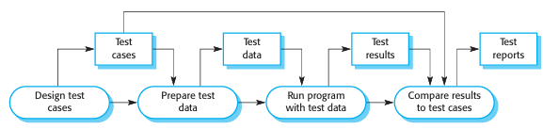
Software Testing Process

Slide 6
Stages of Software Testing
Development Testing
  Done during development to find bugs.
Release Testing
  Done by a separate testing team before release.
User Testing
  Done by users/customers in their own environment.

Slide 7
Unit Testing
Unit testing focuses on small parts of the program.
Examples-
  Testing one method
  Testing one class
  Testing one function

Slide 8
Purpose of Unit Testing
Check whether each method works correctly.
Test object class behavior.
Find defects early.
Support debugging.
Reduce problems before component testing.

Slide 9
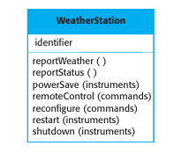
Example – Testing an Object Class
Each method should be tested with suitable test cases.

Slide 10
Testing Method Sequences
Some methods cannot be tested alone.
Example:
  To test shutdown(), the system may first need to execute restart().
  Therefore, some unit tests require a sequence of method calls.

Slide 11

Unit Testing and Object States
Objects may have different states.

Slide 12
Choosing Unit Test Cases
Method for choosing test cases.
  Partition Testing
  Boundary Value Testing

Slide 13
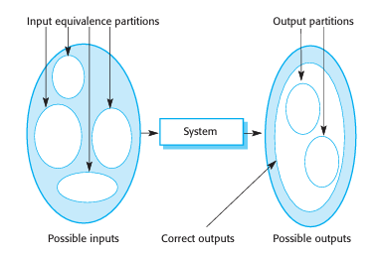
Partition Testing
Steps-
  Identify groups of inputs with common characteristics.
  Select test cases from each group.

Slide 14
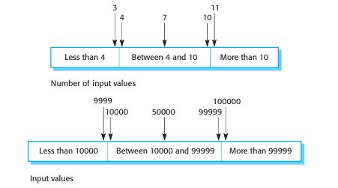
Boundary Value Testing
After identifying partitions, choose test cases-
  On the boundary
  Near the boundary
  Near the middle of the partition

Slide 15
Automated Unit Testing
Unit testing should be automated whenever possible.
Automated unit testing uses testing frameworks such as
  JUnit for Java
  NUnit for .NET
  PyTest for Python
  Jest for JavaScript

Slide 16
Component Testing
Focus areas-
  Interfaces between units
  Data passed between components
  Interaction errors
Example-
  Testing login form + database validation together.

Slide 17
System Testing
System testing checks the complete system.
Purpose-
  Find errors caused by component interaction.
  Check functional requirements.
  Check non-functional requirements.
  Test overall system behavior.

Slide 18
Release Testing
Release testing tests a system version before it is delivered to users.
Key points-
  Should be done by a separate testing team.
  Focuses on validation.
  Checks whether the system is good enough for use.
  Usually uses black-box testing.

Slide 19
Performance Testing
It checks whether the system can handle its expected workload.
Stress testing is a type of performance testing.
Example-
  A system is designed for 300 transactions per second.
  First test below 300 transactions per second.
  Then gradually increase the load beyond 300.

Slide 20
User Testing
User testing is done by real users or customers.
Purpose-
  Check software in the real working environment.
  Identify usability, performance, and reliability issues.
  Confirm whether the system meets user needs.

Slide 21
Types of User Testing
Alpha Testing
  Selected users test early versions with developers.
Beta Testing
  A larger group of users test the software before final release.
Acceptance Testing
  Customer decides whether to accept or reject the system.

Slide 22
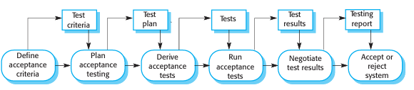
Acceptance Testing
Acceptance testing checks whether the system is ready for deployment.
Possible results-
  System accepted.
  System rejected.

Slide 23
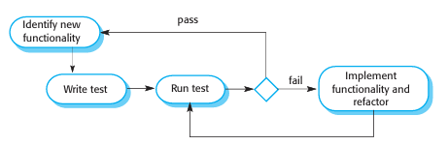
Test-Driven Development
Tests are written before writing the program code.
Code is developed to pass the tests.
Tests are run automatically after changes.

Slide 24
Summary
Testing can show errors, but cannot prove that software has no defects.
Development testing is done by the development team.
Release testing should be done by a separate team.
User testing involves customers or real users.

