Slide 1
HNDIT 4012 Software Engineering
Software Maintainance

Slide 2
Topics covered
Factors of Software maintenance
Types of software maintenance
Cost of maintenance
Software re enginnering

Slide 3
Introduction
Software maintenance is widely accepted part of SDLC now a days. It stands for all the modifications and updations done after the delivery of software product.

Slide 4
Necessity of Software Maintenance
Market Conditions - Policies, which changes over the time, such as taxation and newly introduced constraints like, how to maintain bookkeeping, may trigger need for modification.
Client Requirements - Over the time, customer may ask for new features or functions in the software.

Slide 5
Necessity of Software Maintenance
Host Modifications - If any of the hardware and/or platform (such as operating system) of the target host changes, software changes are needed to keep adaptability.
Organization Changes - If there is any business level change at client end, such as reduction of organization strength, acquiring another company.

Slide 6
Types of maintenance
Corrective Maintenance
Adaptive Maintenance
Perfective Maintenance
Preventive Maintenance

Slide 7
Corrective Maintenance
This includes modifications and updations done in order to correct or fix problems, which are either discovered by user or concluded by user error reports.

Slide 8
Adaptive Maintenance
This includes modifications and updations applied to keep the software product up-to date and tuned to the ever changing world of technology and business environment.

Slide 9
Perfective Maintenance
This includes modifications and updates done in order to keep the software usable over long period of time. It includes new features, new user requirements for refining the software and improve its reliability and performance.

Slide 10
Preventive Maintenance
This includes modifications and updations to prevent future problems of the software. It aims to attend problems, which are not significant at this moment but may cause serious issues in future.

Slide 11
Problems associated with software maintenance
Software maintenance work typically is much more expensive than what it should be and takes more time than required.
In software organizations, maintenance work is mostly carried out using ad hoc techniques.
Another problem associated with maintenance work is that the majority of software products needing maintenance are legacy products.

Slide 12
Estimate Cost of Maintenance
Boehm [1981] proposed a formula for estimating maintenance costs as part of his COCOMO cost estimation model.
Boehm’s maintenance cost estimation is made in terms of a quantity called the Annual Change Traffic (ACT).

Slide 13
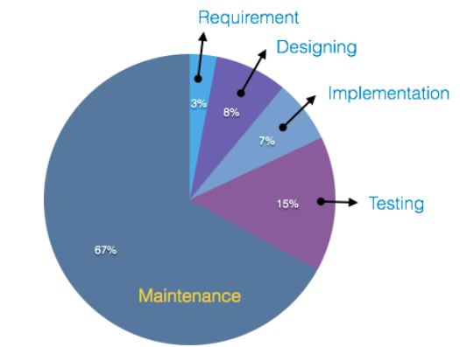
Cost of Maintenance

Slide 14
Software Re Engineering
Software reverse engineering is the process of recovering the design and the requirements specification of a product from an analysis of its code.

Slide 15
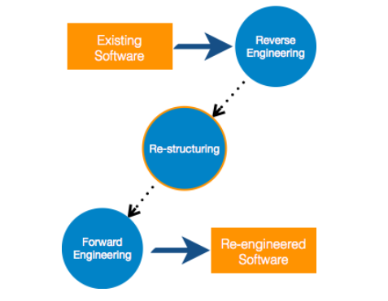
Re-Engineering Process

Slide 16
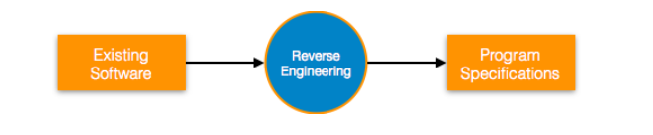
Reverse Engineering

Slide 17
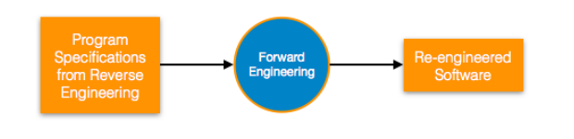
Forward Engineering
Forward engineering is a process of obtaining desired software from the specifications in hand which were brought down by means of reverse engineering.

Slide 18
Component Reusability
In OOP, the objects are designed are very specific to their concern and have fewer chances to be used in some other software.
In modular programming, the modules are coded to perform specific tasks which can be used across number of other software programs.
There is a whole new vertical, which is based on re-use of software component, and is known as Component Based Software Engineering (CBSE).

Slide 19
Legacy Software
It is prudent to define a legacy system as any software system that is hard to maintain.
The typical problems associated with legacy systems are poor documentation, unstructured (spaghetti code with ugly control structure), and lack of personnel knowledgeable in the product.
Many of the legacy systems were developed long time back

Slide 20
Discussion
Configuration management

