Slide 1
HNDIT 4012 Software Engineering
Software Project Management

Slide 2
Learning Outcomes
Define Software Project Management
Explain the role of a Project Manager
Identify project risks
Describe risk management activities
Understand people management

Slide 3
What is Software Project Management?
Software Project Management is the process of-
  Planning
  Organizing
  Monitoring
  Controlling

Slide 4
Why Project Management is Important?
Software projects are subject to-
  Budget constraints
  Schedule constraints
  Resource limitations
  Customer expectations

Slide 5
Why Software Projects are Difficult to Manage?
Challenge 1: Software is Intangible
Challenge 2: Projects are Unique
Challenge 3: Software Processes Vary

Slide 6
Role of a Software Project Manager
Project Planning
Risk Management
People Management
Reporting
Proposal Writing

Slide 7
Project Planning
Defining project objectives
Deliverables and milestones
Work Breakdown Structure (WBS)
Activity identification
Activity sequencing
Project scheduling

Slide 8
Project Risk Management
Types of software project risks
Risk identification
Risk analysis
Risk response planning
Risk monitoring and control

Slide 9
What is a Risk?
A risk is an uncertain event that may negatively affect a project.
Examples-
  Team member resigns
  Technology failure
  Requirement changes
  Budget reduction

Slide 10
Types of Risks
Project Risks-
  Staff shortages/Delays in delivery
Product Risks
  Poor performance/Security vulnerabilities
Business Risks
  Market changes/Customer cancellation

Slide 11
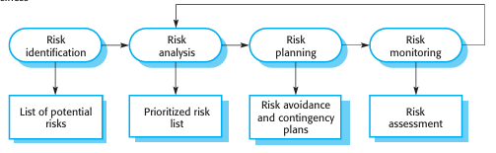
Risk Management Process
Risk Identification
Risk Analysis
Risk Planning
Risk Monitoring

Slide 12
Risk Identification
Identify Possible Risks
Examples-
  Staff turnover
  Requirement changes
  Hardware failures
  Security threats
  Supplier delays

Slide 13
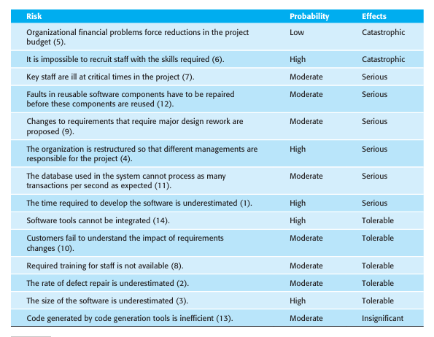
Risk Analysis

Slide 14
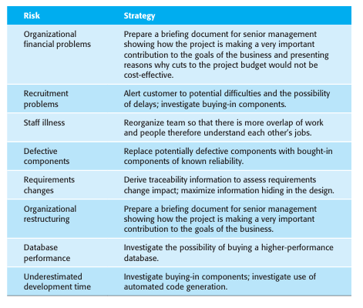
Risk Planning

Slide 15
Risk Monitoring
Team morale
Project progress
Budget status
Technical issues

Slide 16
Managing People
People are the most valuable asset in software projects.
Motivate staff
Resolve conflicts
Improve communication
Build strong teams

Slide 17
Teamwork in Software Projects
A software team may consist of-
  Project Manager
  Business Analyst
  Software Developers
  Testers
  UI/UX Designers
  DevOps Engineers

Slide 18
Characteristics of Effective Teams
Clear goals
Open communication
Trust
Cooperation
Strong leadership
Shared responsibility

Slide 19
Project Scheduling Process
Main Steps
  Identify Activities
  Estimate Effort
  Determine Dependencies
  Allocate Resources
  Create Schedule
  Monitor Progress

Slide 20
Identifying Project Activities
A task that must be completed during the project.
Examples
  Requirements Analysis
  System Design
  Database Design
  Coding
  Testing
  Deployment

Slide 21
Milestones
A milestone is a significant project event or achievement.
Examples
  Requirements Approved
  Design Completed
  Prototype Delivered
  Testing Completed
  Final System Released

Slide 22
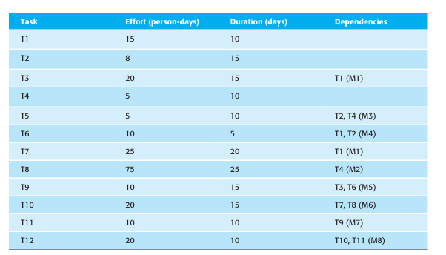
Types of Dependencies
Finish-to-Start
Start-to-Start
Finish-to-Finish

Slide 23
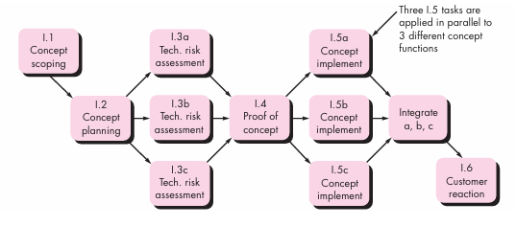
Activity Network Diagram
Activities
Dependencies
Task sequence

Slide 24
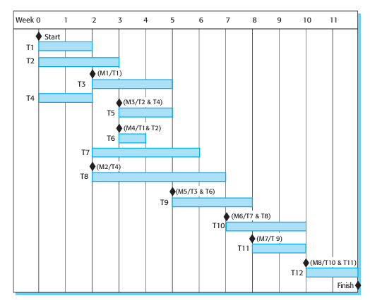
What is a Gantt Chart?

Slide 25
Critical Path Concept
The sequence of activities that determines the minimum project completion time.
Longest path in project schedule
No delay allowed
Delay in critical activity delays entire project

Slide 26
Discussion
Characteristics of Software Projects
Project Success and Failure Factors
Role of a Software Project Manager

